Slide 1
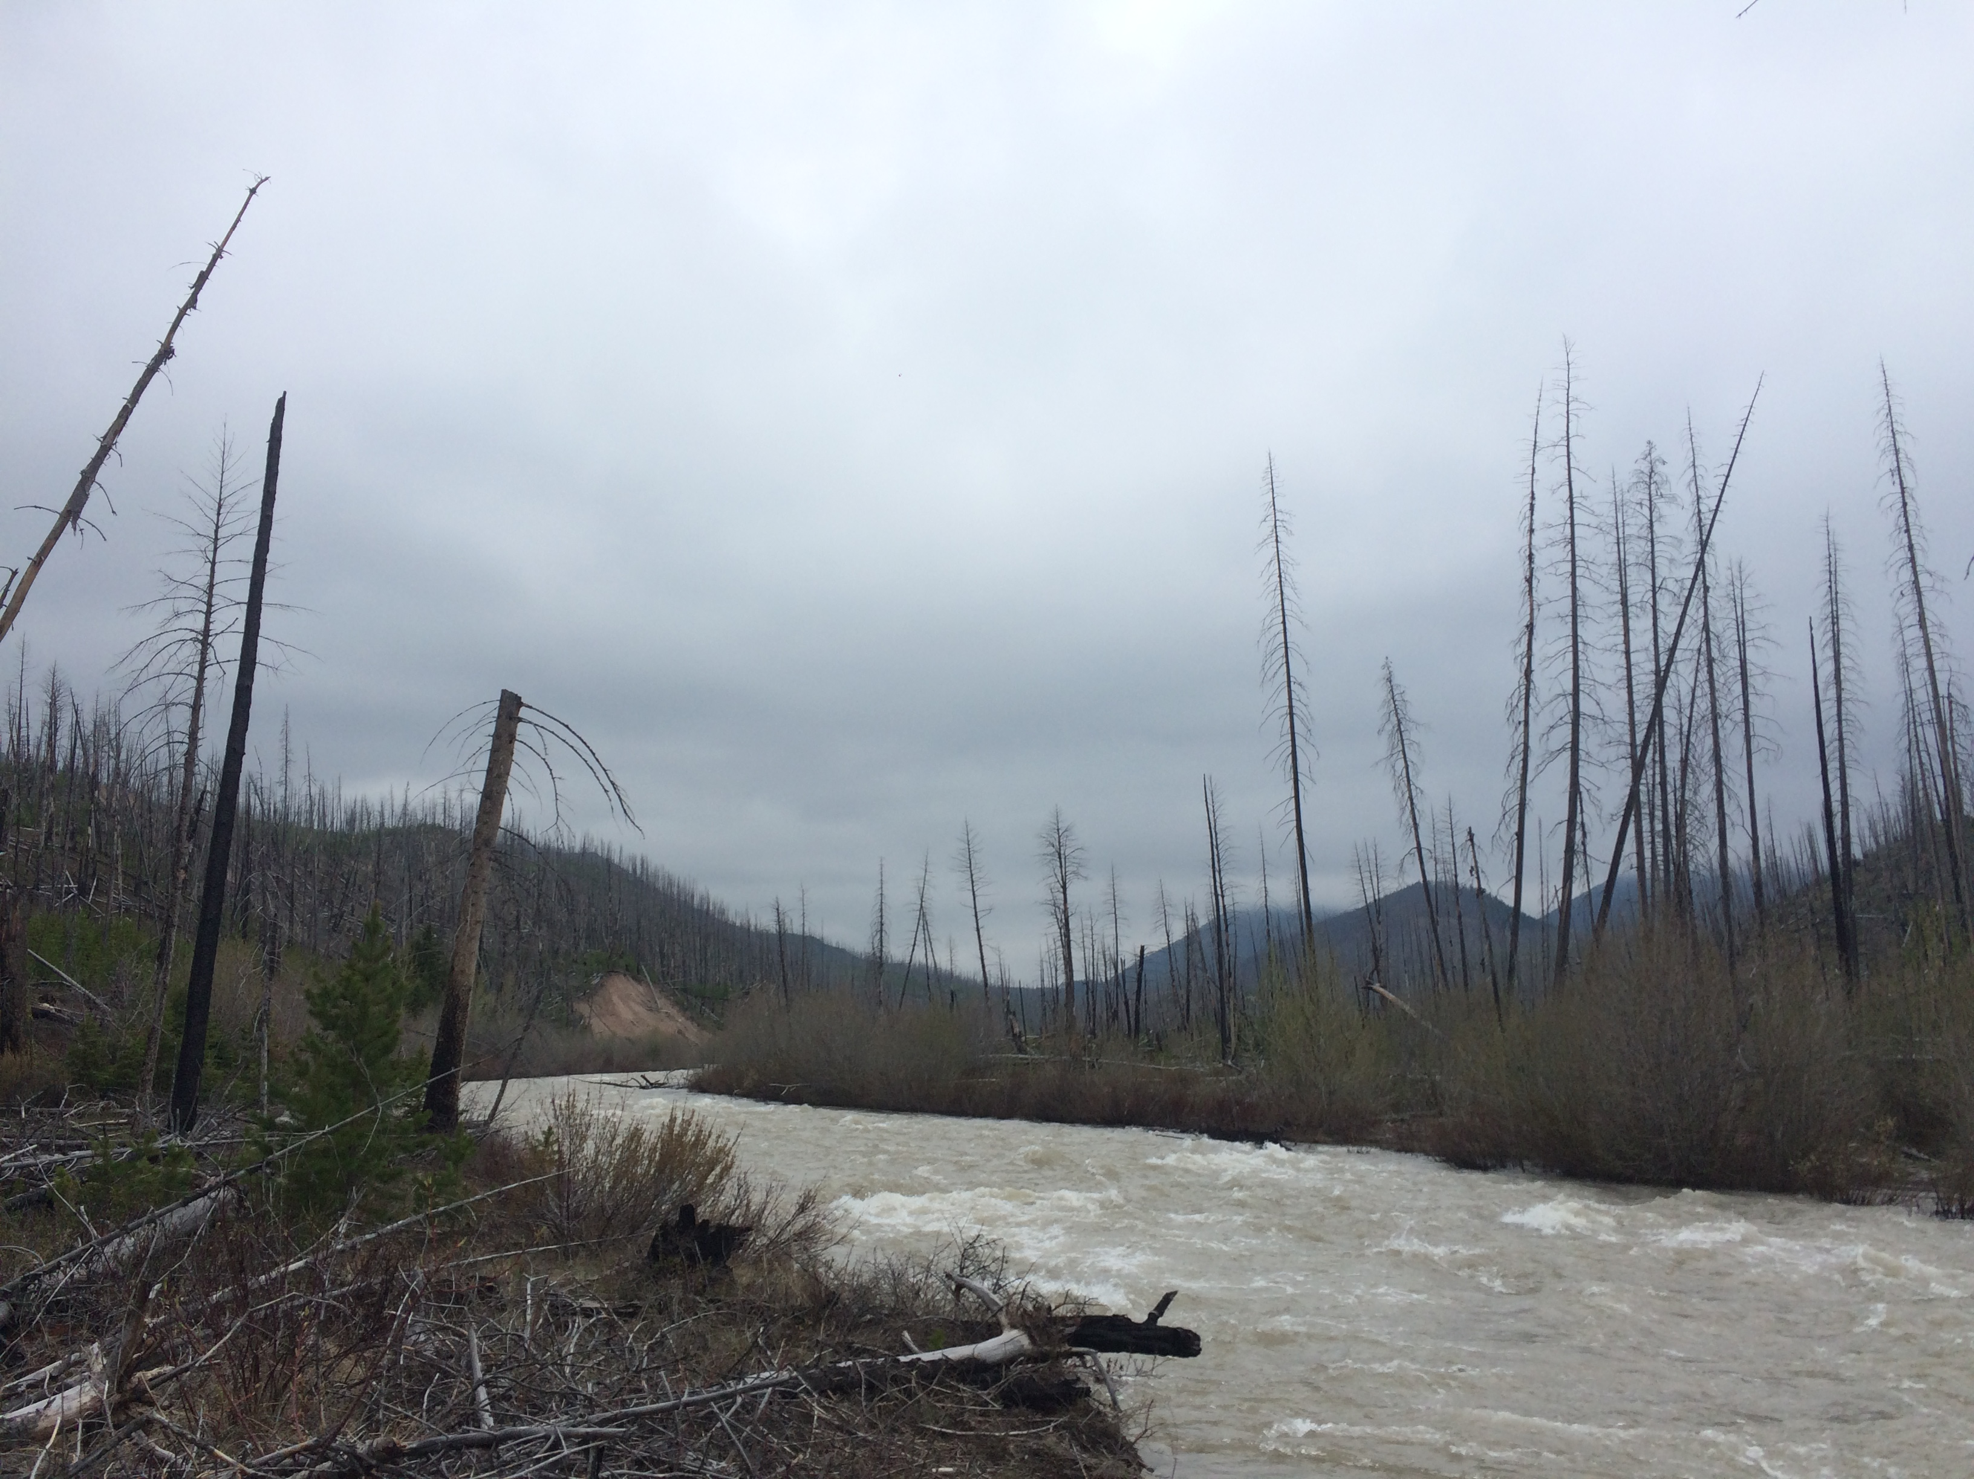
Climate Change and Groundwater Access Provisions in Native American Water Rights Settlements
Marea Kuehl
W.A. Franke College of Forestry and Conservation
UMCUR April 17, 2019
Notes:
Good morning everyone, my name is Marea Kuehl and I am a Resource Conservation major in the College of Forestry and Conservation. Before we begin, I’d like to acknowledge that we are on ancestral Salish and Kootenai tribal lands and thank them.
This morning I’m going to talk about my research on tribal water rights settlements, climate change, and groundwater. I chose to engage in this research because I am really interested in water policy, availability, and administration in our ever-changing future.

Slide 2
Outline
My research on Tribal Water Rights Settlements, groundwater, and climate change
Why this research matters
Background on Tribal water rights settlements
Research process
Methods
Implications for water policy
Preliminary Findings
Notes:
Brian’s Notes:
Potential logical progression of research explanation:
Climate change is impacting water availability, use, and consequently water rights in MT and the West – through changes in timing, distribution
That has implications for our use of that water, i.e. through water rights
Native American water rights are different – tribal reserved water rights (Winters)
Why does this matter?
The process of quantifying Tribal water rights was different and often comes from negotiation and settlement (why, and how that relates to other rights)
Tribes (in the West) often occupy lands that will be most effective from immediate climate changes
Legacy of settlements (legally) is yet to be determined—i.e. we don’t know how they all work when there isn’t enough water to satisfy rights
Research (policy) needed to determine how settlements view/discuss/advise/approach groundwater and climate change
Narrative:
What was the research?
- Finding what legal or intended context, if any, exists in tribal water settlements for discussing how climate change and the relationship it has with water availability could affect tribal water rights and the livelihoods and health of native people.
Why it was interesting to you
- The implications for lacking a plan to deal with climate change’s effects on the landscape are numerous and will most certainly affect the health and socio-ecological wellbeing of native people.
Why it is important for others to know (in the world)—i.e. its relationship to a bigger problem or question
- Water scarcity is a continuous issue that we can only hope to plan for, but planning is the first part of addressing the issue. Additionally, water is essential for life everywhere and indigenous people around the world are poised to be/are being most affected by shifting water availability.
How you did it
- One literature review and consolidation of settlements later, I used qualitative data analysis software Nvivo to deductively search the settlements and associated documents for mentions of climate change, groundwater allocation and access, and mitigation efforts. Further consolidation of language allowed me to associate specific settlements with the context they provide in allocating water rights to tribes.
What you found
No mention of climate change by name or really even by process in any of the settlements
About 40 percent (get a real number) of the settlements brought back results on groundwater allocation and access tribes
The word ‘mitigation’ started occurring
Why it matters
-
What you would do next if you had time/resources
-

Slide 3
Issue
Climate change does and will continue to impact timing and distribution as well as quantity and quality of the water allocated for use through water rights on a landscape scale.
Notes:
Bullet 1 above is “what you are interested in generally”; next step would be to explain how tribal water rights are different and interact with this question of groundwater and climate change
The question I centered my research around is how climate change and its effects alter the timing, quantity, and quality of tribal water rights. In Montana, and the West generally, water use and distribution already determine the way we deal with water rights. (Any changes have implications for large amounts of future alterations.)
Tribal water rights came to be in a fundamentally different way than water rights of an individual party. The water rights administration system is complex, but all we need to know for now is that the tribes have reserved water rights as a part of their relationship with the U.S. government.
Save bullets 2-4 for explanation of the above (your interest and eventual research question)
2.Groundwater allocations on reservations and their relationship with aquifers (ie recharge)
3. Climate change is a well-known and ongoing subject of study, especially in the realm of water availability and rights. Native American
4.Note “how” climate change projections will likely alter hydrologic aspects of the American West—use Montana data as an example to illustrate your point
Potential logical progression of research explanation:
Climate change is impacting water availability, use, and consequently water rights in MT and the West – through changes in timing, distribution
That has implications for our use of that water, i.e. through water rights
Native American water rights are different – tribal reserved water rights (Winters)
Why does this matter?
The process of quantifying Tribal water rights was different and often comes from negotiation and settlement (why, and how that relates to other rights)
Tribes (in the West) often occupy lands that will be most effective from immediate climate changes
Legacy of settlements (legally) is yet to be determined—i.e. we don’t know how they all work when there isn’t enough water to satisfy rights
Research (policy) needed to determine how settlements view/discuss/advise/approach groundwater and climate change

Slide 4
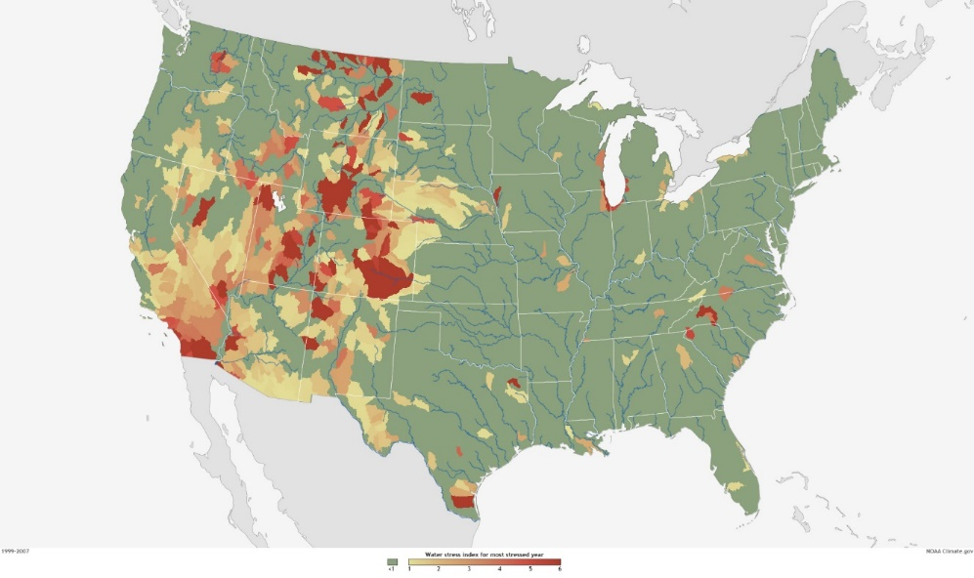
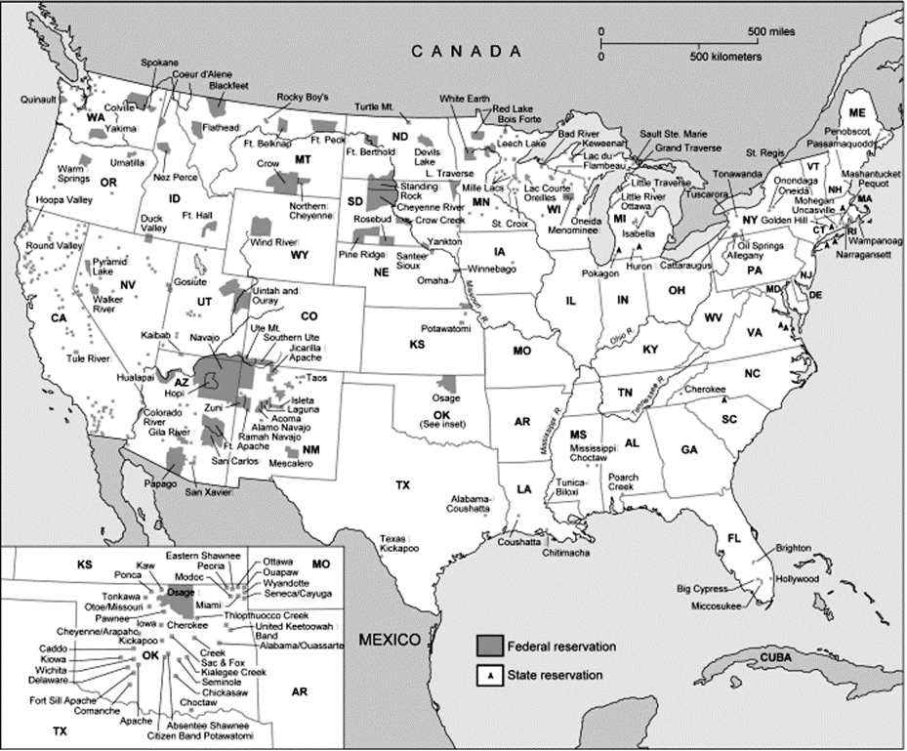
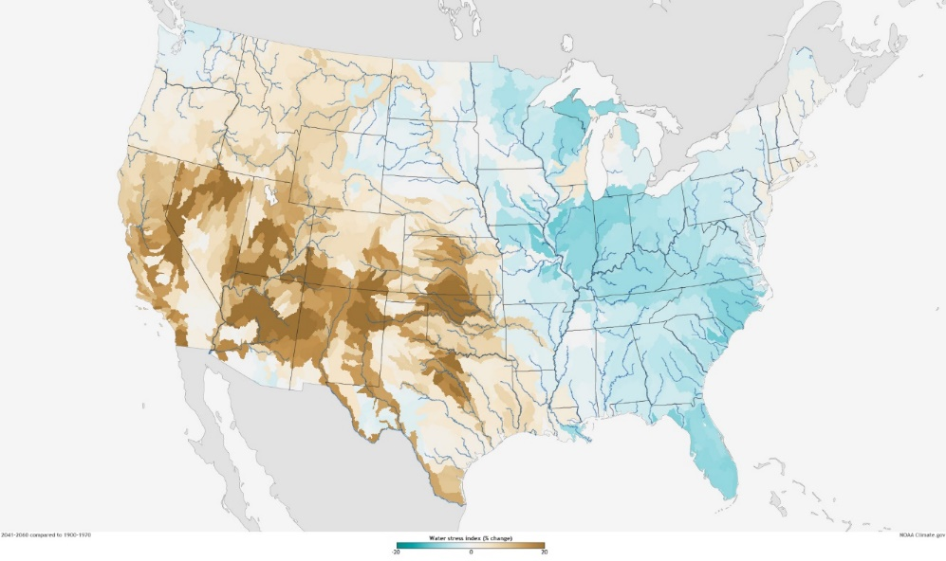
Average water stress
Change in water stress
Notes:
Climate change is affecting the distribution and availability of water in the United States. The first map in the upper left shows the average water stress for the United States over a period of time (How long and what years??) and the one directly below it shows a trend of increasing water stress in the brown and decreasing stress in the blue. Reservations in the US, as the third map shows, are disproportionately disadvantaged by an increasing water scarcity trend in the west. The implications of climate change for Tribal water includes the

Slide 5
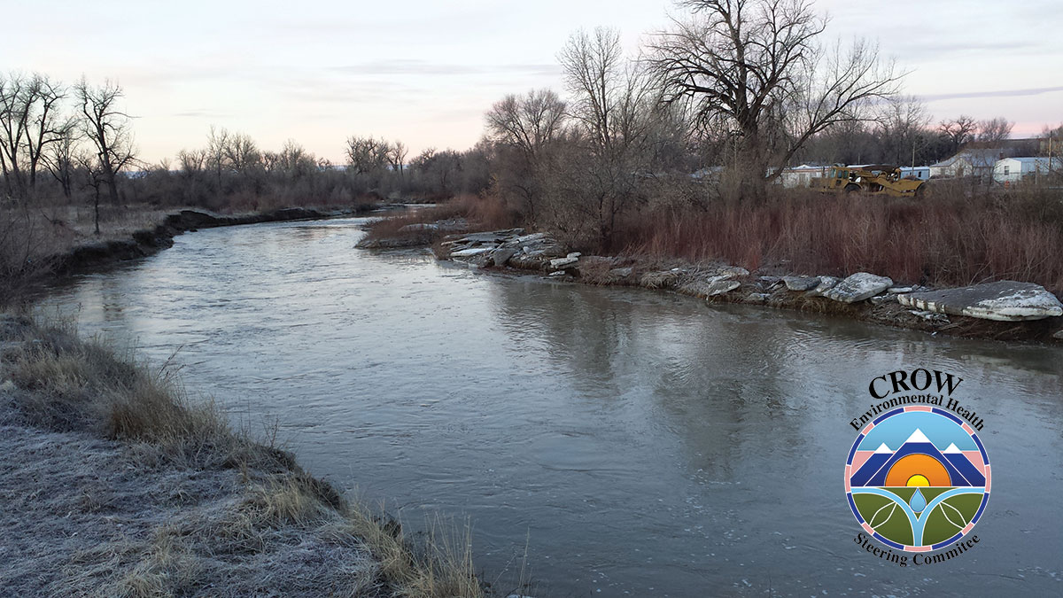
Why does this matter?
Very little to no prior research has focused on if or how Tribal water rights settlements address climate change and/or the allocation of groundwater.
Notes:
Follow up to this slide: re-emphasize why understanding how a focus on groundwater allocation and climate change (scenarios) is important when addressing Tribal water in policy.
As well as a lack of research on this specific topic, it is important to understand how focusing on climate change and groundwater allocation can help address tribal water rights in policy-making and ultimately implementation of that policy. For example, planning for drought in places like the Blackfoot Watershed by Ovando comes down to the exact measurement of water at a stream gauge and who holds rights for what amount of water, measured in acre feet. Another important part of that scenario is what the water right holder decided to use their right for, whether that be instream flow for culturally relevant species conservation or agricultural irrigation.
How does climate change affect hydrology…… AND WHAT DOES THAT MEAN FOR TRIBES?
Increased need for water with a decreased supply = scarcity
Recharge process for groundwater undercut by erratic weather patterns due to climatic shifts

Slide 6
HISTORY: Last Half of 19th Century
Creation of reservations—treaties, congressional legislation, and executive order
Treaties are not grants to Tribes, but Tribal reservations of rights
Water generally left out of most reservation creation
Senior water rights went initially to non-native settlers in the West
1908 Winters rights – Supreme Court decided that reservation rights include IMPLIED water rights
Notes:
In the last half of the 19th century, the U.S. government created native American reservations using treaties, congressional legislation, and executive orders. These actions removed Native Tribes to only part of their traditional territories or onto federal lands.
Reservations are not grants to tribes, but rather represent what Tribes have “reserved” for themselves, often including the right to hunt and fish in usual and accustomed places, for example. During the creation of reservations, water was generally left out of the rights reserved for the Tribes.
Non-native settlers filled in much of the West and claimed water rights under a system known as Prior Appropriation. This system allows the person with the oldest claim to water to receive their allocation before anyone else with a younger, or more junior, claim to water receives their water. Known as “first in time, first in right” (is this necessary?)
In 1908, a Supreme Court case, now known as the Winters rights decision, decided that reservation rights include IMPLIED water rights to allow fulfillment of the purpose of reservations. The purpose of reservations was interpreted, through more court cases and over time, to mean agricultural and domestic uses.
2. Reservations do not always mean resources explicitly allocated with the land, water generally left out of most reservation rights
3. system of prior appropriation used in west.
“Dating to a 1908 Supreme Court ruling [Winters], courts generally have held that many tribes have a reserved right to water sufficient to fulfill the purpose of their reservations and that this right took effect on the date the reservations were established” (Stern 2017; 2).
Last bullet: In 1908 Supreme Court (Winters) decided that this includes IMPLIED water rights for Native American reservations to accomplish the purpose of reservations—this has translated into agriculture and domestic use (over time and more court cases… which you don’t have time to describe)

Slide 7
HISTORY: Last 50 Years
a period of pursuing settlements instead of costly litigation to adjudicate water rights in state courts for tribal reservations (i.e. 1908 Winters Rights).
Main Motivations for Settling:
Tribal: secure water for cultural and domestic uses, possibly for the first time
Federal: settle outstanding and potential claims in developed basins; eliminate uncertainty
Notes:
Bottom line: reservations have legal right to use water… and in most cases this right is not quantified (or has not been quantified) until recently; causing an upheaval in previously determined rights to use water in a basin (i.e. priority dates/amounts under prior appropriation)

Slide 8
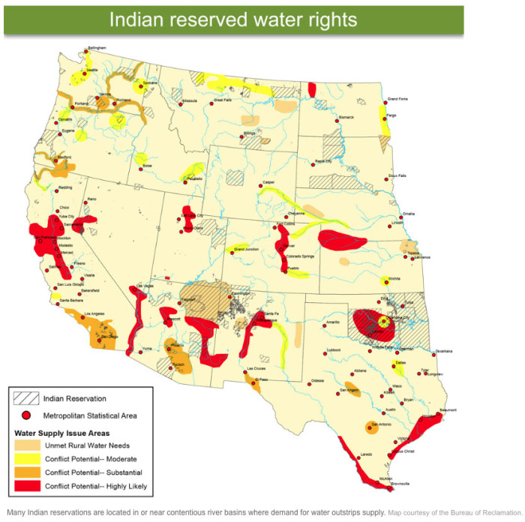
WHAT IS A WATER RIGHT?
States hold water in the public trust
Includes surface + groundwater, and often wetlands
Duty to protect public uses of water (i.e. navigation, commerce, and fishing)
Private allocation of rights to use water via a state agency (e.g. MT DNRC)
Water rights give the ability to use water
Notes:
States hold water itself in the public trust and allow for the private allocation of rights to use water through a state agency such as the Montana Dept of Natural Resources and Conservation (DNRC). Water rights afford someone the ability to use water on their property. The type of water held in the public trust varies by state, but generally includes surface and groundwater and often wetlands.
State has the duty to protect public uses of water such the right to use waters for navigation, commerce, and fishing
People can own water rights by themselves, property with associated water rights, or just property with no right to the water.

Slide 9
What is a Tribal Water Rights Settlement?
An agreement that defines water rights for tribes negotiated between the federal government, state government, and sovereign indigenous tribes in the United States
Waives the Tribes’ rights to bring further claims against U.S.
Financial, physical, or legal resources used to promote development and/or protection of critical resources
Notes:
provides a waiver of the Tribes’ rights to bring further claims against
the U.S. with regard to outstanding water rights (federal motivation).
Many settlements provide resources to tribes used to promote devt and/or protection of resources including water, aquatic habitat, and species.

Slide 10
Why Do Tribal Water Rights Differ From Those Held By Other US Citizens?
Priority date: Individual vs Tribal rights
Abandonment and requirements for use
Flexibility to address purposes of reservation vs mandated “beneficial use”
Notes:
As discussed earlier, the latter half of the 19th century was spent confining indigenous people to reservations, many of which either did not have (much) water associated with them or didn’t explicitly reserve water for the purposes of the reservation (Native domestic activities, irrigation, etc.)
Before 1924, Native Americans were not considered citizens of the United States; Congress passed the Indian Citizenship Act.
As discussed earlier, the latter half of the 19th century was spent confining indigenous people to reservations, many of which either did not have (much) water associated with them or didn’t explicitly reserve water for the purposes of the reservation (Native domestic activities, irrigation, etc.)
Date of reservation
Do not expire; do not have to be put to use
Flexible to address purposes of reservation—which can change; so today, that includes instream flow for culturally-important species habitat (i.e. Bull trout, salmon, etc.)

Slide 11
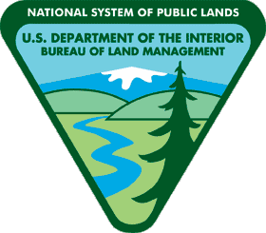
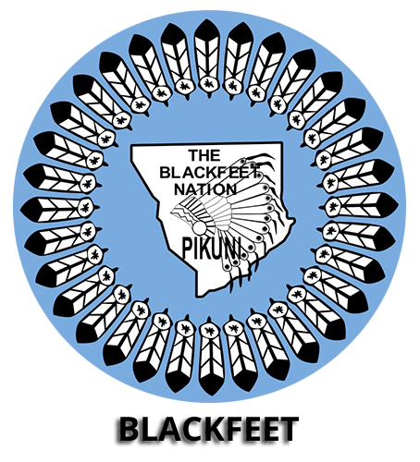
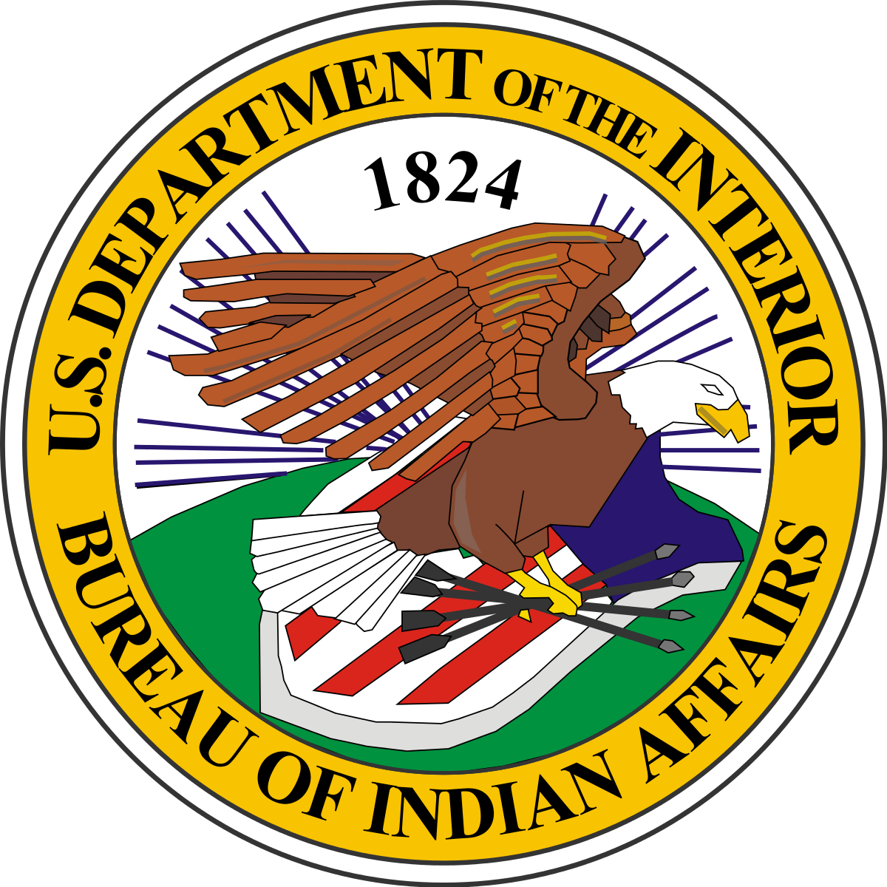
What Came Before?
Federal government: 36 settlements since 1978
Congress has enacted 32 settlements
Remaining settlements approved by the Secretary of the Interior or the U.S. Attorney General or by judicial decree. (Stern 2017, 10).
Settlement nominal cost ranges from $6 million to $2.3 billion (Stern 2017)
Involve:
Federal government
State government(s)
Native American Tribes
Previous research:
Instream flow
Cultural uses of water rights
Overall cost
Notes:
1-slide, super brief
What do we know about settlements based on this lit review
Stern paper highlights (#s, geography, range of $$$, any other interesting facts that describe settlements as a whole/group)
Negotiation—Feds have set up an office to approach this process
Feds negotiate (or are supposed to) on behalf of the tribes as their trustee (in the federal-tribal trust relationship; a legal doctrine that dictates that U.S. must advocate on behalf of Tribes)

Slide 12
Methods
Gathered 85 settlements and associated administrative documents from UNM database and Stern (2017) Congressional Research Service report.
Organized documents chronologically, by Tribe, and settlement process
Using qualitative data analysis software (Nvivo) to deductively search the text of documents to identify evidence of:
Attempts to address climate change implications for Tribal water rights
Determinations of groundwater access rights and/or development opportunities
Analysis of language identified in settlements compared across settlements in an effort to discover general trends
Analysis of language identified in the context of representative cases/Settlements

Slide 13
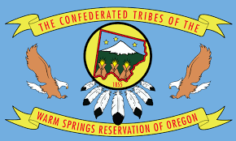
Climate Change
Confederated Tribes of the Warm Springs Reservation (1997) and (2013)
“C. MODIFICATION…Subject to the consent of the Parties and the Court having jurisdiction over the decree, this Agreement may also be modified, amended or amplified in the event of substantial changes in climatic conditions, significantly affecting physical, hydrologic or other conditions, which justify or require such modification, amendment or amplification” (28).
CTWSR located in OR
Allocated water amt: 51,800 acre ft/yr
No federal action taken (2013)
Notes:
EXAMPLE CASES—use the above to describe in terms of climate change and groundwater
This describes the settlements themselves a bit – in the context of you researching them
A slides discussing analysis more indepth
Characterize them in terms of “type of settlement” (i.e. what were they mainly about in terms of water sources, rights, uses of water), dollar amount settled, geographic location of tribe, size of reservation and/or tribal population, type of agreement creating reservation (treaty, EO, legislation), whether or not the settlement considers instream flow, habitat, off-reservation rights, or other water rights/use issues not directly related to on-reservation winters rights…
C. MODIFICATION. This Agreement, the decree and the order approving this Agreement, may not be modified in any manner whatsoever except with the joint written consent of the duly authorized representatives of the Parties and the consent of the court approving this Agreement, after providing notice and an opportunity to be heard to all parties who may be affected by such proposed modification. Subject to the consent of the Parties and the Court having jurisdiction over the decree, this Agreement may also be modified, amended or amplified in the event of substantial changes in climatic conditions,
significantly affecting physical,hydrologic or other conditions, which justify or require such modification, amendment or amplification. (p. 28)
Salt River Pima (1988) - Groundwater
Language:12.2 Notwithstanding the execution by SRPMIC of the waiver and 13 release described in Paragraph 12.1 hereof, SRPMIC, its members, 14 and the United States on their behalf, shall retain the right to 15 assert the following claims: 16 (a) Any claim for damages to water quality; provided, 17 however, that Paragraph 12.1 hereof shall be construed to bar 18 SRPMIC and its members from asserting any claim for damages to 19 water quality caused by (1) the withdrawal of groundwater in 20 accordance with the Arizona Groundwater Management Act; (122)
Water sources: surface, ground water
Rights:
Dollar Amount:
Geographic Location: Arizona,

Slide 14
Groundwater Salt River Pima –Maricopa Indian Community (1988)
“12.2 Notwithstanding the execution by SRPMIC of the waiver and release described in Paragraph 12.1 hereof, SRPMIC, its members, and the United States on their behalf, shall retain the right to assert the following claims: (a) Any claim for damages to water quality; provided, however, that Paragraph 12.1 hereof shall be construed to bar SRPMIC and its members from asserting any claim for damages to water quality caused by (1) the withdrawal of groundwater in accordance with the Arizona Groundwater Management Act;” (122).
SRPM located in AZ
Allocated water amt : 122,400 acre ft/yr
Estimated federal cost: $47.5 million
Notes:
EXAMPLE CASES—use the above to describe in terms of climate change and groundwater
This describes the settlements themselves a bit – in the context of you researching them
A slides discussing analysis more indepth
Characterize them in terms of “type of settlement” (i.e. what were they mainly about in terms of water sources, rights, uses of water), dollar amount settled, geographic location of tribe, size of reservation and/or tribal population, type of agreement creating reservation (treaty, EO, legislation), whether or not the settlement considers instream flow, habitat, off-reservation rights, or other water rights/use issues not directly related to on-reservation winters rights…
C. MODIFICATION. This Agreement, the decree and the order approving this Agreement, may not be modified in any manner whatsoever except with the joint written consent of the duly authorized representatives of the Parties and the consent of the court approving this Agreement, after providing notice and an opportunity to be heard to all parties who may be affected by such proposed modification. Subject to the consent of the Parties and the Court having jurisdiction over the decree, this Agreement may also be modified, amended or amplified in the event of substantial changes in climatic conditions,
significantly affecting physical,hydrologic or other conditions, which justify or require such modification, amendment or amplification. (p. 28)
Salt River Pima (1988) - Groundwater
Language:12.2 Notwithstanding the execution by SRPMIC of the waiver and 13 release described in Paragraph 12.1 hereof, SRPMIC, its members, 14 and the United States on their behalf, shall retain the right to 15 assert the following claims: 16 (a) Any claim for damages to water quality; provided, 17 however, that Paragraph 12.1 hereof shall be construed to bar 18 SRPMIC and its members from asserting any claim for damages to 19 water quality caused by (1) the withdrawal of groundwater in 20 accordance with the Arizona Groundwater Management Act; (122)
Water sources: surface, ground water
Rights:
Dollar Amount:
Geographic Location: Arizona,

Slide 15
Implications
Mitigation in the future may be an uphill battle
Acknowledging climate change and planning for its effects are still difficult to grasp within settlements
Groundwater supplies may be overallocated into the future, like much of the West’s surface water
Timing and quality of water may drastically change without active policy guiding management
But could be avoided with proactive planning

Slide 16
General Findings
Interestingly: “climatic conditions” only appears ONCE in Settlements as text!
(Confederated Tribes of the Warm Springs Reservation settlement)
Groundwater appears often – context of additional water just in case
The word “mitigation” starts to show up in the mid 2000(s)
More legal stipulations to do with claims to water amount for Tribes located in arid environments
Notes:
- “Climatic change” appears once in the CTWSR settlement (1997) and specifically refers to change that significantly alters hydrologic/physical conditions. This language also allows for modifications to the settlement agreement if such conditions occur.
-Groundwater often appears settlements and associated documents with a handful of cases in which it is completely absent. Usually, the groundwater-related language refers to water that supplements surface water rights or can be used for development purposes such as drilling wells for housing and other domestic uses.
The word ‘mitigation’ started showing up in settlements in the mid 2000s (2006 – Gila River Indian Community Settlement Amendment No1). Mitigation seems to be discussed primarily as a response to audits of water systems for tribes that reveal a deficit in acre feet which must be replaced by water from another source.
A general trend I noticed while searching the documents was the amount of legal criteria and rules placed on tribes located in more arid environments such as AZ.

Slide 17
Future Directions
What does this mean moving forward?
Potential need for amendments
Lack of flexibility = threatened water uses
What could a next step be?
Ask tribes what they want to do next!
Turn this data into a jumping-off point
Notes:
What does this mean moving forward?
Potential need for amendments to tribal water settlements to be able to mitigate for human-caused and natural effects of climate change on water availability.
Without that flexibility, water uses on tribal lands could be threatened, especially instream flow for cultural use and endangered species protection.
What could a next step be?
First step is to start asking tribes (both government and community members) what they think the next step should be.
Example questions:
What kind of legal action/policy change may be necessary to protect tribal water uses?
Do tribal water uses need protecting? (ask the people themselves, they know best)
What do communities currently do to mitigate change over time, if anything?
Do they want to do something more that necessitates outside funding or academic research?
Turn this data into a jumping-off point for further data-gathering in the form of interviews and community visits with tribes.
Could be specifically a montana project or an AZ project or another arid state/region

Slide 18
Questions?
Acknowledgments
Brian C. Chaffin, advisor and project sponsor
W.A. Franke College of Forestry and Conservation
University of Montana Conference of Undergraduate Research

