Slide 1
The Role of Participatory GIS in Community-Centered Ecotourism Management in the Bossou Forest Reserve, Guinea
Sydney Qualls
Bachelor of Science in Geography
With a Geographic Information Systems & Technology Certificate
UMCUR
University of Montana- Missoula, Montana
April 17th, 2019
Advisor: Dr. Sarah Halvorson, Department of Geography
Notes:
Hello my name is Sydney Qualls and I am currently a senior working towards obtaining my bachelor of science in Geography with a certificate in Geographic Information Systems and Technology. Today I will be presenting a project I have been working on this semester and that is the Role of Participatory GIS in the community centered Ecotourism Management in the Bossou Foreset Reserve IN Guinea.

Slide 2
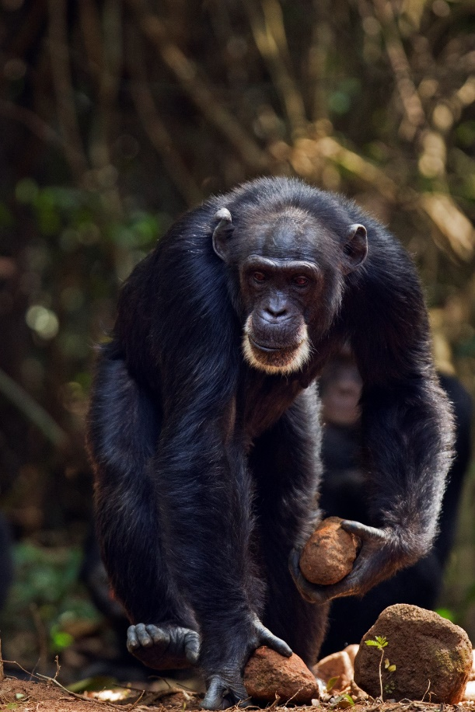
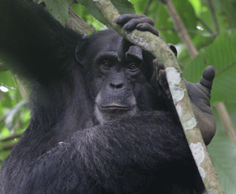
Western Chimpanzee (Pan troglodytes verus)
Destina Samani
The Chimpanzees of Bossou and Nimba
Destina Samani
Notes:
The chimpanzees in the Bossou Forest Reserve are a western chimpanzees, a sub species of the common chimpanzee. The majority of the western chimpanzees are found in upper guinea forests. These chimpanzees are on the red list of endangered species for the ICUN (International Union for Conservation of Nature) and they have already disappeared in 4 countries.

Slide 3
Chimpanzees of the Bossou Forest Reserve
Chimpanzee Population over Time
Factors Influencing the Decline of Chimpanzees
Urbanization
Forest fires
Increase in population
Cultivation
Indiscriminative poaching
Chimpanzee diseases
Mining
Inappropriate farming practices
Image Source: The Chimpanzees of Bossou and Nimba
Notes:
The Bossou chimpanzee community is a semi-isolated group that is separated from neighboring groups of chimpanzees due to deforestation. There has been a large decline in the chimpanzee population of the Bossou Forest Reserve in the past decades. There were about 27 chimpanzees in the 1970 and only 7 left today, 3 male and 4 female.
Decline in the chimpanzee populations is due to both anthropogenic and environmental factors and include Urbanization, forest fires, population increase, cultivation, and indiscriminative poaching, chimpanzee diseases, mining, and inappropriate farming practices.

Slide 4
Research Question
How can participatory mapping be used to support and inform an ecotourism management plan with a focus on conservation
Notes:
At the beginning of this semester I was invited to join a research team made up of graduate students and faculty in the W.A. Franke College of Forestry and Conservation. This project is funded through the U.S. Forest Service International Programs which has activities coordinated here at UM by Dr. Keith Bosak. Since January, two of Dr. Bosak’s graduate students have been undertaking fieldwork for this project. Meanwhile, from the Geography GIS labs in Stone Hall I have been in close contact with them and processing their field data and observations
The question I have been aiming to address this semester with in conjunction with the research underway is how participatory mapping can be used to support and inform an ecotourism management plan with a focus on conservation.

Slide 5
Research Objective
Transform local level qualitative data into a digital cartographic environment
Create a set of detailed maps for the communities and region
Notes:
I had 2 main research objectives when I was beginning this project. The first being to transform local level qualitative data into a digital cartographic environment and the second was to create a set a detailed maps for the communities and region that were lacking basic geographic data.

Slide 6
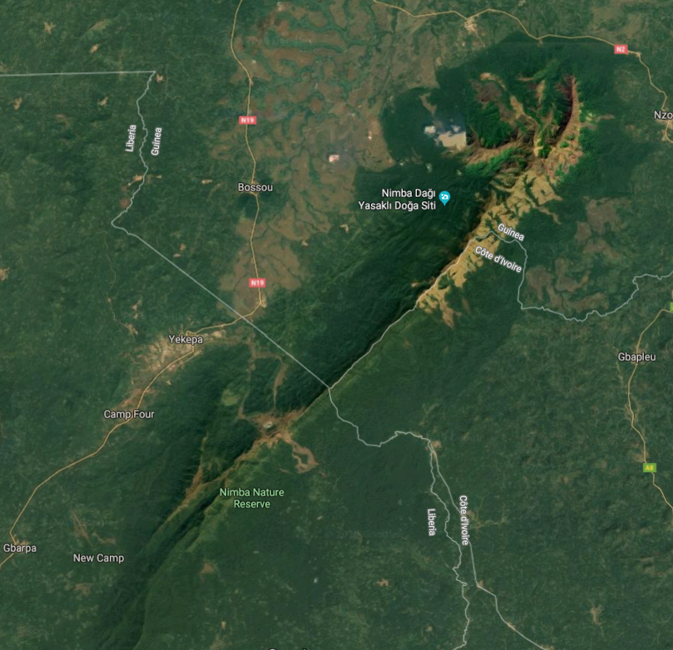
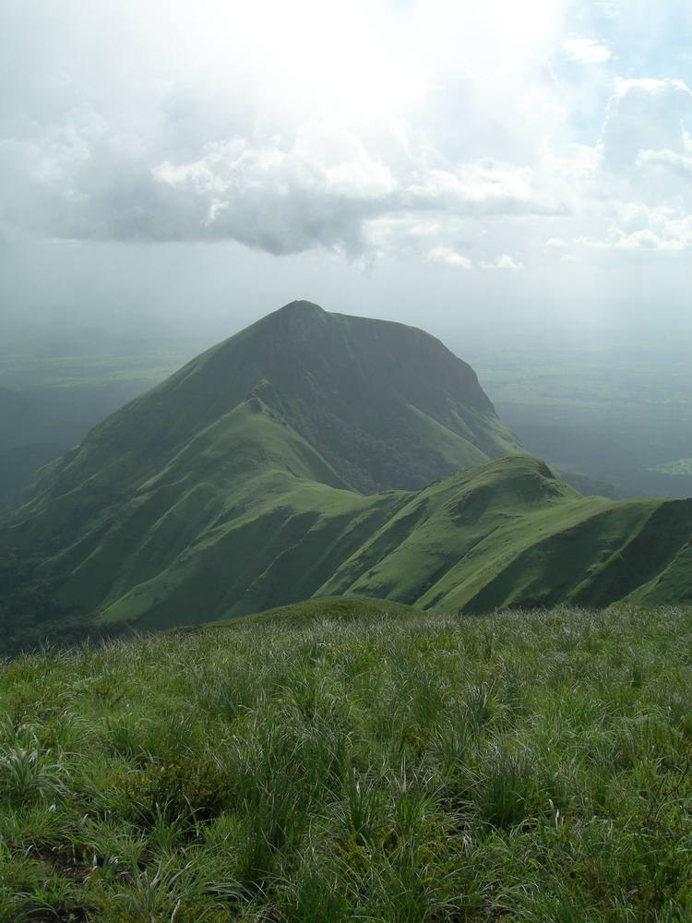
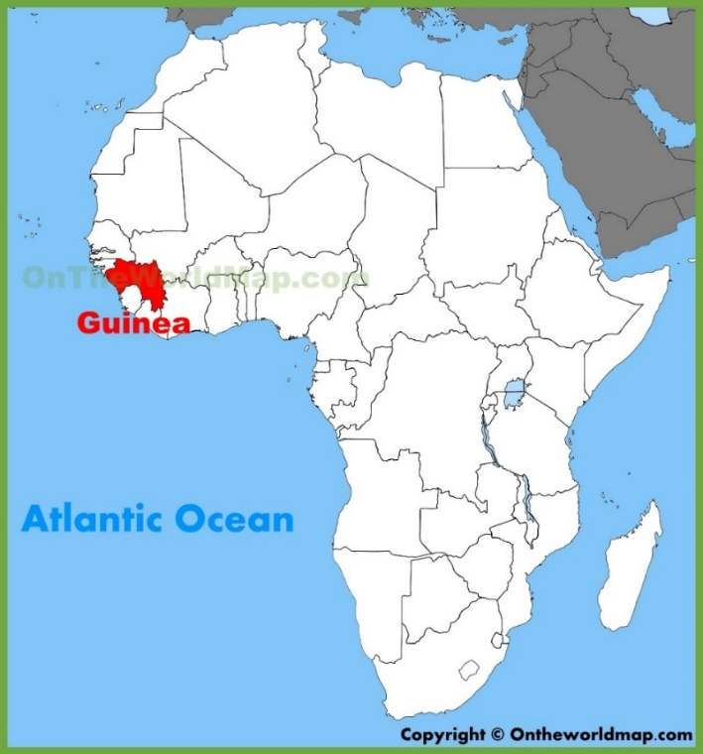
Bossou Forest Reserve and the Nimba Mountains
Maps of the World
Natural World Heritage Sites
Google Earth Engine
Notes:
This study focuses on the area around the Bossou Forest Reserve its connectivity to the Mount Nimba strict Nature Reserve located in south east Guinea.
Overall, the Bossou Forest Reserve is a deteriorated area with a considerable fragmentation and disconnected forests. The Bossou Forest Reserve had been connected to the Mount Nimba Strict Nature Reserve area, but there are no longer forested corridors that connect to two areas. The strict rules in place within the nature reserve do not extent to the Bossou Forest Reserve and a lack of management of the area has left it in a degraded state

Slide 7
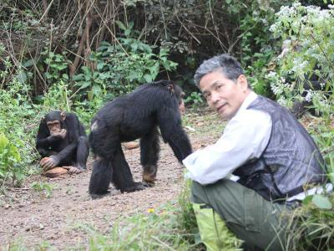
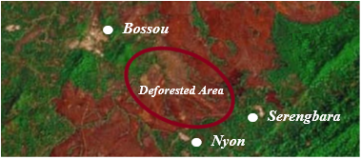
Study Communities: Bossou, Nyon, and Serengbara
The Chimpanzees of Bossou and Nimba
The Chimpanzees of Bossou and Nimba
Notes:
The three communities involved with this study are Bossou, Nyon, and Serengbara. Bossou is the host community for the Forest Reserve while Nyon and Serengbara are connected to the both the Nimba Mountain Range and the Bossou Forest Reserve. These 3 communities have been coexisting and sharing resources with the group of chimpanzees that surround them.
Consequently the chimpanzees' home range is fragmented and surrounded due to both cultivated and abandoned fields and farms.

Slide 8
Methods

Slide 9
Work Flow
Base Maps
(Kevin McManigal)
Community Workshops, Dirt maps → A1 maps
(Destina Samani)
Data Transferred and Created in ArcMap
Editing Process with Communities
(Destina Samani)
Changes Implemented on Each Map Using ArcMap
Data from each Community Complied into One Map
Corridor Map Constructed
Notes:
Base maps (created by Kevin McManigal) sent with Destina to Guinea → Meeting with each community (dirt map then transferred to the A1 base map) → Pictures of these maps taken from above sent to me → Georefferenced → Data created on map → map sent back to Destina → Communities input on edits and adding more data → changes made on individual maps → data grouped together for one large map with all inputs on it.
Concept mapping (used brainstorming sessions to determine underlying concerns and drivers of existing challenges of current management. Communities reached a consensus generally through rigorous constructive debate.)

Slide 10
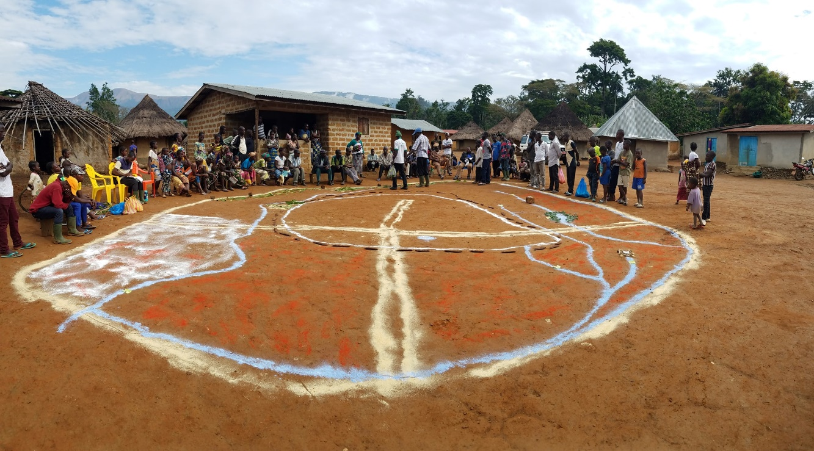
Dirt Mapping
Destina Samani
Destina Samani
Notes:
The 3 communities showed enthusiasm over the opportunity to participate and get involved with the management of their own area.
Each community went through a workshop to determine what variables they wanted to be mapped and where exactly those variables were located.
The first step in this process was done with dirt mapping. Colored chalk was used to represent the extent of different variables and the sticks and stones were used to convey the location of natural elements as well.
The process allowed for large community discussion to collectively define each variable together. Then this information was transferred to the physical base map by a few leaders in the community.

Slide 11
ArcGIS
Notes:
High quality photographs of the base maps were then sent to me with the communities input. I then got to work using Esri’s ArcMap. ArcMap is a geographic information system processing program that I worked with to create digital data for each community.

Slide 12
Data Sources
Bossou
Nyon
Serengbara
Notes:
Other than this data, all of the data was created and sourced by the community’s collective knowledge. There were universal resources that each community wanted to be mapped and then also variables that were unique to each group of people. Many land covers showed up among all three communities such as, savanna, chimpanzee corridor, forest, plantations, and bat caves.

Slide 13
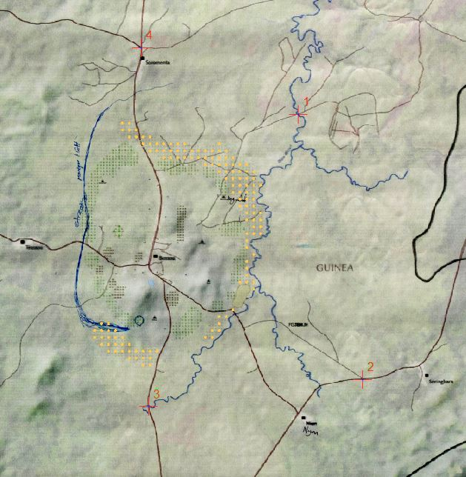
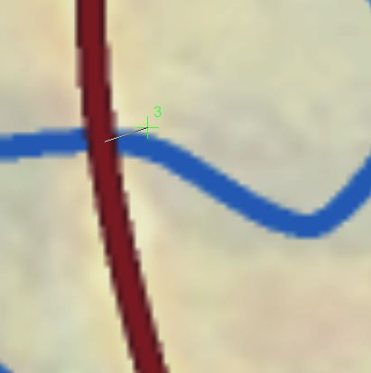
Geo Referencing
Notes:
The first step after receiving an image of each community’s base map was to assign spatial information to them. This processes is done through geo referencing in order to place the image in its appropriate real world location.
Because the base maps exist within a geographic coordinate system, the images of the newly created maps can be geo referenced to this. 4 Points from the image of the new map are referenced to the same location on the base map and this assigns spatial information to the photographs.

Slide 14
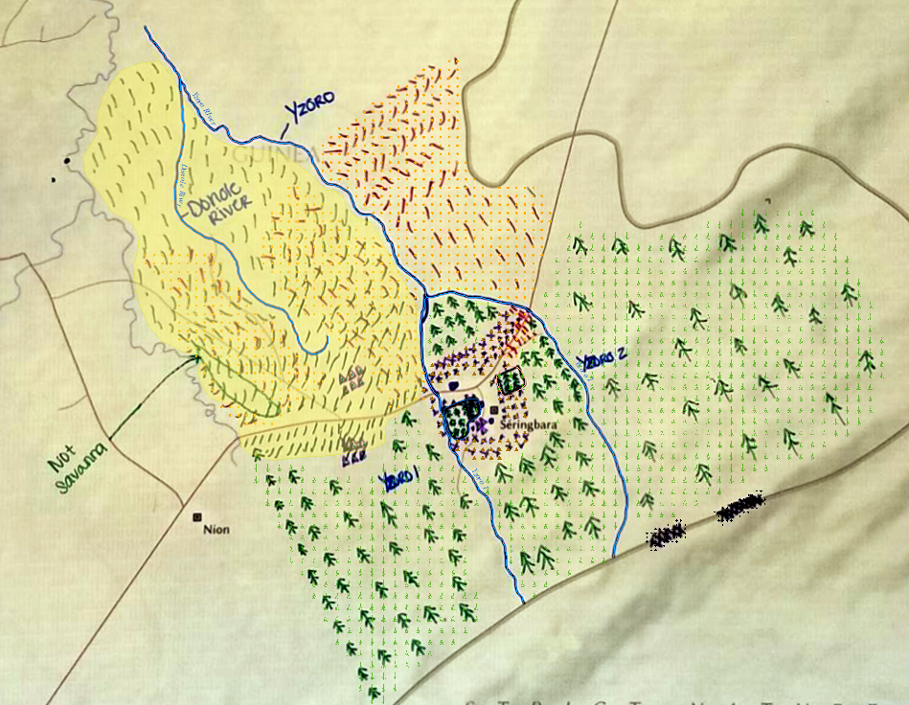
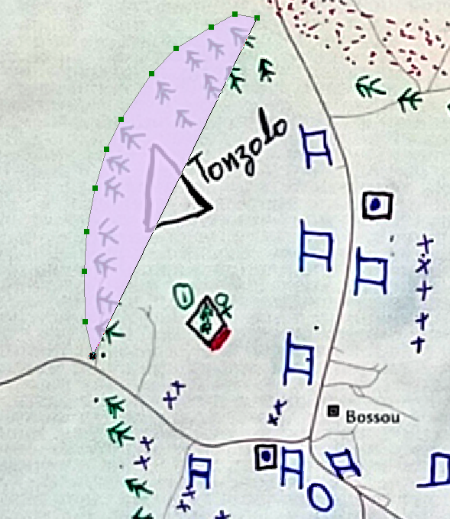
Digitizing and Creating Data
Notes:
Once the images have been geo referenced, data can begin to be transferred into the digital world. New features in the form of polygons, lines, and points were created for each qualitative variable by tracing the feature from the photograph. Appropriate symbology was then applied to display that variable on the digital map.

Slide 15
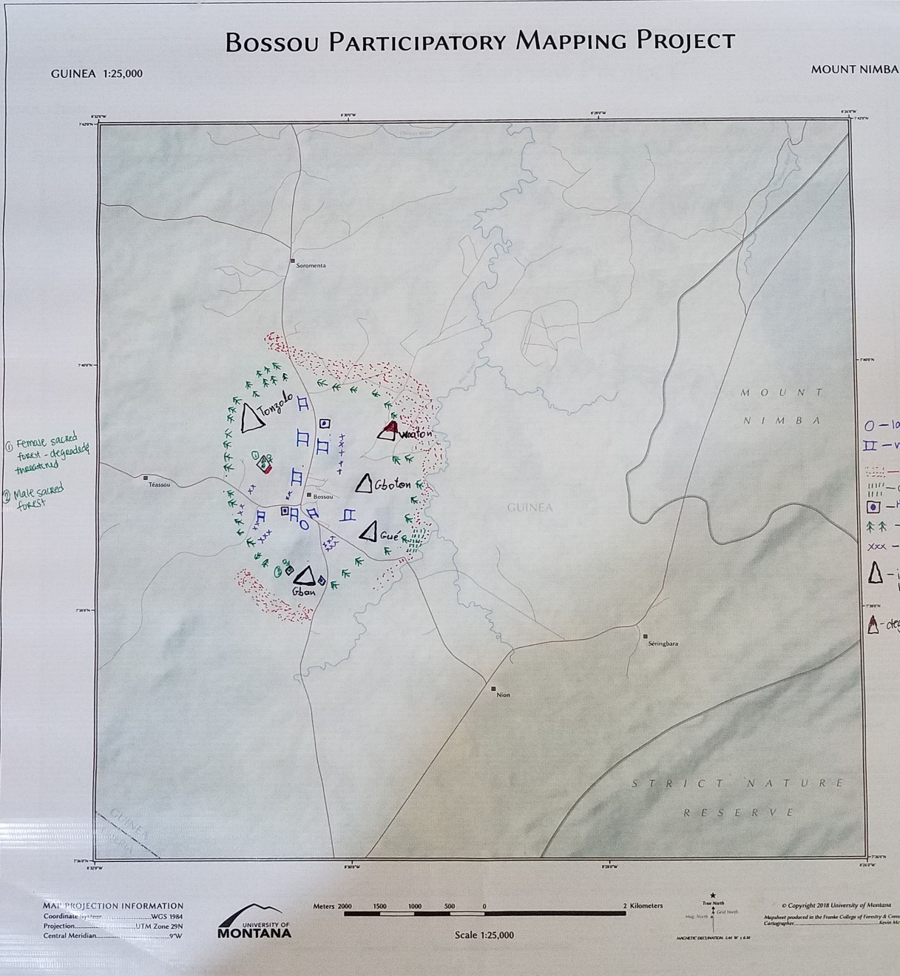
Bossou

Slide 16
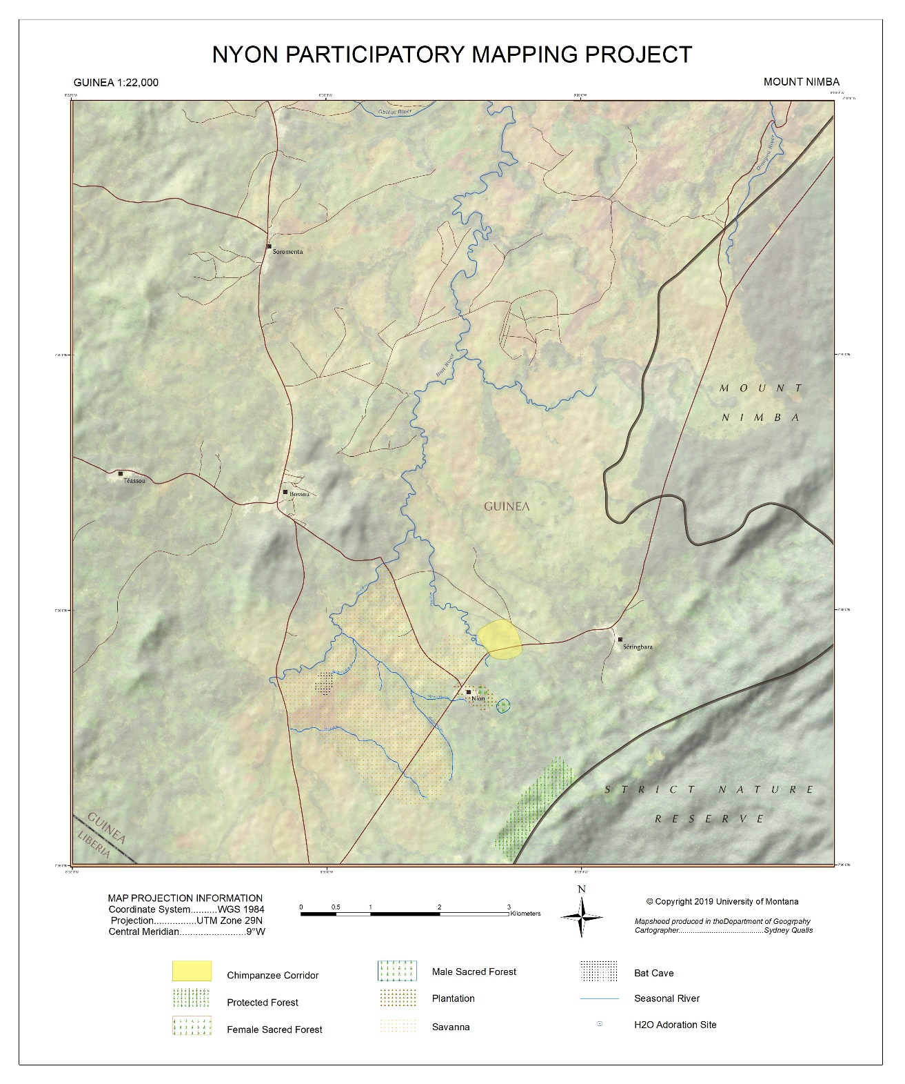
Nyon

Slide 17
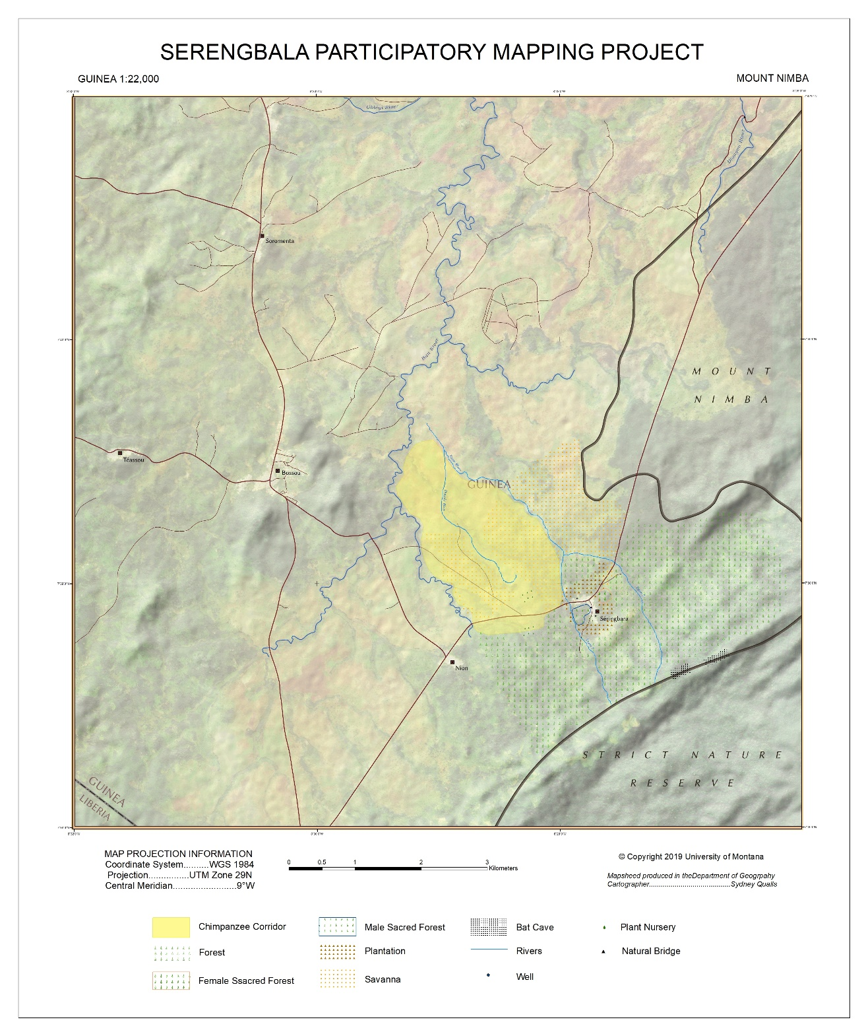
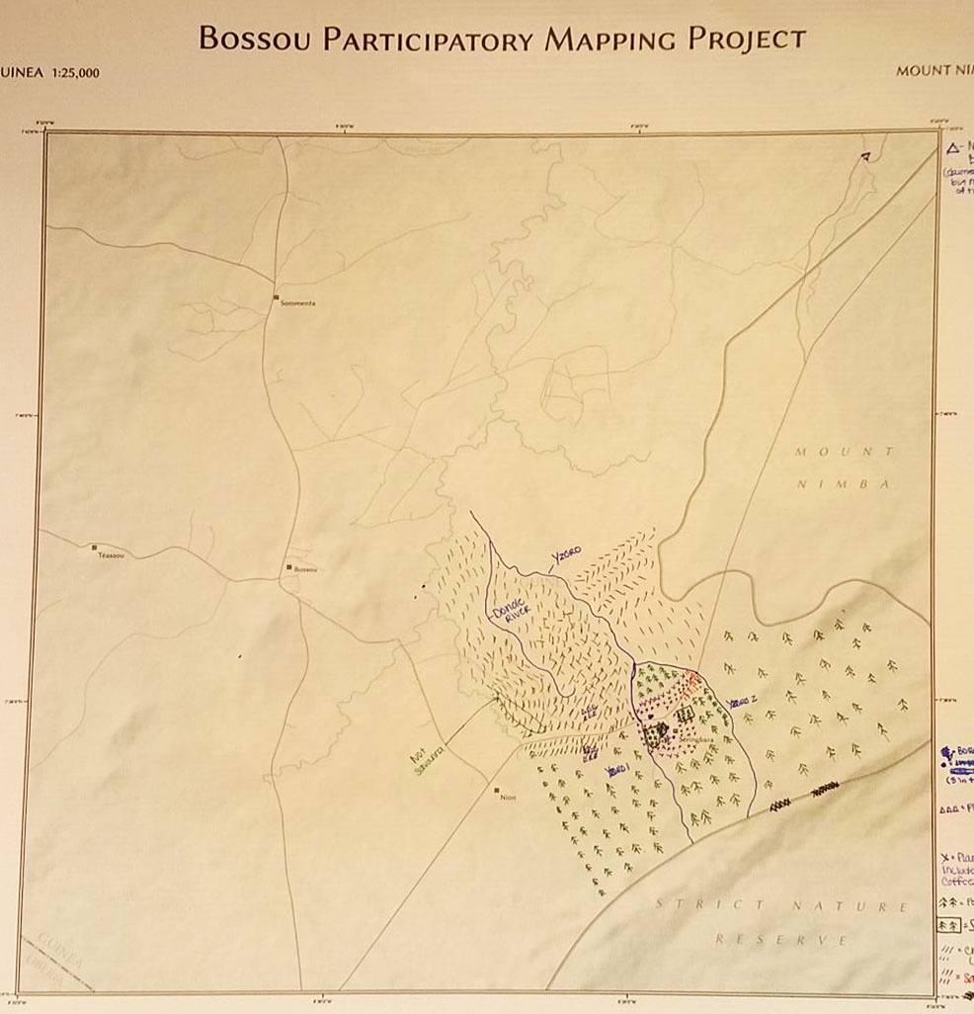
Serengbara

Slide 18
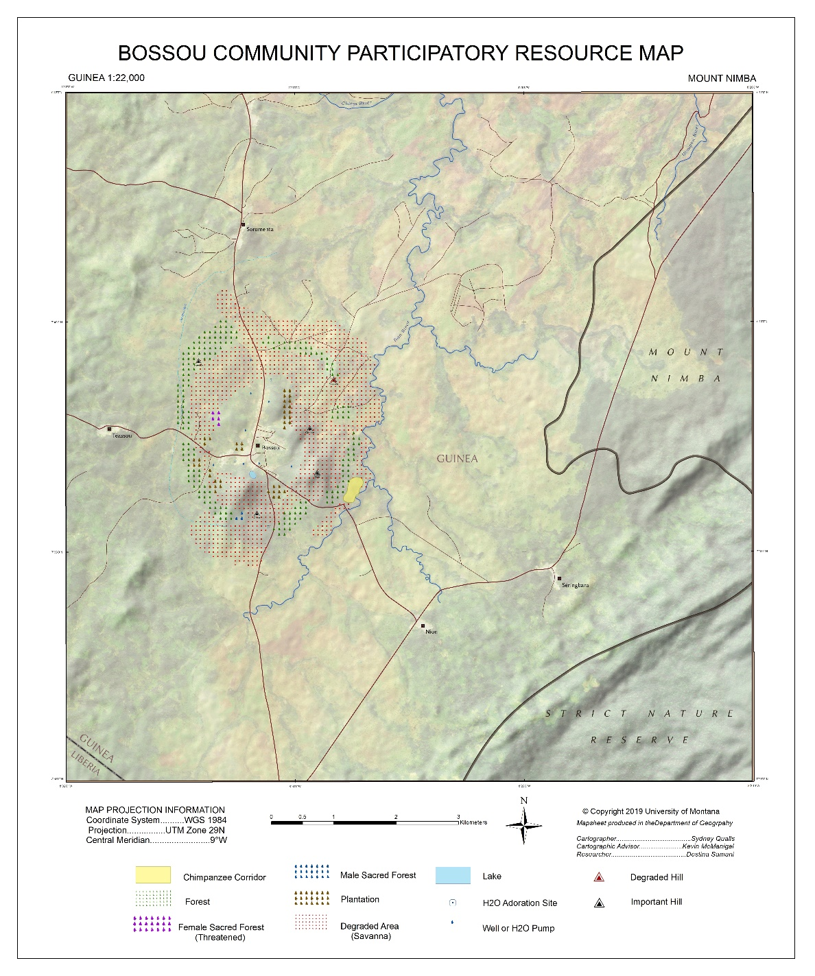
Iterative Editing Process
Notes:
After these maps were completed they were sent back to Destina to share with community leaders for clarifications. Several notes were sent back including things to change with colors and symbols. The process was very collaborative, I wanted to make sure that each community had the map that they needed in order to utilize it for more effective management strategy.
Due to complications, pictures of the newly edited maps were not able to be sent until this Sunday meaning I have not had time to go through and edit each one.
A few examples of changes made to the Bossou map include savanna being changed to degraded area and to brighter red dots, it also encompasses more area now. The plantation, sacred forest, and well symbology all changed as well.

Slide 19
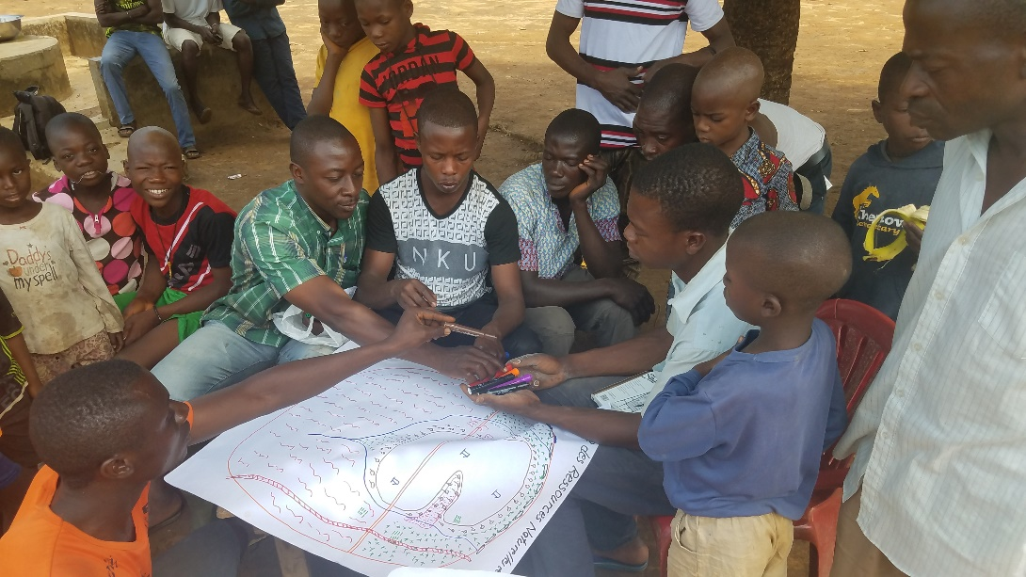
Discussion
Destina Samani
Notes:
The goal for these maps was to
Include the community in planning management strategies for their surrounding areas
Provide a detailed map of an area that has little to no geographic data available to it
Through the editing process, each community will have access to a map which they will then be able to use when implementing new ecotourism management strategies.
Problems with this project lied mostly in the communication as access to service was limited. Also access to high resolution cameras provided an issue as the pictures needed to be of high quality.

Slide 20
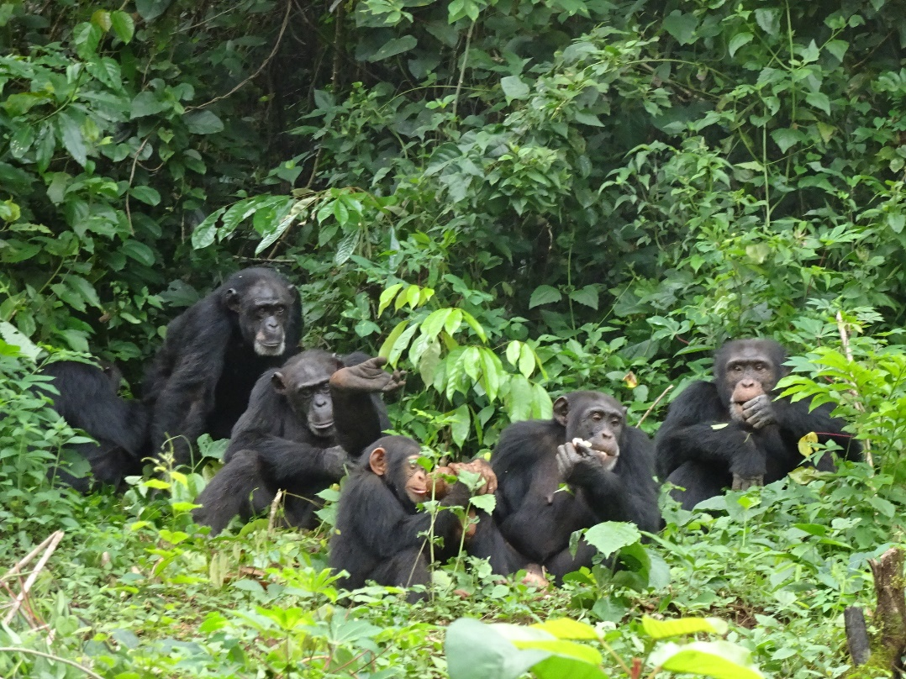
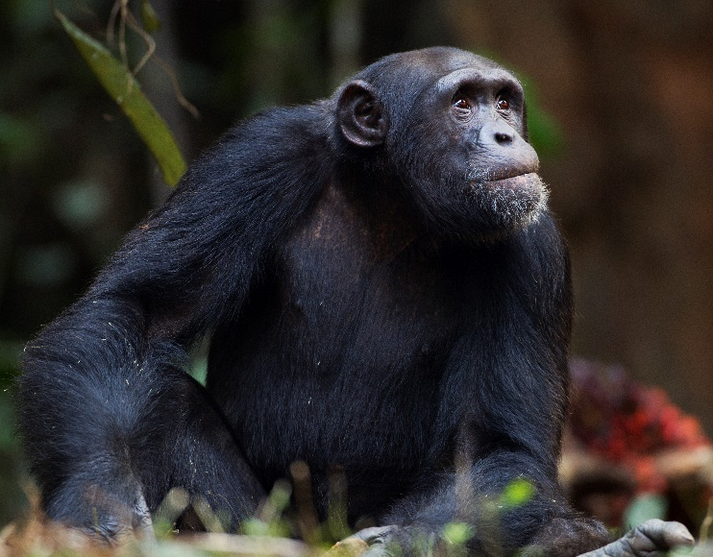
Conclusion
Notes:
Detailed maps of surrounding resources were created through a process driven by each community’s involvement. This was important because there are not maps of this area. Maps are essential when developing an ecotourism management plan as it’s necessary to know where resources are located and which areas are facing threats of degradation. This project also identified the chimpanzee habitat of the Bossou Forest Reserve as defined by each of the communities that know the area the best.

Slide 21
Acknowledgements
Sarah Halvorson, Academic Advisor
Kevin McManigal, Instructor of GIS
Destina Samani, Graduate Student, Researcher
Sophie Demartine, Graduate Student, Researcher
Keith Bosak, Funding, U.S. Forest Service International Programs
UM Geography Department

Slide 22
Questions

Slide 23
References
The Chimpanzees of Bossou and Nimba (www.greencorridor.info)
Hockings, Jane Hockings (March 2007). Human-chimpanzee coexistence at Bossou, the Republic of Guinea: A chimpanzee perspective
Base Map Data
World Database on Protected Areas: Protectedplanet.net
STRM 30 meters: Bing
Vector Data: Open Street Map

