Slide 1

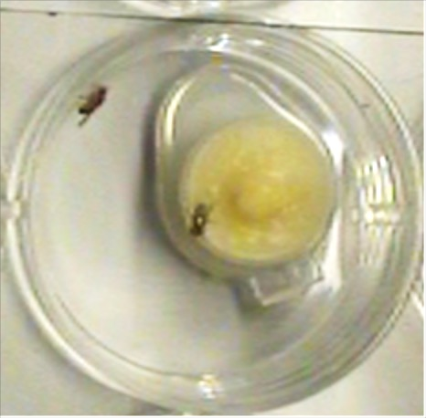
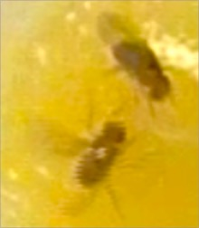
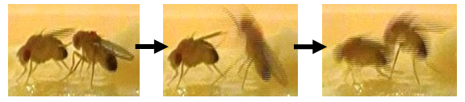
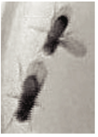
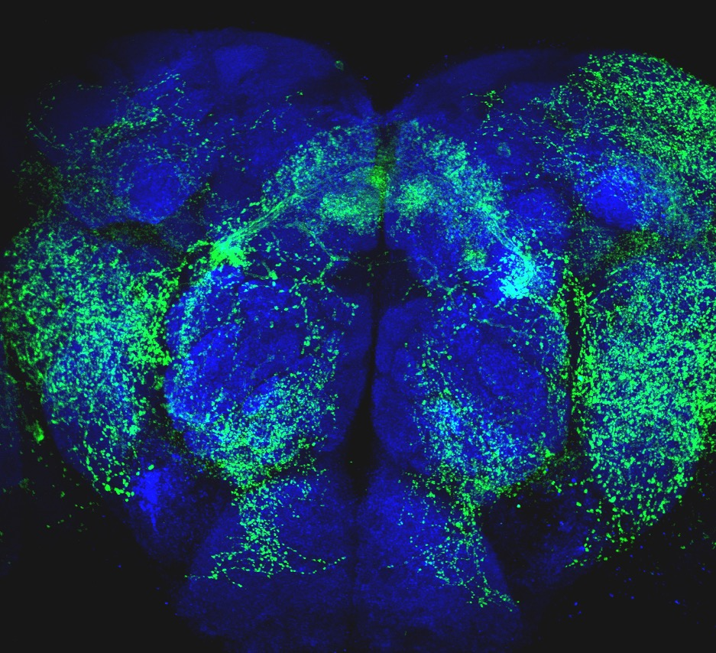



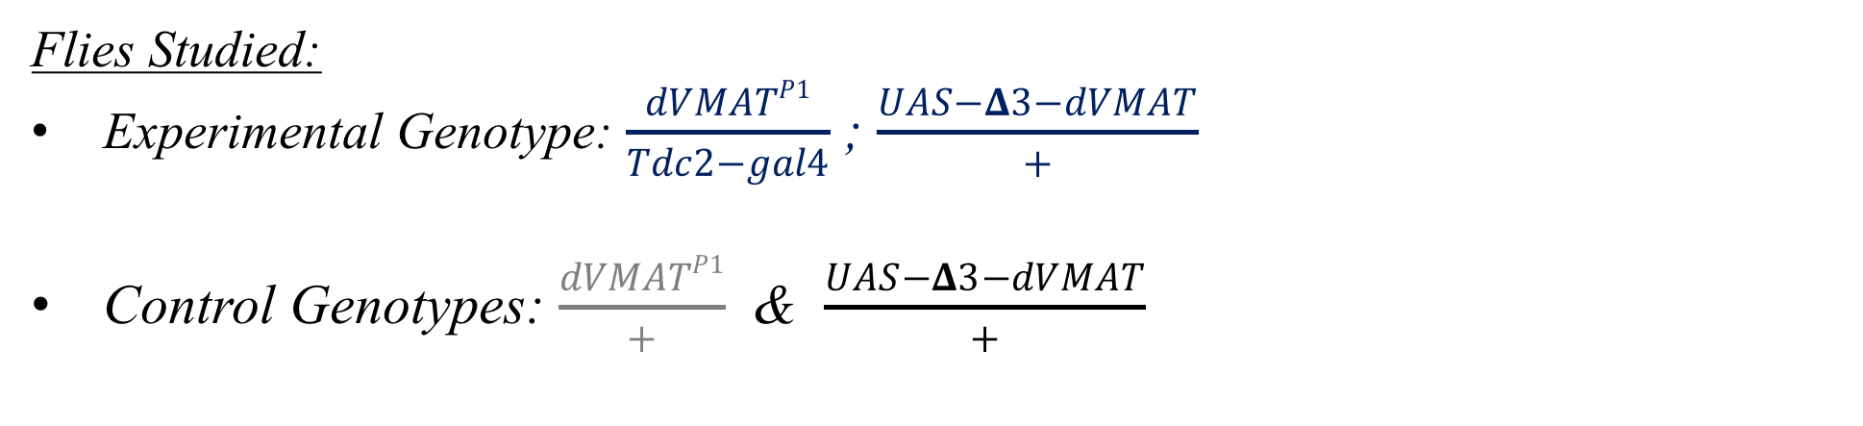


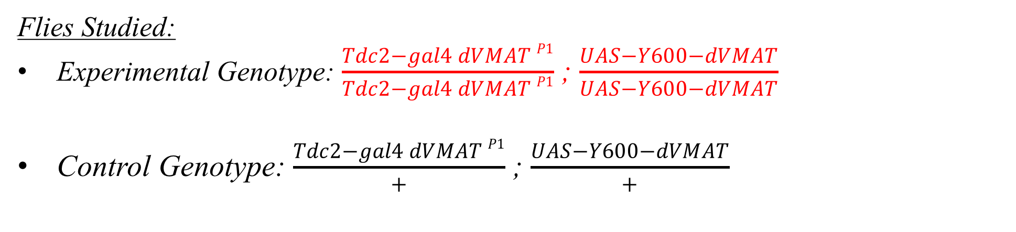
Behavioral Impacts of Octopamine Release on a Global vs. Local Scale
Bisom T. ¹, Catudio Garrett E.² , Sherer L.², and Certel S. ^{1,2}
¹Center for Structural and Functional Neuroscience, The University of Montana, Missoula, MT, ²Cellular, Molecular and Microbial Biology Graduate Program, The University of Montana, Missoula, MT
1) Introduction
2) Tools for manipulating monoamine release
3) Aggression Protocol
Neurons support at least two distinct signaling mechanisms of amine transmitters: release by synaptic vesicles (SVs) and large dense-core vesicles (LDCVs).
SVs are found at the active zone of the synapse, and thus, they are required for neurotransmitter release into the synaptic cleft.
Unlike SVs, the release of monoamines from LDCVs occurs extrasynaptically from axon terminals, neuronal cell bodies, and dendrites. From these extrasynaptic sites, receptors on multiple targets locally and distantly may be activated by diffusion. Thus, extrasynaptic release can extend the timing of a signal affecting the nervous system for several hours.
Figure 2. A single OA neuron illustrating the great distances from the soma (arrow) and synaptic endings found in these adult amine neurons. Genotype: MB022C-Gal4;UAS-sytEGFP.
Aggression Protocol:
Group-housed males were transferred to 16 X 100 mm glass vials after eclosion.
Painted CO₂ anesthetized flies after eclosion.
Two size and age-matched (3-5 days) males of same genotype were gently aspirated into the aggression chamber.
Aggression was scored 30 minutes after the first lunge.
Behavioral patterns measured were:
E
How a nervous system weighs and integrates amine release from SVs versus LDCVs on cellular targets and circuit output is unknown.
Both SVs and LDCVs store and release amine neurotransmitters through the action of a family of membrane-embedded proteins, the vesicular monoamine transporters (VMATs).
Drosophila melanogaster has only one VMAT family member, dVMAT. Complications of redundancy are therefore not a concern in the Drosophila model system.
  latency to lunge
  lunge number
  wing threats
  male-male courtship
Aggression Chamber
Figure 4. Aggression chamber where behavioral assays were performed. A dot of yeast paste was added to the center of each food cup, so the flies had territory to defend.
Experiments in this project tested the hypothesis that reducing amine release from synaptic vesicles could alter the functional properties of octopamine (OA) neurons and subsequently change circuits that modulate aggressive behavior.
G
VMAT alleles:
VMAT^{P1} – complete loss of function
VMAT^{Y600A} – an alanine substitution mutant that specifically disrupts a tyrosine-based sorting motif that decreases the localization of VMAT to SVs
VMAT^{∆3} – a 23 aa deletion at the dVMAT terminal which disrupts endocytosis signals proposed to be required for de novo trafficking and recycling to SVs following exocytosis at the synapse
A
Behavioral Patterns:
B
Wing Extension
Figure 1. Circuit modulation by synaptic vs. extrasynaptic release.
Proposed model of aggression circuitry temporally and spatially modulated by OA release from synaptic vesicles (SV) and extrasynaptic release from large dense core vesicles (LDCV).
Still images of a lunge, an aggressive behavior pattern.
Male-male Courtship
Figure 3. Illustration depicting release of monoamine via SVs.
Figure 5. Images depicting (A) aggressive behaviors and (B) courting behaviors.
4) Experiments with half of wildtype vMAT present did not change aggression
5) Altering SV to LDCV distribution reduces male aggression
6) Conclusions and Acknowledgements
Flies Studied:
Experimental Genotype: $\frac{dVMATP1}{Tdc2−gal4}$ ; $\frac{UAS−Δ3−dVMAT}{+}$
Control Genotypes: $\frac{dVMATP1}{+}$ & $\frac{UAS−Δ3−dVMAT}{+}$
Flies Studied:
Experimental Genotype: $\frac{Tdc2−gal4 dVMAT P1}{Tdc2−gal4 dVMAT P1}$ ; $\frac{UAS−Y600−dVMAT}{UAS−Y600−dVMAT}$
Control Genotype: $\frac{Tdc2−gal4 dVMAT P1}{+}$ ; $\frac{UAS−Y600−dVMAT}{+}$
Conclusions:
Previous results likely did not show significant differences in aggression because the experimental flies only carried one null dVMAT^{P1} allele, and thus, had 50% wildtype VMAT function.
Experimental flies in this project were homozygous for the null dVMAT^{P1} allele. The only VMAT produced was the Y600A allele from the UAS transgene.
My preliminary results indicate that the output of OA-mediated aggression circuits are modified when the release of OA was shifted to LDCVs, suggesting that wildtype aggression levels requires the release of OA into the synapse.
A
B
C
D
A
B
C
D
20
150
C
25
80
50
150
15
20
15
100
20
60
40
100
10
15
Lunge Number
15
Male-Male UWE
30
Latency to Lunge (min.)
Number of Wing Threats
Latency to Lunge (min.)
Lunge Number
Number of Wing Threats
Male-Male UWE
10
n = 9
n = 4
n = 14
50
10
40
20
50
5
10
5
5
20
10
n = 14
n = 15
5
$$\frac{UAS−Δ3−dVMAT}{+}$$
$$\frac{dVMATP1}{+}$$
$\frac{dVMATP1}{Tdc2−gal4}$ ; $\frac{UAS−Δ3−dVMAT}{+}$
$\frac{Tdc2−gal4 dVMAT P1}{+}$ ; $\frac{UAS−Y600−dVMAT}{+}$
$\frac{Tdc2−gal4 dVMAT P1}{Tdc2−gal4 dVMAT P1}$ ; $\frac{UAS−Y600−dVMAT}{UAS−Y600−dVMAT}$
Future Directions:
Recently, Dr. Steve Stowers has used genome-editing to generate a conditional V5-tagged VMAT that will enable us to visualize endogenous VMAT localization in OA neurons (Figure 8).
Figure 6. (A) Latency to lunge, (B) Number of Lunges, (C) Wing Threats, and (D) Male-male unilateral wing extensions (UWE). Dunn’s Multiple Comparisons and Kruskal-Wallis tests were conducted in (A-D) to determine statistical significance. Error bars denote S.E.M. * equals p≤0.05, ** equals p≤0.01, *** equals p≤0.001
Figure 7. (A) Latency to lunge, (B) Number of Lunges, (C) Wing Threats, and (D) Male-male UWE. A Mann Whitney test was performed in (A-D). Error bars denote S.E.M. * equals p≤0.05, ** equals p≤0.01, *** equals p≤0.001
When males expressing dVMAT^{∆3} in a heterozygous null wildtype dVMAT background were compared to controls, a significant difference was observed in male-male courtship, but significant differences were not observed with lunges, wing threats, nor latency to lunge.
When males expressing dVMAT^{Y600A} in a homozygous null wildtype dVMAT background were compared to controls, significant differences in latency to lunge and number of lunges were observed.
Acknowledgements:
Figure 8. Image by Lewis Sherer
Tdc2-gal4;Cha-Gal80/K5RT>vMAT-V5
Funding was provided by NIH R01 GM115510 to SJC and RSS.

