Slide 1
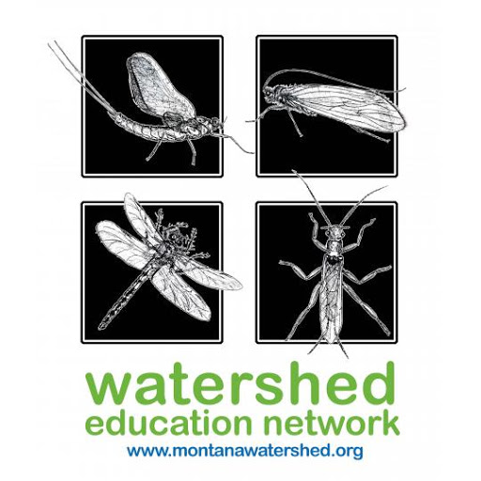
Developing a Reference Model to Evaluate Vegetation Restoration after the Removal of Rattlesnake Dam
By: Corey Leach and Kati Barreiros
UM Ecosystem Science and Restoration Program
Partners: Christine Brissette - Trout Unlimited;
Deb Fassnacht, Aissa Wise, David Cole - Watershed Education Network
Notes:
(C)Overview of TU project+what were doing

Slide 2
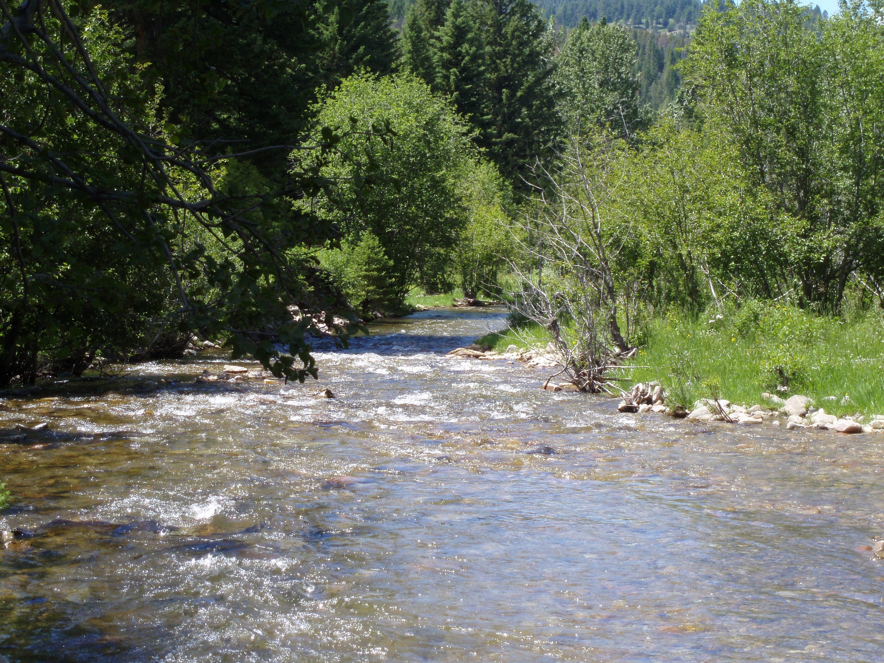
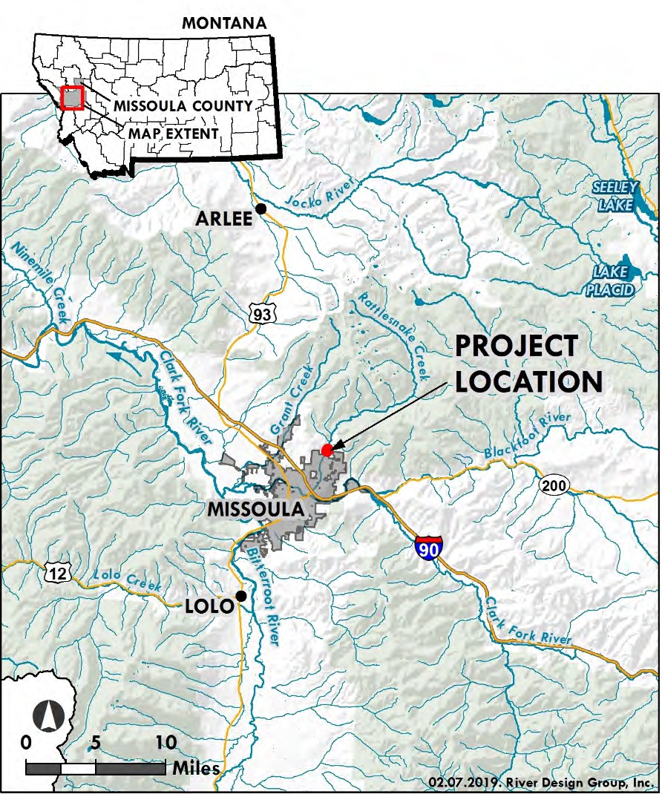
Rattlesnake Creek
Notes:
(k) Flowing N to S into Clark Fork River in Missoula -Beginning in the Rattlesnake Wilderness N of Missoula the creek is 26 mls.
Flows through Rattlesnake Wilderness (upper) and (lower) flows through Rattlesnake National recreation area -Mixed ownership (private and public) causes pressure on the creek including recreation, agriculture, urbanization -main water supply to Missoula residents until 1983

Slide 3
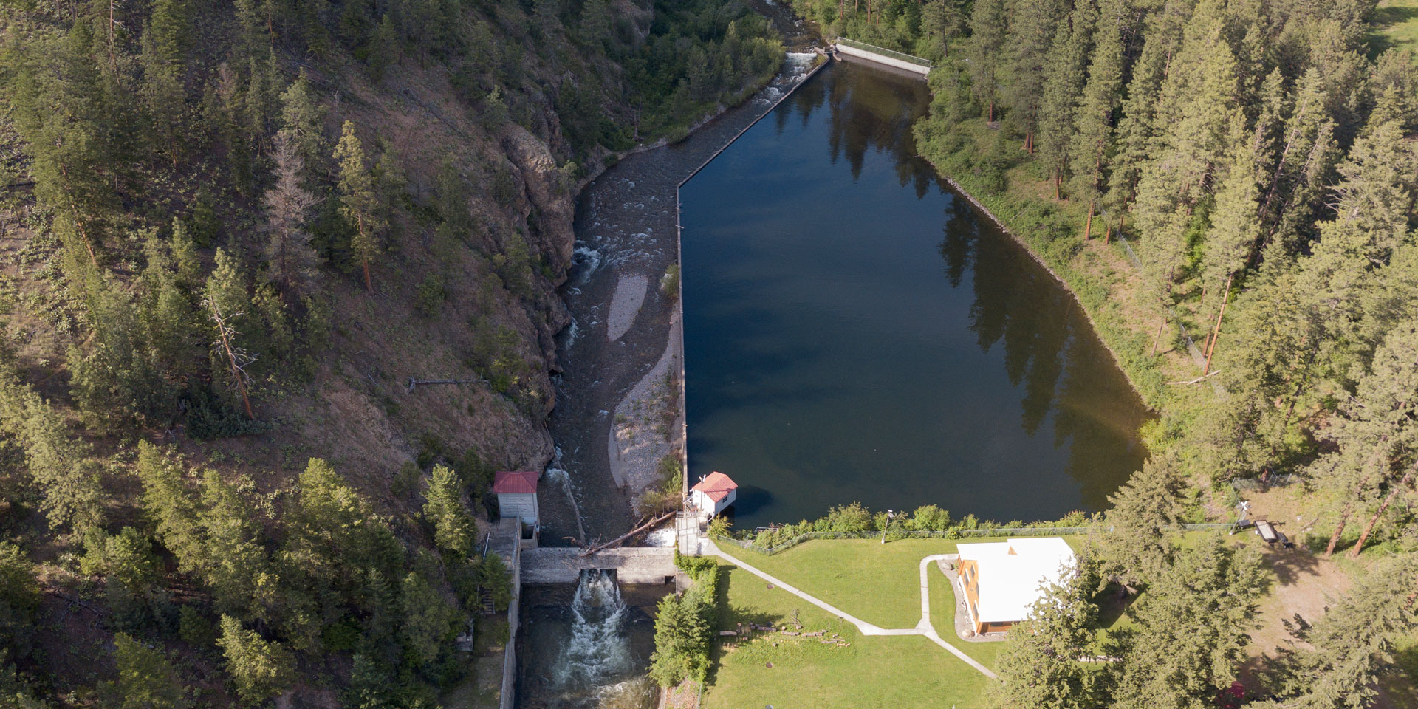
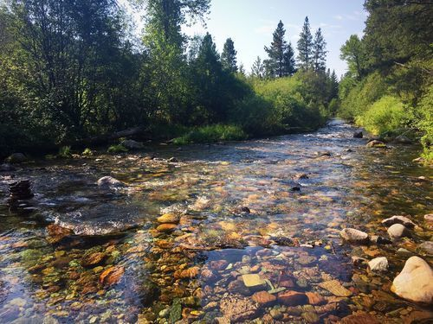
Importance of Dam Removal
Notes:
(C)

Slide 4
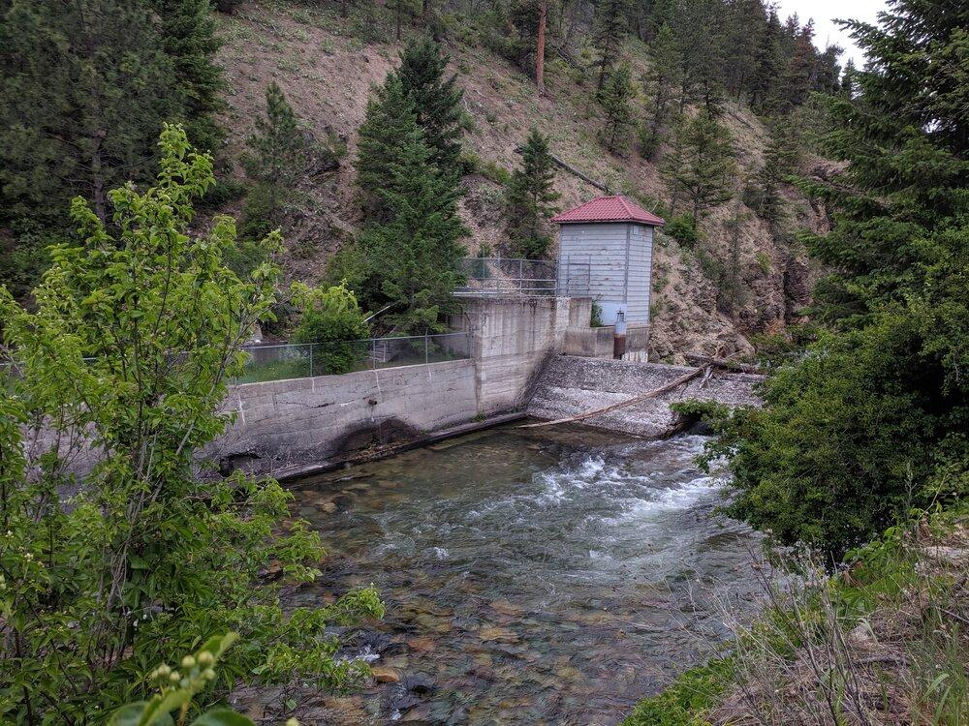
History:
Rattlesnake
Creek
Dam
1904 → 1983 → 2004 → 2020
Notes:
(k)1904- dam built ----2004- fish ladder was incorporated into the dam/ installed to help create an easier passage for migratory fish -easier ability to get past the dam to spawn upstream ---2020- TU, WEN, and FWP are partnering up to remove the dam and restore the surrounding landscape
3 million gallon water reservoir will be turned into floodplain/riparian habitat

Slide 5
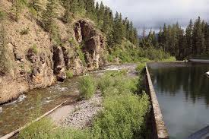
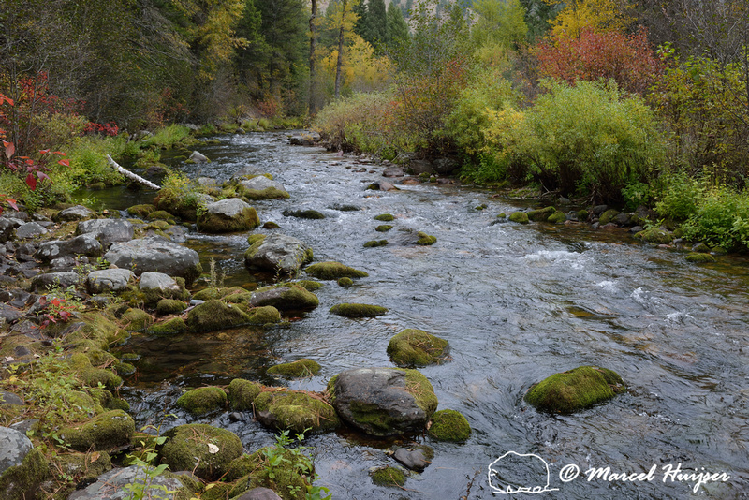
Reference models and Importance
Project Site
Reference Site
Notes:
(C)

Slide 6
Creating a reference model
Identify suitable sites
Include variables from all ecosystem attributes
Include enough sites to determine mean conditions

Slide 7
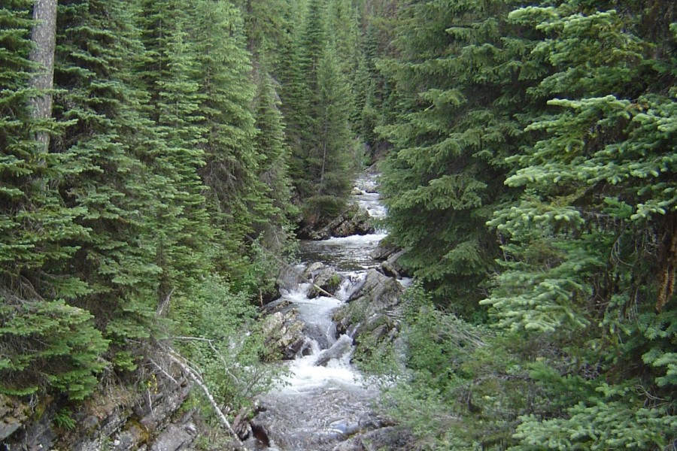
Limitations when creating and using a model
Montana-Trout-Unlimited-Photo-Rattlesnake-Creek-Rob-Roberts-
Notes:
(K) As you can see in this picture it is different from the others shown---Never a one size fits all--Environment is always changing
Surrounding habitats are very different in Wilderness vs. Urban Size of channel varies
MARKET PITCH- There are many ways to determine the necessary steps and a wide variety of variables to consider when restoring a landscape after dam removal, ----the missing piece that is critical to success is having a reference model to follow during restoration----Using our model will save time and money by eliminating the challenging components of the planning process. You must determine what level of accuracy you want to obtain and this is based on knowing the right places to use for data collection and including enough sites to get an accurate level of precision.

Slide 8
Specific Objectives
●Create a reference model for the Rattlesnake Creek Dam removal site to guide riparian restoration monitoring;
●Test the efficacy of the reference model with respect to precision of estimation achieved and required sample sizes; and
●Provide recommendations for best practice in creating models for creeks similar to Rattlesnake Creek
Notes:
(C)

Slide 9
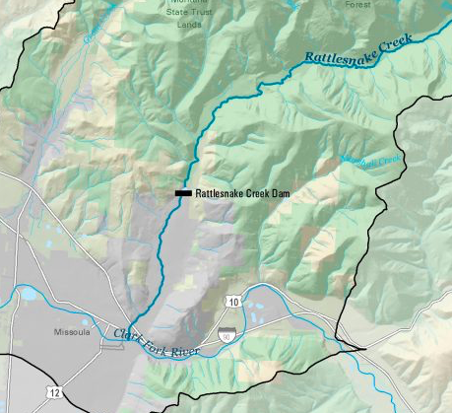
Methods: Site Selection
Two Approaches:
Upstream of Rattlesnake Dam
Local analogs
Notes:
(C)-Stream order
-Climatic factors -Temp and Precipitation
-Geographic location-Elevation
-Similar vegetation composition to upstream of Rattlesnake Creek
-Level of degradation (based on MT classification; Suplee et al 2005)

Slide 10
Methods:
Study Variables
ECOSYSTEM COMPOSITION
ECOSYSTEM STRUCTURE
ECOSYSTEM FUNCTION
Notes:
(K)

Slide 11
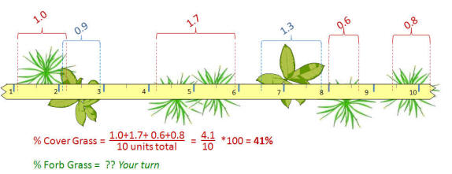
Methods: Experimental Design
Point-line intercept -perpendicular transect from creek to measure vegetation cover
Measure each (live) tree @DBH that falls within 1m of transect
Highlight common/most abundant species present for each transect
Notes:
Determine percent of vegetative present between each meter of the 90 ft transect(K)broken into 27 - 1 meter grids-Each grid broken up into 10 units (0.1 m mark on meter sticks)-----3 at each site -GPS cords at each point (beginning and end) 27 meters recorded on each transect (1-2, 2-3,...26-27)
percent cover (of specific species) on the transect between the specific meter in question
For each live tree, note its species and DBH (at 4.5 ft). Also note the number of dead standing trees, by species, within the sample area.

Slide 12
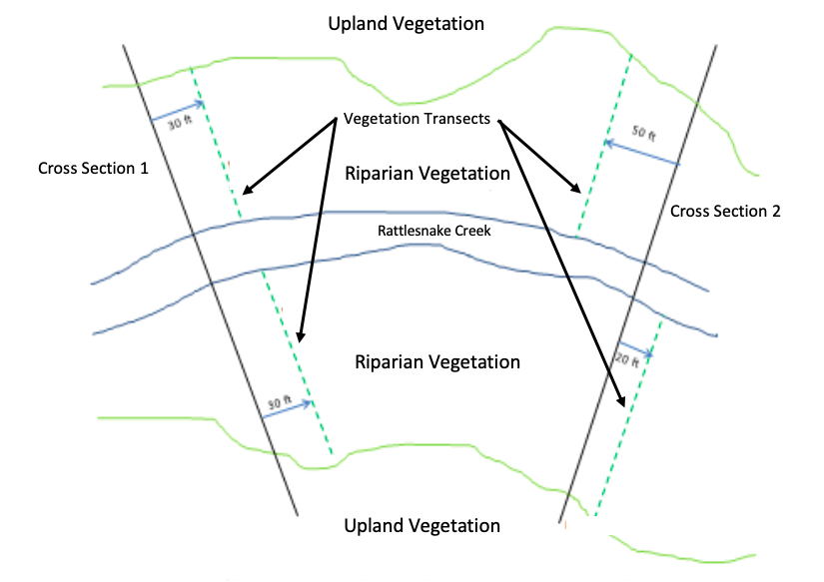
Watershed Education Network Study Design
-Two cross sections perpendicular to Rattlesnake Creek
-Four 90 ft transects parallel to cross section
Transect 1
Transect 3
Transect 2
Transect 4
Cross section- 1
Cross section- 2
Notes:
(C) We will be collecting data determining upslope vegetation, also known as, upland vegetation, as well as, determine the dominant riparian vegetation species present between the cross sections and transect lines.

Slide 13
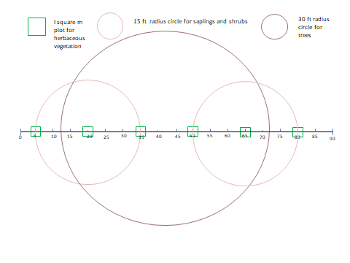
Transect
for
data
Collection
at dam location
-90 foot transects
-Measuring percent cover of herbaceous vegetation, saplings, shrubs and tree diameters
Notes:
(K)Zooming in on the transects- 6 locations across transect ---Equal distance from one another starting at least 3 feet from the starting point of transect ----90 foot transect (90/6=15) -each quadrat will be 15 feet apart (EX: 5, 20, 35, 50, 65, 80) where you measure percent cover of herbaceous vegetation in 1 square meter plot _Labeled (1-6) 1 being closes to the stream. ---------Saplings and shrubs -15ft radius -30ft diameter -----Trees- 30 ft radius -60 ft diameter ----We will look at the percent vegetation cover, litter, and bare ground-----Estimate percent cover in one of the following classes:
Cover classes put on data sheet: ----1 = ≤ 5%; 2 = 6-15%; 3 = 16-25%; 4 = 26-50%; 5 = 51-75%; 6 = 76-95%; 7 = ≥ 95%.------2 cross sections---4 transects---EACH TRANSECT- 6 quadrats, 2-30 diameter sapling and shrub points, 1-30ft radius tree species (dead or alive) present and DBH calculation

Slide 14
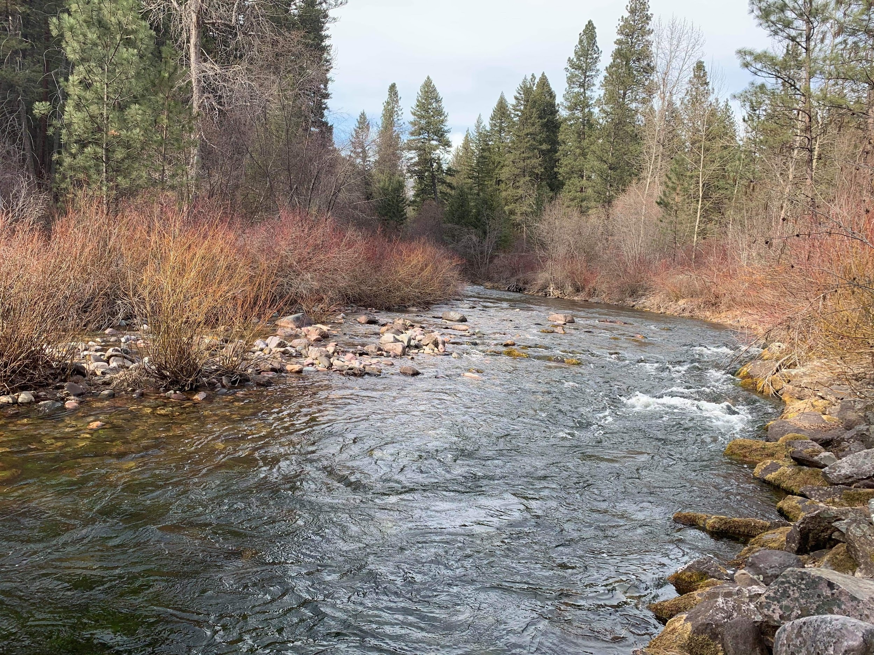
Significance
Notes:
Vegetation and canopy are important ecosystem attributes that help the ecosystem by reducing erosion, providing shade and organic matter inputs into the creek and protecting the ecosystem from invasion of undesired species. Species composition and arrangement are 2 of the main structural components to an ecosystem and how an ecosystem functions through living and nonliving interactions play a major role for the success and productivity of the ecosystem as a whole.

Slide 15
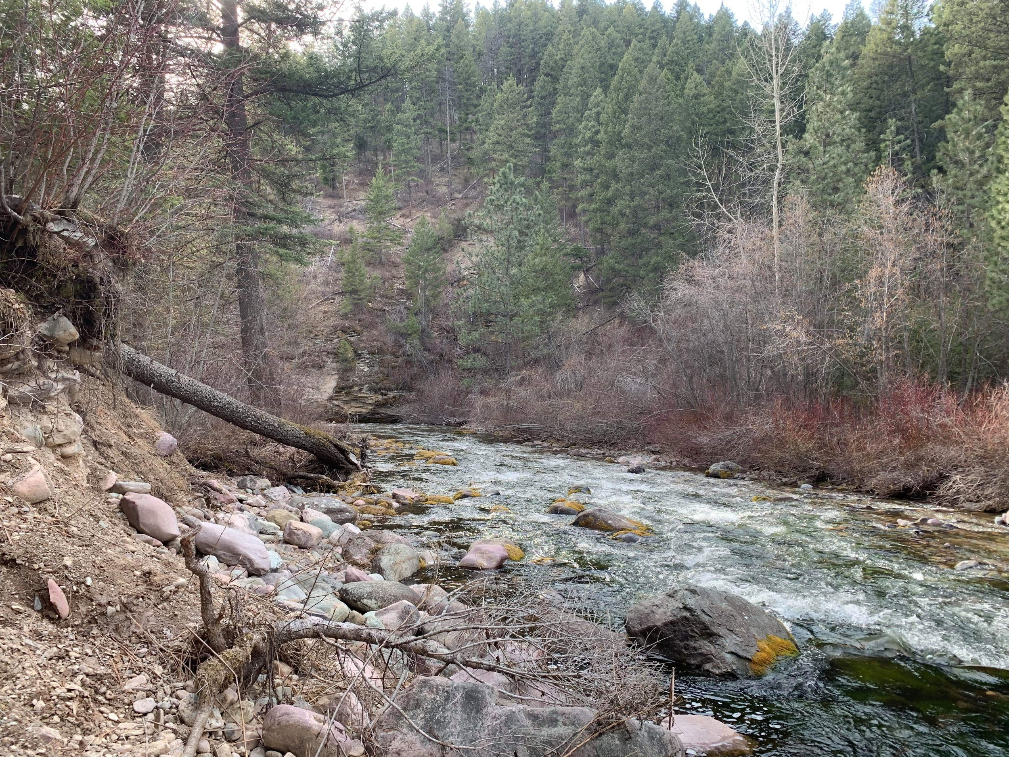
EXAMPLE:
REFERENCE SITE-UPSTREAM RCD
Notes:
I personally took this photo upstream from the dam and reservoir and shows a natural system where we have a combination of debris, trees, grass, shrubs, bare ground, litter, etc...These are all important variables to take into account when creating a reference model to determine how these variables may respond to change and what these changes mean for an ecosystem.

Slide 16
Research questions
Does Trout Unlimited’s revegetation design adequately represent accurate species composition of reference sites?
What number of sites need to be evaluated to get an accurate mean of the natural conditions, and what is the margin of error associated with our estimates?
What is the species richness found at the reference sites we analyzed?
Notes:
C and K

