Slide 1
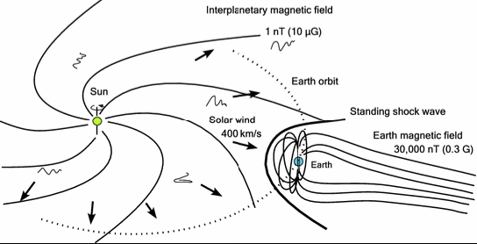
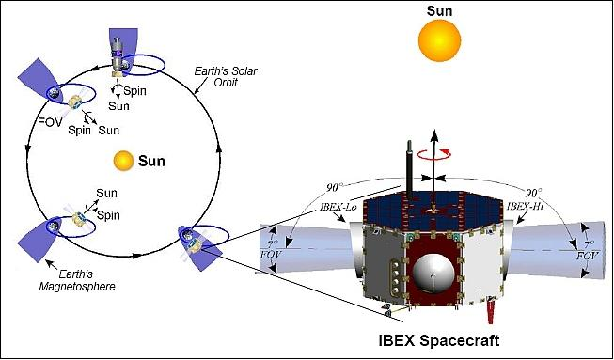
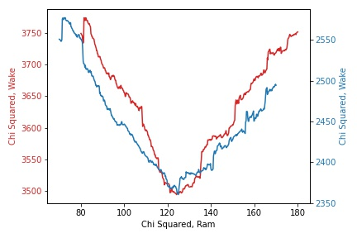
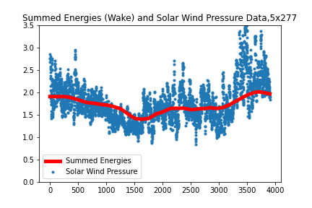
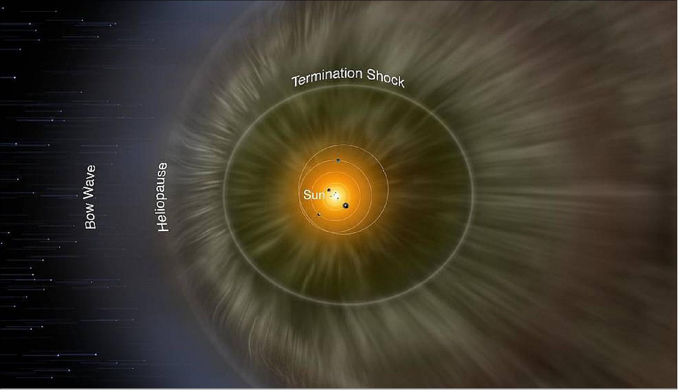
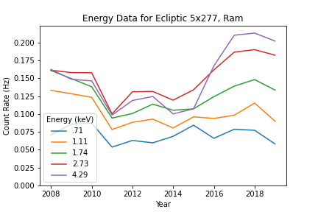
Correlating ENA rates with solar wind pressure to find the scale of the heliosphere
Joe Kelly, University of Montana
Dr. Paul Janzen, Physics Dept, University of Montana
Solar Wind
The IBEX Satellite
Results
Solar wind is a continuous
stream of charged particles
(protons and electrons)
produced by the Sun which
propagate outwards along
the Suns’ magnetic field
lines. Solar wind comes in
two forms: slow and fast
solar wind.
Slow solar wind
400 km/s, originates in the Sun’s equatorial belt
Fast solar wind
750 km/s, originates in coronal holes
More fast solar wind near the poles of the Sun
As the solar wind reaches the edge of the solar system, it slows down by 10% and gradually ionizes. The pressure and density of solar wind changes over time.
The Interstellar
Boundary Explorer
(IBEX) is a satellite
orbiting the Earth
which monitors
incoming ENAs.
It has been
collecting data since
2009. The nose of
the satellite is
always oriented
towards the sun,
meaning it collects data from each patch of the sky twice a year, once while moving towards that area (called “Ram”) and once while moving away (called “Wake”). Incoming ENAs may be counted by five different energy detectors, each corresponding to a different energy range. This project focused on IBEX data taken between 2009 and 2019.
We limited our search area to the equatorial region of the “nose” of the heliosphere. This allows us to make simplifying assumptions about the solar wind speed and the complexity of the interactions in the termination shock. An example the
distance
minimization
technique is shown
to the right. Both
the “Ram” and
“Wake” data sets
show the distance
to the termination
shock at roughly
125 astronomical
units (AU). Visually,
the summed ENA
curves match very
well with solar wind
pressure. Repeating
this procedure for
five patches of the
sky, we find the
ideal distance to be
between 115 and 130
AU, which matches
with previous estimates
of the scale of the
heliosphere, indicating
that solar wind pressure
was reflected in ENA
data in the way expected.
The Heliosphere and ENAs
Project Goal
Our solar system
is situated within
the interstellar
medium, the
region which
exists between
solar systems and
has a weak,
directional
magnetic field.
The heliosphere
is a vast, bubble-
like region surrounding the solar system which exists inside the interstellar medium, defined by the location where the Sun’s stronger magnetic field is dominant. This magnetic field is propagated outwards by solar wind. At the edge of the heliosphere is the termination shock, where the interaction between the Sun’s magnetic field and the interstellar magnetic field begins to occur. The termination shock also has a “nose” and “tail” defined by the direction of the interstellar medium. As some solar wind neutralizes in the region, it becomes Energetic Neutral Atoms (ENAs), which continue along their trajectory at the moment they neutralized. Some ENAs, which are primarily hydrogen are directed back into our solar system.
Changes in solar wind pressure will result in more charged particles arriving at the termination shock, producing more ENAs. By correlating ENA data with past solar wind pressure data, we can find the distance to the termination shock. To do so, we can choose a distance, determine the length of time it would take for the ENAs of each energy to make a round trip. We then sum each offset ENA curve together for that chosen distance and compare it to the solar wind pressure data. We do this with a $χ^{2}$ test, which tells us how much in common two data sets have. The distance where $χ^{2}$ minimizes is the distance to the termination shock.
Conclusion
Past estimates of the scale of the heliosphere indicated that it is roughly 120 AU in size. By applying this method of correlating ENA observations with solar wind pressure data, we found these data sets reflected each other as anticipated and reflected the size of the heliosphere.
References
[1] McComas et. al., Seven Years of Imaging the Global Heliosphere with IBEX, 2017. [2] McComas et. al., Expanding Global Features in the Outer Heliosphere, 2019. [3] IBEX, the European Space Agency. [4] Reisenfeld et. al, Tracking the Solar Cycle through IBEX, 2019.

