Slide 1
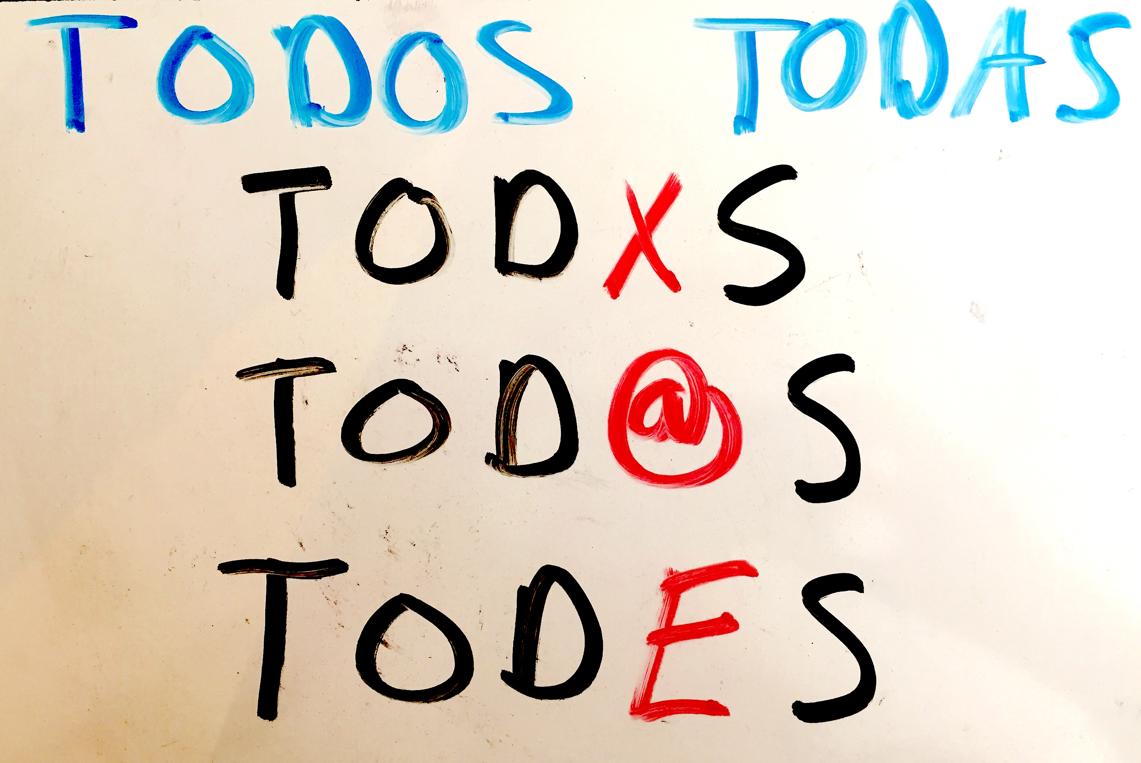
Les Chiques: The Addition of a Third Gender-Neutral Option in the Spanish Language
Fiona Bean
Davidson Honors College
University of Montana

Slide 2
Inclusive language

Slide 3
Gender in the English language
"The tall boy"/ "the tall girl"
"The tall child"
"The tall children"

Slide 4
Gender in the Spanish language
"El chico alto"
"La chica alta"
"El chico alto"
"La chica alta"
"Los chicos altos"

Slide 5
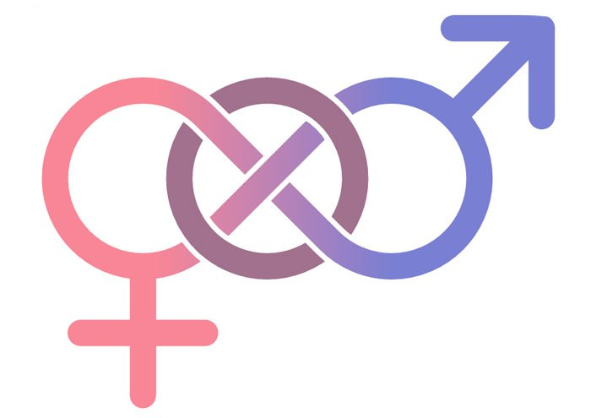
WHO DOES THIS affect?
Women
Non-binary people and others who identify outside the gender binary

Slide 6
Psycholinguistics

Slide 7
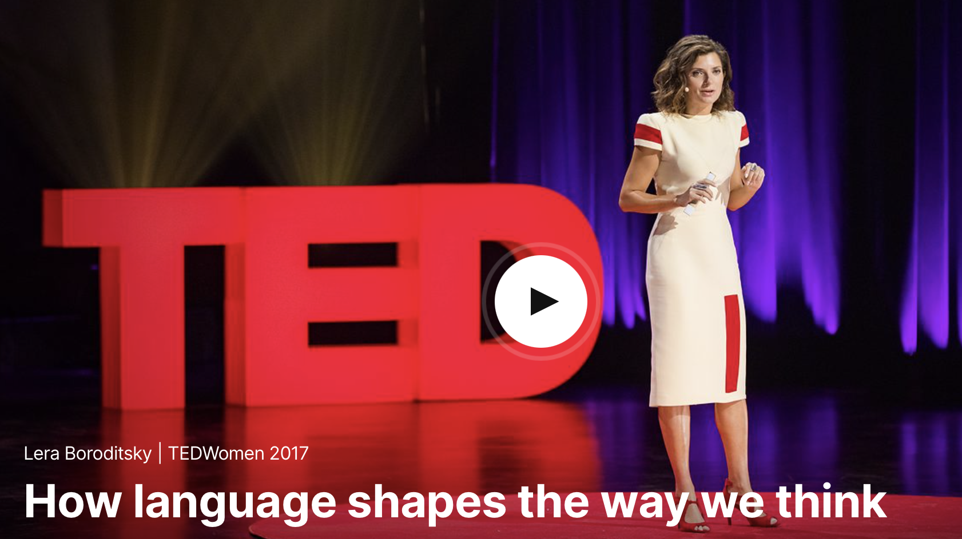
"The Bridge"
Spanish: el Puente
German: die brücke
Masculine
Feminine
"Strong", "large"
"Elegant", "beautiful"

Slide 8
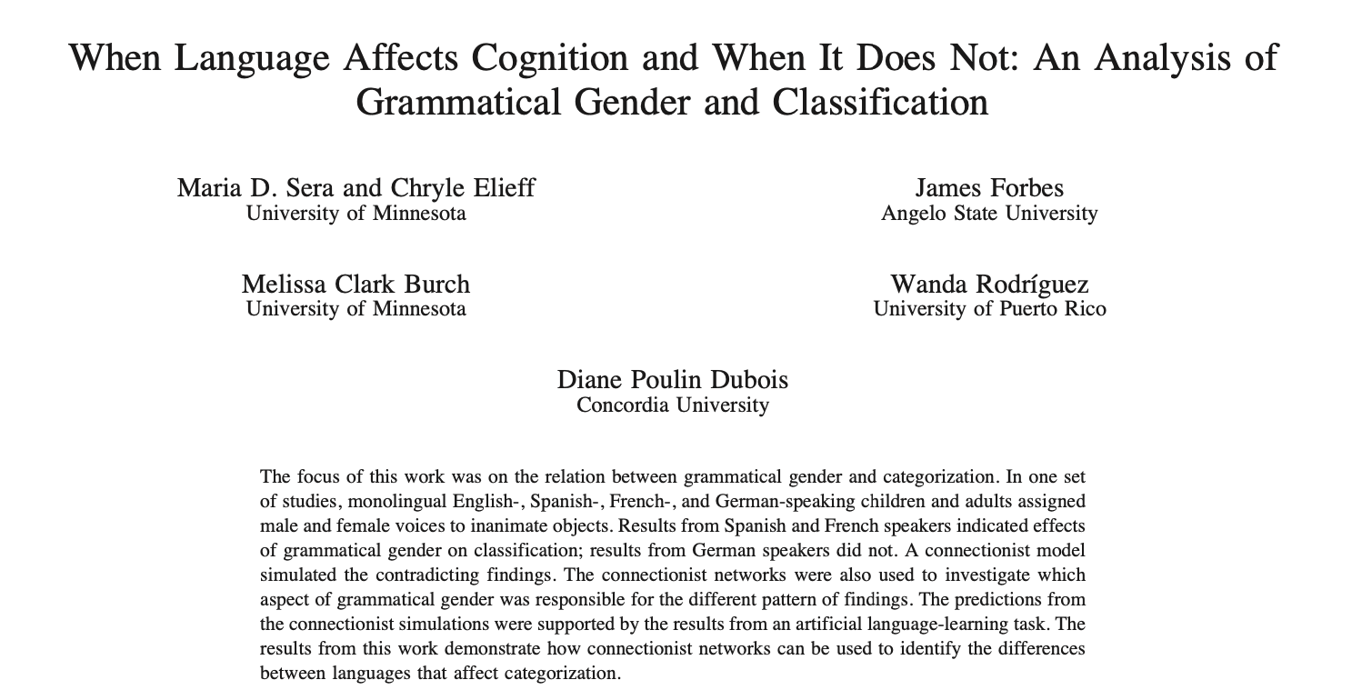
Classification of objects
Assigning voices to inanimate objects
Non-gendered language: arbitrary
Gendered language: 93% influence

Slide 9
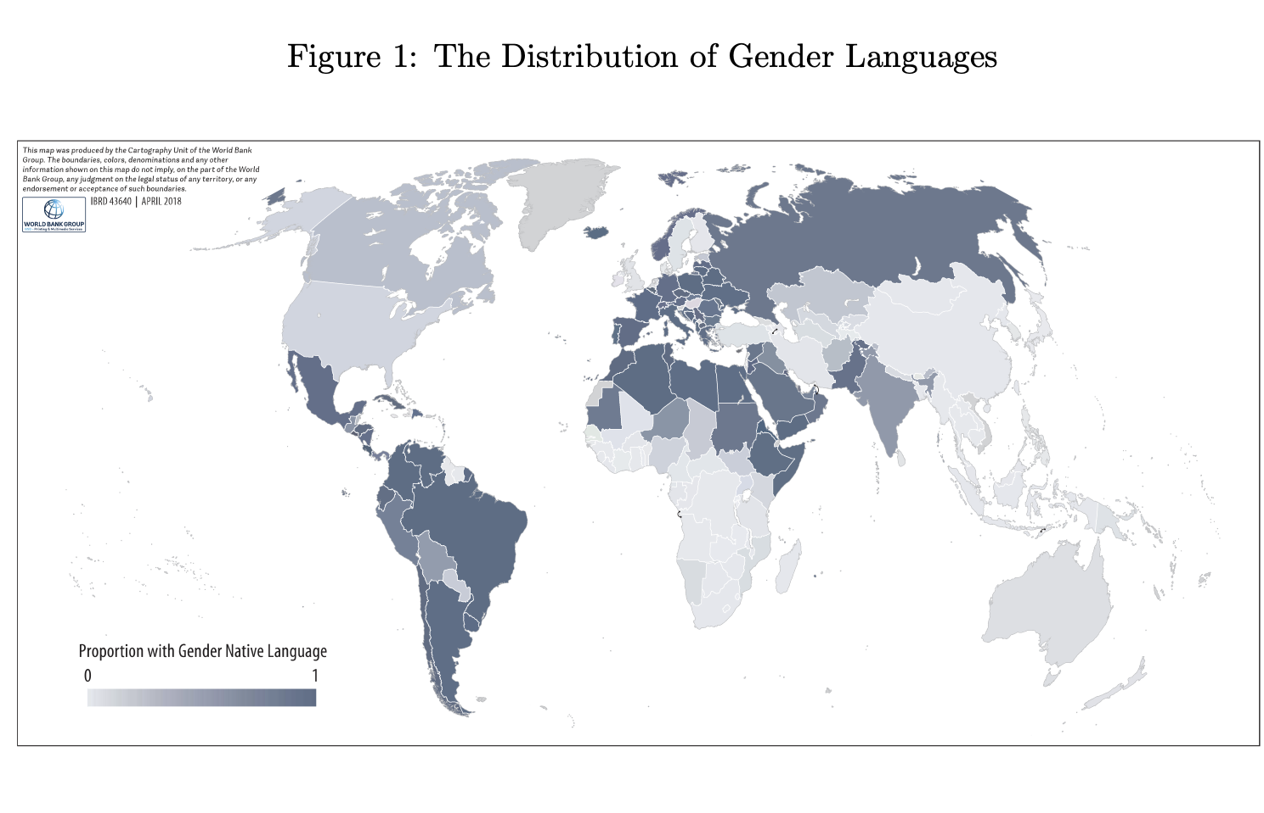
Women in the work force
Gendered vs. non-gendered languages
15% gap in female participation in the work force
125 million women
Confounding factors: education, religion, development, geography

Slide 10
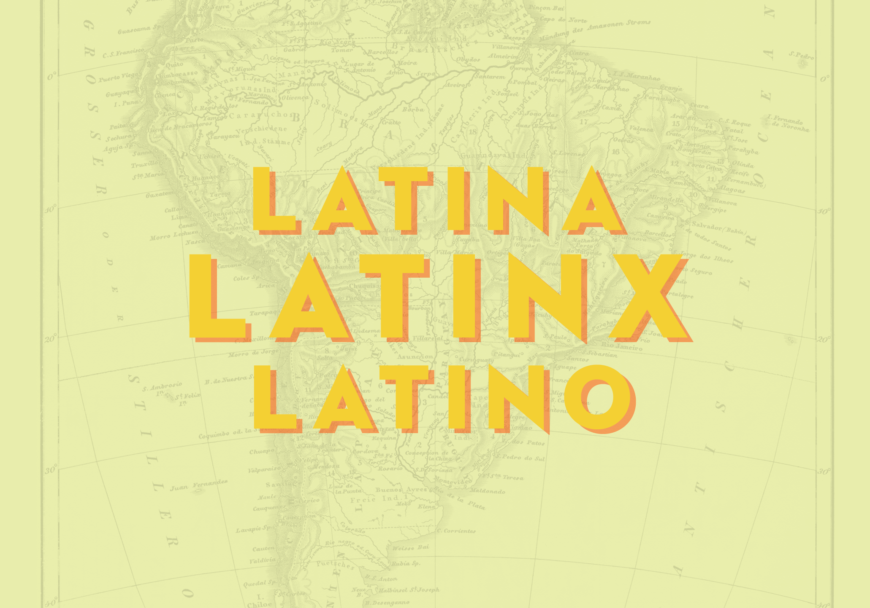
Options
"X"
"La chica" and "el chico"
"Lx chicx"
"@"
"La chica" and "el chico"
"L@ chic@"

Slide 11
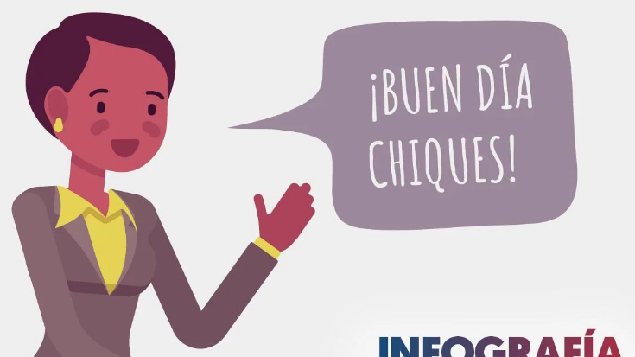
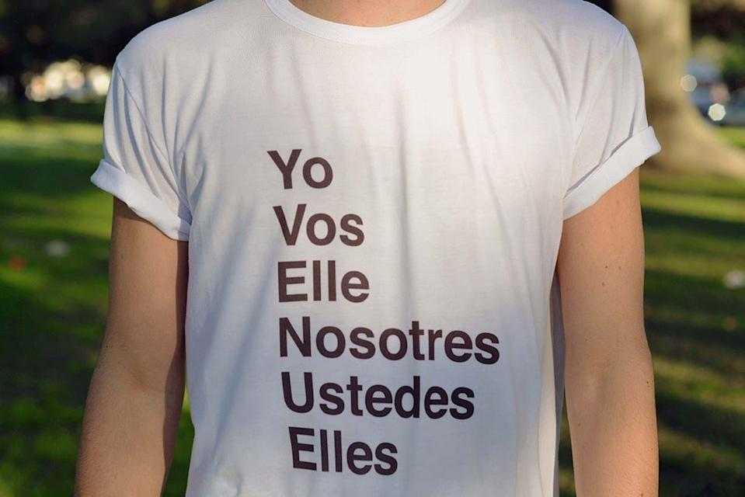
Options
"El chico" and "la chica"
"E"
"Le chique"

Slide 12
Implementation
Colloquial speech
Written language
Official change

Slide 13
Case study: Sweden
Colloquial speech
Written language
Official change
"Hen" in daily speech
Book published in 2012
Immediate backlash
2013: use with caution
2014: officially recognized

Slide 14
Case study: Argentina
Colloquial speech
Written language
Official change
Judge uses neutral "e" in 2019
Inclusive language manual
2020: officially accepted

Slide 16
"It's not a little word, it's a right"
"You don't have to be a lawyer to defend someone else's rights"
"We respect how we want to be identified- we should also respect how they want to be identified"

Slide 17
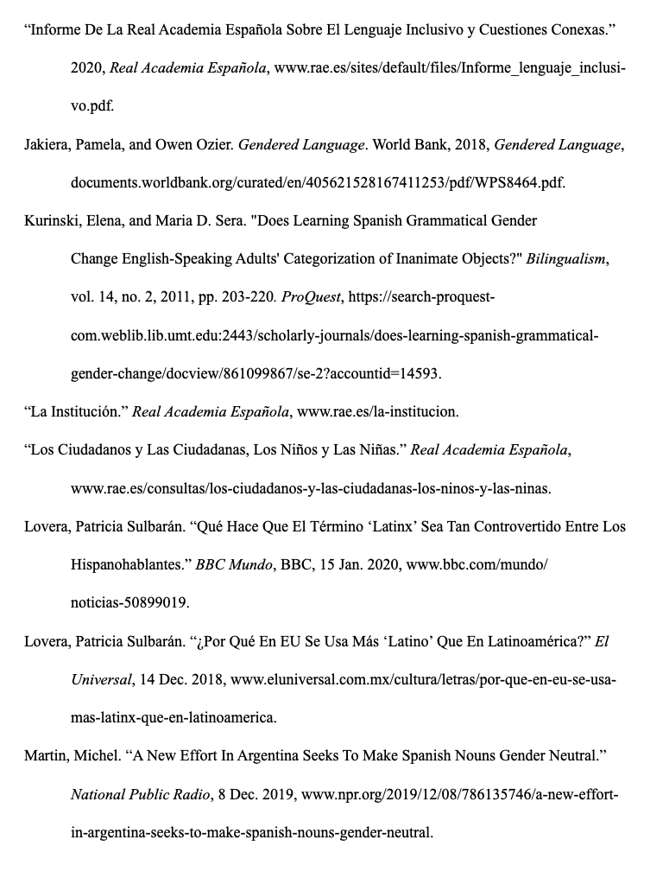
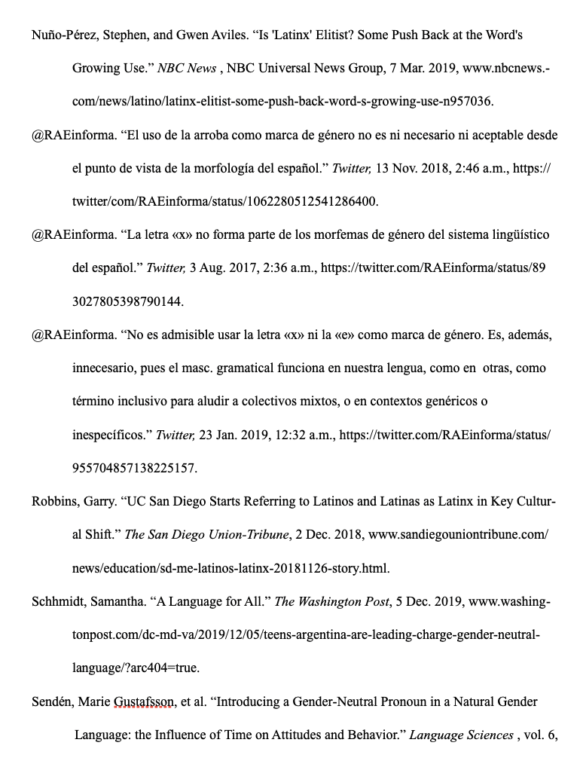
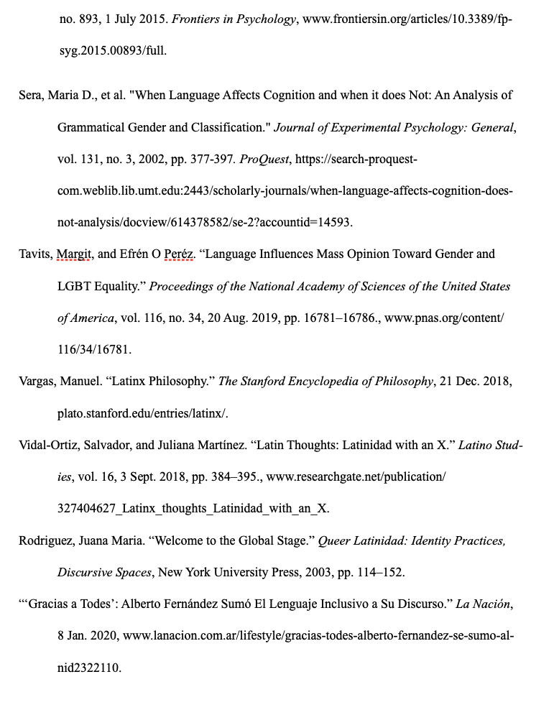
Research Sources

Slide 18
Image sources
Slide 1: https://commongroundinternational.com/spanish-teachers/inclusive-language-in-spanish/
Slide 2: https://www.youtube.com/watch?v=kdwQDYfBHq8&t=2s
Slide 5: https://www.hudsonmckenzie.com/passports-gender-neutral/gender-neutral-symbol/
Slide 6: https://libguides.wustl.edu/psycholinguistics
Slide 7: https://www.ted.com/talks/lera_boroditsky_how_language_shapes_the_way_we_think/transcript?language=en
Slide 8: https://search-proquest-com.weblib.lib.umt.edu:2443/scholarly-journals/when-language-affects-cognition-does-not-analysis/docview/614378582/se-2?accountid=14593
Slide 9: http://documents1.worldbank.org/curated/en/405621528167411253/pdf/WPS8464.pdf
Slide 10: https://www.goodhousekeeping.com/life/a33806428/what-latinx-means/
Slide 11: https://misionesonline.net/2018/10/15/la-ede-la-discordia-se-usa-sirve-lenguaje-inclusivo/, https://www.versionrosario.com/lenguaje-inclusivo/por-que-produce-tanto-rechazo-la-e-la-igualdad-n2151
Side 15: https://www.lavoz.com.ar/ciudadanos/lenguaje-inclusivo-en-unc-avanza-uso-oficial-del-todes
Slide 16: https://www.youtube.com/watch?v=kdwQDYfBHq8&t=2s

