Slide 1
Costco Wholesale’s Dominance in the Market
Elliot Johnson
Presented at UMCUR
16 April 2021

Slide 2
Introduction
-Purpose
-Costco Wholesale’s Business Model
-Costco is running low on working capital
-Costco should issue more stock

Slide 3
Industry and External Context
-Competitors: BJs, Sam’s Club, Kroger, Winco
-Mature Industry; low threat of new entrants
-Specific customer niche
-High sensitivity to economic conditions
-High sensitivity to tax rate changes and regulations
-New threats of Amazon and similar services

Slide 4
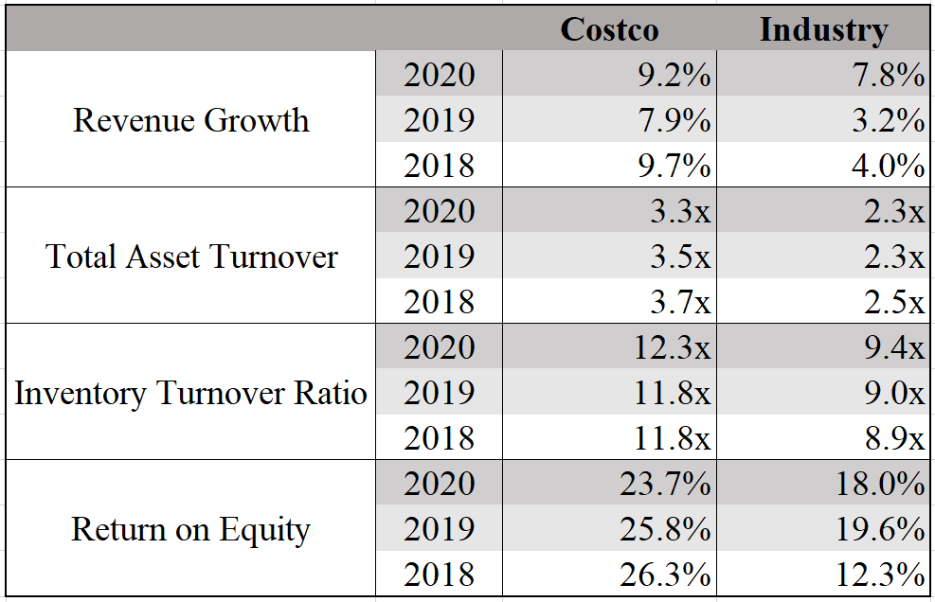
Costco’s Finances
High revenue growth
High TAT and Inventory Turnover
High ROE
(Standard & Poor’s, 2021)

Slide 5
Resources and Competencies
-Core Competency: Supply Chain Management
-Efficiency
-Strategic acquisitions and partnerships (Costco Annual Report, 2020)
-NO advertising budget (Green, 2020)
-High customer satisfaction @ 90% membership renewal (Tyler, 2019)
-High opportunities for overseas expansion

Slide 6
Strategic Alternatives
Acquisitions and Partnerships
Private Manufacturing
Pros
-No need to “reinvent the wheel”
-Historical success
Cons
-Few companies align
-Expensive
Pros
-Better quality, lower price
-More effective distribution
Cons
-Does not leverage competencies

Slide 7
Strategic Recommendation: Issue More Stock
Pros
Cons
-Allows for faster rate of growth
-Faster international expansion
-Greater returns for shareholders
-Need to quickly source merchandise
-Exchange rate risk

Slide 8
Conclusions
-Costco is an industry leader
-Costco excels in efficiency and supply chain management
-High opportunities for overseas growth
-Equity financing could accelerate this growth

Slide 9
Thank you
Costco. “2020 Annual Report.”Accessed 28 Feb., 2021. https://investor.costco.com/index.php/static-files/05c62fe6-6c09-4e16-8d8b-5e456e5a0f7e
Green, Timothy. “3 Reasons Costco Is a Great Company.” Investopedia, Investopedia, 15 Oct. 2020, www.investopedia.com/stock-analysis/040915/3-reasons-costco-great-company-cost.aspx#:~:text=Target%20spends%20more%20than%202,coupons%20sent%20to%20existing%20members.
Standard & Poor's. (2021, March 10). Costco Wholesale Corporation. Standard & Poor's Financial Ratios. Retrieved from S&P NetAdvantage database.
Tyler, Jessica. “We Shopped at Costco and BJ's Wholesale to See Which Store Had the Better Deals, and We Found One Had a Clear Edge over the Other.” Business Insider, Business Insider, 23 July 2018, www.businessinsider.com/costco-bjs-compared-photos-details-2018-4.

