Slide 1
Caregivers of GBM Need Support from Family and Friends
Dishanna Miller
Notes:
Hi everyone. My name is Dishanna Miller, and I am a human biology student at the University of Montana. Today I will be talking about the benefits of family members and friends helping and supporting caregivers of patients with glioblastoma multiforme.

Slide 2
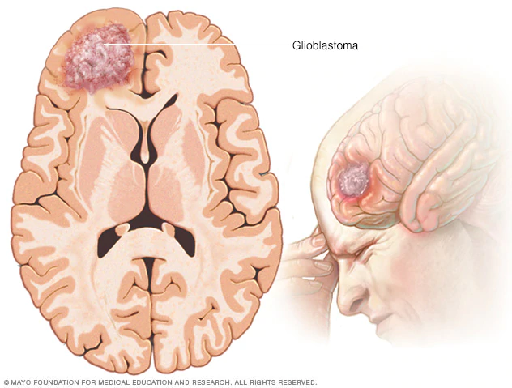
Background
Glioblastoma multiforme (GBM) is the most frequent malignant brain tumor (Ostrom et al., 2015)
has been correlated with low medical prognosis for patients.
Some of the first sign of glioblastoma multiforme are (but are not limited to) vomiting, intense migraines, loss of vision, and speech difficulty (American Association of Neurological Surgeons, 2021)
Often times, female spouse become the caregiver to the patients. With the household, familiar, and now caregiving pressures placed on these women, it becomes a challenge to stay afloat.
Previous studies suggest longer life expectancy in GBM patients correlates with better caregiver mastery.
This study aims to provide ways for family members and friends to increase the care for patients and caregivers alike.
Notes:
First and foremost, what is glioblastoma, or GBM? It is the single most frequent form of malignant brain cancers among adults, correlating with low prognosis for patients diagnosed with it. This type of tumor can be found anywhere in the brain and affects the astrocyte cells. Some of the first symptoms of GBM include, but certainly are not limited to the following: vomiting, intense migraines, loss of vision, and speech difficulty.
GBM is diagnosed more in men, and as a result, caregivers of the patients are often female spouses or female family members. With societal pressures, such taking care of children and the home, already placed among them, these caregivers face an incredible challenge by trying to provide the best care to the patients.
With previous studies already suggesting longer life expectancies for GBM patients correlating with better caregiver mastery, ensuring that caregivers have the support they need is important.
In this study, I aim to provide ways for family members and friends to increase the care for patients and caregivers alike.

Slide 3
Participants/Methods
Mixed Methods: 102 letters provided from Female Spouse Caregivers were read through for the following key words
Family
Friends
Son
Daughter
Father
Mother
Children
These were further read through to find a quantitative answer to what caregivers found helpful or what they wish they had known/had during their time caregiving
Approved by the IRB of UM (IRB #224-19) and all letters were used had informed consent
Notes:
Using a mixed methods system, 102 letters were compiled from GBM caregivers asking about their story as caregivers. The main criteria for these letters was for the letter writer to be over the age of 18, be the female spouse of a GBM patient, and they had to be the sole caretaker and provider for said patient. These letters were then read thoroughly, looking for they key words family, friends, son, daughter, father, mother and children. Once the letters containing these keywords were identified, I began reading these letters looking for ways family and friends had helped the caregiver in journey, or ways the caregiver had wished family and friends had helped. This study has been approved by the Institutional Review Board of the University of Montana and all letters used in this study had informed consent to be used.

Slide 4
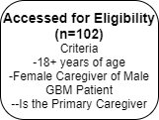
Flow Diagram
Notes:
Here we have a flow diagram to give a visual representation how I decided what letters were to be used in the research process. From the very beginning, 102 letters were sent to us detailing their struggles of being a caregiver to a GBM patient. 1 letter had been excluded as it did not meet the criteria for this research, bringing the number of letters to be analyzed to 101. While sifting through the letters to find the keywords, 40 letters were excluded as they did not have any said key words. In the end, 61 letters were found to have at least one of the following words: family, friends, children, son, daughter, father, or mother.

Slide 5
Qualitative Analysis
When looking for ways that that family/friends can help, the letters were looked through to find letters that mentioned how they helped directly.
After a second pass through using context clues, 19 more letters were included as they mention what would have been helpful without directly mentioning family/friends
Notes:
As stated before, a mixed methods approach was used to conduct this study. A similar qualitative analysis as seen in this diagram was used when reading the 61 letters, looking for ways that family and friends helped the caregiver. In the first pass through of the letters, I only compiled letters that had mentioned how family and friends had helped directly, meaning that when the caregiver had mentioned any of the keywords, they were referring to the actions that they took to help the caregiver. In a second pass through, using context clues of the letters, I was able to find 19 more letters that had mentioned what would have been helpful without directly saying that this help came from family and friends. These letters still had the key words within them, just not in the same context as the letters that were compile in the first pass through.

Slide 6
Results- Can Family/Friends Truly Help?
Letter Statistics on Family/Friends
Characteristics | # of Letters
Mentioned Family/Friends | 61
Mentioned What Could Have Helped | 51
Mentioned Family/Friends Helping* | 32
*This refers to both letters that mention actually having help from family members and friends and letters that wished that they had more help from them
Notes:
As I had said before, 61 letters out of the first 101 letters had contained any of the key terms. From those 61, 51 letters gave insight on would have helped them or what did help them, 32 of them saying how family and friends were involved in the support. It is worth saying that the letters included in these statistics were both letters where the caregiver said that they had received help AND letters where the caregiver detailed ideas as to what would have been helpful, but the did not receive that support.

Slide 7
Results- How Can Family/Friends Help?
Letter Statistics on Support for Caregivers
Type of Support | # of Caregivers
More Information on GBM Overall | 39
Emotional | 24
Financial | 8
Resources/Support Groups | 24
Having an Extra Set of Hands | 37
Notes:
When studying the letters, I had found 5 main themes of support. Some letters only mentioned one of these types of support, but many have mentioned more than one or even all 5. The biggest concern I found was that these women had felt that they did not have enough information about what glioblastoma was when they became a caregiver. 39 letters went into detail about this. The next type of support that was introduced was emotional support, having 24 letters bring this up. Next is financial support with 8 letters, resources and support groups with 24 letters, and finally we have a type of support that I have decided to call “having an extra set of hands.” 37 letters mentioned this.

Slide 8
Ages of Caregivers and Patients
 | Mentioned Friends/Family in Letter |  | Did Not Mention Friends/Family
Characteristics | Caregiver | Patient | Caregiver | Patient
Total Sample and Range | 31-73 (n=23) | 28-77 (n=40) | 32-65 (n=20) | 32-72 (n=34)
Mean | 52.7 | 55.5 | 52.4 | 57.6
Median | 54 | 56 | 55 | 59.5
Notes:
Before I jump right into how this data can be applied, I would like to present some more data that was analyzed. While collecting the data for this study, I came curious to whether the age of the caregivers and the patients had any effect on if family or friends were mentioned in the letters. With the letters that had provided the ages, I compiled the ages into the averages and the medians of both letters that did mention the key words, and the letters that did not mention the key words. After comparing the two, you can see that the difference in age is not statistically significant. This goes to show that regardless of age of the caregiver and patient, help from family and friends is important. I will now go into detail about all 5 types of support systems that were listed before, including resources and ideas that family and friends can use for future reference when attempting to ease the burden of caregiving for GBM patients.

Slide 9
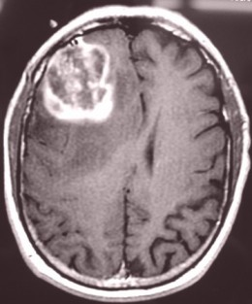
Providing GBM Information
One of the major concerns for caregivers of GBM was lack of knowledge of the disease.
Having sites and resources regarding what Glioblastoma multiforme is would be beneficial.
The information would be the most useful would be:
Symptoms
Diagnosis
Treatment Options
Resources:
-American Brain Tumor Association
-American Cancer Society
-Brain Tumor Society
-National Cancer Institute
(American Association of Neurological Surgeons, 2021)
“At the beginning I would have liked to know more. There was written information but the doctors didn’t give it to me and I found it much later. It would have helped me a lot because I spent hours online to find out the very same…..”
Notes:
The most talked about support that was mentioned among the letters in this study was having enough information about what GBM really is. A number of caregivers felt that they were not given enough details about what to except and resorted to having to do their own research. Helping caregivers find reputable sources of information that include symptoms, the process of diagnosis, and treatment options is a great way to assist in making sure that the caregiver feels more confident in what to expect out of being a caregiver of GBM. While there are numerous quality sources to search through, the American Brain Tumor Association, the American Cancer Society, the Brain Tumor Society, and the National Cancer Institute are good places to start.

Slide 10
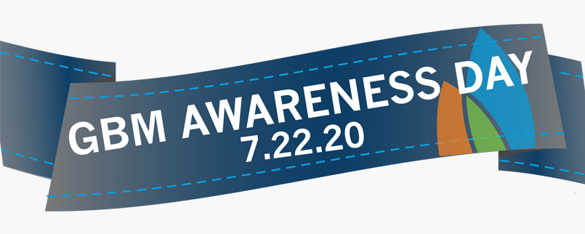
Being a “Helping Hand”
Since it is common for the caregiver of a patient of GBM to be a wife or female family member, caregivers will often feel overloaded with responsibilities
Being available to either help the caregiver with the patient directly or help perform tasks to reduce the burden can help prevent caregivers from becoming overwhelmed
“Over the years, we have been fortunate to have huge support from a variety of friends. They would sit with [patient’s name], bring us meals, and help in a myriad of ways. We would not have made it this far without that support.”
Ways to Help:
-Be available to drive patients to appointments
-Deliver groceries to caregiver
-Help look after children
-Provide company to the patient
Notes:
The next way that family and friends can help support caregivers is to simply be around as a “helping hand.” It is very common for these caregivers to be overwhelmed with daily tasks and responsibilities. Many caregivers expressed times of concern where they were not sure if they could physically move the patient to a wheelchair or into bed.
Being available to physically help the caregiver is one way to reduce this burden. Other ideas to be of help is being available to drive patients to doctor appointments, deliver groceries to the caregiver, helping watch over children if there are children in the household, and simply providing company to the patient. There were numerous letters that talked about how grateful the caregiver was to know that family and friends were happy to accompany the patient throughout the day.

Slide 11
Resources for Support
Many caregivers find that they need someone who they can relate to.
Finding support groups or a trained social workers can help provide a sense of community for the caregivers and patients.
These are also beneficial as these groups are trained to assist cancer patients and their caregivers
“Thankfully, three months after my husband was diagnosed, I found an online support group of women whose husbands also had GBM. Because of these wives’ willingness to share their experiences, I was at least somewhat prepared for what we might face and found invaluable advice from other wives who had also become caregivers.”
Resources:
-Social Workers that specialize in oncology
-Facebook Groups such as “Glioblastoma Support Network” and “GBM Caregivers Support Group”
-Support Line at Cancer Support Community, 888-793-2282
(National Brain Tumor Society, 2021)
Notes:
Similarly to wishing they had more information on what glioblastoma actually is, caregivers expressed concern on the lack of the resources provided to them as caregivers. Being able to relate to someone in a similar situation or have someone to guide you through a difficult time can be incredibly beneficial. While some caregivers are made aware that there are social workers available to them, making sure that they know that these resources are there can help them navigate this job a great first step to ensuring the GBM caregiver has excellent support. ALso reminding the caregiver that there is a support line at Cancer Support Group
Another excellent resource that family and friends should show the caregiver are social support groups for GBM patients and caregivers. There are a plethora of Facebook pages and website available with many people going through a related struggle.

Slide 12
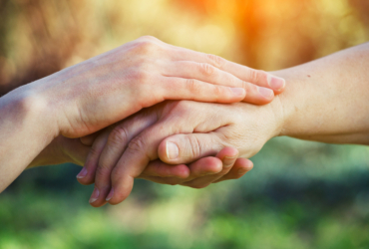
Emotional Impact
The emotional toll for GBM caregivers is quite apparent.
Many caregivers in their letters expressed feeling lonely, anxious, depressed, and lack of understanding from other. This in turn will have a negative effect on the caregiver’s mental health and the care provided to the patient.
Being there for the caregiver emotionally and encouraging them to seek counseling can help the caregiver remember that they are not alone in their situation.
“Family and friends simply did not understand my story and did not live the day to day effects of GBM.”
“I was left with PTSD, anxiety, sleepless nights, nightmares, and borderline panic attacks. The trauma of watching his decline with no professional help has stayed with me. The trauma of not being provided with emotional support has stayed with me.”
Notes:
While anyone could guess that becoming a glioblastoma caregiver to someone you love is an emotional rollercoaster, there were still women who comminuted that they need their family and friends there for them. They brought up their battles with depression, anxiety, loneliness, and PTSD. As stated before, if the caregiver is suffering emotionally, it may affect the care that they can provide to the patient. It is crucial as family and friends to make certain that the caregiver feels that you are emotionally there. Additionally, the caregiver will most likely find seeing a therapist valuable for their mental health.

Slide 13
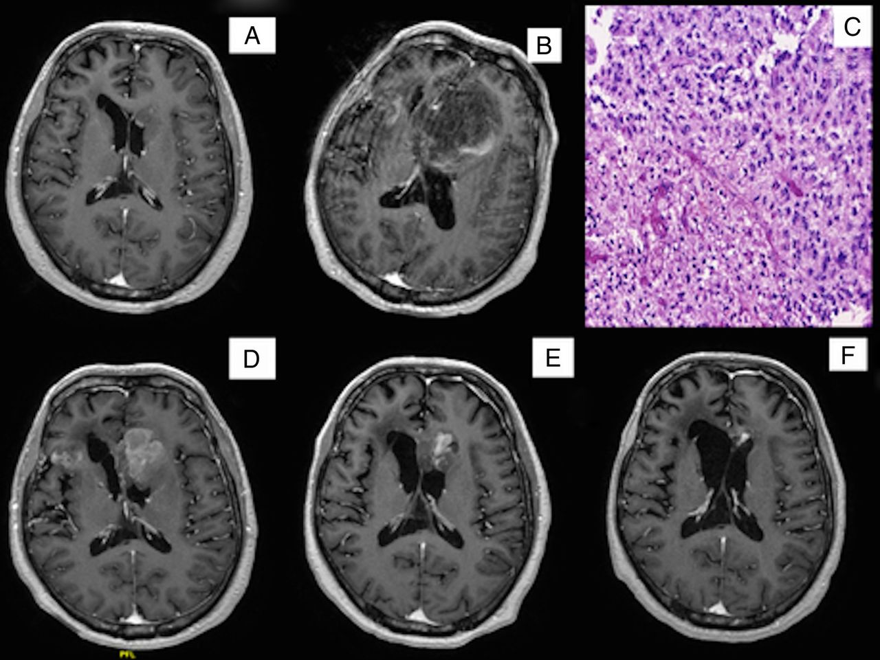
Financially Helpful
When a patient is diagnosed with GBM, medical bills/debt often unavoidable. GBM diagnosis frequently requires expensive surgery, medication, and hospice.
Even if some of the medical bills are covered, the patient can no longer work and the caregiver may not be able to care of the patient and have a job.
With little income between the patient and the caregiver, financial issues are commonly a worry
Ways to Help Financially:
-Help raise money
-Research insurance/coverage plans for caregiver
-Help pay for smaller bills such as groceries
“..., I never could have done it had my extended family not stepped up physically, emotionally and financially.”
Notes:
Most people are aware that when a person is diagnosed with GBM, floods of medical bills and debt will ensue. Even if insurance is able to help cover the surgeries and medication, hospice and other treatments are usually expensive. On top of all of this is unusual for the patient to be able to still work. The caregiver also is more than likely have to cut back on work if they were working before the diagnosis. This makes being able to be financially stable a challenge.
While paying for medical bills may not be feasible, family and friends can find other ways to be financially helpful. Some of the ways are helping raise money, researching resources such as specific insurance and coverage plans, and even paying smaller bills like buying groceries.

Slide 14
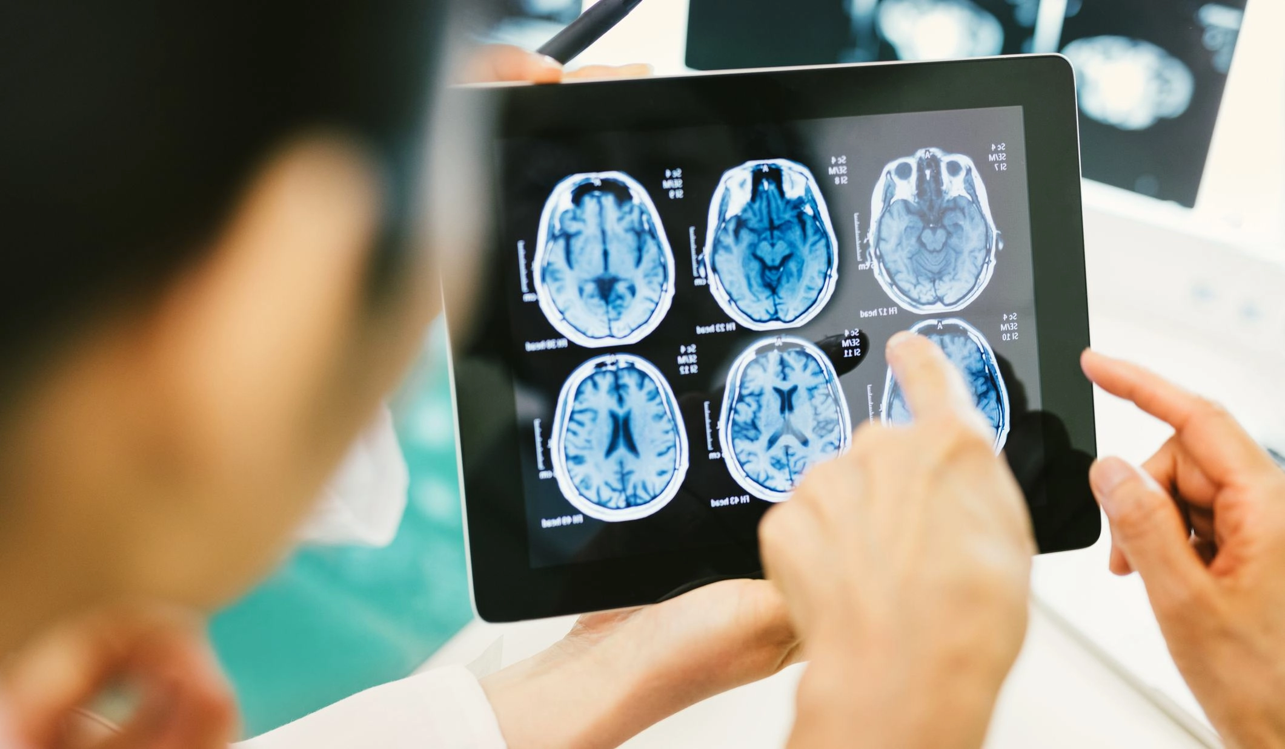
Further Studies
Hearing from more caregivers of GBM patients may help understand how friends and family can help
More extensive research for can be conducted to find more resources for family and friends to provide for the caregiver
More advocating for better resources for caregivers would favorable
Notes:
When it comes to further studies that can be conducted, hearing more from other caregivers to compare their experience could provide more insight to how someone can be of help to caregivers. More extensive research could supply better resources for the family and friends to present to the caregiver. Finally, there needs to be better advocating for caregivers of glioblastoma patients.

Slide 15
Acknowledgments
Laurie Minns, PhD
Madison
Emily Burke
Karlee Trebesch
Molly Massman
Parminder Singh Mathaun
Mark Hirschfelder
Participants in this study

Slide 16
References
Glioblastoma Multiforme – Symptoms, Diagnosis and Treatment Options. (2021). American Association of Neurological Surgeons. https://www.aans.org/en/Patients/Neurosurgical-Conditions-and-Treatments/Glioblastoma-Multiforme#:%7E:text=Glioblastoma%20multiforme%20(GBM)%20(also,as%20a%20grade%20IV%20astrocytoma.
National Brain Tumor Society. (2019, December 3). Finding Support & Coping. https://braintumor.org/brain-tumor-information/finding-support-coping/
National Brain Tumor Society. (2020, June 10). I am a GBM Caregiver. https://braintumor.org/take-action/gbm-caregiver-whiteny-hayden/
Ostrom, Q. T., Gittleman, H., Fulop, J., Liu, M., Blanda, R., Kromer, C., Wolinsky, Y., Kruchko, C., & Barnholtz-Sloan, J. S. (2015). CBTRUS Statistical Report: Primary Brain and Central Nervous System Tumors Diagnosed in the United States in 2008–2012. Neuro-Oncology, 17(suppl 4), iv1–iv62. https://doi.org/10.1093/neuonc/nov189
Notes:
Thank you so much for listening to my presentation!

