Slide 1
How students reacted to the transition due to COVID-19
Drake Leonard, Alex Stuczynski, Dr. Laurie Minns

Slide 2
Background
In Spring of 2020 the effects of COVID-19 forced classes from a face-to-face format to a remote form of instruction.
A study done at UAE found that 55% of students saw classes online as a better use of funds and time. (Hussein et al., 2020)
In contrast, within the same study it was found that 53% of students found it difficult to focus in a remote setting (Hussein et al., 2020)
https://www.fda.gov/food/food-safety-during-emergencies/food-safety-and-coronavirus-disease-2019-covid-19

Slide 3
What the transition looked like for BIOH370 students
Class moved to an online Asynchronous lecture
Face to Face interaction prohibited
Recorded lectures/ Review sessions

Slide 4
What we asked the students
The results recorded in this study were approved by the University of Montana IRB. (IRB#186-19). All students that were participating in the survey signed a FERPA agreement
3 survey questions were given to the students:
What was the most challenging?
What do you wish the professors knew?
What do you wish the University administration knew?

Slide 5
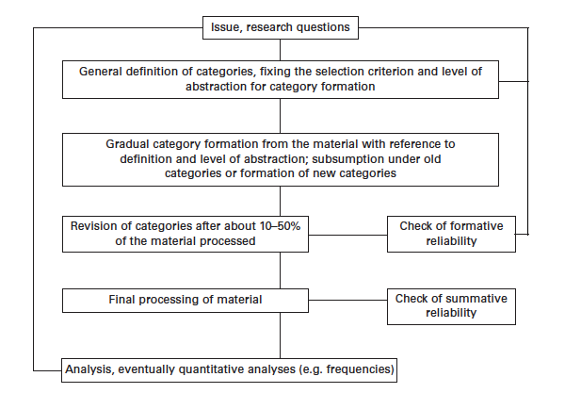
Key words
Qualitative analysis
Most Challenging:
In-person, Date/Time, Pace, Focus/Motivation, Money, Mental Health, Contact with Professor, Unknown/Uncertainty.
Wish Professors Knew:
Negative: Harder, Overwhelming, Negative, Don’t learn well, Not effective, Overcompensating, Hands on, Stressed, Should understand, difficult
Positive: Appreciate, good, pleased, same page, I enjoy, loved
Wish Administration Knew:
Negative: Training, Development, Communicate, Not ideal, In-person, Transition, Consistency, Tuition, Retain information, Difficult
Positive: CCR grading, Proud, Good job
Mayring P (2004) Qualitative content analysis. In: Flick U, von Kardoff E, Steinke I (eds) A companion to qualitative research. Sage, London, pp 266–269

Slide 6
The Process for analyzing “Most Challenging”
All students (n=50)
Responses that were included (n=52)
In-Person (n=10)
Date/ Time (n=7)
Pace (n=3)
Procrastination (n=1)
Focus/motivation (n=11)
Some student's responses had multiple key words

Slide 7
Most Challenging
When looking at the results from the question: What was the most challenging part of the transition? We see the following trends. (n=50) Some students responses had multiple key words, so there are 52 counted responses
Most challenging
In person | 10
Date/time | 7
Pace | 3
Procrastination | 1
Focus/ motivation | 11
Money | 10
Mental Health | 5
Contact with professor | 2
Unknown/Uncertainty | 3

Slide 8
The process for analyzing “Wish Professors knew”
All students (n=47)
Students who were included
(n=39)
Postive responses
(n=13)
Negative responses (n=26)
Remote learning (n=9)
Non-academic
(n=6)
Acommodation (n=7)
Transition
(n=4)
Communication (n=2)
Transition
(n=4)
remote learning
(n=1)
General Praise (n=8)
Student who did not respond with positive or negative feed back were not included

Slide 9
Wish Professors Knew
Here are the results and trends seen with the question: Wish the professors knew? (n=47) Some students did not respond with positive or negative feedback, hence the total word count being 39.
 | Wish Professors knew
Negative |  | Positive
Harder | 7 | appreciate | 5
overwhelming | 1 | good | 2
negative | 1 | pleased | 1
Don't learn well | 2 | helpful | 2
Not effective | 1 | same page | 1
Overcompensating | 1 | I enjoy | 1
Hands on | 1 | loved | 1
Stressed | 2 | Total | 13
Should understand | 3
difficult | 7
Total | 26

Slide 10
Process for analyzing “Wish Administration Knew”
All students (n=50)
Responses that were included (n=44)
Postive responses (n=33)
Negative responses (n=11)
CCR grading (n=3)
Proud (n=1)
Good Job (7)
Training (n=5)
Tution (n=5)
Retain Information (n=7)
A portion of students directed their responses towards professors instead of administration

Slide 11
Wish University Administration Knew
Here are the results for the question: Wish University Administration Knew? (n=50) A large population of students did not understand the question and addressed professors instead of administration, we found 44 total answers that fit the criteria
 | Wish Admins knew
Negative |  | Positive
Training | 5 | CCR grading | 3
Development | 1 | Proud | 1
Communicate | 4 | Good job | 7
Not ideal | 1 | Total | 11
In-person | 2
transition | 1
Consistency | 2
Tution | 5
retain information | 7
difficult | 5
Total | 33

Slide 12
General Conclusions
Overall conclusions:
The overall trend is that the transition due to COVID affected students negatively.
A portion of students in both “Wish professor knew, and “Wish administration knew” showed praise towards professors/administration for their efforts.

Slide 13
Conclusions from “Most Challenging”
The 3 most seen terms were: In-Person (10), Focus/ Motivation (11), and Money (10).
We can see that 2 of those terms are directly connected to academics.
Some students lost their jobs and housing, which added challenges on top of normal academic challenges.
Some other topics that should be considered, was the topic of mental health (5), and just the overall uncertainty or fear at the time (3).
These may not directly link to academic performance, but these are significant challenges students faced, along with pursuing education.
From these results, if Universities are forced to make a similar transition in future housing and financial burdens should be taken into consideration.
Offering students housing at reduced costs
Creating jobs on campus that can be done remotely to create income.

Slide 14
Conclusions for “Wish Professors Knew”
When looking at the negative comments we saw that students were concerned about the transition to remote instruction (9) and professors being accommodating (7).
A lot of students mentioned the change of workload seen through out the transition and felt that professors had an unrealistic expectation.
When looking at the positive comments we see the highest response being general praise (8) and then the transition (2) and communication (2)
Most of the general praise was directed towards the Professor of BIOH370.
Moving forward, we can see that just because a course has moved online does not make it necessarily easier. Also, we can see that for students at the University of Montana remote learning is not the ideal form of instruction.

Slide 15
Conclusions for “Wish Administration Knew”
When looking at the positive responses we see the highest response being general praise (8). The only other positive topic that was brought up was CCR grading.(3)
Students appreciated the Credit-No credit option. It is the only accommodation mentioned by students.
When looking at the negative responses we see the biggest concern being retention of information. (7) Followed by concerns regarding tuition(5), and consistent training for administration and professors.(5)
Students showed concerns with retention were directed towards preparation for graduate schools/programs. Students also felt like they should have been given part of their tuition back.
Moving forward consistent training amongst professors/ administration. Also, returning a portion of tuition back to students may help relive some of the stress students encountered due to the transition.

Slide 16
Acknowledgements
Very special thank you to:
Dr. Laurie Minns
Alex Stuczynski
Baylee Dye
Jadyn Petersen
Raegan Hauschildt

Slide 17
Resource
Hussein, E., Daoud, S., Alrabaiah, H., & Badawi, R. (2020). Exploring undergraduate students’ attitudes towards emergency online learning during COVID-19: A case from the UAE. Children and Youth Services Review, 119(August), 105699. https://doi.org/10.1016/j.childyouth.2020.105699

