Slide 1
Brain Cancer Caregivers Experience High Emotional Distress
4-11-21
Sunny Mathaun, Dr. Laurie Minns
University of Montana, Missoula, MT, USA

Slide 2
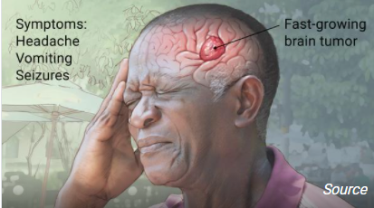
Table of Contents
Background
Research Question
Methods (2)
Flow Diagram
Study Demographics table
Results via graph
Results via Frequency table (4)
Conclusion
References
Acknowledgments

Slide 3
Background
Glioblastoma Multiforme (GBM) is a highly malignant tumour associated with the central nervous system, specifically with the brain. Grade 4 GBMs are the most aggressive of primary tumors of the brain.
Facts about GBM grade 4:
Very poor prognosis.
No cure and very limited medical treatment.
Affects more males than females.
Age demographic on average ranges from 42-70 years.
Neurological and Cognitive functions decline rapidly over time.
On average, more female GBM caregivers than male.
Why is this important?
The female caregivers face significant emotional symptoms mainly due to caregiver mastery and burden.
Definition of caregiver mastery = being in control of the care situation.
Emotional symptoms that caregivers face: anxiety, depression, high levels of stress, and more.

Slide 4
Research Question
Our research study wants to examine if the emotional symptoms of the caregivers are influenced by the survival rate and medical interventions delivered for GBM patients.

Slide 5
Methods Part 1/2
Total sample size (n=102)
This study utilized 2 methodical approaches:
Qualitative analysis using specific keywords relative to our research question.
Quantification of keywords from caregiver letters relative to our research question.
Inclusion criteria:
Were the primary caregiver of GBM patient.
Were the female spouse of GBM patient.
Caregivers are over the age of 18.
Exclusion criteria:
Are not the primary caregiver of GBM patient.
Are not the female spouse of GBM patient.
Caregivers are under the age of 18.
Participant timeline: Letters by the participants were submitted in the Summer of 2019, between months of June-August.
This study was approved by the institutional review board of the University of Montana (IRB #224-19) and all letter writers completed informed consent.

Slide 6
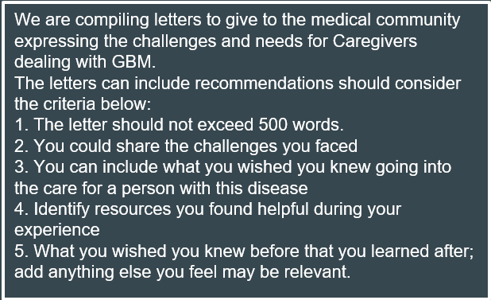
Methods Part 2/2
Instructions for the compiled letters are as follows:

Slide 7
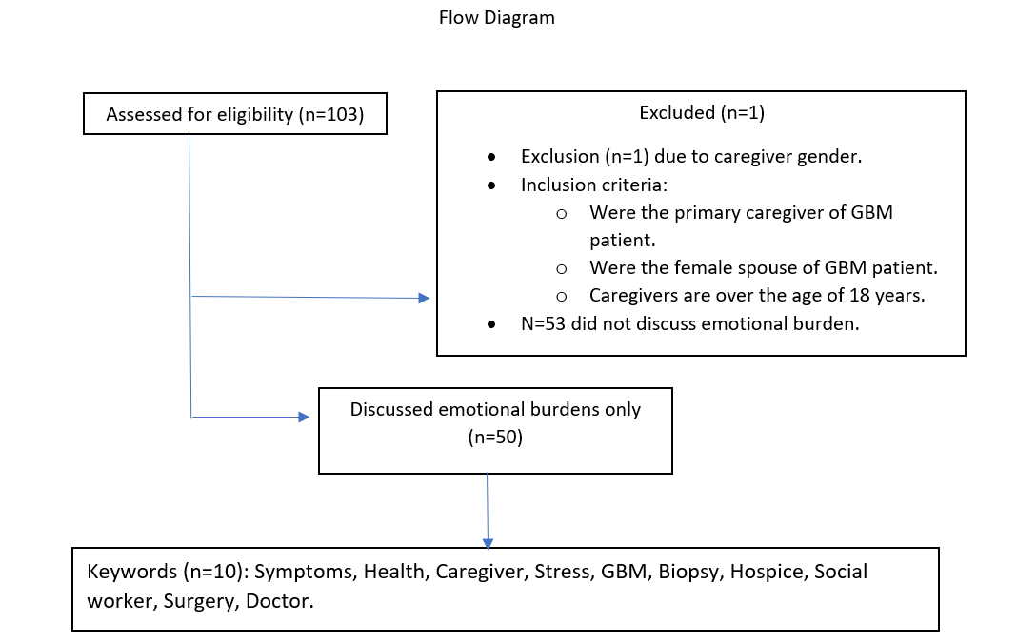

Slide 8
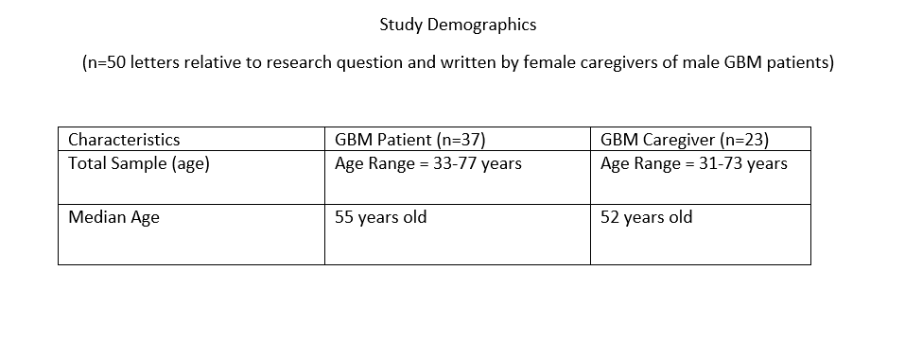

Slide 9
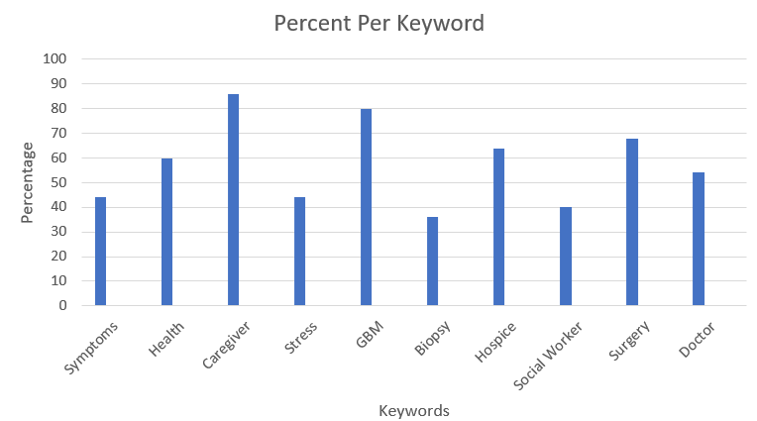
Results (graph)
Graph represents keywords relative to research question (n=50).
Rank of highest percentages:
Caregivers
GBM
Surgery
Hospice
Health
Doctor
Symptoms
Stress
Social worker
Biopsy

Slide 10
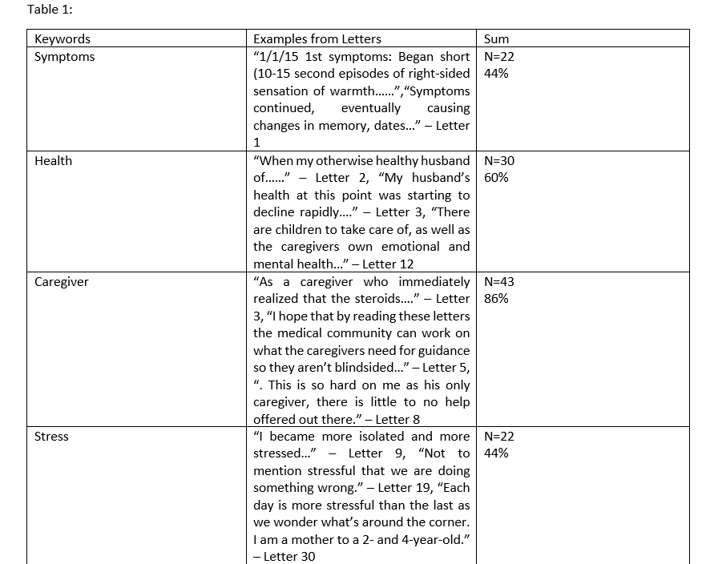
Results (frequency table) Part 1/4
Table 1: keywords were taken from n=50 letters relative to research question.
Percentages represent the percent of each keyword.
3 direct quotations provided for each keyword.

Slide 11
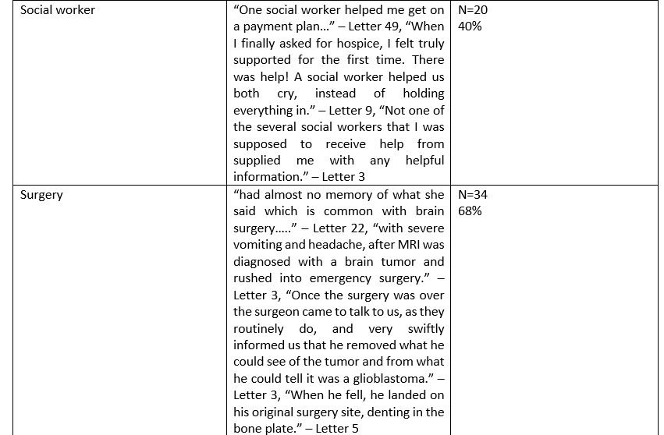
Results Part 2/4

Slide 12
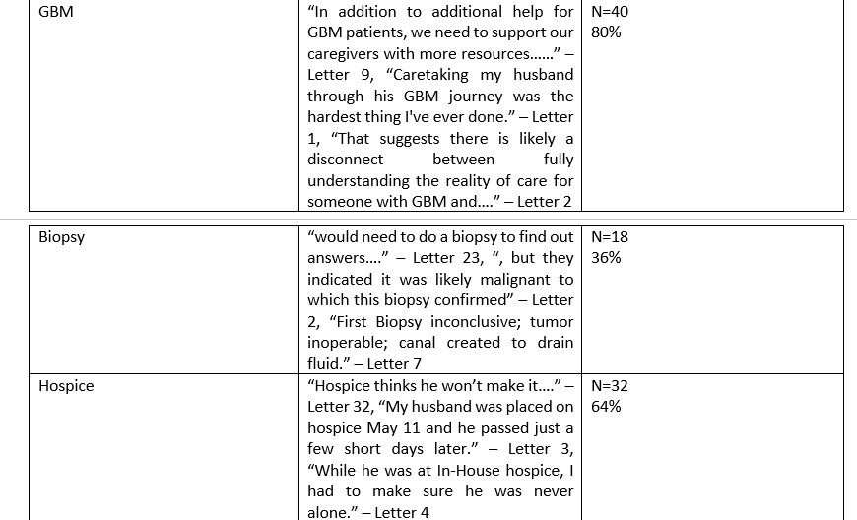
Results Part 3/4

Slide 13
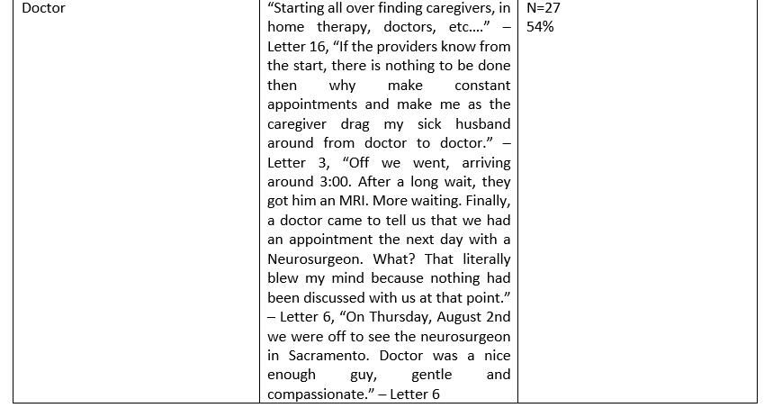
Results Part 4/4

Slide 14
Conclusion
What do the results tell us?
The results from qualitative content analysis tells us the poor survival rates and medical interventions needed for GBM patients have a significant influence on the emotional burden for GBM caregivers.
The keywords, relative to GBM survival rates and medical interventions, insinuates the high expression of emotional symptoms impacting the caregivers.
What kind of an impact can these results make?
These results can help set a precedent to lessen caregiver burden by:
1. Possibly improving quality of care delivered for GBM patients.
2. Bringing more awareness to this issue for medical providers in order to provide better care for the caregivers and patients.

Slide 15
References (24 total)
1. Stupp R, Mason WP, Van den Bent MJ, et al. Radiotherapy plus concomitant and adjuvant temozolomide for glioblastoma. N Engl J Med. 2005; 352:987–996. [PubMed: 15758009]
2. Alvarez de Eulate-Beramendi S, Alvarez-Vega M, Balbin M, Sanchez-Pitiot A, Vallina-Alvarez A, Martino-Gonzalez J. Prognostic factors and survival study in high-grade glioma in the elderly. British journal of neurosurgery. 2016 Epub ahead of print.
3. Dirven L, Aaronson N, Heimans J, Taphoorn M. Health-related quality of life in high-grade glioma patients. Chinese Journal of Cancer. 2014; 33:40–45. [PubMed: 24384239]
4. Mukand JA, Blackinton DD, Crincoli MG, Lee JJ, Santos BB. Incidence of neurologic deficits and rehabilitation of patients with brain tumors. American journal of physical medicine & rehabilitation. 2001; 80:346. [PubMed: 11327556]
5. Lucas MR. Psychosocial implications for the patient with a high-grade glioma. Journal of Neuroscience Nursing. 2010; 42:104–108. [PubMed: 20422796]
6. Sterckx W, Coolbrandt A, Dierckx de Casterle B, et al. The impact of a high-grade glioma on everyday life: A systematic review from the patients and caregivers perspective. European Journal of Oncology Nursing. 2013; 17:107–117. [PubMed: 22658206]
7. Peters K, West M, Hornsby W, et al. Impact of health-related quality of life and fatigue on survival of recurrent high-grade glioma patients. Journal of Neuro-Oncology. 2014; 120:499–506. [PubMed: 25115739]
8. Rooney AG, Carson A, Grant R. Depression in cerebral glioma patients: a systematic review of observational studies. Journal of the National Cancer Institute. 2011; 103:61–76. [PubMed: 21106962]
9. Choi CW, Stone RA, Kim KH, et al. Group-based trajectory modeling of caregiver psychological distress over time. Annals of Behavioral Medicine. 2012; 44:73–84. [PubMed: 22585179]
10. Russell B, Collins A, Dowling A, et al. Predicting distress among people who care for patients living longer with high-grade malignant glioma. Supportive Care in Cancer. 2015; 24:43–51. [PubMed: 25910750]
11. Trad W, Koh E, Daher M, et al. Screening for psychological distress in adult primary brain tumor patients and caregivers: considerations for cancer care coordination. Frontiers in Oncology. 2015 eCollection 2015.
12. Gaugler J, Hanna N, Linder J, et al. Cancer caregiving and subjective stress: a multi-site, multidimensional analysis. Psycho-Oncology. 2005; 14:771–785. [PubMed: 15750995].
13. Mausbach B, Patterson T, von Kanel R, et al. The attenuating effect of personal mastery on the relations between stress and Alzheimer caregiver health: a five-year longitudinal analysis. Aging & mental health. 2007; 11:637–644. [PubMed: 18074251]
14. Bookwala J, Schulz R. The role of neuroticism and mastery in spousal caregivers' assessment of and response to a contextual stressor. The Journals of Gerontology Series B. Psychological Sciences and Social Sciences. 1998; 53:155–164.
15. Gaugler J, Linder J, Given C, Kataria R, Tucker G, Regine W. Family cancer caregiving and negative outcomes: the direct and mediational effects of psychosocial resources. Journal of family nursing. 2009; 15:417–444. [PubMed: 19776210]
16. Cantwell J, Muldoon O, Gallagher S. Social support and mastery influence the association between stress and poor physical health in parents caring for children with developmental disabilities. Research in developmental disabilities. 2014; 35:2215–2223. [PubMed: 24927515]
17. Torti F, Gwyther L, Reed S, Friedman J, Schulman K. A multinational review of recent trends and reports in dementia caregiver burden. Alzheimer Disease & Associated Disorders. 2004; 18:99– 109. [PubMed: 15249854]
18. Brodaty M, McGilchrist C, Harris L, Peters K. Time until institutionalization and death in patients with dementia: role of caregiver training and risk factors. Archives of neurology. 1993; 50:643– 650. [PubMed: 8503802]
19. Kuzuya M, Enoki H, Hasegawa J, et al. Impact of Caregiver Burden on Adverse Health Outcomes in Community-Dwelling Dependent Older Care Recipients. The American Journal of Geriatric Psychiatry. 2011; 19:382–391. [PubMed: 20808120]
20. Grunfeld E, Coyle D, Whelan T, et al. Family caregiver burden: results of a longitudinal study of breast cancer patients and their principal caregivers. Canadian Medical Association Journal. 2004; 170:1795–1801. [PubMed: 15184333]
21. Wadhwa D, Burman D, Swami N, Rodin G, Lo C, Zimmermann C. Quality of life and mental health in caregivers of outpatients with advanced cancer. Psycho-Oncology. 2013; 22:403–410. [PubMed: 22135229]
22. McConigley R, Halkett G, Lobb E, Nowak AK. Caring for someone with high-grade glioma: a time of rapid change for caregivers. Palliative Medicine. 2010; 24:473–479. [PubMed: 20123944]
23. Canstat: A digest of facts and figures on cancer. Cancers of the brain and central nervous system. (2010). In: Victoria CC (ed)
24. Dally M, Rosenthal M, Drummond K, Murphy M, Cher L, Ashley D, Thursfield V, Giles G (2009) Radiotherapy management of patients diagnosed with glioma in Victoria (1998-2000): a retrospective cohort study. J Med Imaging Radiat Oncol 53(3):318–324. doi: 10.1111/j.1754-9485.2009.02072.x

Slide 16
Acknowledgments
I would like to thank the following people for helping me finalize this research project:
Dr. Laurie Minns (PI).
Markus Hirschfelder and Karlee Trebesch (project members).
GBM patients and GBM caregivers via informed consent (data).

