Slide 1
Enhancing the public’s general vaccine knowledge through a comprehensive and user-friendly website.
Bonnie Long

Slide 2
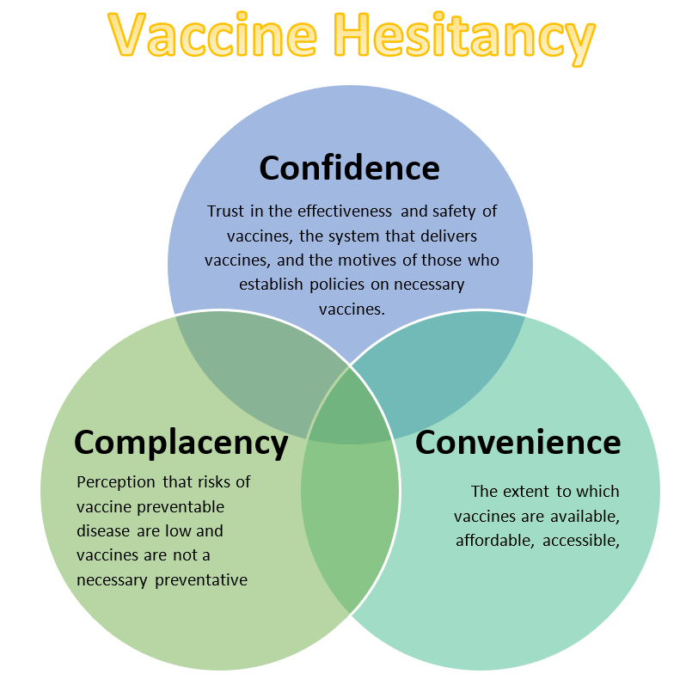

Slide 3
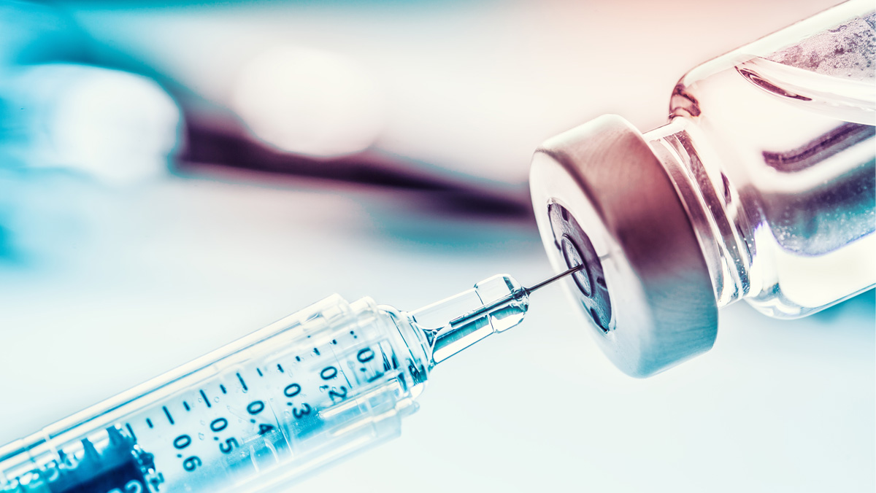
RESEARCH QUESTIONS AND OBJECTIVES
How do vaccines trigger an immune response?
What are the ingredients in vaccines and are they safe?
How do the various types of vaccines differ from one another?

Slide 4
Question 1: How do vaccines trigger an immune response?
Issues with Current Vaccine Information
Large abundance of websites that oversimplify vaccine science.
Lack of articles with easily understandable language.

Slide 5
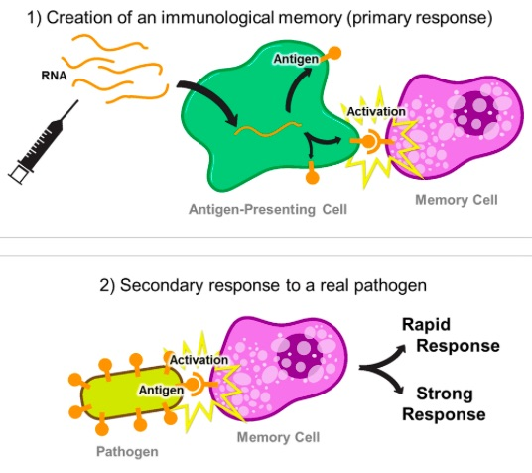
Vaccine Immunity
1) Vaccination introduces an antigen, which is displayed by antigen-presenting cells. Binding of the antigen will activate cells in the immune system, including memory cells that will recognize the antigen in the future.
2) When the actual pathogen enters the body, the memory cells recognize the antigens on the pathogen's surface and will respond quickly to neutralize it.
Image courtesy of Harvard University: Graduate School of Arts and Sciences.
The Y-shaped structure of antibodies has two variable antigen-binding fragments at the ends, which recognize and bind to specific antigens. Image courtesy of the National Institutes of Health and National Human Genome Research Institute.

Slide 6
Herd Immunity
Takes place when a large percentage of a population is immune to a particular disease.
Can be achieved by building immunity either through vaccination or recovery from the disease.
Herd immunity gives a disease very little chance of spreading because those who have immunity are less likely to transmit it to others who are not immune.

Slide 7
Question 2: What are the ingredients in vaccines and are they safe?
Lack of
Resources
World Health Organization
U.S. Food and Drug Administration (FDA) “The FDA is responsible for protecting the public health by ensuring the safety, efficacy, and security of human and veterinary drugs, biological products and medical devices.”

Slide 8
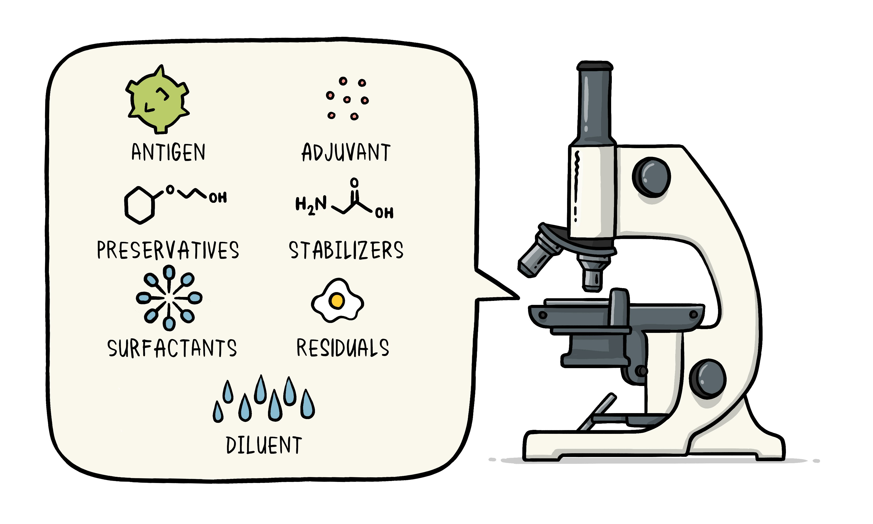
Vaccine Ingredients
Stabilizers: help to ensure the vaccine is effective from manufacturing to administration.
Remaining components used in cell culture: after manufacturing, some vaccines may still contain nutrients or materials used for growing the microorganism.
Inactivating Ingredients: prevent the vaccine from being contaminated with other viruses or bacteria during processing and administration.
Adjuvants: added components that help stimulate the immune system and improve the overall immune response.

Slide 9
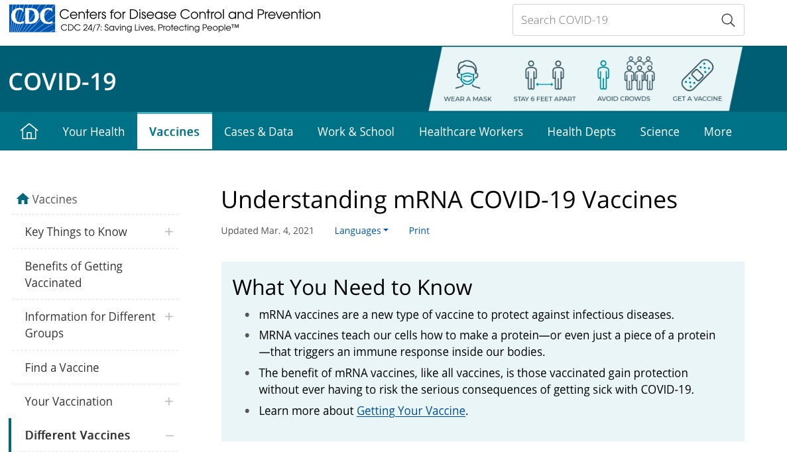
Question 3: How do the various types of vaccines differ from one another?
Resources
Lack of
Centers for Disease Control and Prevention: Vaccines and Preventable Disease Webpage

Slide 10
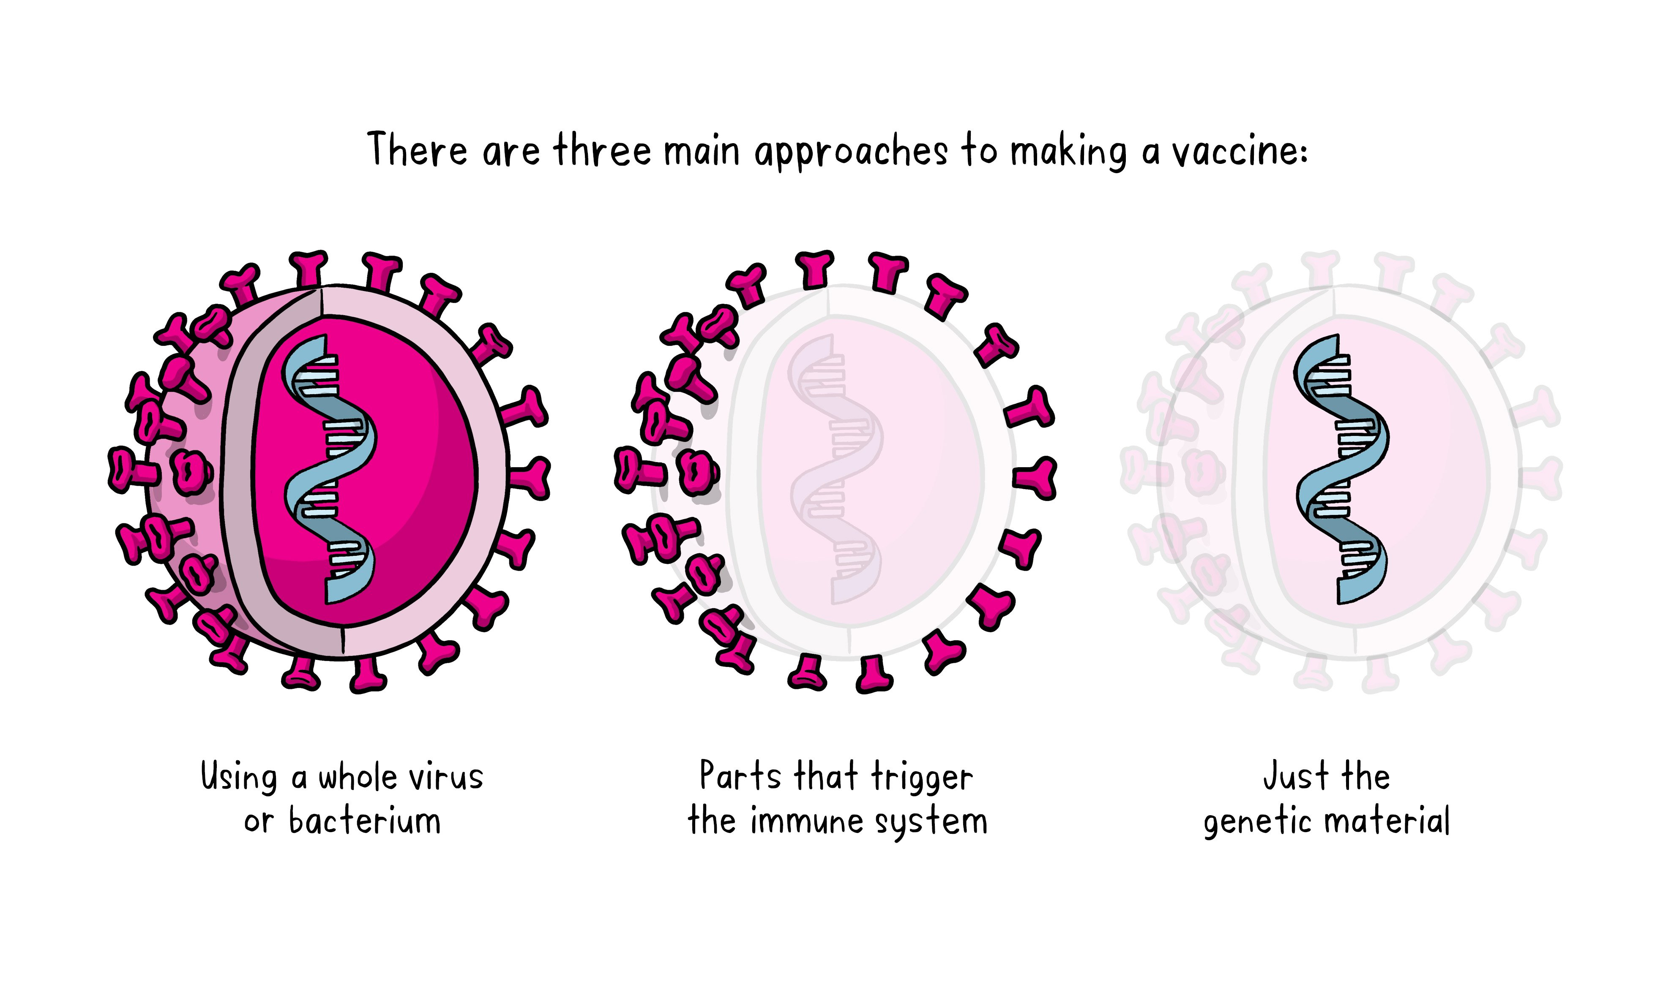
Vaccine Types
Live, attenuated vaccines: contain a weakened form of the virus.
Killed vaccines: contain a pathogen that has been destroyed with chemicals, heat, or radiation.
Toxoid vaccines: contain inactivated bacterial toxins.
mRNA vaccines: include messenger RNA, which acts as instructions to direct cells to synthesize a protein found on the virus.

Slide 11
Research Review
Mentor: H$\acute{e}$l$\grave{e}$ne Bazin-lee
“The research focus of our group is the design, synthesis, and development of new and safe vaccine adjuvants.”

Slide 12
Final website
Vaccine Education for Community Immunity :
https://vaccineeducation.wixsite.com/communityimmunity

