Slide 1
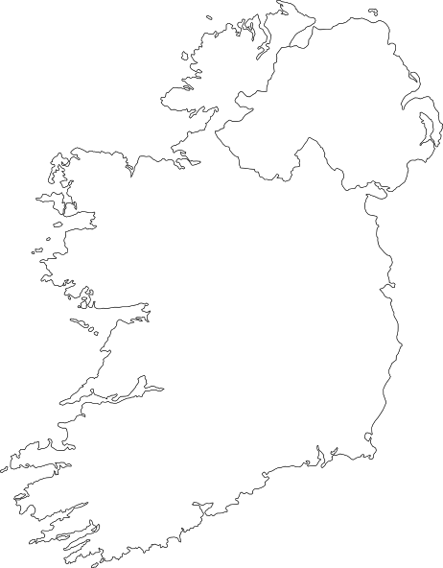
Integrated Education in Northern Ireland
Northern
Ireland
Ireland
A big step forward after a long history

Slide 2
Research Question and Process

Slide 3
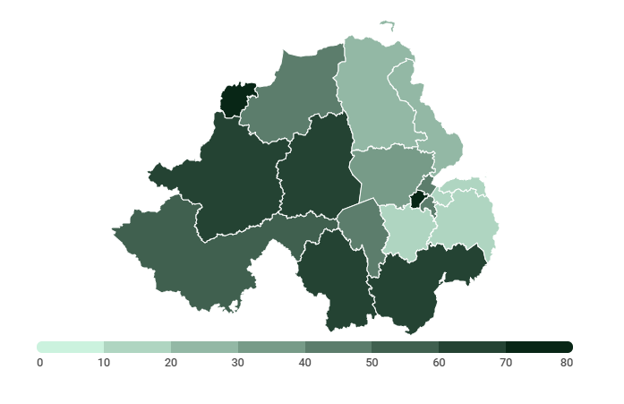
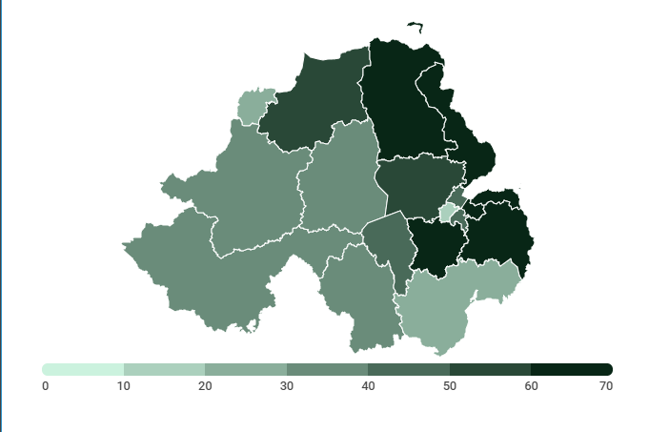
Religious Divide
Roman Catholics
Protestant and Other Christian
These maps were created from 2011 census data. They show the percent of people in each county that were either practing or were raised in that religion.

Slide 4
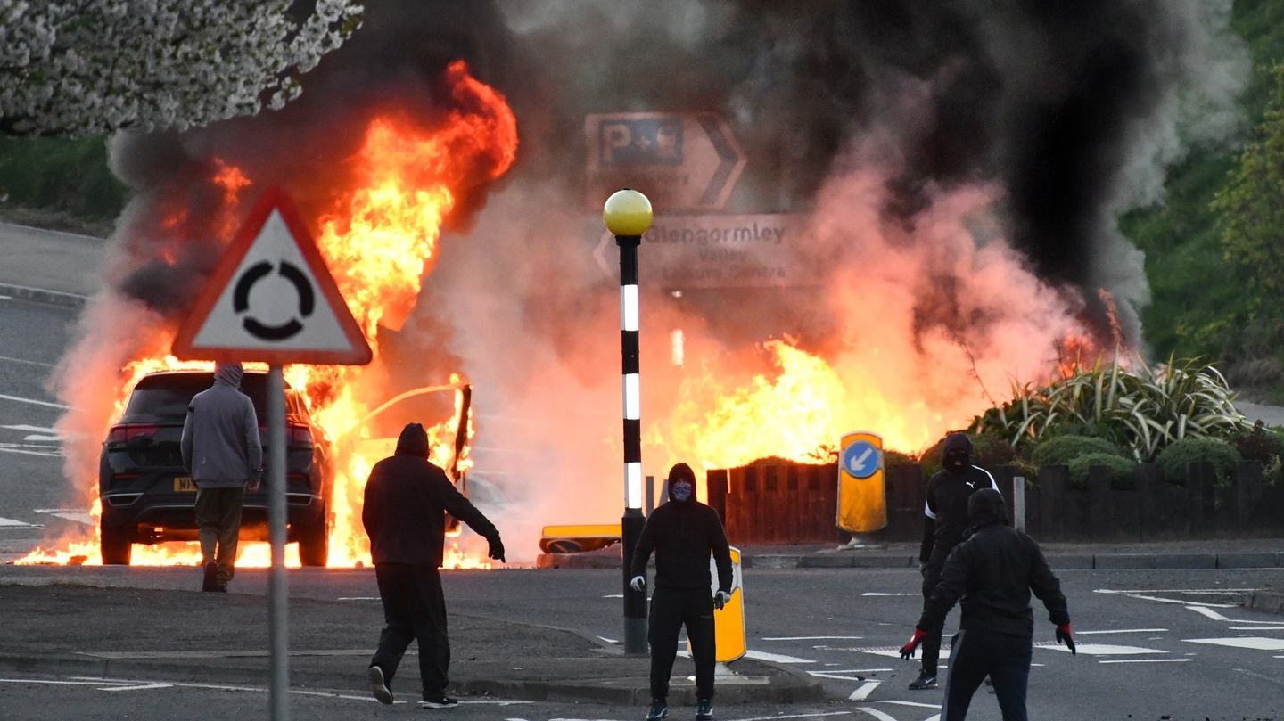
Violence April 3 at Cloughfern in the loyalist Rathcoole area of Newtownabbey, Belfast. Photograph: Alan Lewis/Photopress

Slide 5
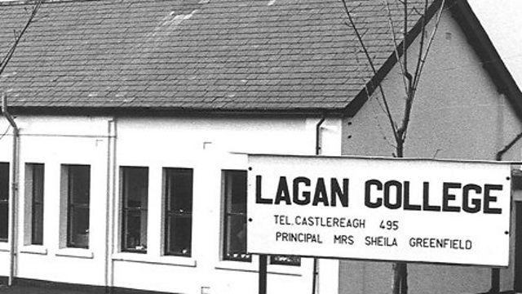
Religion and Education
Langan college was the first integrated school in Northern Ireland and was established during the height of the Troubles.

Slide 6
<10%
400
71,000
of students were enrolled in integrated schools
schools would operate at a deficit in 2017
unfilled desks

Slide 7
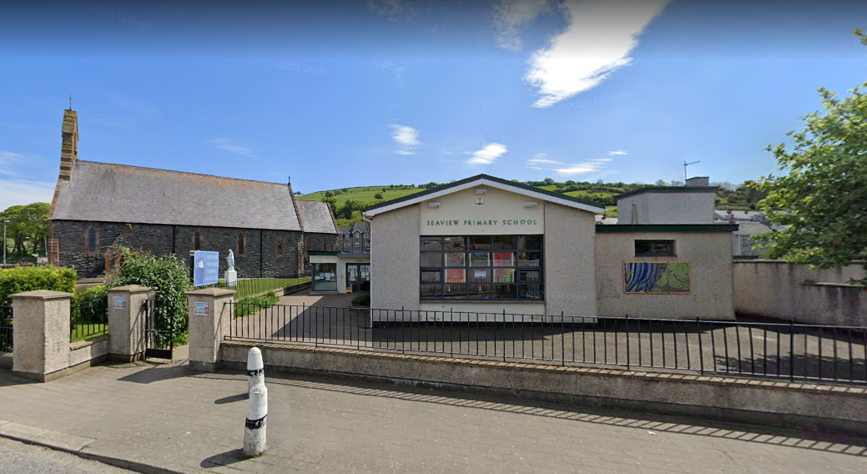
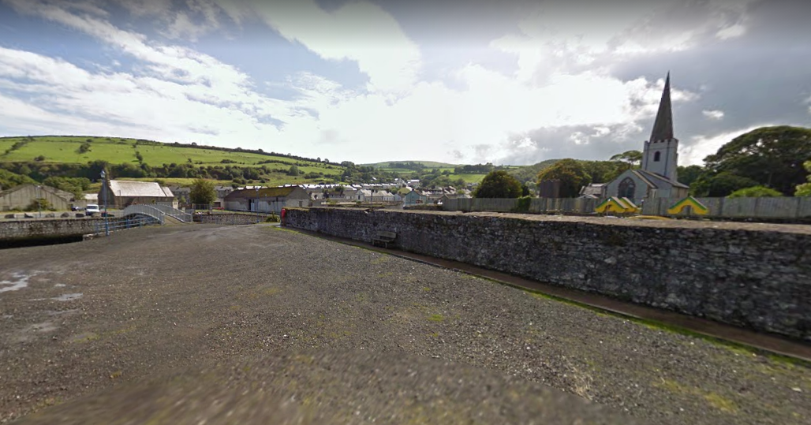
Seaview Primary in Glenarm
Images from Google Street View

Slide 8
“I want to congratulate all of the parents, staff and governors in schools right across Northern Ireland, who are taking courageous steps to ensure children from different traditions, will get to learn and play together, every day, in the same school," he said.
“Well done. I am so proud of you all.”
journalismabroad.jour.umt.edu

