Slide 1
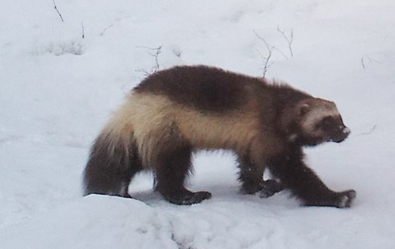
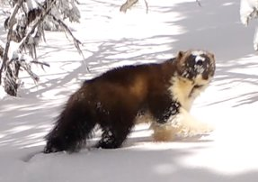
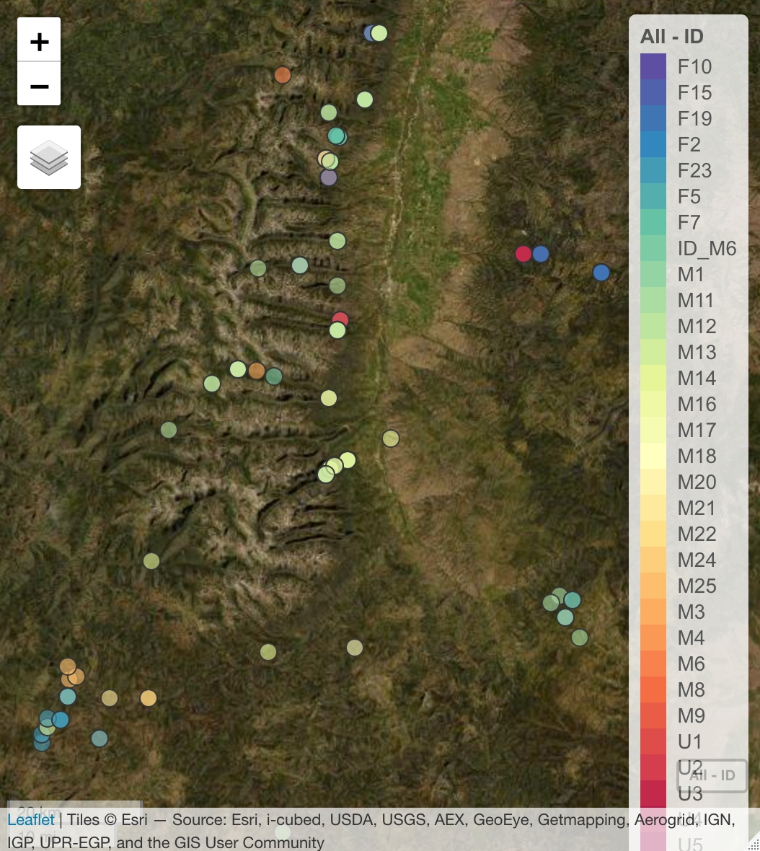
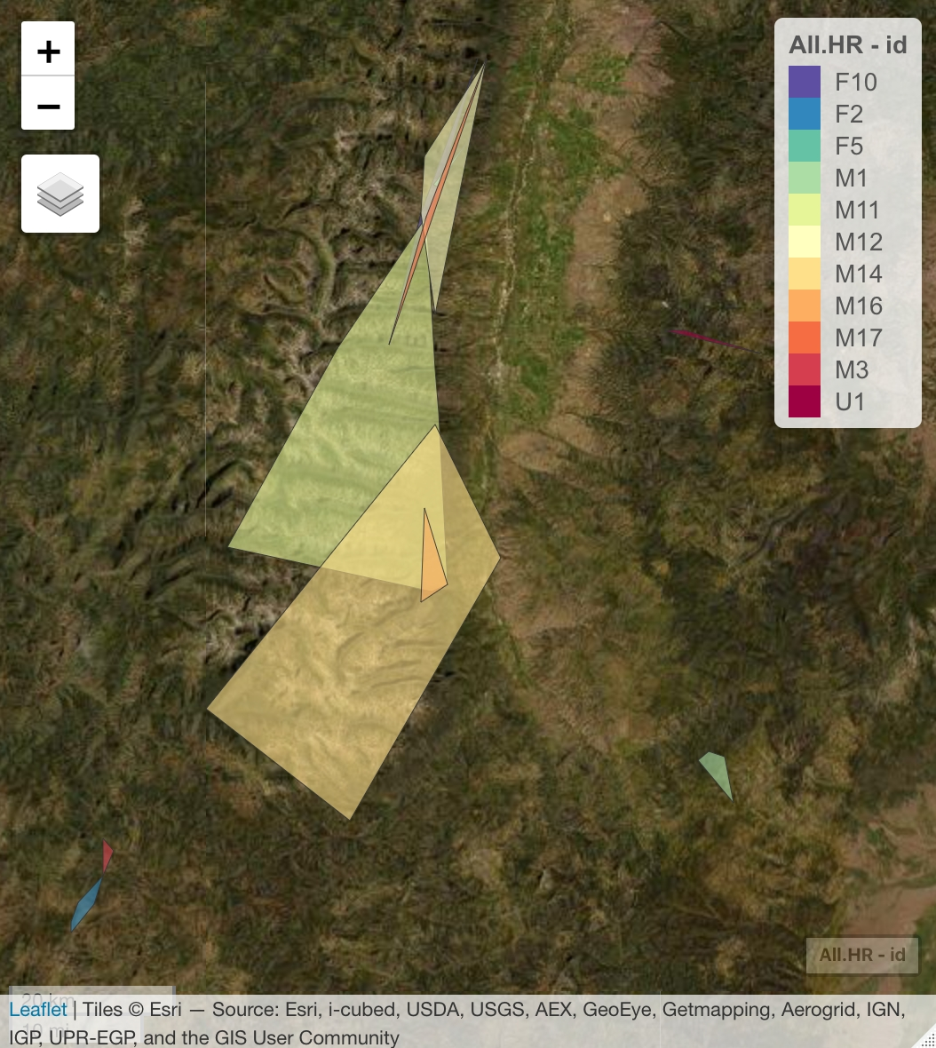
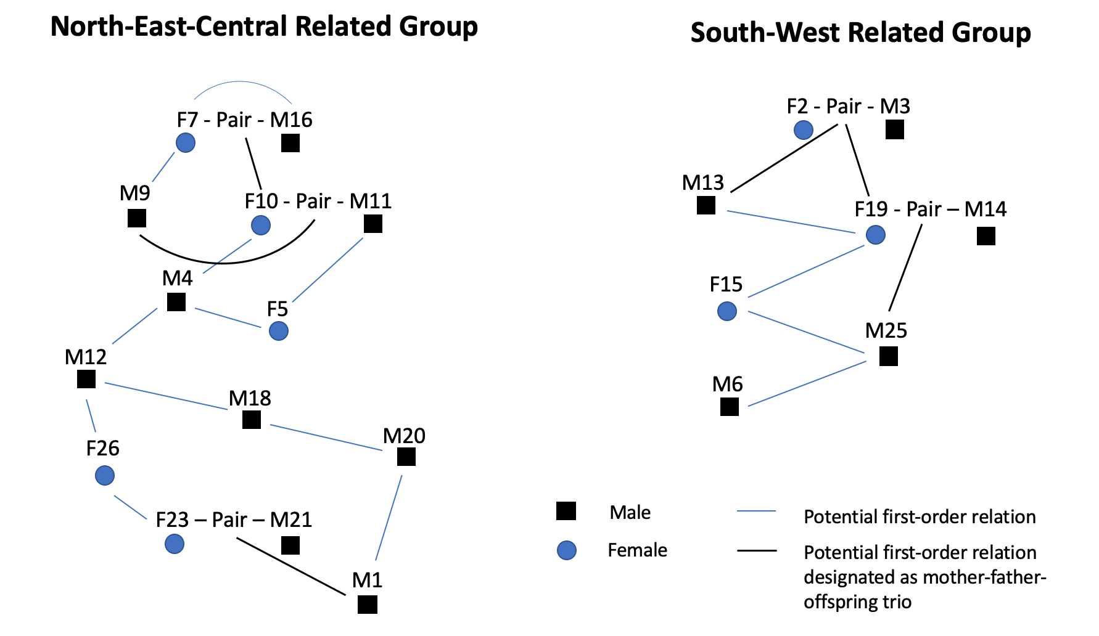
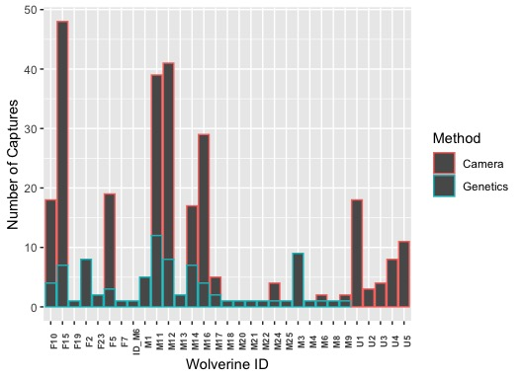
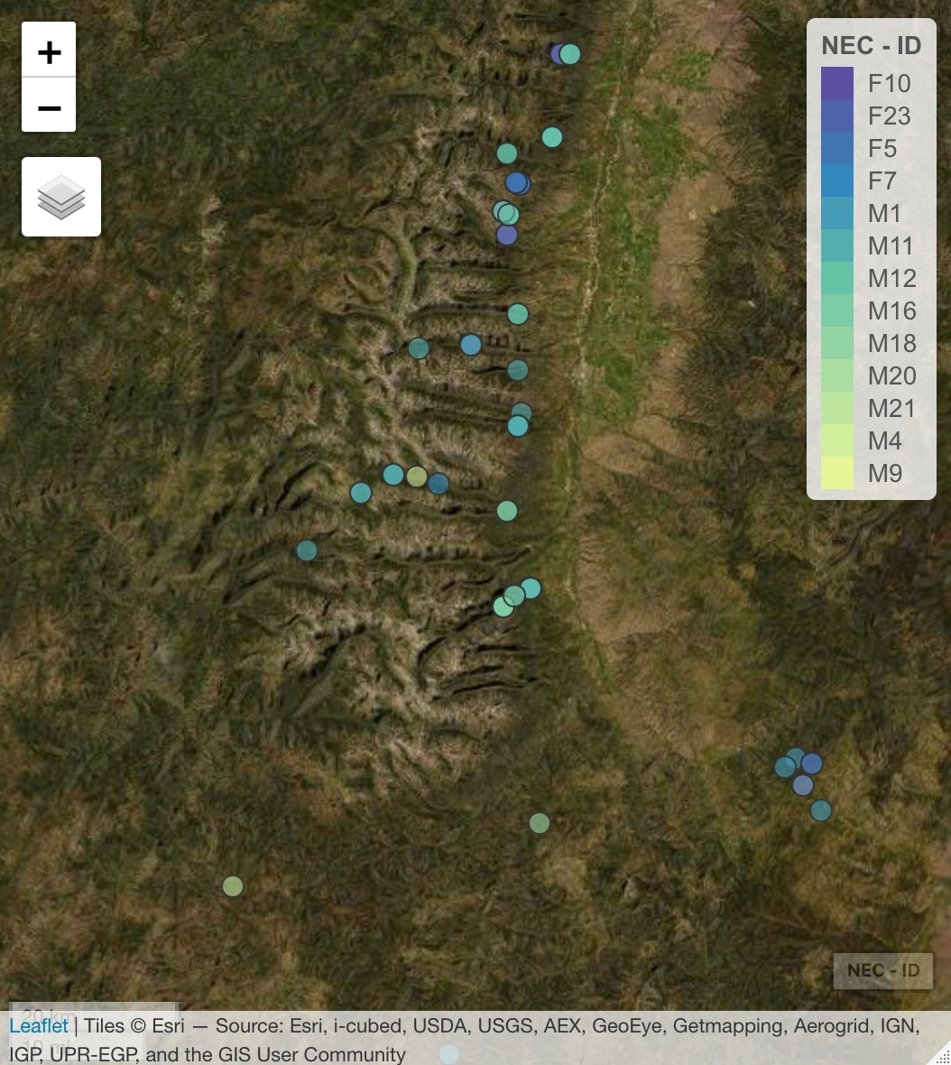
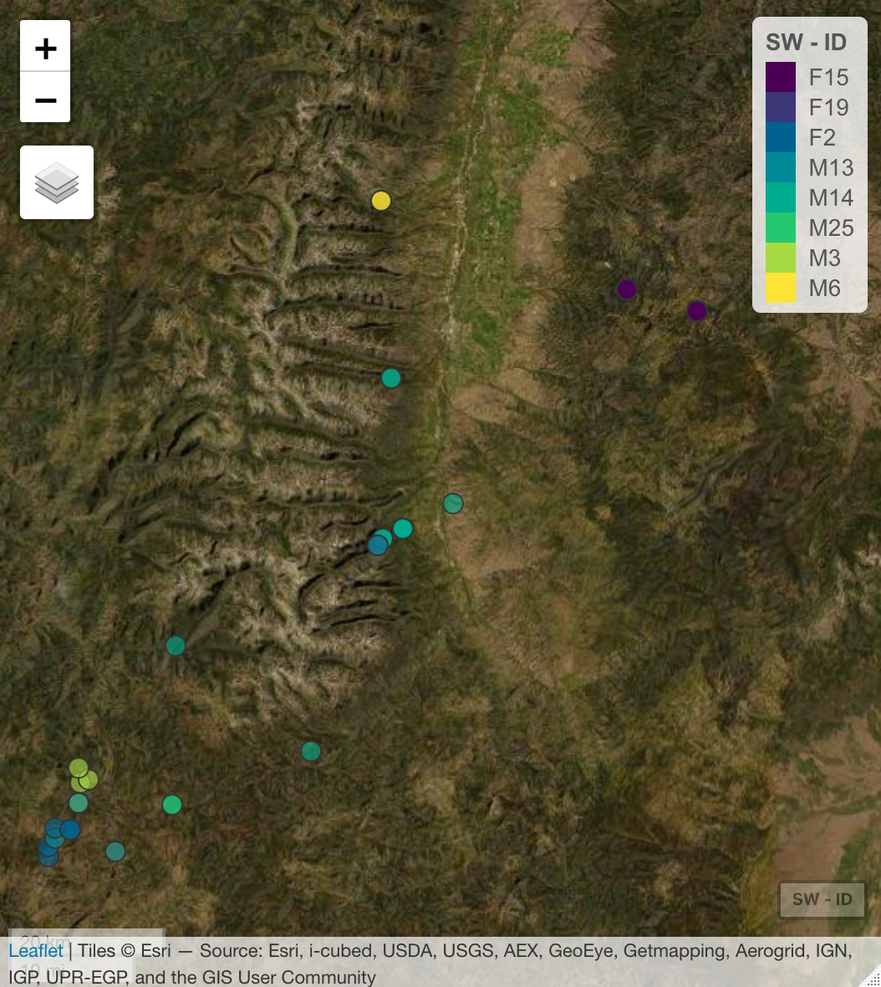
Improving Population Monitoring of Wolverines
Nicole Bealer¹, Kylie Paul², Jessie Golding³, Kristy Pilgrim⁴, Mark Hebblewhite¹, Kevin McKelvey³
¹Wildlife Biology Program, University of Montana, ²Wolverine Watchers, ³USFS Rocky Mountain Research Station, ⁴National Genomics Center for Fish and Wildlife Conservation
Background and Purpose
Monitoring wolverine populations is difficult because of their rarity and remote habitat, so scientific information about their populations is limited^{1,2,3}.
Wolverines require persistent spring snow making climate change a threat, and they were unsuccessfully petitioned for protection under the Endangered Species Act^{1,2,4}.
Citizen science project Wolverine Watchers monitored wolverines in the Bitterroot National Forest (BNF) with baited detection stations equipped with remote cameras and noninvasive genetic sampling hair snags from 2014-2020³.
USFS Rocky Mountain Research Station monitored forest carnivores with similar methods during same time period¹.
Between the two projects, 27 unique individuals were identified by genetics¹.
The purpose of this research is to integrate genetic and camera detection data to improve the monitoring of wolverines in the BNF.
Results and Analysis
Spatial:
26 identified and 5 unidentified wolverines were detected 304 times over six years
67.7% of individuals were detected more than once, 54.8% more than twice
Mean estimated home range area: 10.5 km² for females, 213.0 km² for males (much smaller than expected total home range¹)
Genetic:
Observed genotypes demonstrated adequate genetic variation (heterozygosity proportion = 0.514) and strong ability to correctly identify individuals (positive identification measure = 2.24x10⁻¹¹)
Potential relationships revealed two distinct subgroups (8 and 14 individuals) with no potential relationships between groups
Integration:
Related groups occupy generally different spatial areas and potential mating pairs exhibit overlapping ranges
Bitterroot Valley
Bitterroot Valley
Bitterroot National Forest
Bitterroot National Forest
Large Male Home Ranges
F2 and M3 Pair
All Detections of Wolverines
All Estimated Home Ranges
Limitations of Noninvasive Wildlife Research
Detection locations are biased, as detection only occurs at pre-selected locations and stations are baited to attract wolverines
Age of individuals is unknown, and year of first detection is unreliable as a proxy as wolverines may be undetected or immigrants, making assignment of familial relationships difficult
Detections of Wolverines by Method of Capture
Significance
Integration of spatial, temporal, and genetic data improves scientific understanding of wolverine population structure and demographics, with potential for increased information as analysis continues
Noninvasive monitoring contributes meaningful information about the status of wolverine populations to be applied to conservation decision-making
This novel integrative approach may be applied to monitor many other mesocarnivores or rare and remote species
Methods – A Noninvasive Approach
Genetic Methods:
Identified wolverines were genotyped at 20 noncoding microsatellite loci (particular segments of DNA), which were analyzed with the software Cervus for genetic relatedness
Potential first-order relationships (parent-offspring or siblings) were identified via exclusion of genetically mismatched candidates, which were used to construct potential family groups and relationships
Spatial Methods:
WW previously identified individuals via both genetics and visual markings, allowing camera detections to be integrated with genetic detections
Individuals detected at more than two locations were fitted with minimum convex polygons estimating their home range extent using the R package adehabitatHR
Spatial Distribution of N-E-C Group
Spatial Distribution of S-W Group
Acknowledgments
A huge thanks to all those who have supported this project and contributed to its success! My coauthors who made this project possible, Kylie Paul, Russ Talmo, Jessie Golding, Dave Lockman, and many others who conducted wolverine monitoring, my advisor Mark Hebblewhite, Kristy Pilgrim and others at the NGC who worked on genetic analysis, and all of my other supporters!
Bitterroot Valley
Bitterroot Valley
Bitterroot National Forest
Bitterroot National Forest
Literature Cited
¹ Golding, J.D., et al. 2018. Multispecies mesocarnivore monitoring: USDA Forest Service multiregional monitoring approach. Gen. Tech. Rep. RMRS-GTR-388. Fort Collins, CO: U.S, Department of Agriculture, Forest Service, Rocky Mountain Research Station. 68 p.
² Lukacs, P. M., et al. 2020. Wolverine Occupancy, Spatial Distribution, and Monitoring Design. The Journal of Wildlife Management. 84: 1-11
³ Paul, K. 2020. Wolverine Watchers: Citizen-based multi-species carnivore monitoring in the Bitterroot National Forest. Five-year project report.
⁴ U.S. Fish and Wildlife Service. 2018. Species status assessment report for the North American wolverine (Gulo gulo luscus). Version 1.2. March 2018. U.S. Fish and Wildlife Service, Mountain- Prairie Region, Lakewood, CO.
Wolverine images from Kylie Paul. All other images created by the researcher.

