Slide 1
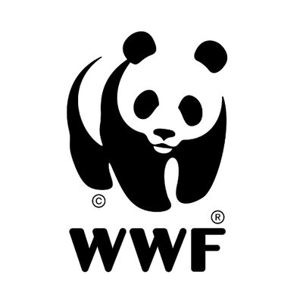
Conservation Nonprofits and Communication of Values
Madeline Damon

Slide 2
The Problem
The Environment: A Political Issue
Environmental communication uses message framing appealing to liberal audiences
Language should match values and beliefs of a large audience rather than contributing to political polarization
Conservation Nonprofits: Connecting the Public to Conservation Efforts
Nonprofits reveal values of communities
Build trust between researchers and community members by building social capital
What are conservation nonprofits today communicating to the public?

Slide 3
Guiding Theory and Literature: Schwartz Values Theory
Schwartz describes values as:
Beliefs linked to emotional affect
Referring to desirable goals that motivate action
Transcending actions and situations
Standards that guide individuals
Internally ordered by importance
Relative importance of values guides action
(Schwartz 1992, 2012)

Slide 4
Value | Focus
Self-direction | Independent thought and action
Stimulation | Excitement and challenge
Hedonism | Self-indulgence
Achievement | Personal Success
Power | Social status and prestige
Security | Safety and stability
Conformity | Restraint, preserve status quo
Tradition | Commitment to customs
Benevolence | Welfare of ingroup
Universalism | Welfare and tolerance outside ingroup
(Schwartz 2012)

Slide 5
Reveals two additional continuums:
Conservation vs Openness to Change
Self-Enhancement vs Self-Transcendence
(Barnea and Schwartz 1998)
(Schwartz 2012)

Slide 6
Politics and Values
Value priorities predispose individuals to vote for particular political parties in response to their ideological symbols and messages
Rokeach (1973) identifies two value dimensions associated with political ideologies: freedom and equality
Since then, researchers have expanded these original dimensions and connected them with other values and personality models
Conservatism:
Resistance to change
Necessity for inequalities
High orderliness and politeness
Lower compassion
Respect for tradition
Respect for authority
Free enterprise
Liberalism:
High compassion
Equality
High openness
Focus on social change
Freedom of choice
Government intervention
(Olver and Mooradian 2003) (Barnea and Schwartz 1998) (Fleishman 1988) (Hirsh et. al. 2010)

Slide 7
Importance of Branding and Message Framing
Promotion strategies that appeal to values are most successful and highly effective: values affect how we choose products and services.
Strong social media presence has positive effects on brand loyalty and trust
People reject information that conflicts with pre-existing values, regardless of factual content
People are increasingly relying on mass media for science and policy information
Framing issues in conservative moral language changes their views on typically liberal stances
(Vinson et al. 1977, Wolsko et al. 2016, Laroche et al. 2013, Hurst & Stern 2020)

Slide 8
Purpose
The purpose of this study is to evaluate the effectiveness of conservation nonprofit communication with the public through:
Values they want to portray through their mission, vision, and values statements (MVVs)
Values they are communicating to the public via social media (Twitter)
Similarity between values in MVVs and tweets
Identifying connections between nonprofit size and values similarity
Identifying which types of audiences a nonprofit’s values resonate most with

Slide 9
Research Questions:
What are the basic values portrayed by a nonprofit’s mission, vision, and values statements (MVVs) in relation to:
Schwartz’s theory of 10 basic values?
Word frequencies of the MVVs?
What are the basic values portrayed in conservation nonprofits’ tweets in relation to:
Schwartz’s theory of 10 basic values?
Word frequencies of the tweets?
Are the values communicated by conservation nonprofits’ MVVs congruent with the values portrayed by tweets?
Is there a correlation between a conservation nonprofit’s size and how effectively they communicate their values?
Can the values embedded within nonprofit communication be used to identify a current target audience?

Slide 10
Text Mining
Methods:
Collecting data from text
Text mining is an unsupervised method that involves collections of documents (Transcripts, news articles, PDFs, tweets, etc.) with the goal of analyzing and classifying them

Slide 12
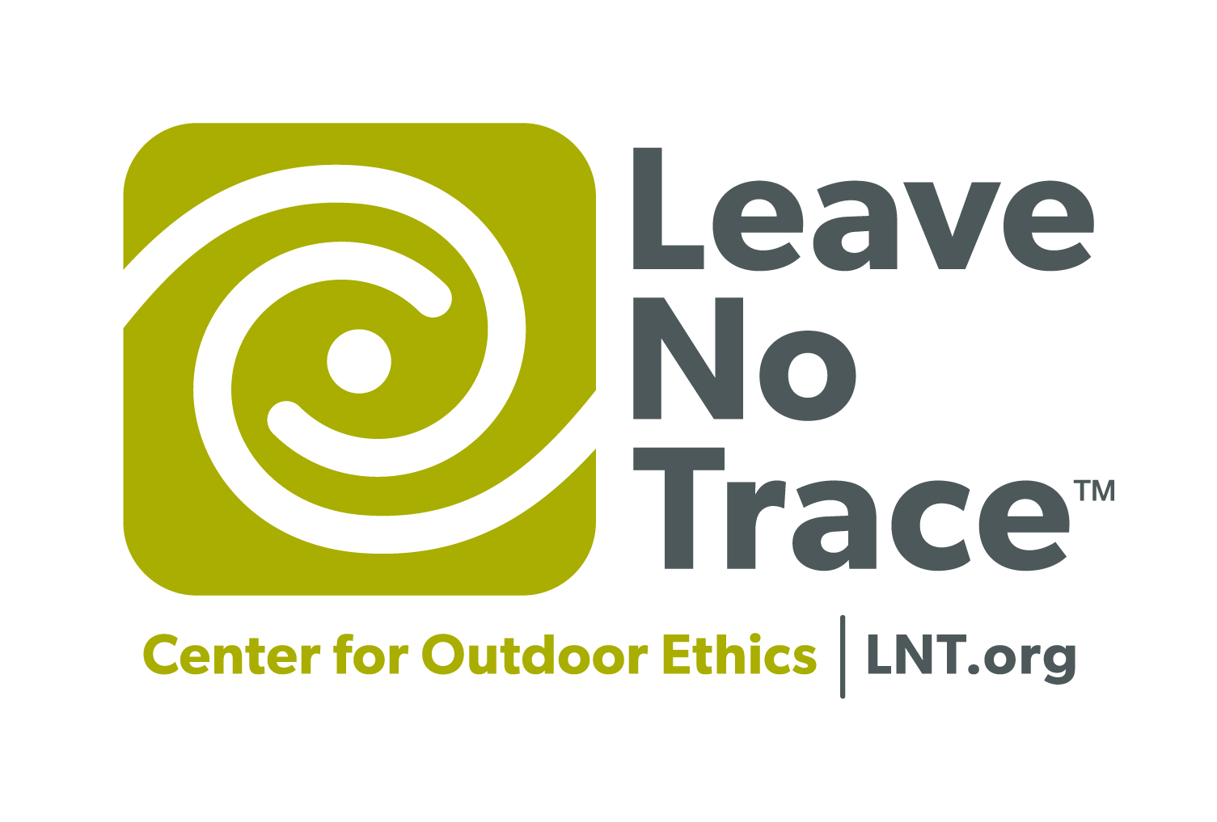
Defining the Sample
Nonprofits will be selected from the Charity Navigator database of nonprofits - Filtered by Environmental Protection and Conservation subject area
30 total nonprofits, grouped by size
10 Small (Expenses ≤ $3.5 million, n= 208)
10 Medium (Expenses ranging $3.5 million - $13.5 million, n = 91)
10 Large (Expenses ≥ $13.5 million, n = 40)

Slide 13
Extracting MVVs
Extracting Tweets
Web scraping in Python can be used to collect and store MVVs by pulling all of the text from a webpage (i.e. ‘About Us’, ‘Our Mission’)
Using the tweepy package in Python, I will pull up to 1,000 tweets from each nonprofit included in the study.

Slide 14
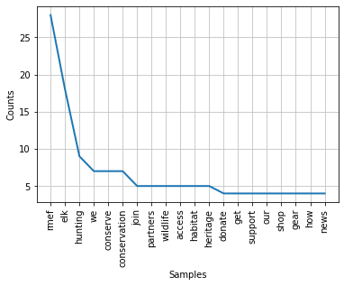
Identifying Most Common Tokens
Example: RMEF tweets
Identifying the most common tokens (words) for each nonprofit’s MVVs and tweets will allow me to see the topics that each nonprofit focuses on most

Slide 15
Schwartz Values Theory Analysis
A function I build in Python will:
Calculate the frequency of each value (i.e. benevolence) by:
Counting the number of words that appear in both a values synonyms list and the text file
Divide number of matching words by total number of words in the file

Slide 16
Sample output:
Sample Output:
File used = Greenpeace Tweets
{'achievement': 0.036,
'benevolence': 0.0216,
'conformity': 0.0212,
'hedonism': 0.0118,
'power': 0.0313,
'security': 0.04,
'self_direction': 0.0426,
'stimulation': 0.0278,
'tradition': 0.0081,
'universalism': 0.0377}

Slide 17
Cosine Similarity and Principal Components Analysis
Cosine Similarity: How similar are the values frequencies for each organization’s tweets and MVVs?
Sample Output for Greenpeace and Trout Unlimited
'The cosine similarity between tweets and MVVs for Greenpeace is 0.585'
'The cosine similarity between tweets and MVVs for Trout Unlimited is 0.910'
Principal Components Analysis: Is there a pattern in values frequencies for conservation nonprofit MVVs or tweets?

Slide 18
Results:
Studying the most common words used in tweets and MVVs

Slide 19
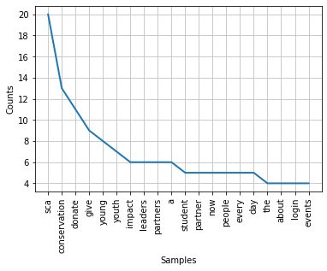
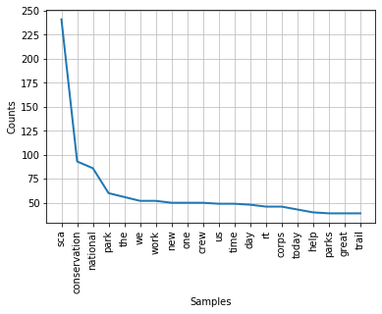
Student Conservation Association
(Large Organization)
MVVs
Tweets

Slide 20
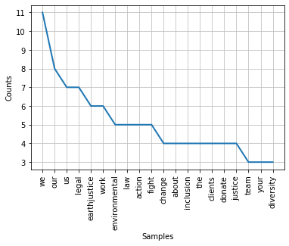
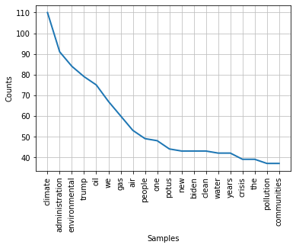
Earthjustice
(Large Organization)
MVVs
Tweets

Slide 21
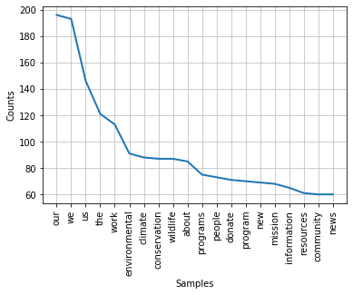
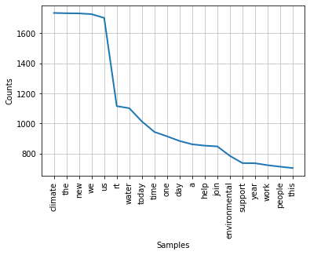
Combined MVVs and Tweets
MVVs
Tweets

Slide 22
The Secret Life of Pronouns
James Pennebaker
Our, we, and us: indicators of group cohesiveness
“Function word usage is highly contagious… people tend to adopt the language styles of the people around them. Our words, especially our function words, inadvertently reveal what we are doing and where we are. Just as our accents, body language, and clothes reveal our social and psychological selves, so do our words.” (p. 268)
“We-words tell us about group identity. By analyzing them closely, it is possible to get a sense of the speakers’ connections with others.” (p. 249)
“Words such as we, us, and our can be powerful markers of identity…. “our business” and “our community” are groups that are a part of who we are.” (p. 242)

Slide 23
Values Analysis

Slide 24
Which values did conservation nonprofits use most?

Slide 25
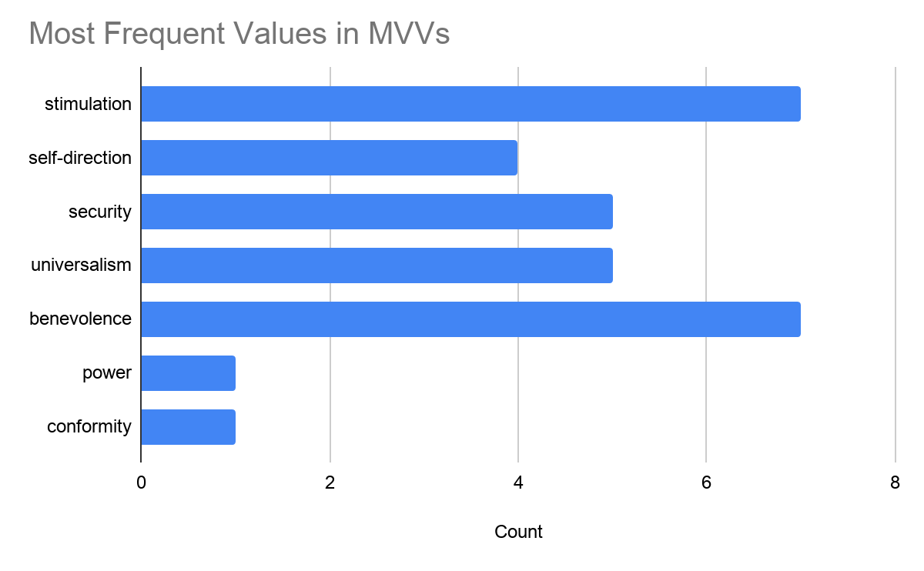
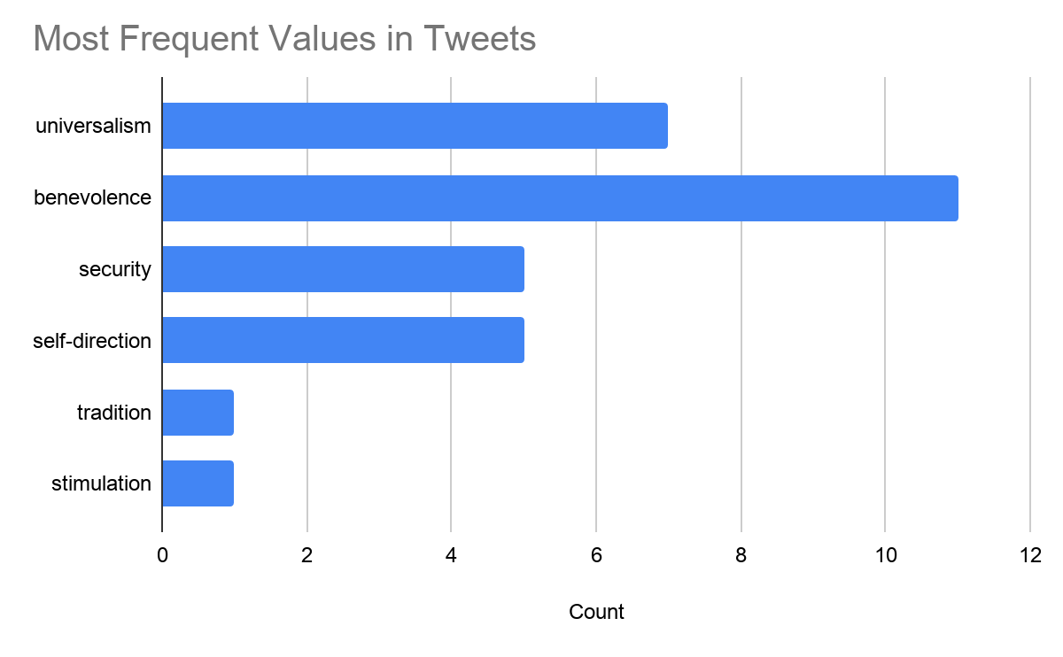

Slide 26
Value | Higher Order Dimension | Common Synonyms in MVVs and tweets
Five Most Common
Universalism | Self-Transcendence | Climate, environmental, global, justice, right, environment, even, everyone, international, united, equity, bipartisan, coalition
Benevolence | Self-Transcendence | Help, thank, thanks, love, friends, share, give, service, gift, provide, volunteer, helping, giving, care, donate
Self-Direction | Openness to Change | Make, opportunity, plan, made, think, research, build, create, vote, explore, planning, plans, conversation, advocacy
Stimulation | Openness to Change | Energy, change, action, opportunity, excited, challenge, risk, movement, challenges, adventure, diversity
Security | Conservation | Clean, health, protect, crisis, fight, safe, healthy, save, protecting, safety, dangerous, emergency, threat
*Since tweets and MVVs had different values appear most often, these are not listed in any order
Synonyms that appeared in both MVVs and tweets for each value and consequent higher order value dimension (Jones et al. 2018, Schwartz 2012)

Slide 27
Other Values
Achievement | Self-Enhancement | Win, best, growth, well, develop, goal, progress, perfect, improvement, success, benefit, congratulations, advance
Hedonism | Self-Enhancement | Celebrate, happy, beautiful, enjoy, fun, game, recreation
Power | Self-Enhancement | Administration, power, leaders, director, lead, strong, powerful, management, demand, strengthen
Conformity | Conservation | Support, group, honor, laws, order, honored, agree, follow, rule, legal, illegal
Tradition | Conservation | Preserve, restore, holiday, wisdom, heritage, respect, culture, traditional
*Since tweets and MVVs had different values appear most often, these are not listed in any order
Synonyms that appeared in both MVVs and tweets for each value and consequent higher order value dimension (Jones et al. 2018, Schwartz 2012)

Slide 28
Cosine Similarity

Slide 29
Cosine Similarity Summary
 | Mean | SD | Skew
Size
Small | 0.814 | 0.106 | -0.700
Medium | 0.823 | 0.045 | -0.264
Large | 0.787 | 0.130 | -0.567
Combined Orgs | 0.808 | 0.101 | -0.860
*No outliers were identified using the IQR method
*One-Way ANOVA test for differences in means indicated that means were not significantly different (pvalue=0.73)

Slide 30
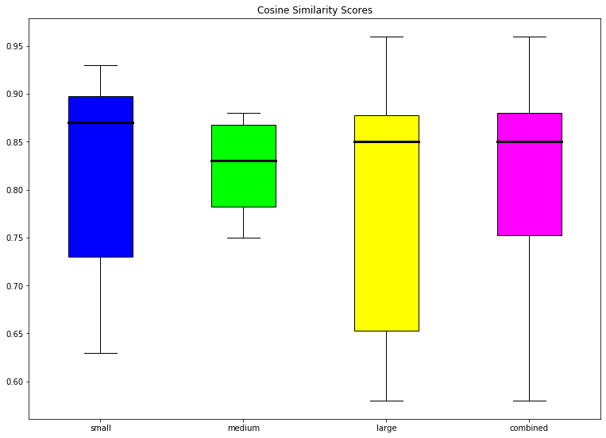

Slide 31
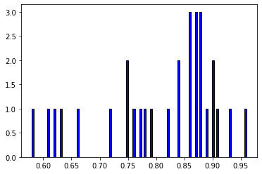
Combined Organizations

Slide 32
Organizations with the lowest similarity
Name | Size
Chattahoochee Riverkeeper | Small
Earthshare | Small
1000 Friends of Oregon | Small
Mohonk Preserve | Medium
Ceres | Large
Earthjustice | Large
Grow NYC | Large
Student Conservation Association | Large
Based on the lowest 25% of distance data. The above organizations are in the lower quartile for similarity, which means their similarity was lower than the other 75% of organizations

Slide 33
Organizations with the highest similarity
Name | Size
Community Environmental Council | Small
Global Green | Small
International Conservation Caucus | Small
Quebec-Labrador Foundation | Small
Sonoran Institute | Small
Washington Trails Association | Medium
Climate Reality Project | Large
Resources for the Future | Large
Waterkeeper Alliance | Large
Based on the highest 25% of distance data. The above organizations are in the upper quartile for similarity, which means their similarity was higher than the other 75% of organizations.

Slide 34
Principal Components Analysis (PCA)

Slide 35
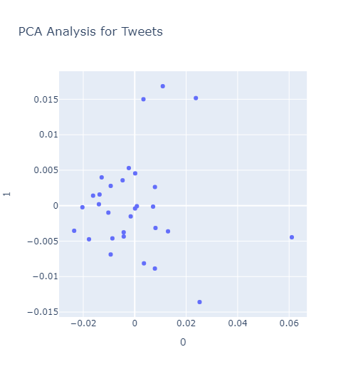
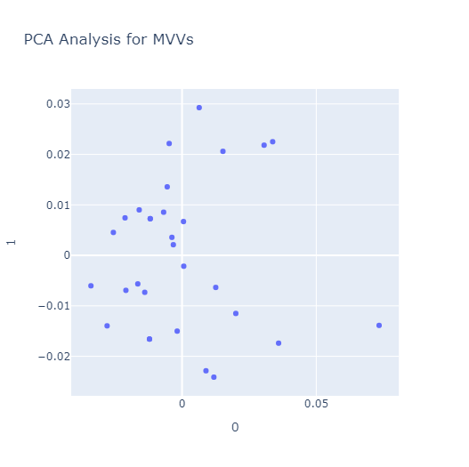
Sets of values frequencies were ultimately more variable in MVVs, more consistent in tweets

Slide 36
Literature Review

Slide 37
Value | Higher Order Dimension | Common Synonyms in MVVs and tweets
Five Most Common
Universalism | Self-Transcendence | Climate, environmental, global, justice, right, environment, even, everyone, international, united, equity, bipartisan, coalition
Benevolence | Self-Transcendence | Help, thank, thanks, love, friends, share, give, service, gift, provide, volunteer, helping, giving, care, donate
Self-Direction | Openness to Change | Make, opportunity, plan, made, think, research, build, create, vote, explore, planning, plans, conversation, advocacy
Stimulation | Openness to Change | Energy, change, action, opportunity, excited, challenge, risk, movement, challenges, adventure, diversity
Security | Conservation | Clean, health, protect, crisis, fight, safe, healthy, save, protecting, safety, dangerous, emergency, threat
Numerous studies connect self-transcendence and openness to change dimensions to politically liberal audiences
No strong values appeals to politically conservative audiences
Reaffirms traditional liberal message framing of environmental communication
Hurst & Stern 2020, Feinberg & Willer 2013, Wolsko et al. 2016)

Slide 38
Suggestions for Improving Environmental Communication
A better match between environmental messages and the social identity across the political spectrum should decrease the defensive urge to automatically reject information for identity-protective reasons
How can we reduce the gap between liberals and conservatives in environmental concern using message framing?

Slide 39
Utilizing Values in Communication
Security: abuse, clean, crisis, emergency, defend, fight, protect, safety, salvation, refuge, save, secure, stability, shelter
Tradition: belief, blessed, custom, devote, faith, inherit, heritage, patriot, respect, restore, tradition, preserve
Conformity: abide, adhere, approval, command, compliance, compromise, conform, duty, embrace, honor, law, mandate, obey, polite, restrain, rule, support
Power: advantage, authority, command, authorize, control, demand, dictate, dominance, enforce, expansion, force, govern, intimidate, leader, manage, oversee, prestige, status, strength, supervise, wealth
(Jones et al. 2018)

Slide 40
Appealing to Conservative Morals
Loyalty/Betrayal: together, nation*, homeland*, family, group, loyal*, patriot*, unite*, devot*, ally
Authority/Subversion: obey, duty, law, legal, honor, respect*, tradition*, authority, serve, comply
Sanctity/Degradation: purity, clean, integrity, virtuous, refined, pristine
(Wolsko et al. 2016, Graham & Haidt 2009)

Slide 41
Future Applications
Values Research
Not many studies on synonyms
Create my own message framing study
Values surveys to nonprofit supporters

Slide 42
Coding Applications
Create code that allows users to determine values and identifying audience in text
Expand sample size to confirm patterns found
Nonprofit Outreach
Create a guide for constructing environmental messages
Present to conservation nonprofit boards

Slide 43
Thank you!
Madeline Damon, madeline.damon@umontana.edu
I am very passionate about connecting social research and conservation, and I’m excited to start completing my M.S. in Wildlife Biology at the University of Montana next fall!

Slide 44
References
Barnea, M., & Schwartz, S. (1998). Values and Voting. Political Psychology, 19(1), 17-40.
Evans, Geoffrey A, & Heath, Anthony F. (1995). The measurement of left-right and libertarian-authoritarian values: A comparison of balanced and unbalanced scales. Quality & Quantity, 29(2), 191-206.
Fleishman, J. (1988). Attitude organization in the general public: Evidence for a bidimensional structure. Social Forces, 67(Sep 88), 159-184.
Graham, J., Haidt, J., & Nosek, B. A. (2009). Liberals and conservatives rely on different sets of moral foundations. Journal of personality and social psychology, 96(5), 1029.
Hirsh, J., Deyoung, Xiaowen Xu, & Peterson. (2010). Compassionate Liberals and Polite Conservatives: Associations of Agreeableness With Political Ideology and Moral Values. Personality and Social Psychology Bulletin, 36(5), 655-664.
Hurst, K., & Stern, M. J. (2020). Messaging for environmental action: The role of moral framing and message source. Journal of Environmental Psychology, 68, 101394.
Jones, K., Noorbaloochi, S., Jost, J., Bonneau, R., Nagler, J., & Tucker, J. (2018). Liberal and Conservative Values: What We Can Learn From Congressional Tweets. Political Psychology, 39(2), 423-443.

Slide 45
Roccas, Sonia, Sagiv, Lilach, Schwartz, Shalom H, & Knafo, Ariel. (2002). The Big Five Personality Factors and Personal Values. Personality & Social Psychology Bulletin, 28(6), 789-801.
Laroche, M., Habibi, M. R., & Richard, M. O. (2013). To be or not to be in social media: How brand loyalty is affected by social media?. International journal of information management, 33(1), 76-82.
Rokeach, M. (1973). The nature of human values. Free press.
Schwartz, S. H. (1992). Universals in the content and structure of values: Theory and empirical tests in 20 countries. In M. Zanna (Ed.), Advances in experimental social psychology (Vol. 25, pp. 1-65). New York: Academic Press.
Schwartz, S. H. (2006). Basic human values: An overview. Recuperado de http://www. yourmorals. org/schwartz.
Schwartz, S. H. (2012). An overview of the Schwartz theory of basic values. Online readings in Psychology and Culture, 2(1), 11.
Olver, James M, & Mooradian, Todd A. (2003). Personality traits and personal values: A conceptual and empirical integration. Personality and Individual Differences., 35(1), 109-125.

Slide 46
Pennebaker, J. W. (2011). The secret life of pronouns. New Scientist, 211(2828), 42-45.
Tausczik, Yla R, & Pennebaker, James W. (2010). The Psychological Meaning of Words: LIWC and Computerized Text Analysis Methods. Journal of Language and Social Psychology., 29(1), 24-54.
Vecchione, Michele, Alessandri, Guido, Barbaranelli, Claudio, & Caprara, Gianvittorio. (2011). Higher‐order factors of the big five and basic values: Empirical and theoretical relations. The British Journal of Psychology, 102(3), 478-498.
Vinson, Donald E, Scott, Jerome E, & Lamont, Lawrence M. (1977). The Role of Personal Values in Marketing and Consumer Behavior. Journal of Marketing., 41(2), 44-50.
Wolsko, C., Ariceaga, H., & Seiden, J. (2016). Red, white, and blue enough to be green: Effects of moral framing on climate change attitudes and conservation behaviors. Journal of Experimental Social Psychology, 65, 7-19.

