Slide 1
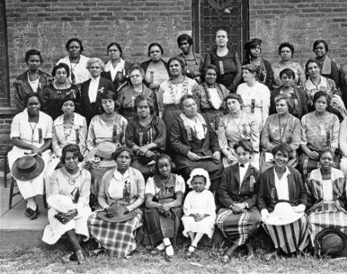
African-American Women in Montana
Molly Putnam
Faculty Mentor Dr. Tobin Miller Shearer

Slide 2
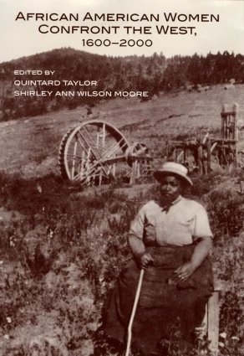
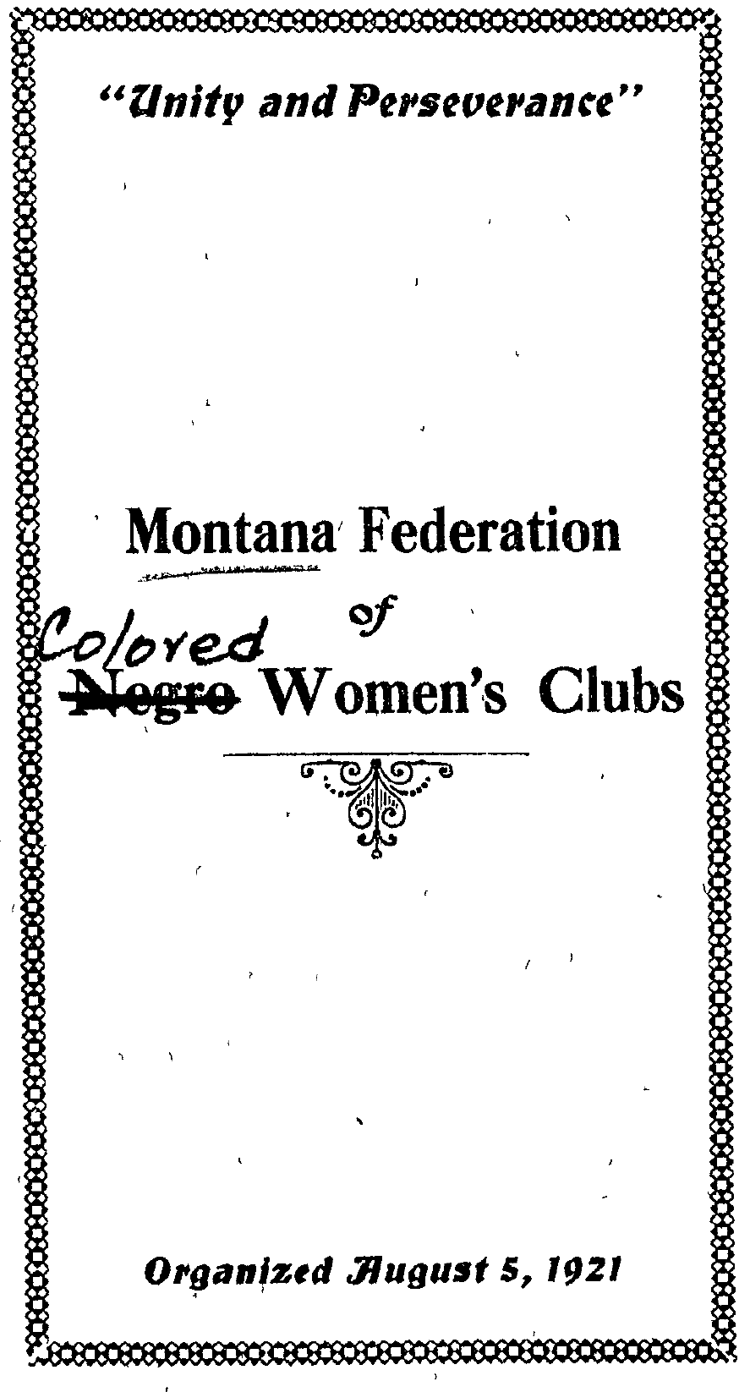
Methodology

Slide 3
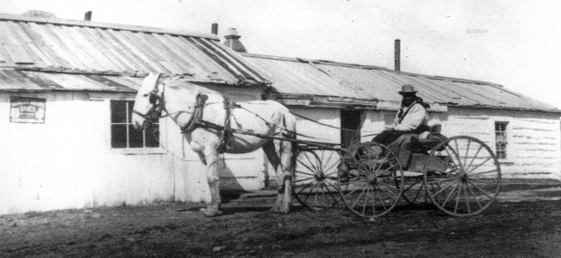
Racism in Montana
Unidentified Great Fall-area homesteader on the agricultural frontier.
Great Falls Photo View Company, Ken Robison Collection
Mary Fields arriving in Montana in the mid 1800s
Ursuline Sisters Archives, Great Falls

Slide 4
African-American Western Women

Slide 5
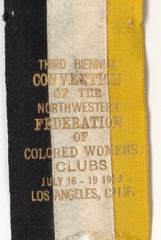
The Montana Federation of Colored Women’s Club

Slide 6
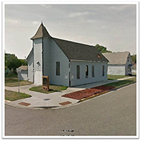
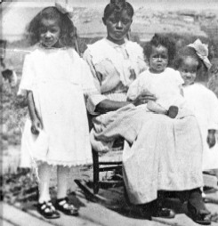
The Church
Union Bethel Church
Great Falls, MT
Wayman AME Chapel, Billings, MT
Emma Riley Smith
Great Falls, 1920s

Slide 7
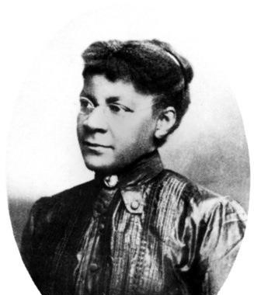
Case Studies
Octavia Bridgewater
Sarah Bickford

Slide 8
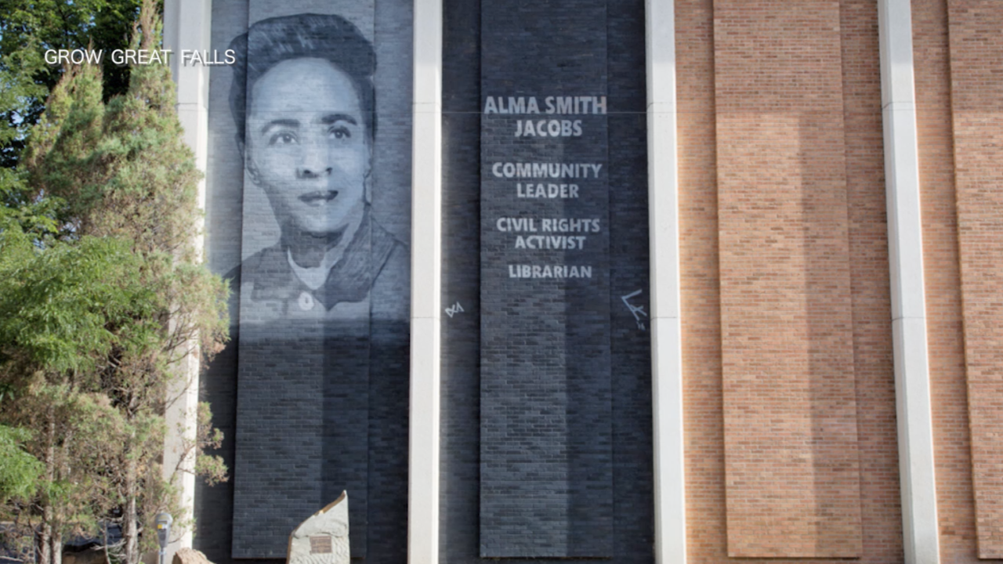
Legacy

Slide 9
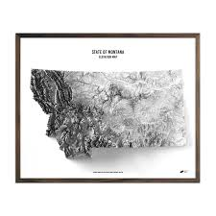
THANK YOU

