Slide 1
Developing Quality of Life Indicators for Open Space and Mountain Parks Management: A Three-Pronged Approach
4/22/2022
Thomas Mangan
Colorado Public Radio
Lane Arthur (he/him) – The University of Montana (Missoula, MT)
- In collaboration with:
Dr. William L. Rice (he/him) – The University of Montana (Missoula, MT)
Deonne VanderWoude, Heidi Seidel, and Anna Reed – City of Boulder Open Space and Mountain Parks (Boulder, CO)
OSMP signs and human dimensions field staff – City of OSMP (Boulder, CO)
University of Boulder CO
The University of Montana is in the aboriginal territories of the Salish, Kootenai, and Kalispel people. We honor the path they have always shown us in caring for this place for the generations to come.

Slide 2
Agenda
Meet the presenter
Background
Methods
Study Design
Data Analysis
Results
Defining Outcome Indicators
Defining Relative Spatial Distribution of Outcomes
Key Takeaways and Outcomes
Acknowledgements
Q & A
The Clymb
Boulder OSMP Instagram

Slide 3
Meet the presenter
Lane is in his senior year at the University of Montana, earning a dual degree in Parks, Tourism, & Recreation Management (B.S.) and Wildlife Biology (B.S.). After graduating, Lane hopes to pursue a masters degree program that blends his background in the social and natural sciences. As a Research Assistant in the Wildland and Recreation Management lab at the U. of Montana, he was fortunate enough to gain undergraduate research experience working with Dr. Will Rice and the Boulder, CO, OSMP Team.

Slide 4
Background
Boulder, Colorado, Open Space and Mountain Parks manages over 45,000 acres of protected space that contains 155 miles of trails (OSMP, 2022)
OSMP is considering managing the land using outcome-focused management (OFM) framework following the city’s charter that states the land shall be managed for “recreational value and its contribution to the quality of life of the community” (Boulder, Colorado Charter art. XII, sec. 176).
Managing for these values has been tricky despite various attempts to develop methods to measure quality of life and well-being outcomes (Manning, 2012; Miller et al., 2018; Rice et al. 2019).
Ranger Hammond – OSMP Instagram

Slide 5
What We Wanted to Accomplish
1
Quantitatively assess salient outcome domains related to quality of life and well-being
2
Qualitatively define relevant indicators using Recreation Experience Preference Items for each of these domains
3
Identify the spatial distribution of the associated outcome domains

Slide 6
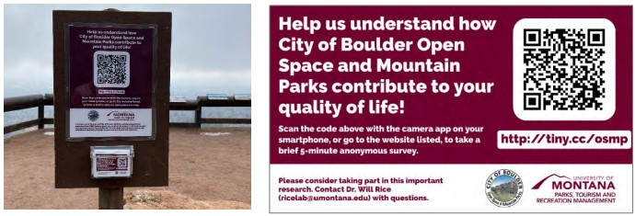
Methods
Data collection consisted of posting an online survey accessed via quick response (QR) code-enabled signage placed across OSMP property by OSMP signs and human dimensions field staff.
The survey was broken into three sections
1) Multiple choice section with 15 REP items and varying degrees of impact.
2) Open-ended section summarizing chosen REP domains.
3) Participatory mapping section allowing participants to map where, on OSMP property, they received REP domain items.

Slide 7
Timeline
Present at OSMP staff meeting
Move Survey to New Trailheads
MAR 2022
Launch Survey
APR/MAY 2021
AUG/SEP 2021
Start Final Report
JAN 2022
JAN
FEB
MAR
APR
MAY
JUN
JUL
AUG
SEP
OCT
NOV
DEC
JAN
FEB
MAR
APR
MAY
JUN
JUL
AUG
SEP
OCT
NOV
DEC
2021
2022
Submit journal article
Move Survey to New Trailheads
Move Survey to New Trailheads
JUN/JUL 2021
FEB 2022
NOV/DEC 2021
Present at UM CUR
APR 2022

Slide 8
Data Analysis
Sec. 2: Inductively code and calculate the frequency of each REP item following the methods of Saldaña (2016).
Boulder OSMP Instagram
Boulder OSMP Instagram
Sec. 1: Calculate the frequency and Pearson correlations between chosen REP items.
Sec. 3: Analyze geospatial data using methods of Pietilä (2017) and Drage et al. (2021).
Lorah O Meyer – Boulder OSMP Instagram

Slide 9
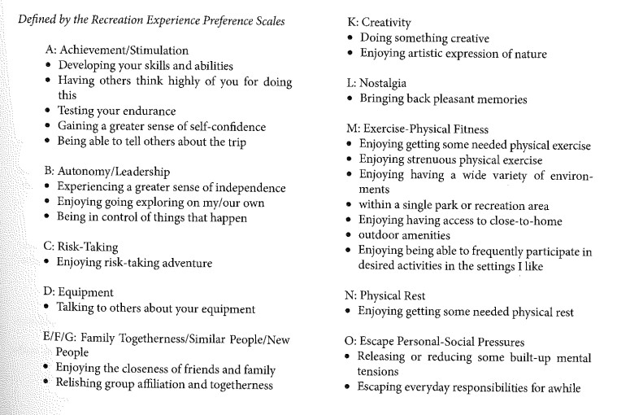
REP Item List Example
Driver, B. L., & Bruns, D. (2008). Implementing OFM on public nature-based recreation and related amenity resources. In Driver, B.L. (Ed.), Managing to optimize the beneficial outcomes of recreation (pp. 39-74). State College, PA: Venture Publishing.

Slide 10
Results - Demographics
52 %
469
52
88.5 %
Men
Total Surveys
Average Age
White

Slide 11
Quality of Life and Well-Being Domain Frequencies

Slide 12
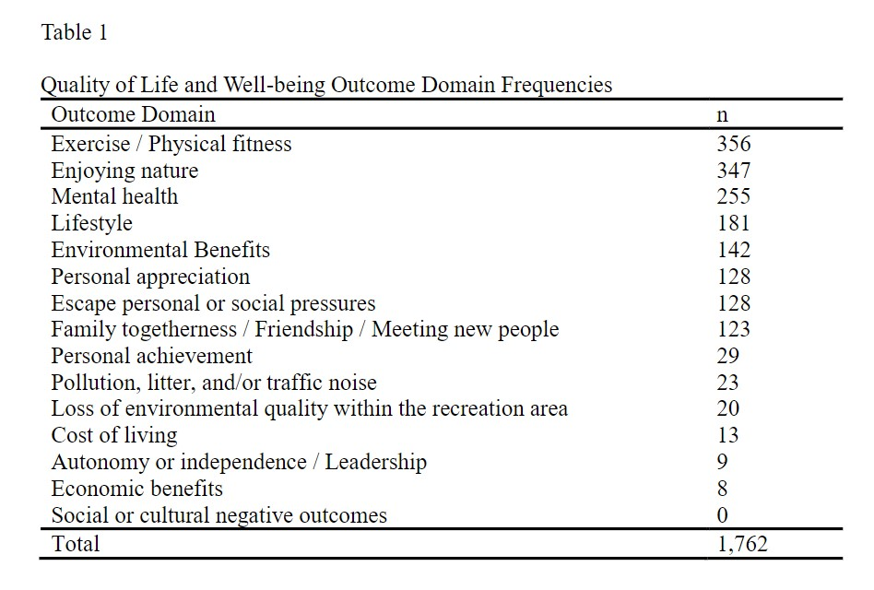
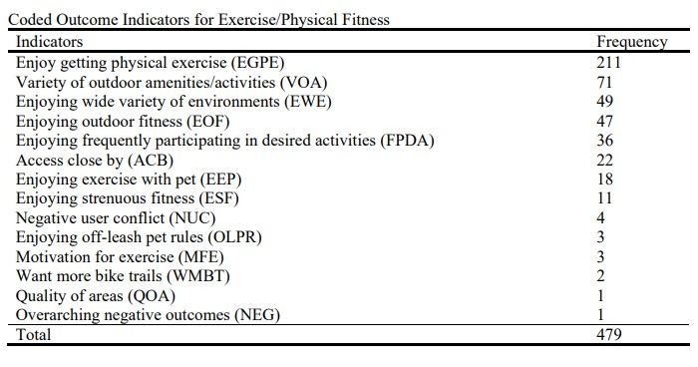
Defining Outcome Indicators
- Top Three Domains: 1) Exercise / Physical Fitness, 2) Enjoying Nature, 3) Mental Health
- Natural break between 8th and 9th indicator
- Top Three Indicators: 1) Enjoying getting physical exercise (EGPE), 2) Variety of outdoor amenities/activities (VOA), 3) Enjoying wide variety of environments (EWE).

Slide 13
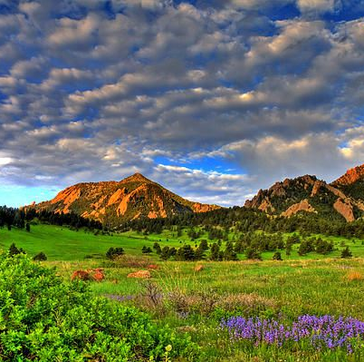
“I run, climb, hike, and bike all across the Boulder[‘s] Open Space; having such high-quality space so easily accessible is very important to me.”
Allornothingalli - Instagram
Scott Mahon
Croppigail - Instagram
OSMP User – Outcome Indicator for Exercise/Physical Fitness

Slide 14
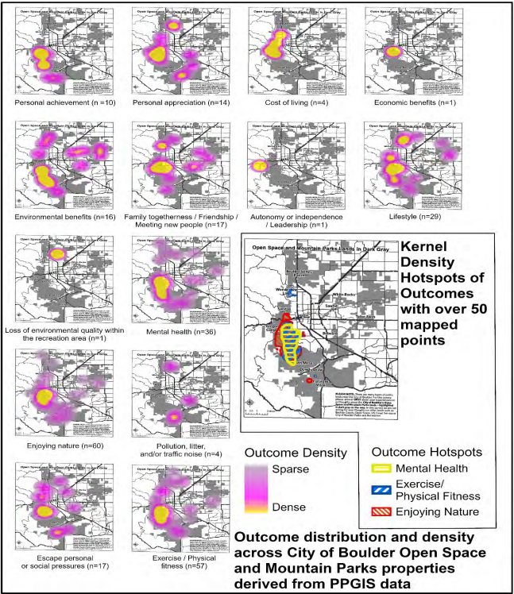
Spatial Mapping
Spatial distributions vary widely by domain.
Exercise/physical fitness, enjoying nature, and mental health outcomes received the highest density of hotspot data with more than 50 observations.
All three of those outcomes contain sweeping hotspots that encompass the Flatirons and portions of Gregory Canyon and South Mesa trails.

Slide 15
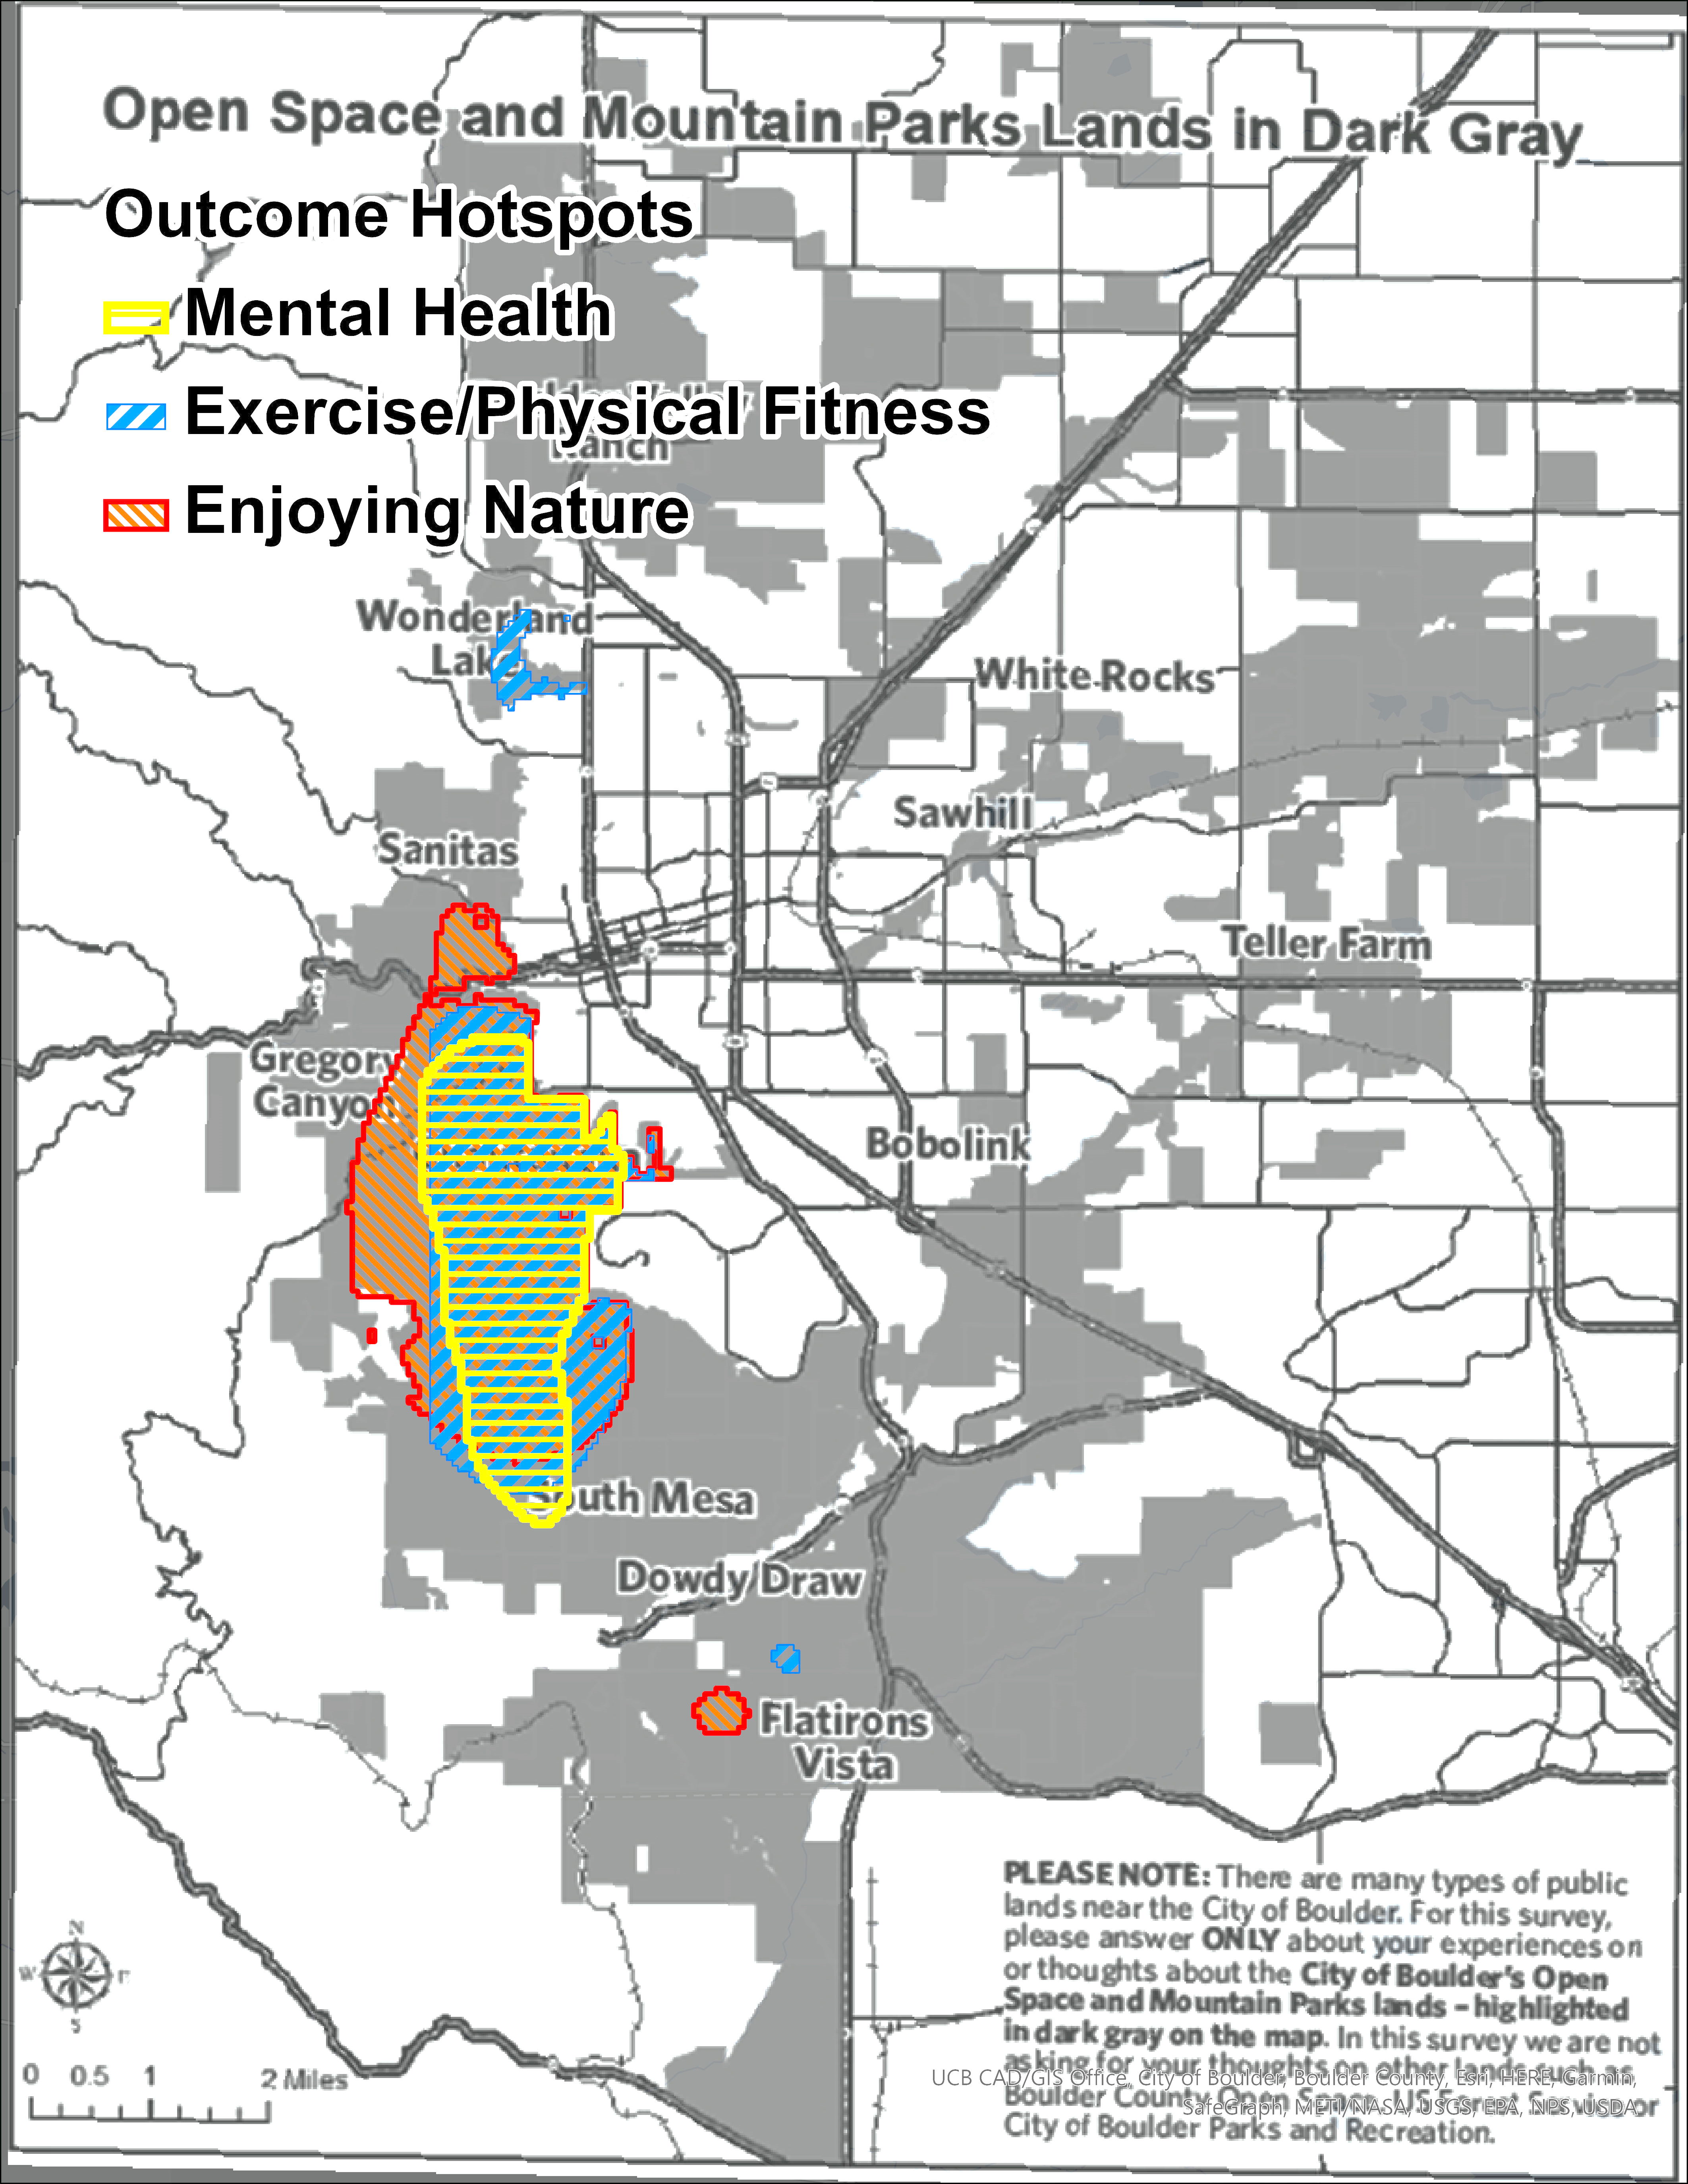
Mapping Hotspots Example
Drage, E., Rice, W. L., Miller, Z. D., Newton, J. N., D’Antonio, A., Newman, P., & Taff, B. D. (2021). Mapping spatial dimensions of Wilderness recreation outcomes: A study of overnight users. Journal on Protected Mountain Areas Research and Management, 13(1), 31–40.
Pietilä, M. (2017). Do visitor experiences differ across recreation settings? Using geographical information systems to study the setting-experience relationship. Visitor Studies, 20(2), 187–201.

Slide 16
Key Takeaways from OSMP Users
The top 8 outcome domains ranged from exercise to family togetherness
Most outcomes and outcome indicators were associated with positive aspects
Outcome spatial distribution varied widely across OSMP property
Goddes_Travels - Instagram

Slide 17
Outcomes for Open Space and Mountain Parks Management
A three-pronged approach to identify quality of life and well-being outcomes
A template for measuring outcomes that most impact users in protected areas
Current outcomes of OSMP users and a baseline for future research

Slide 18
Outcomes for Protected Area Managers
A template for OFM researchers and managers for measuring outcomes that most impact users in protected areas
A systematic approach to better understanding people and their outcomes while in protected areas helping to better manage for desired outcomes
A way to understand human connections with nature, to better manage for a sustainable future
TheBoulderHikerChick - Instagram

Slide 19
Acknowledgements
Through this work, I was able to get hands-on experience conducting social science research – even getting the opportunity to submit this work for publication in the journal of Recreation, Parks, and Tourism in Public Health.
Many thanks to:
Dr. Rice and the WARM Lab for giving me to opportunity to partake in undergraduate research.
Deonne, Heidi, Anna, and the rest of the OSMP team for being such great research partners.
Boulder OSMP signs and human dimensions field staff for support this project.

Slide 20
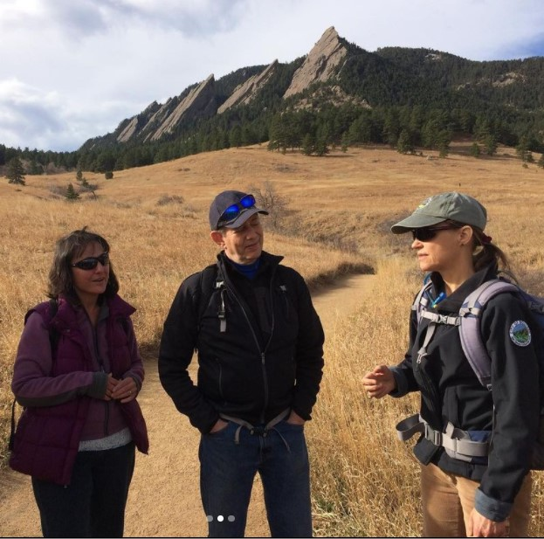
Thank you! Any Questions?
Allornothingalli - Instagram
Jen_Outside - Instagram
Lane Arthur
605.440.0020
lane.arthur@umconnect.umt.edu
https://www.linkedin.com/in/larthur/
Boulder OSMP Instagram

Slide 21
Sources Cited:
Drage, E., Rice, W. L., Miller, Z. D., Newton, J. N., D’Antonio, A., Newman, P., & Taff, B. D. (2021). Mapping spatial dimensions of Wilderness recreation outcomes: A study of overnight users. Journal on Protected Mountain Areas Research and Management, 13(1), 31–40.
Driver, B. L., & Bruns, D. (2008). Implementing OFM on public nature-based recreation and related amenity resources. In Driver, B.L. (Ed.), Managing to optimize the beneficial outcomes of recreation (pp. 39-74). State College, PA: Venture Publishing.
Manning, R. E. (2012). Frameworks for defining and managing the wilderness experience. In D. N. Cole (Ed.), Wilderness visitor experiences: Progress in research and management (pp. 158–176). U.S. Department of Agriculture, Forest Service, Rocky Mountain Research Station.
Miller, Z. D., Rice, W. L., Taff, B. D., Newman, P., Figure, G., & Coleman, J. (2018). Understanding visitor motivations at Jimmy Carter National Historic Site: A principal components approach. Heritage, 1, 328–334.

Slide 22
Sources Cont.
Open Space and Mountain Parks. (n.d.). Open Space and Mountain Parks. City of Boulder. Retrieved February 15, 2022, from https://bouldercolorado.gov/government/departments/open-space-mountain-parks/about#main-content
Pietilä, M. (2017). Do visitor experiences differ across recreation settings? Using geographical information systems to study the setting-experience relationship. Visitor Studies, 20(2), 187–201.
Rice, W. L., Taff, B. D., Newman, P. B., Miller, Z. D., D’Antonio, A. L., Baker, J. T., Monz, C., Newton, J. N., & Zipp, K. Y. (2019). Grand expectations: Understanding visitor motivations and outcome interference in Grand Teton National Park, Wyoming. Journal of Park and Recreation Administration, 37(2), 26–44.
Saldaña, J. (2016). The coding manual for qualitative researchers (3rd ed.). SAGE.

