Slide 1
City of Missoula Partnership Project: Supporting the Affordable Housing Trust Fund
Petra Slater

Slide 2
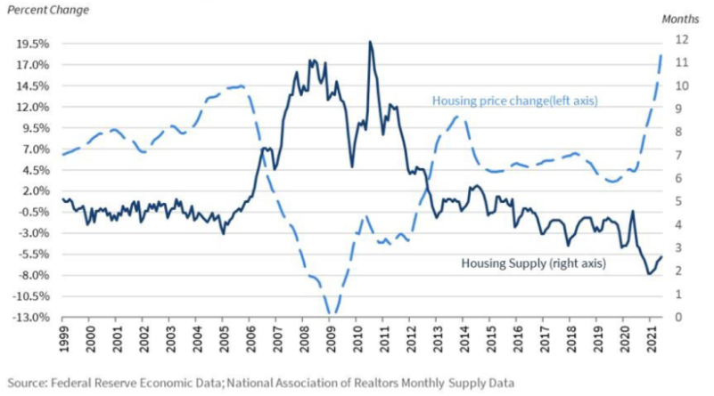
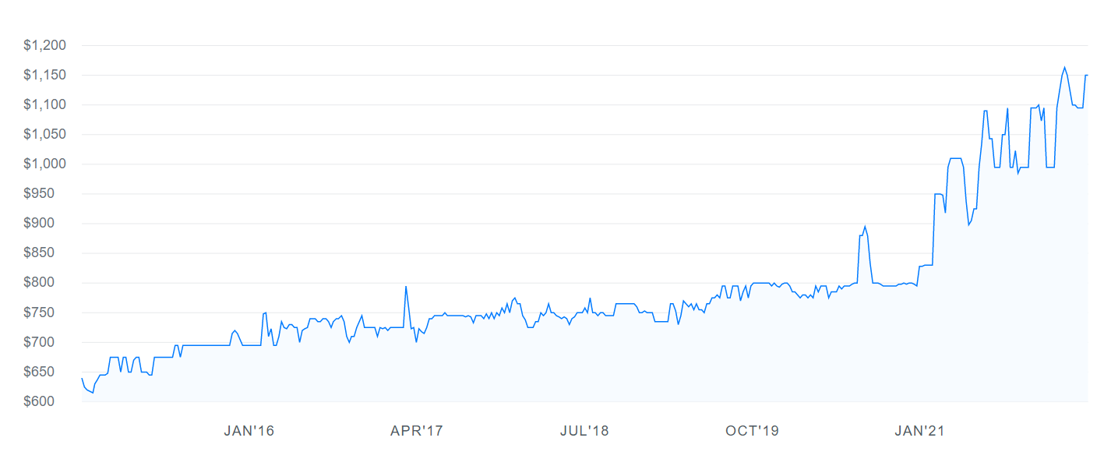
Missoula housing market trends
Average rent prices in Missoula have risen by over 14% in the past year, with a 3% increase from just one month ago.
Low housing supply continues to reduce affordability as the population continues to grow faster than homes are being built.
https://montanafreepress.org/2021/11/29/expert-says-montana-home-costs-driven-by-shortage/
https://www.zumper.com/rent-research/missoula-mt
Notes:
Name, major, graduating, DHC capstone project
Increasing housing prices mean it is more important than ever for Missoulians to be aware of the resources available to them that support access to affordable housing
The following charts prove the increasing prices Missoulians are facing when paying rent and purchasing a home over the last few year.
The first chart shows that as the population of Montana has steadily increased over the past 5 years, the housing supply as steadily decreased. This means the existing housing has become more valuable, leading to ever increasing prices.
The second chart displays rent prices, that have been steadily increasing and recently taken a huge spike in the past year since January 2021. This means displacement for many people, including lower income families and college students that cannot anticipate or afford steadily increasing monthly rent. The monthly rent in Missoula has increased 3% since just March 2022, as of April 11th.
The City of Missoula is aware of these statistics and concerned for the future of many Missoulians. This is why the Affordable Housing Trust Fund was created, and why I partnered with them to help design a webpage specifically for the fund.

Slide 3
The affordable housing trust fund
Established in July 2020
Missoula’s only local funding source for affordable homes
To enable long range planning, multi-year projects, and measured risk taking to address the city’s severe housing needs
Involves a competitive application process
Funding from federal and private sources

Slide 4
Project Goals
Expand community awareness and knowledge of the fund and increase accessibility to funds available.
Condense scattered information into one, easy to find webpage
Increase engagement through use of accessible language for multiple types of audiences
Build and encourage options for fund-raising and private donations
Notes:
Explain that previous info was scattered across the City website, people would have to call to find anything on the website (which defeats the purpose of a website), very few people knew about the fund, private donors didn’t know how to do so

Slide 5
Webpage demo
Project Process
2-month process
Worked closely with staff from the City of Missoula
Organize information
Edit, edit, edit
Now for the final product!
https://petraslater0.wixsite.com/ahtfwebpage
Notes:
Project process and methods:
Weekly meetings with 2 women from the City of Missoula staff that work in Community Planning and Development
Received lots of info to organize and reframe in an easily understandable and accessible way
Developed multiple versions of the page, final one will be passed off to Professional Consultant the City hired to redo entire website
Now will demo my work for you all to see…

Slide 6
Project significance
MIS = solving business problems with technology
Increasing need for companies to digitally upscale
Consulting: helping organizations achieve their goals by problem solving and finding the right tools for them.
Notes:
Management Information Systems is an interesting and engaging major that teaches students how to be professional in business and also proficient in current technologies that are changing the face of the working world everyday. MIS students are adaptable and resourceful, and use their skills to help others in business by solving problems with technology that is up to date and efficient.
As the world continues to modernize and technology is constantly changing, there is an increasing need for companies to digitally upscale and have a coherent digital presence in order to reach their audiences. This has created a high demand for people that understand business problems and how technology can work to solve them.
This summer, I will be starting my career in IT Consulting where I will be working on many projects that help outside companies reform their digital strategies to better support and grow their businesses. Therefore, this project was a great way to get actual hands on “research” in my field of work and provide value to a real client in the community

Slide 7
Project Implications
Helps the City of Missoula achieve their organizational goals
Allows more developers to apply for and receive funding for increased affordable housing options
Gives Missoulians increased access to the affordable homes they deserve!
Notes:
Doing this project not only benefitted me, however. As I mentioned, the page I designed will be launched on the City of Missoula’s website and incorporated in their larger website redesign in the next couple of years. It will be the landing spot for people in the community to find information on a great asset the City has created that will benefit many Missoulians and increase their quality of life. I am very happy with the results of this project and thrilled that I am able to give back to the community that I have come to love very much over the last four years at UM with my senior capstone project.

