Slide 1
Mindful Youth: Empowering Adolescents to Own their Mental Health through an Interactive Online Platform
Rachel Gebhardt, Jesse Jewel, Diana Urry, Jewel Wicks, Kate Hess, and Serena Gardner
Notes:
Kate

Slide 2
What We Will Cover Today
Why did we choose this project?
Our Creative Process
The future of Mindful Youth
Notes:
Kate

Slide 3
WHY?
1
How did we choose this project and why is it important?
Notes:
Serena

Slide 4
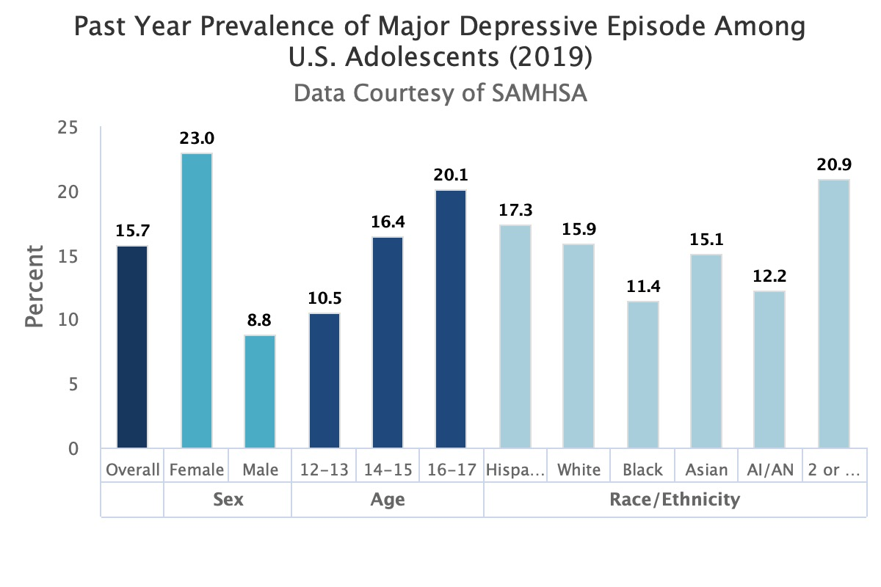
Fall 2021
Recap:
-depression and anxiety very prominent in adolescence
-multiple barriers for individuals to seek help
What we want to do about it
Create a website to power adolescence to take ownership of their mental health
-various video scenarios for common issues adolescence face
-coping mechanisms for those troubles
-additional resources
Notes:
Serena

Slide 5
2,000,000
1,400,000
Suicide is the 3rd leading cause of death
adolescents experiencing anxiety
experiencing depression
adolescents ages 15-25
Notes:
Serena

Slide 6
Importance
-self help tools for those who may not be able to seek professional help
-give adolescents the confidence to take control over their emotions and their mental state
Notes:
Serena

Slide 7
Our Plan
We decided to create a website designed to engage adolescents in ways that help them recognize and own their mental health challenges and explore tangible self-help resources
Notes:
Diana

Slide 8
What did we do about it?
2
The design process and our website
Notes:
Diana

Slide 9
Design Choices: Superhero Theme
-everyone needs someone to look up too
want adolescence to be their own superhero
-calming yet inviting color pallet
-not overload readers with too much reading material
Incorporate lots of videos/pictures/animation

Slide 13
Research Team and
Creative Team
What each group accomplished
Research Team: IRB approval and setting up focus group at Willard High School
Creative Team: creating website layout, designing and accessibility components
Shared Responsibilities: content to publish on website and scenarios for videos
Notes:
Jesse

Slide 14
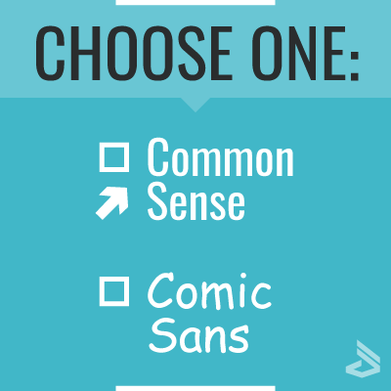
Comic sans meme
Feedback From Willard
1. Technical Issues
- buttons on screen unreadable
2. Design Suggestions
-no comic sans font
-homepage image too large
3. Content Recommendations
-using “mindfulness” instead of meditation
-include more on substance abuse and social media usage
-links to more books or articles for additional resources
Notes:
Jesse

Slide 15
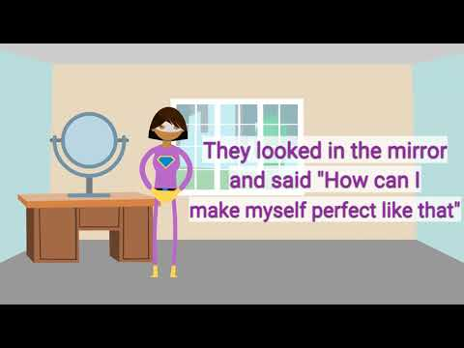
Social Media Video Example
Notes:
Jesse

Slide 16
Addressing Global Context through the lense of Accessibility
General Content:
-symptoms for depression & anxiety
-toolboxes
-situational videos
-resource page
Accessibility:
-alternative text with 21pt font size
-color analyzer
-website can be translated into spanish

Slide 17
What is next?
3
The future of Mindful Youth
Notes:
Rachel

Slide 18
What We Would Continue to Work On…
Journal Prompts
Profile / Account Options
Accessibility Functions such as:
ADHD specific pages
Translated into multiple languages
Testimonials

Slide 19
Where we Hope to Go Next
Future Partnerships
Willard Alternative High School & other local schools
Western Montana Mental Health Center
Changing the domain name: MindfulYouth.com
Notes:
Rachel

Slide 20
In Conclusion…
Research
Feedback from Focus Groups during the Creative Process
The Future of Mindful Youth
Notes:
Rachel / Kate?

Slide 21
Thank You!
Are there any questions?
Notes:
Rachel / Kate?

Slide 22
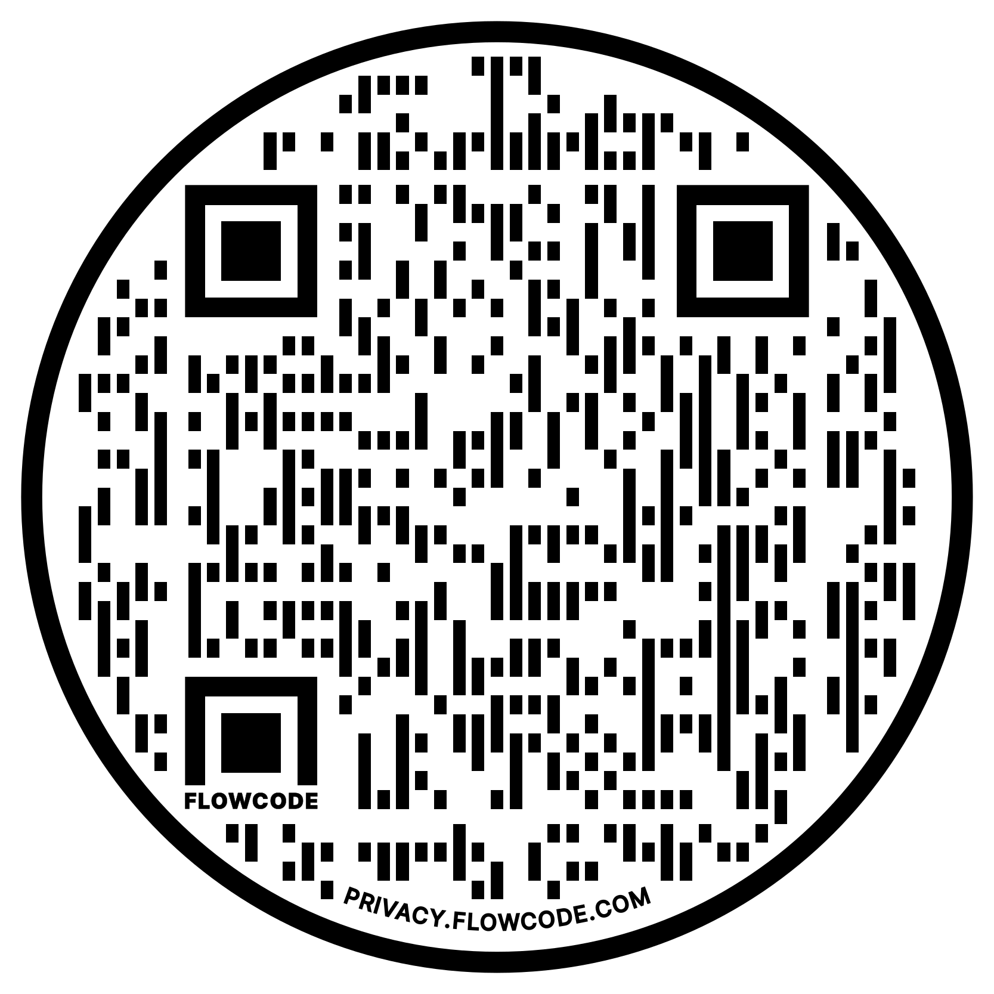
EXPERIENCE MINDFUL YOUTH FOR YOURSELF!
Notes:
Rachel / Kate?

