Slide 1
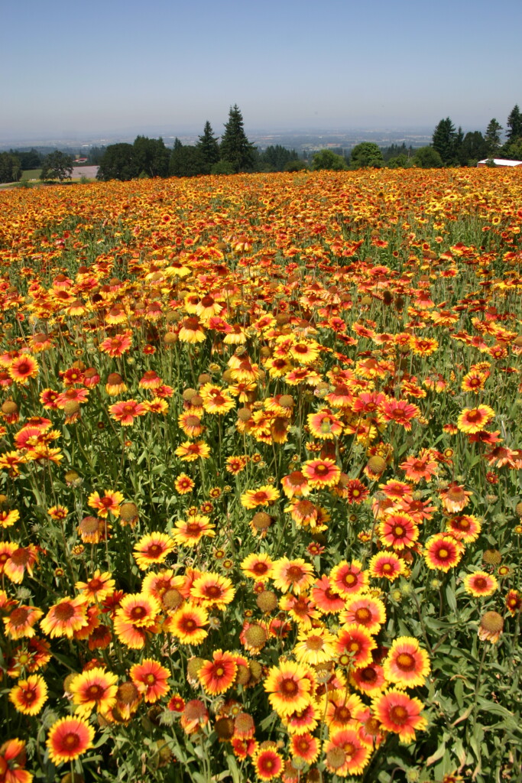
Do soil characteristics mitigate the effects of herbicide on plant germination?
Lauren Spaeth
B.S. Ecosystem Science and Restoration

Slide 2
How do herbicides affect plants?
Herbicide toxins disrupt or inhibit plant systems
They can impede plant germination at the seed stage
Herbicides also persist in soils for long periods of time after application
Notes:
Wordy
Size of words do not fit boxes; icons do not match
Separate slide for each point

Slide 3
Background on herbicides and native plant germination
Herbicides suppress seedling emergence and biomass for non-target native plants (Wagner & Nelson 2014)
Greenhouse studies show the maximum effects of herbicide on germination compared to the field (McManamen et al. 2018)
Dampened effects of herbicide observed in the field may be due to interactions between field conditions and herbicide (McManamen et al. 2018)
Notes:
Wordy
Size of words do not fit boxes; icons do not match
Separate slide for each point

Slide 4
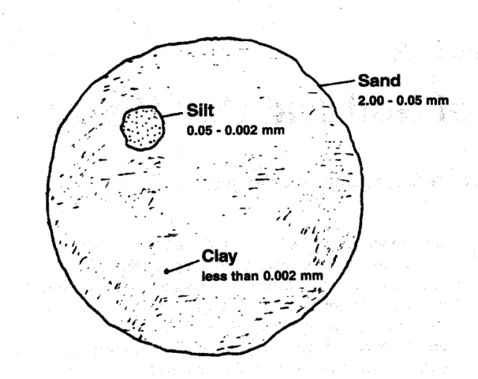
Soil Texture
Soil texture plays an important role in mediating soil-plant interactions
Soil water holding potential increases as particle size decreases
Finer soils adsorb herbicides for longer periods of time due to increased surface area
Notes:
Grasslands: Mollisols- high clay content
Forests: Inceptisols- clay-loam

Slide 5
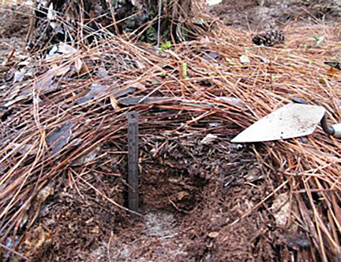
Duff Depth
Duff is the partially decomposed organic material that lies on top of the soil in forests and grasslands
Organic matter forms aggregates in the soil that hold water and other molecules
In addition to water, organic matter aggregates may also hold onto dissolved herbicide residues
Notes:
Grasslands have more organic matter compared to forests because there is more veg
A large portion of herbicide present in the soil is bound to soil colloids (clay, organic matter), and this herbicide is less readily available to plants than the herbicide present in the soil solution.

Slide 6
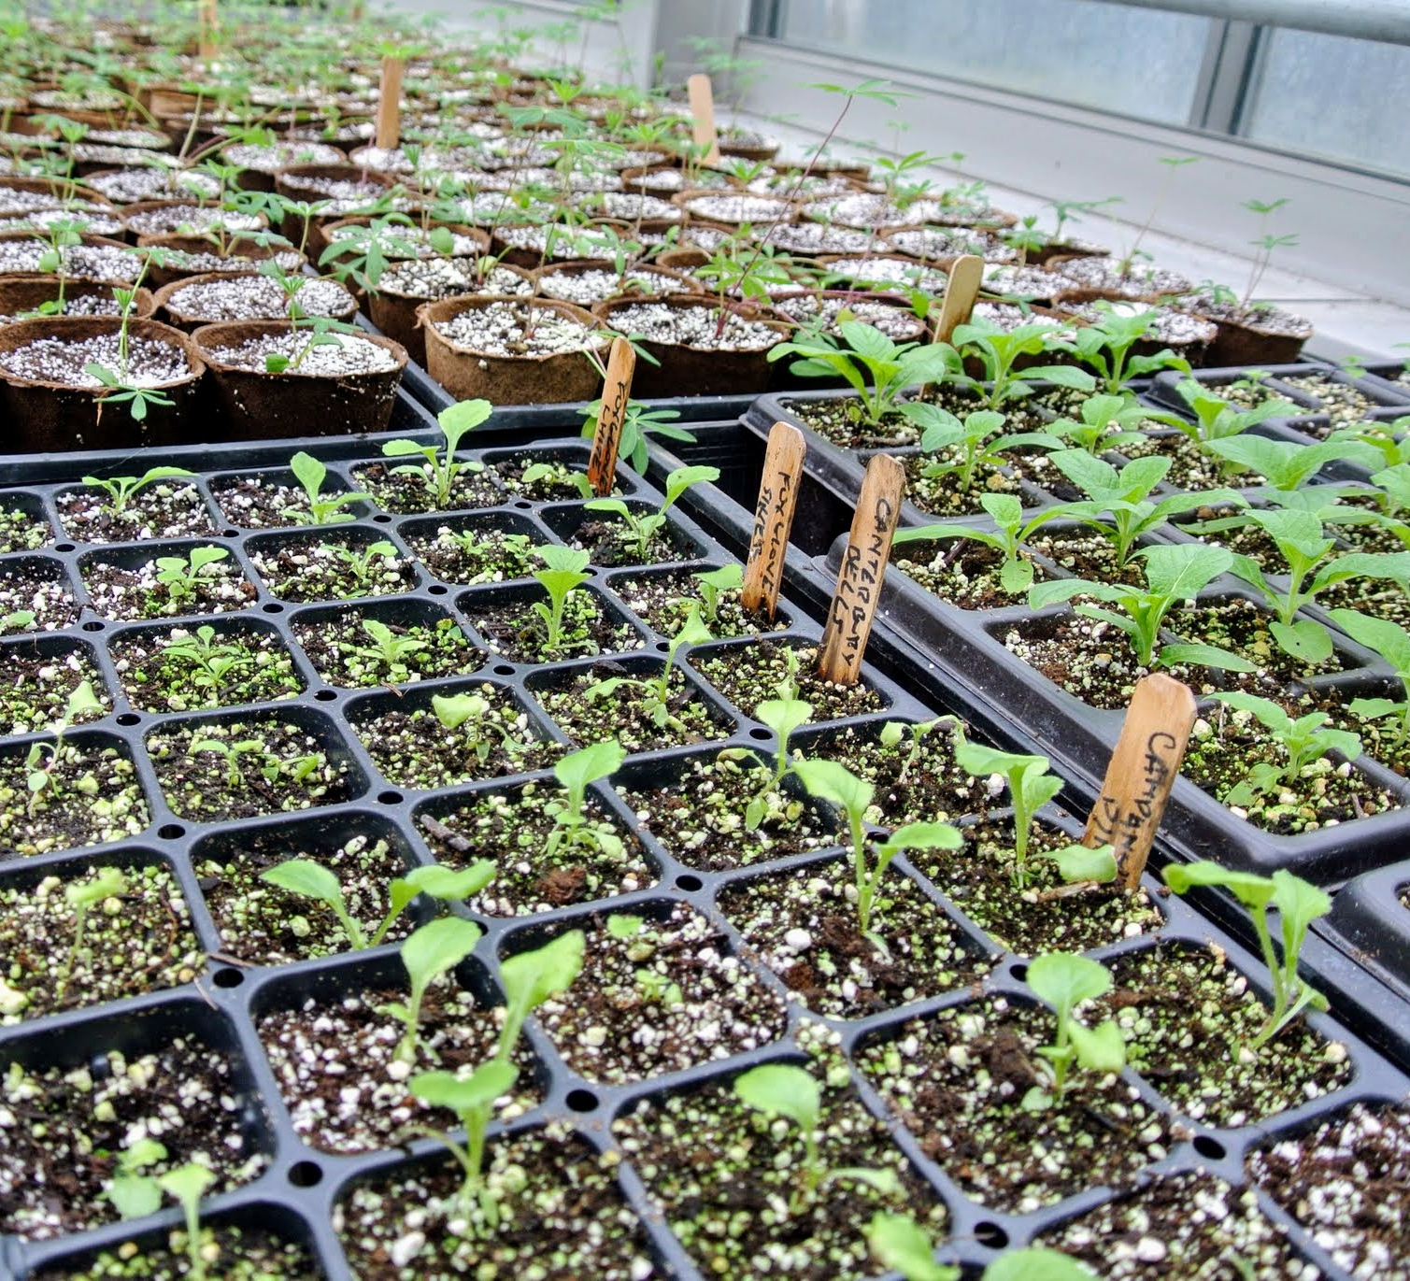
Closing the Gap
Numerous studies have looked into the effect of herbicides on non-target native plants
Because the effects of herbicide on germination differ between the greenhouse and the field, it is important to know why
This study investigates the interactions between soil texture + duff depth and herbicide and how that impacts native plants
Notes:
Emphasize results of studies

Slide 7
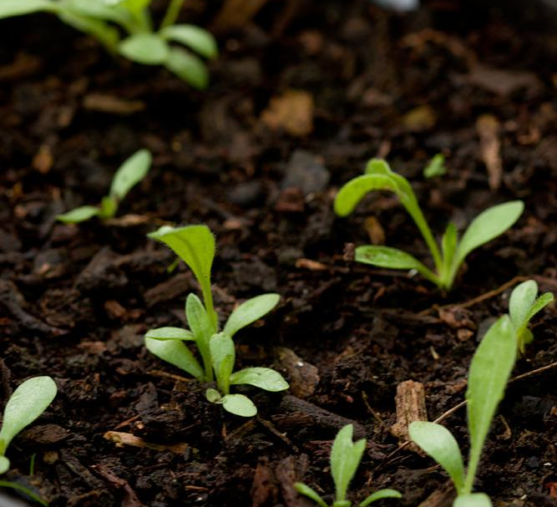
RESEARCH QUESTIONS
(1) To what extent does soil texture affect percent germination of a native plant in soils that have been sprayed with herbicide?
(2) To what extent does duff depth affect percent germination of a native plant in soils that have been sprayed with herbicide?
Notes:
Elaborate on herbicide and species
Info on blanketflower like soil slides
Put pic on title slide and more pics of soil
Make questions bigger and two slides
Next slide blanket flower

Slide 8
Methods: Study species & Herbicide
Study herbicide: Milestone (aminopyralid)
Commonly used in restoration
Targets broadleaf weeds and can control seed germination
Shown to persist in soils for long periods after application
Study species: Gaillardia aristata (blanketflower)
Common native forb in grasslands and forests in Montana

Slide 9
Methods: study design
DUFF DEPTH
SANDY SOIL 0 cm DUFF | SANDY SOIL 2 cm DUFF | SANDY SOIL 5 cm DUFF
SILT SOIL 0 cm DUFF | SILT SOIL 2 cm DUFF | SILT SOIL 5 cm DUFF
CLAY SOIL 0 cm DUFF | CLAY SOIL 2 cm DUFF | CLAY SOIL 5 cm DUFF
SOIL TEXTURE
Notes:
Levels

Slide 10
Methods: Study design
6 Replications
Water (control)
Aminopyralid

Slide 11
TIMELINE
Project Planning
(March - Aug.)
Growing Plants + Collecting Data
(Sept. - Oct.)
Managing Data
(Nov. - Dec.)
Sharing Findings
(Jan. - May)

Slide 12
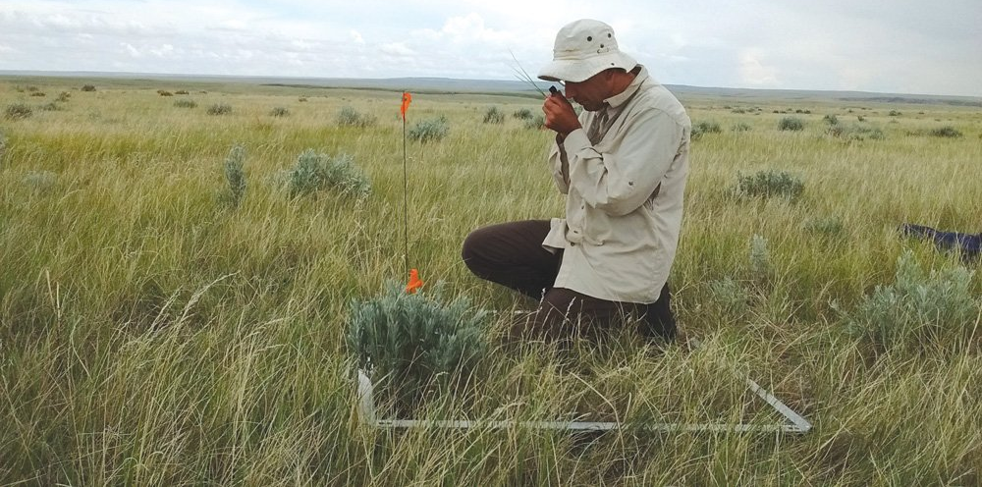
Notes:
We can use this study to inform restoration practitioners on how common herbicide use may impact non-target native plants in invasive species management based on soil characteristics.

Slide 13
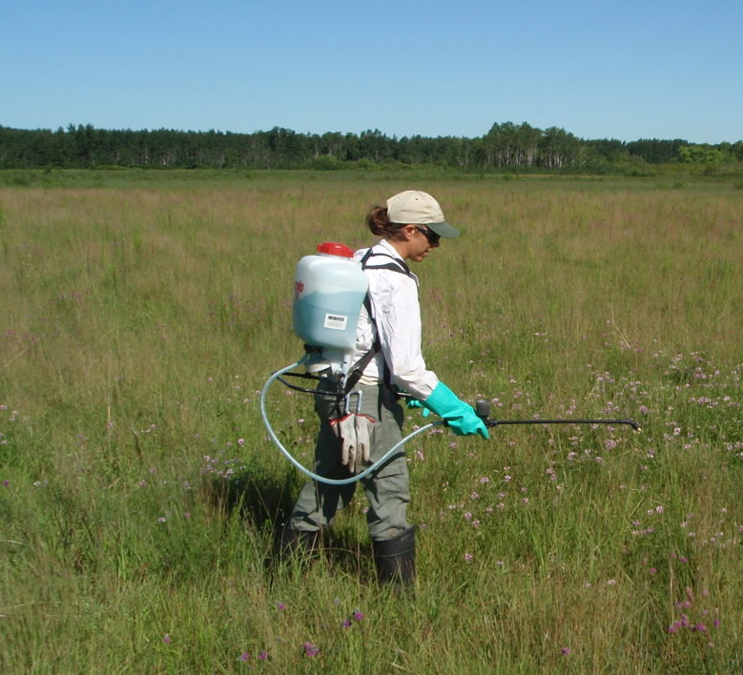
Thank you!
I would like to thank and acknowledge my faculty mentor Cara Nelson for her support and for making this project possible.
I would also like to thank the FCFC for funding this project through the Irene Evers’ Competitive Undergrad Research Scholarship.
Contact Information
Email: lauren.spaeth@umconnect.umt.edu

