Slide 1
Microseismic Mapping of Aftershock Sequences Following the Lincoln, MT M 5.8 2017 Earthquake
University of Montana Conference for Undergraduate Research
Reyer Fenoff & Hilary Martens
04.22.22

Slide 2
via The Seattle Times
Notes:
How many of you have felt an earthquake before?
(If any) Who has felt an earthquake in Montana?
Pretty scary, right? They kinda happen so fast that you don’t even realize what’s going on until it’s over. But for those of you who didn’t raise a hand – stay here in Montana long enough, and there’s a decent chance you’ll feel one. They’re super common out here! In fact, there has been some pretty major earthquakes here, like the M 5.8 earthquake that happened on July 6, 2017 about 11 km southeast of Lincoln, MT.

Slide 3
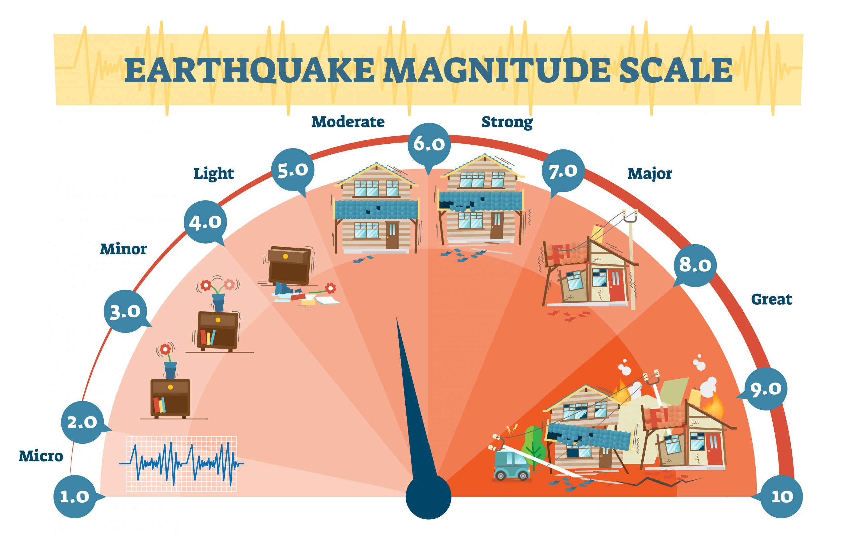
Notes:
Now, an earthquake being M 5.8 might seem a bit abstract. Earthquake magnitudes are often determined by the damage they do at the surface, but Montana has a lot of places where there just isn’t much stuff to be damaged.
So, magnitudes can also be calculated based on the amplitude of the signal from an event on a seismograph, which is that classic EKG looking graph like the one in the bottom left.

Slide 4
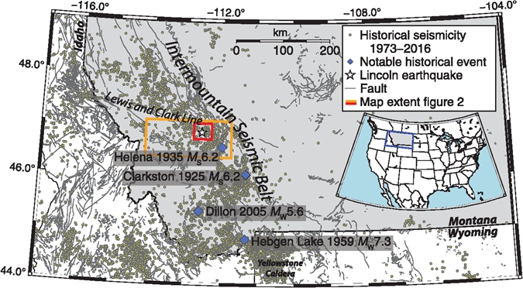
McMahon et al. (2019)
Notes:
There’s been 11 larger events recorded in Montana since the late 19th century as well as thousands of recorded earthquakes that couldn’t be felt at the surface. All the yellow dots here represent earthquakes that have been recorded between 1973 and 2016, and there have been thousands more since then.
Many of these earthquakes are produced by the breaking and slipping of rock along fault planes. Mountains are built by large scale pushing and pulling of rock along these faults, and the location of the Lincoln earthquake happens to be right in the junction of two major regions of pushing and pulling.
The Lewis and Clark Line and the Intermountain seismic belt intersect right around Lincoln, MT. Both of these features seen on the map are massive, regional scale networks of faults on which rocks can slip and slide past one another to cause earthquakes. These earthquakes are a big deal – the Lincoln earthquake was felt as far as 800 km from where it occurred!

Slide 5
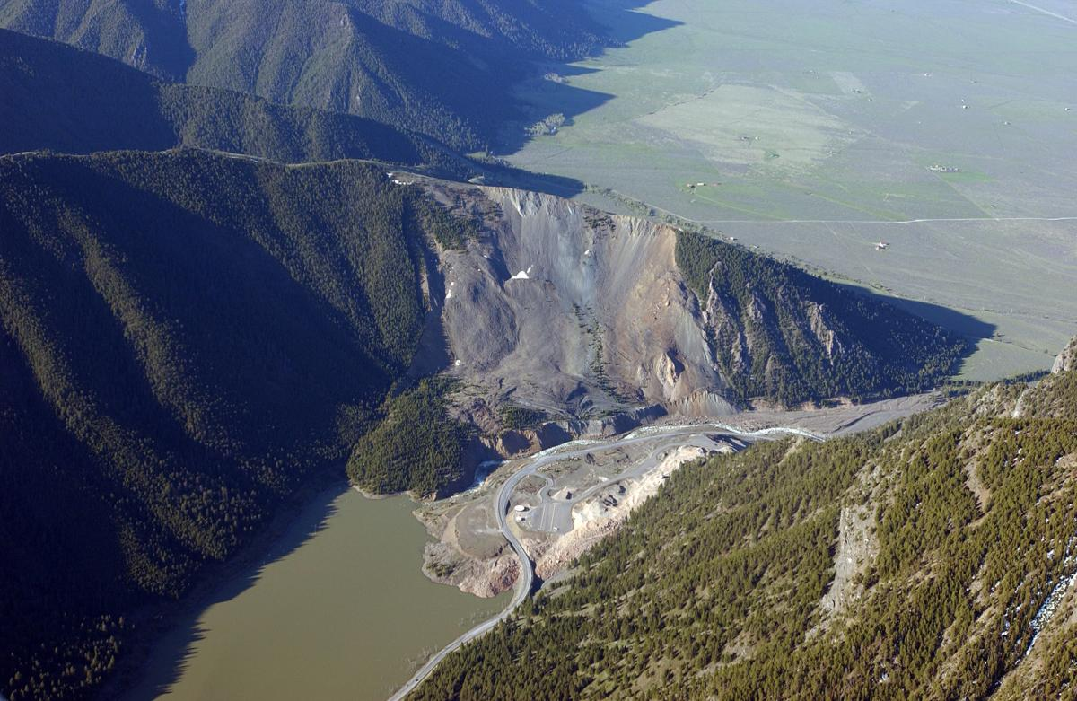
via The Billings Gazette
Notes:
Earthquakes in Montana can be serious, hence why we need to study them and better understand where and why they occur – maybe one day we’ll even be able to predict when they occur. The largest in Montana was the Hebgen Lake Earthquake in 1959.
It was a magnitude 7.3 earthquake that caused up to 6 m of displacement on the surface, 28 deaths, and a massive landslide that created a lake in the Madison River Canyon. This event even caused millions of dollars in damage despite occurring in such a rural area… so imagine the damage it would cause in a place like Missoula.

Slide 6
How can we create a better, more comprehensive record of earthquakes in west-central Montana?
Notes:
The big earthquakes are obvious because they can be felt for hundreds of miles and are recorded by seismometers (instruments that detect earthquakes) at even greater distances.
Yet, very small earthquakes are rarely felt at the surface, so we have to rely on seismometers to know they ever even happened.
The data from these seismometers has to be analyzed to find these small earthquakes, and some can be missed depending on how the data is analyzed. It can be done by manually looking through seismograph data from various stations, or it can be automated – these tactics are often used together. But how many earthquakes have these analyses missed?
My research is to create a catalog that records as many earthquakes as possible after the event in Lincoln in July of 2017. Larger earthquakes are followed by smaller ones, called aftershocks, in surrounding areas. Events like the one in Lincoln can provide huge numbers of aftershocks and in turn an unprecedented amount of data for finding where future earthquakes are most likely to occur and how the Earth’s crust accommodates for stress through the release of seismic energy.

Slide 7
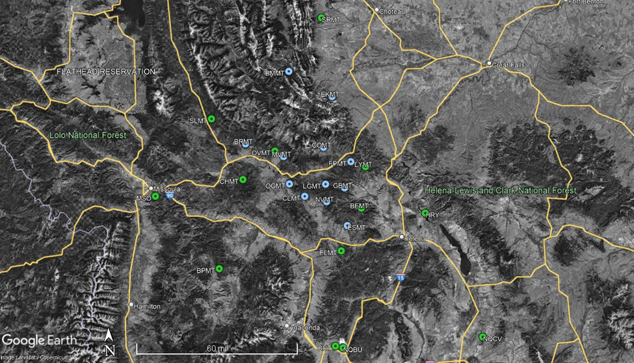
Lincoln
Notes:
The data we used to create the catalog was continuously collected from 27 stations in west-central MT. The 12 stations in blue are a part of the University of Montana Seismic Network
The UMSN was deployed in 2017 shortly after the Lincoln earthquake concentrated around its epicenter. Some stations have been active at different times, and at its highest point, 11 stations were active at once. The current USGS catalog does not include data from the UMSN.
The 15 stations in green are run by the Montana Bureau of Mines and Geology, which in total includes 45 stations across western Montana.

Slide 8
QuakeMigrate:
The look-up table
Detect
Trigger
Locate
Notes:
The software I’m using to develop this earthquake catalog, called QuakeMigrate, can be broken down into 4 main steps: generating the look-up table, detecting earthquakes, triggering the differentiation between real earthquakes and merely noise in the data, and then locating the earthquakes. Each one of these steps is completed by a customized python program.
I also developed Python programs for downloading the necessary data and cataloging earthquake locations, times, and magnitudes in a text file.
QuakeMigrate was developed by a group of geophysicists from Cambridge University and employs a new way to detect and locate earthquakes that uses some of the most useful features from two previous techniques together to mitigate errors.

Slide 9
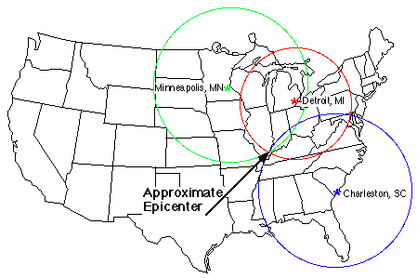
1. The Look-up table
Drew et al. (2013)
Ortiz & Bravo (2022)
Notes:
The QuakeMigrate program that creates the look-up table uses a model of the speeds of seismic waves through the rock in the subsurface specific to the geology of the area around Lincoln to create a 3-dimensional grid.
Each point in the grid is a “node,” represented by the blue dots in the figure. The time for a seismic wave to travel from a node to a given station is determined and stored in the look-up table. Data from seismometers at each station can then be used to help locate earthquakes through the times that seismic waves from the same earthquake take to reach different stations.

Slide 10
2. Detect
time (s)
STA
LTA
40 80 120
Trnkoczy (1970)
Notes:
The detection stage of QuakeMigrate identifies spikes in the earthquake signal (seismograph) data based on short-term and long-term averages of the amplitude of the seismograph. The short- and long-term averages have a length of time or window specified in the code that moves across the continuous data.
The ratio of the short term to the long-term average is computed and represents the “signal to noise ratio,” which is the main criterion for finding potential earthquakes in the data. Spikes in the signal-to-noise ratio indicate possible events that are more than just noise – however, as you can see, spikes that are not from earthquakes may be detected as well.

Slide 11
3. Trigger
Notes:
This is where the trigger stage comes in. The trigger stage uses a user-specified threshold value to weed out artefact events or events that aren’t actual earthquakes, before the events are finally located.
Here is a figure I’ve produced through QuakeMigrate that summarizes what the trigger stage does for potential events on Sept. 15th, 2018.
The possible events are mapped on the left relative to the stations from which data is used. The trigger threshold used to weed out events can be seen in the middle plot on the right – any events with a maximum coalescence greater than the value of the threshold (green line) is considered a real event. The coalescence values are based on the signal to noise ratio found in the detection process.
This raises another interesting question I hope to answer with further research – are the events just under the trigger threshold real and should they be included or not? This is where the manual part of the analysis comes in - I’ll need to look at data for those events individually to see.

Slide 12
4. Locate
Notes:
The locate stage finally uses all the data we’ve collected and all the math that’s been done to find the exact arrival times, locations, and magnitudes of earthquakes, along with a list of statistical analyses and uncertainty values and maps earthquakes in 3 dimensions.
This program also outputs the list of all the information we want to know about each earthquake that will be used to populate the final catalog, which is in the process of being made right now.

Slide 13
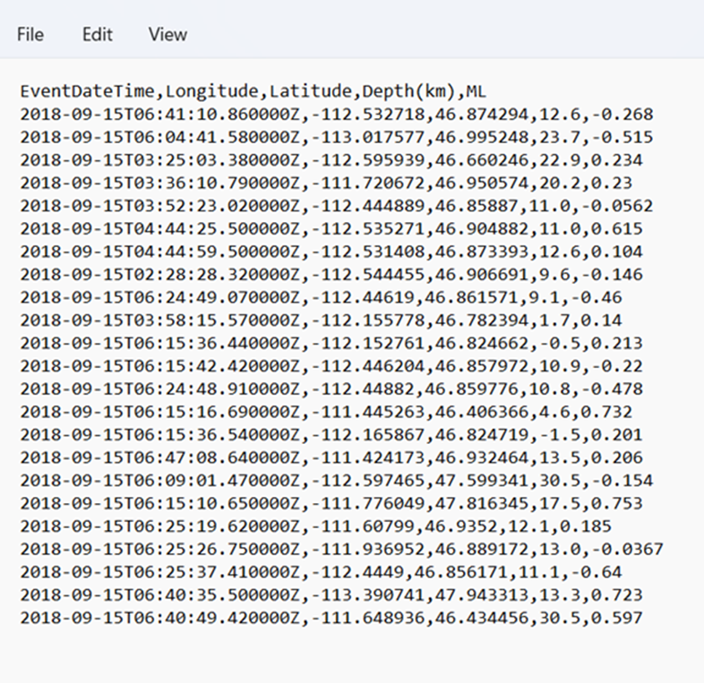
Accessible data for future research!

Slide 14
Learning more about fault structures in Montana!
Smith, Martens, & Stickney (2021)
Notes:
There are research questions all around Montana that could be researched by utilizing this catalog.
Potential projects could include comparison between past earthquake catalogs to see how many events were incorrectly located or missed altogether, the characteristics of those events and why they were missed or incorrect, and how the newly located earthquakes help us further locate and understand faults and earthquakes in Montana and around the world.

Slide 15
References
Drew, J., White, R. S., Tilmann, F., & Tarasewicz, J. (December 2013). Coalescence microseismic mapping. Geophysical Journal International; 195 (3), 1773–1785, https://doi.org/10.1093/gji/ggt331
Earthquake magnitude levels vector illustration diagram, richter scale seismic activity diagram. (2021, April 22). High Touch High Tech. Retrieved April 12, 2022, from https://sciencemadefun.net/blog/the-magnitude/earthquake-magnitude-levels-vector-illustration- diagram-richter-scale-seismic-activity-diagram/
McMahon, N. D., Yeck, W. L., Stickney, M. C., Aster, R. C., Martens, H. R., & Benz, H. M. (2019). Spatiotemporal analysis of the Foreshock– mainshock–aftershock sequence of the 6 July 2017 MW 5.8 Lincoln, Montana, earthquake. Seismological Research Letters; 90 (1), 131–139. https://doi.org/10.1785/0220180180
Ortiz, A., & Bravo, T. (April 2022). Locating an earthquake with seismic data. EarthScope ANGLE. Retrieved April 19, 2022, from https://serc.carleton.edu/ANGLE/educational_materials/activities/205497.html
Smith, E. M., Martens, H. R., & Stickney, M. C. (2021). Microseismic Evidence for Bookshelf Faulting in Western Montana. Seismological Ressearch Letters; 92, 802-809, doi: 10.1785/0220200321
Stickney, M. C. (n. d.). Earthquakes and seismographic monitoring in Montana. MBMG Special Publiucation 122: Geology of Montana; 2, 1- 50, Retrieved April 18, 2022. https://mbmg.mtech.edu/pdf/geologyvolume/StickneyEarthquakesFinal.pdf
Trnkoczy, A. (January 1970). Understanding and parameter setting of STA/LTA Trigger algorithm. GFZpublic. Retrieved April 10, 2022, from https://gfzpublic.gfz-potsdam.de/pubman/faces/ViewItemOverviewPage.jsp?itemId=item_43337

Slide 16
Questions?

