Slide 1
Minimal Change in Benthic Macroinvertebrates Following Dam Removal and Restoration Rattlesnake Creek, MT
Samuel Turner
Ecosystem Science & Restoration Program
W.A. Franke College of Forestry and Conservation

Slide 3
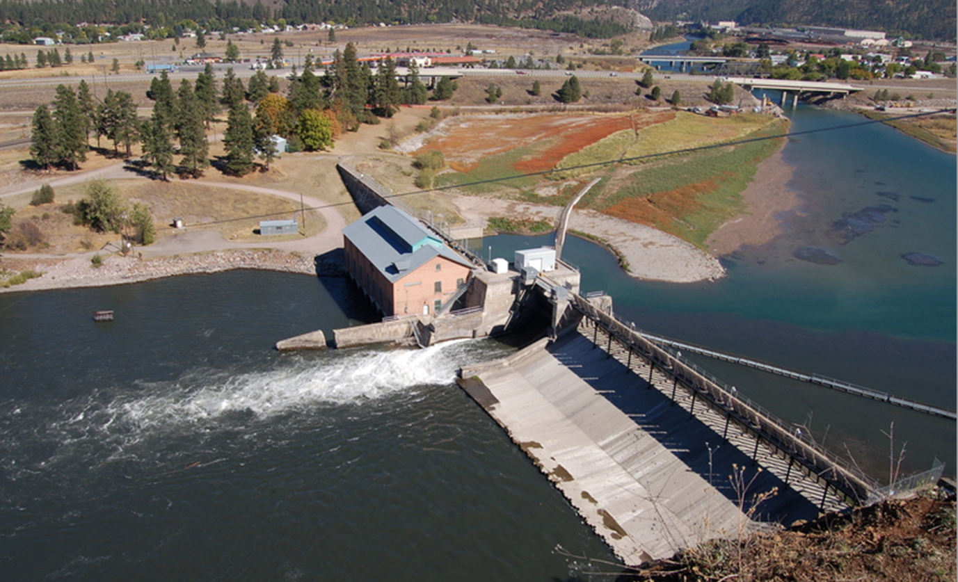
Water
Fish
Passage
Sediment
Upstream
Downstream

Slide 4
Dams built – 81,000
Dams removed - 1,800
Dams evaluated - 10%
Foley et al. 2017

Slide 5
*Bottom of stream
*Benthic *Macro *invertebrates
*visible with naked eye
*lacks backbone
long-lived and sedentary
Diverse and abundant
Vary in sensitivity to different stressors

Slide 6
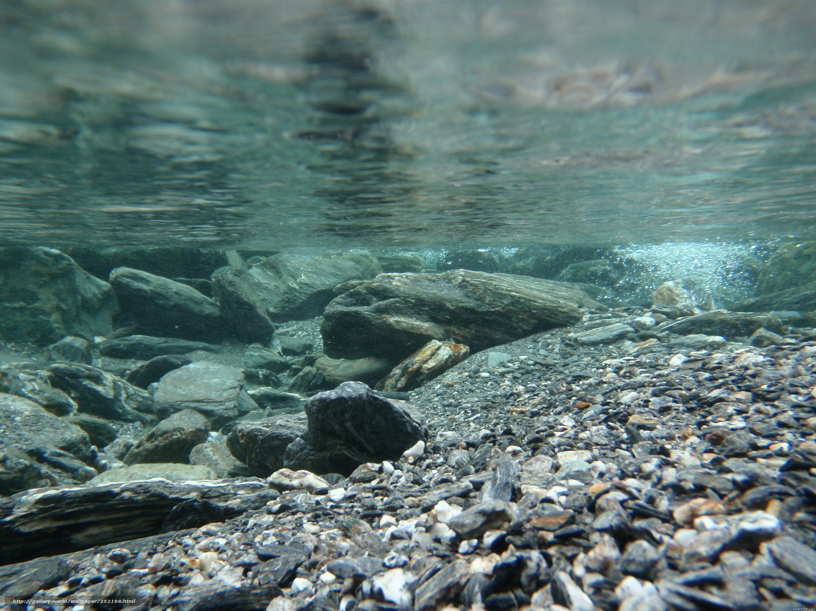
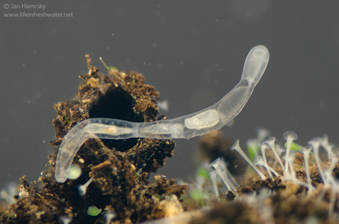
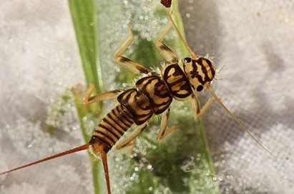
Biomonitoring
Composition → Species present
Richness → Diversity
Tolerance → Environmental conditions
Feeding → Basal resources

Slide 7
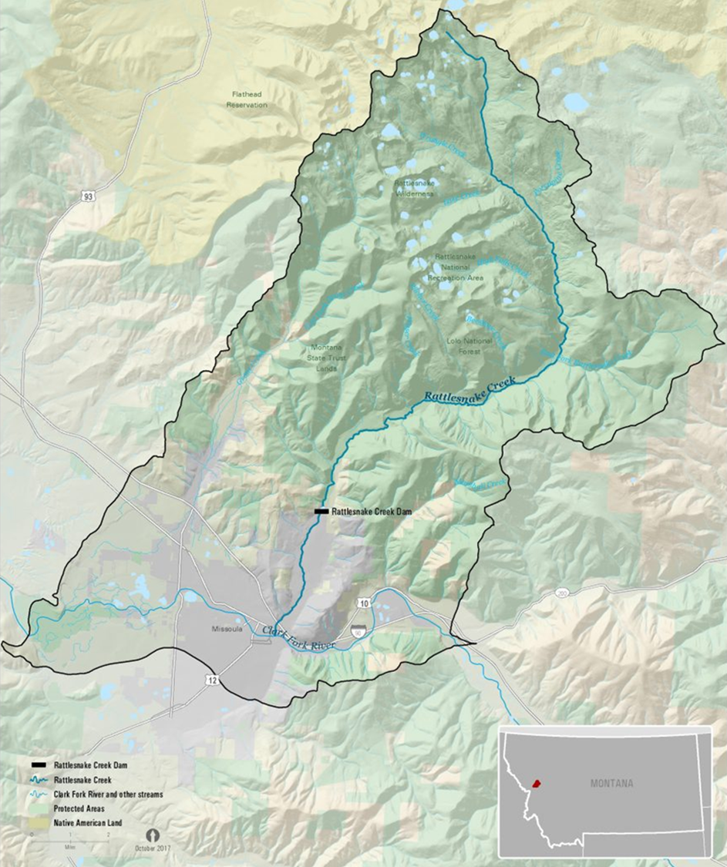
Rattlesnake Creek
100 + years
Removed 2020
Tributary to Clark Fork River
82 mi²
Wilderness → urban area

Slide 8
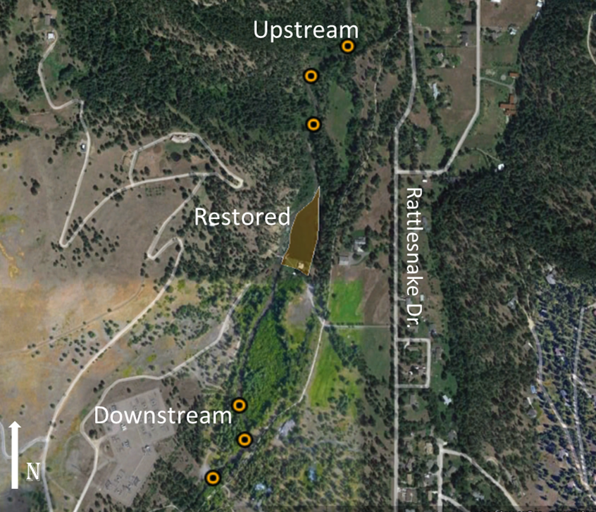
Questions
Difference before and after removal?
Upstream – Downstream 2019-2021
Difference in restored site after removal
Upstream - Restored - Downstream 2019-2021

Slide 9
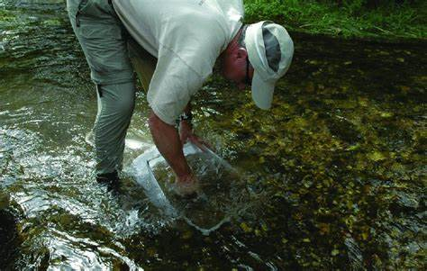
Collection
Surber sampling
Identification
Analysis
Community Metrics
Diversity
Tolerance
Feeding
Habit
1 m²
Rhithron Associates, Inc.

Slide 10
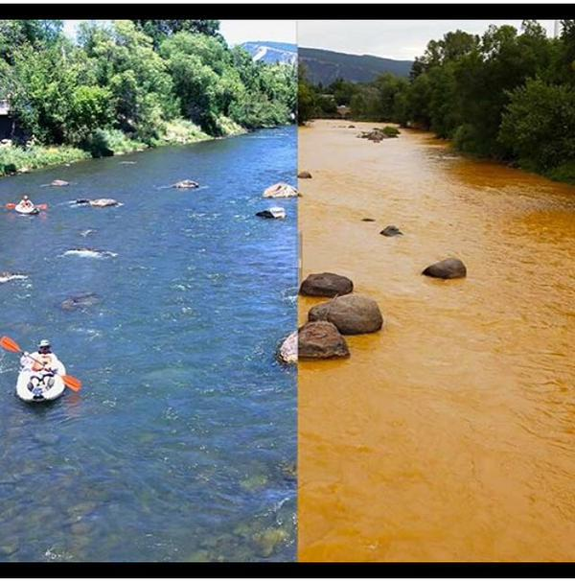
Upstream – Downstream 2019-2021
Richness
Total diversity
EPT diversity
Sediment Tolerant
Expected Response
↓
↓
↑

Slide 11
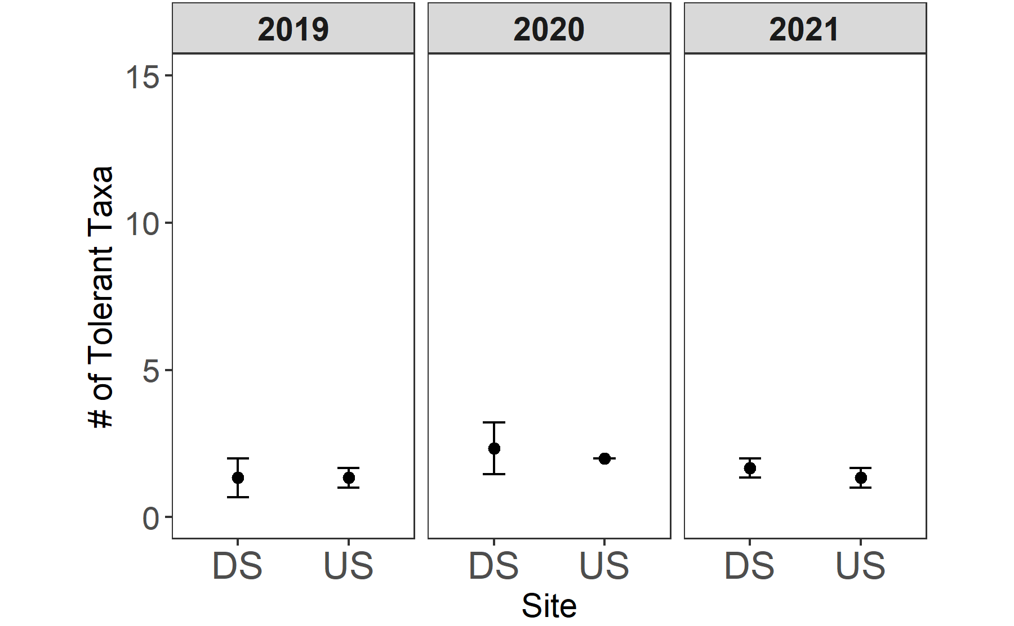
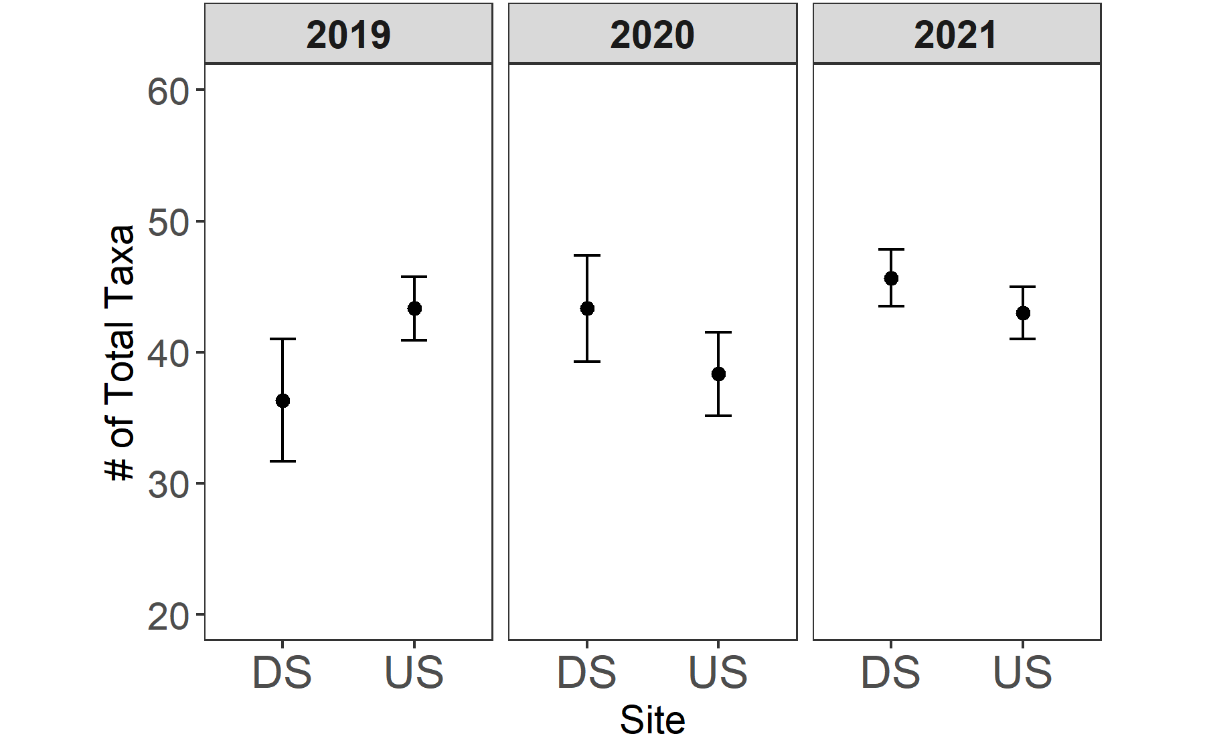
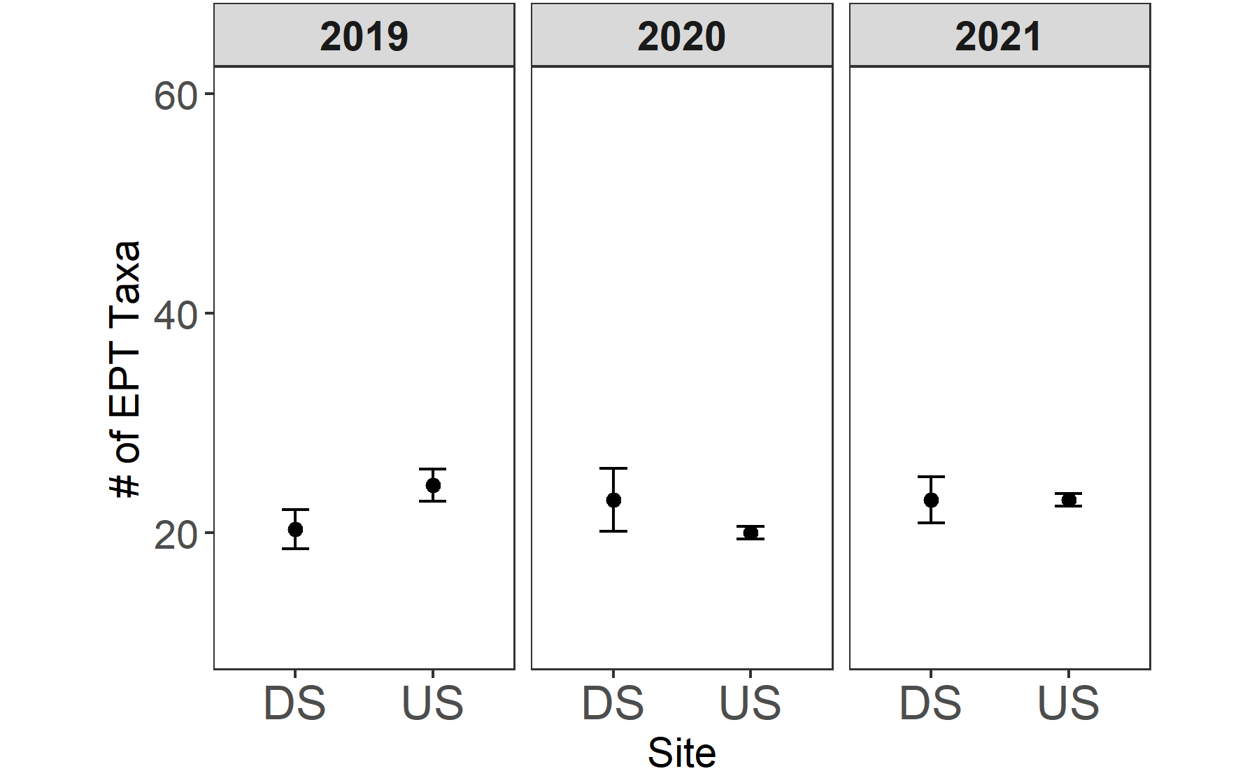
Upstream – Downstream 2019-2021
C.
Total Diversity- ND
EPT - ND
Sediment Tolerant - ND
A.
B.
*ND: Indicating no difference identified

Slide 12
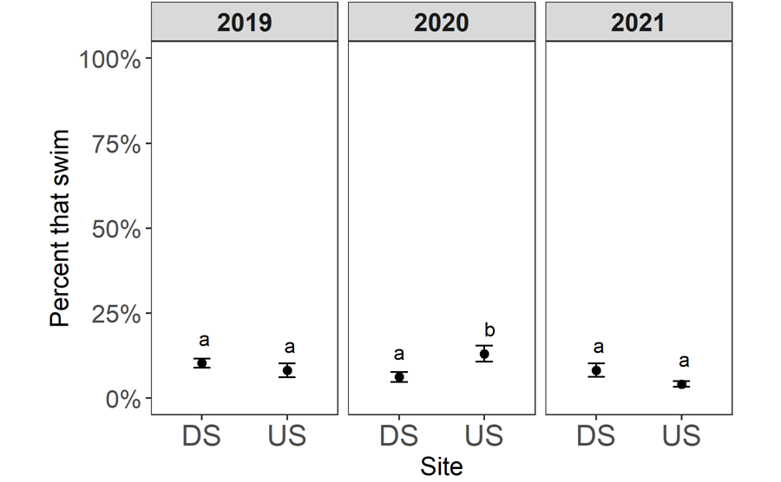
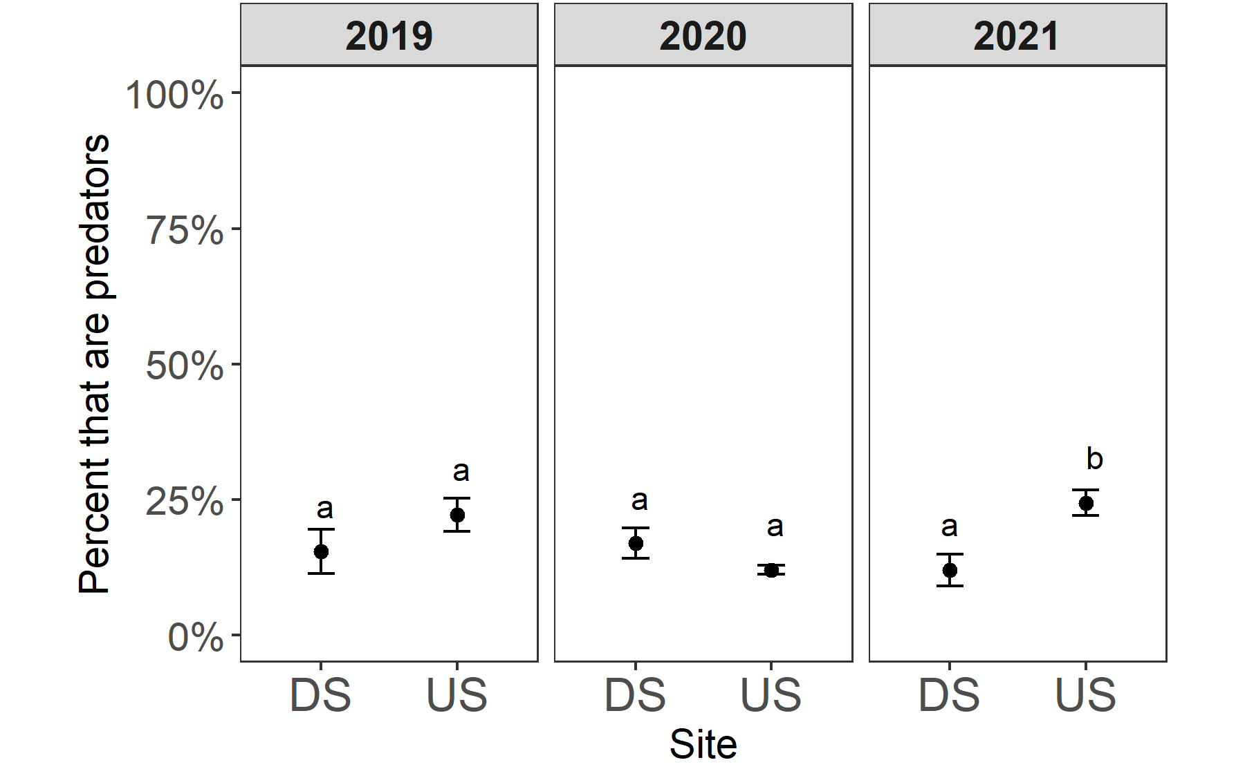
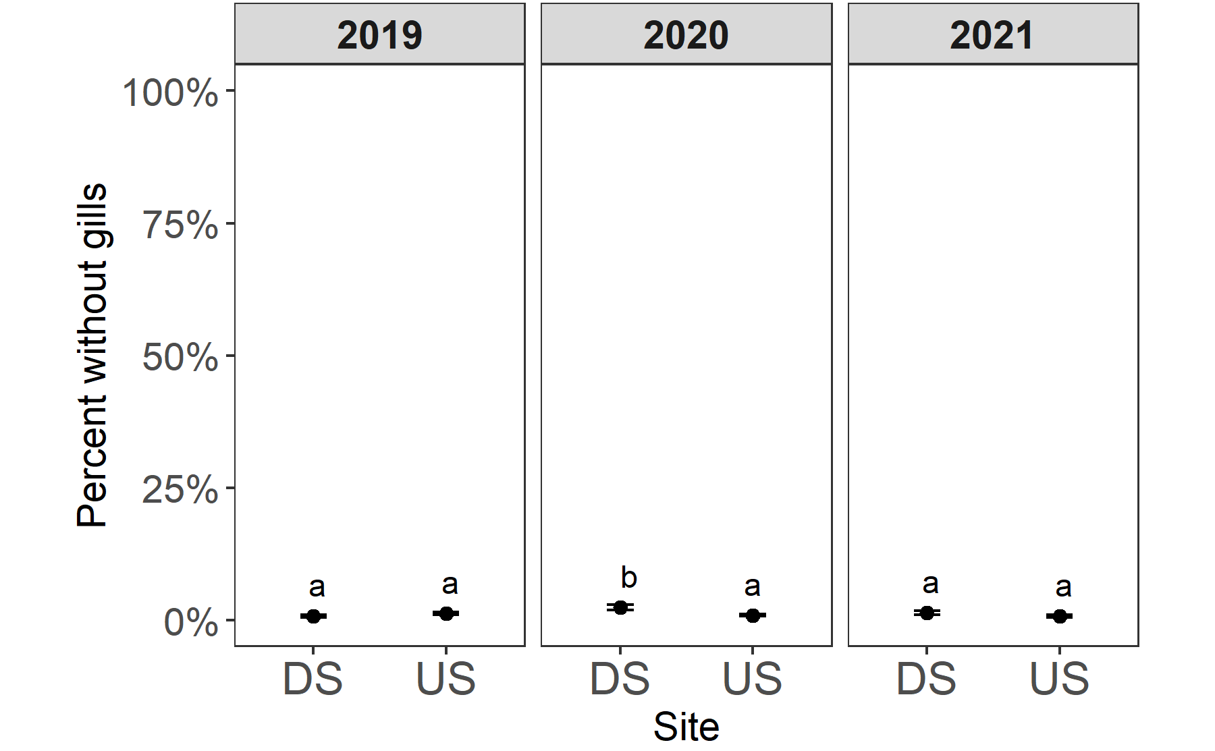
Upstream – Downstream 2019-2021
C.
Statistical variation
% Predators
% Air Breathers
% Swimmers
A.
B.

Slide 13
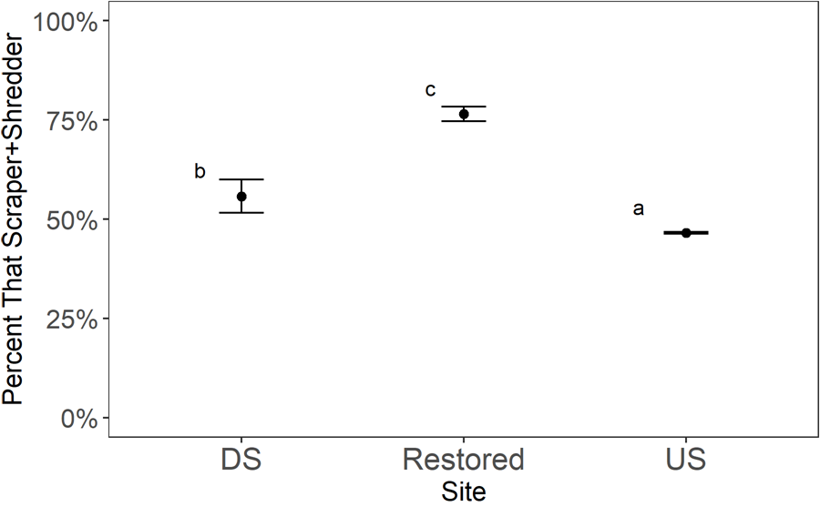
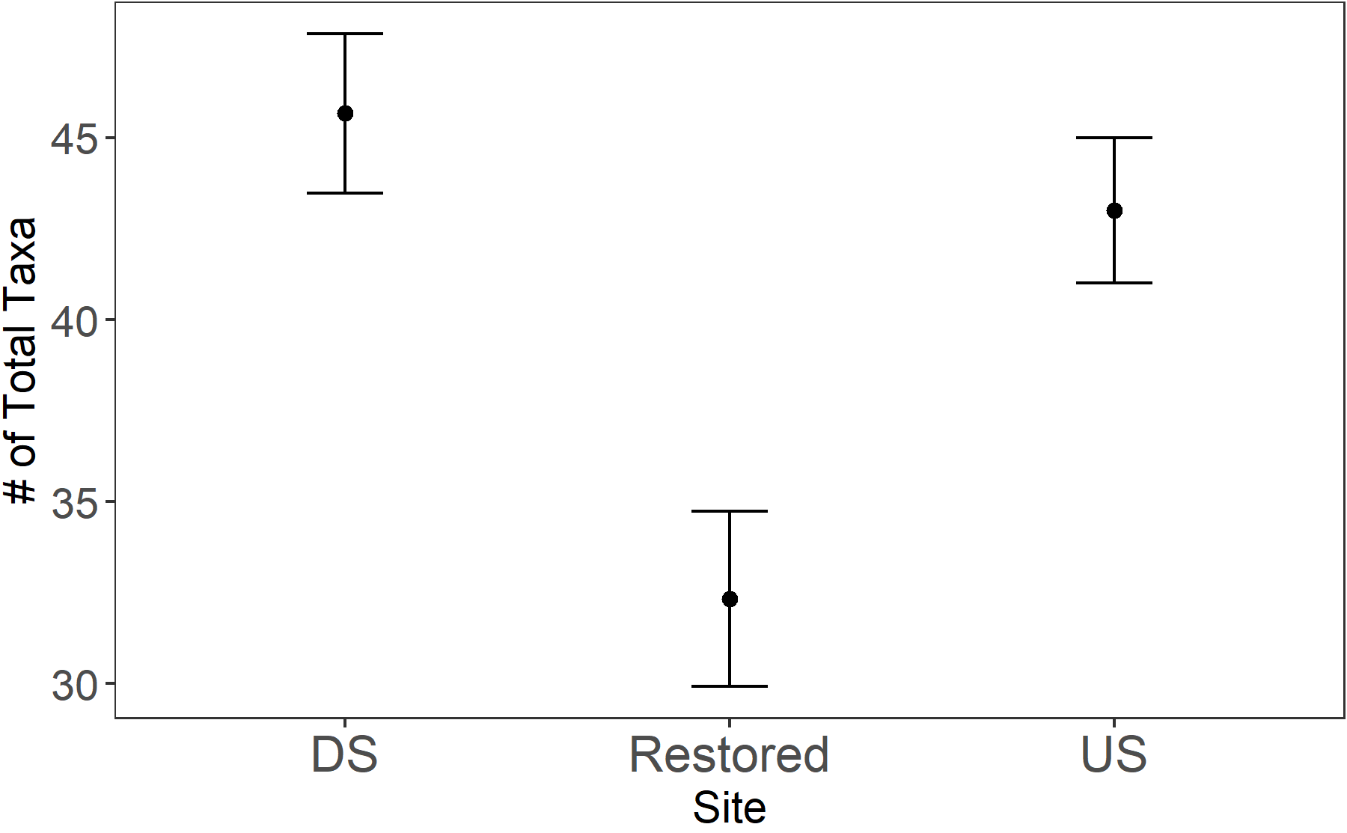
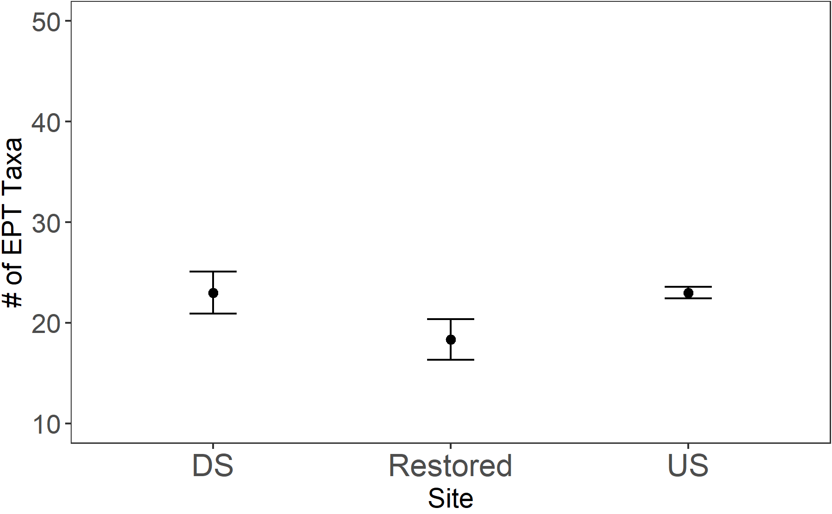
C.
Upstream - Restored - Downstream 2021
All taxa - ND
EPT - ND
Scraper + Shredder *
A.
B.

Slide 14
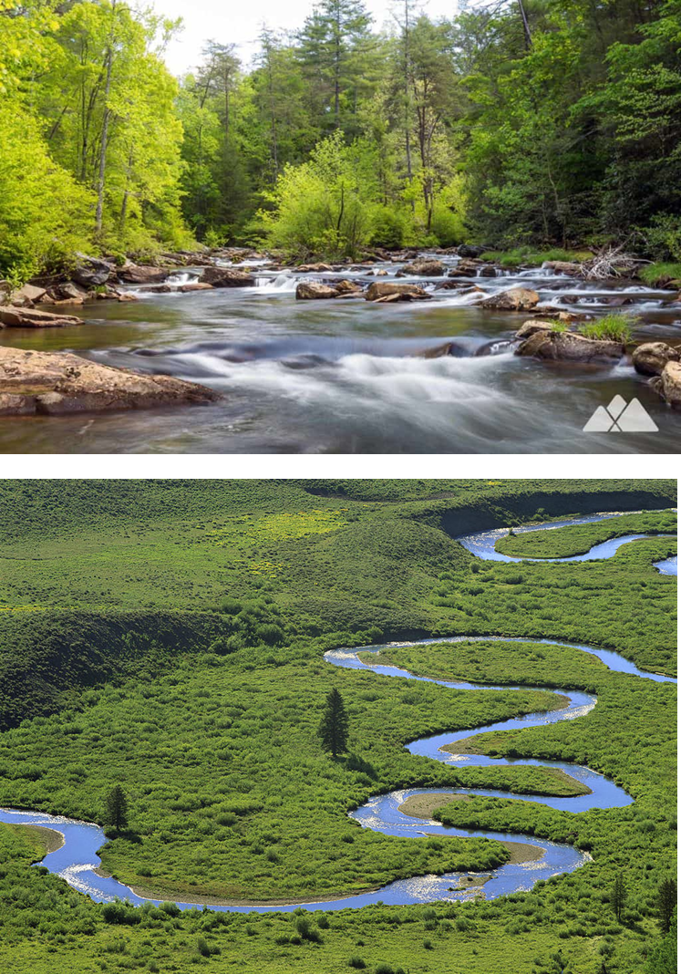
C.
Upstream - Restored - Downstream 2021
Leaves
Scraper + Shredder *
Algae

Slide 15
Rattlesnake Dam Removal: A Success Story?
Restored & downstream unimpaired
Resource availability
Indicative of high quality system
2019
Pre-removal
2020
Removal
2021
Post-removal & restoration

