Slide 1
Graduation Rates and Property Taxes in Montana Impacting Accessibility to Education
By Abigail Robideaux

Slide 2
Question?
Is there a way to change the funding of the education system to increase the graduation rate within Montana?
Does property tax have an impact on graduation rates in Montana?
Is there a connection between property taxes and graduation rates in Montana due to how the education system is funded?

Slide 3
Disclaimer
The data has potential for incorrect reporting, making it incorrect.
This could be due to Native American Reservations having a different reporting system, improper data collection, COVID-19 related issues, and improper data reporting to the state.
As the researcher, I likely bring a bias to the research conducted

Slide 4
Property Taxes
What are they?

Slide 5
How is market value established? Montana Specific
Market value established by….

Slide 6
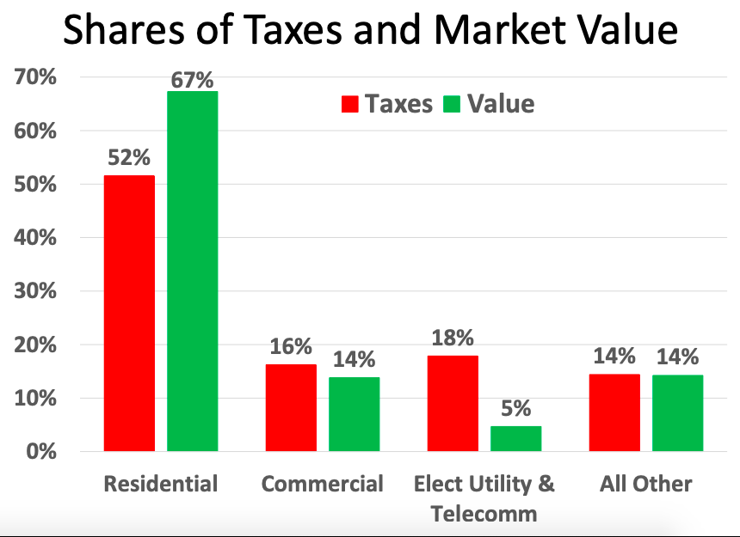
Property taxes compared to market value (Montana)
Value of the property is decided by the combination of that department, the Legislature, and local government and schools that sets the level of taxes
Property tax is an ad valorem tax, meaning the tax is levied in proportion to the value of each property relative to the total value within each taxing jurisdiction.
Therefore, the total amount of property taxes remains the same so if one certain property taxes shift, others must increase within that jurisdiction.

Slide 7
Mill Importance and how it affects property tax

Slide 8
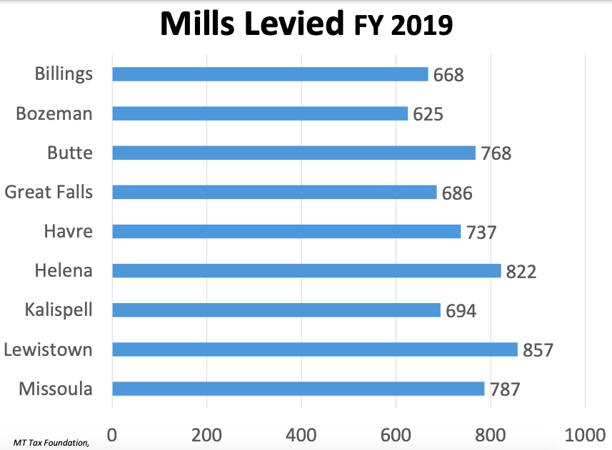
Why do we want mills levied?
It leads to more funding!
Total amount of mills that may be levied vary depending on state, local government, and school districts. State’s mills are statutorily fixed but local governments and school districts set their mills depending on the taxing jurisdiction and specific tax base.

Slide 9
Sources of funding for the education system

Slide 10
Montana Property Tax

Slide 11
Property Taxes turning into funding

Slide 12
Changes in Property tax over time

Slide 15
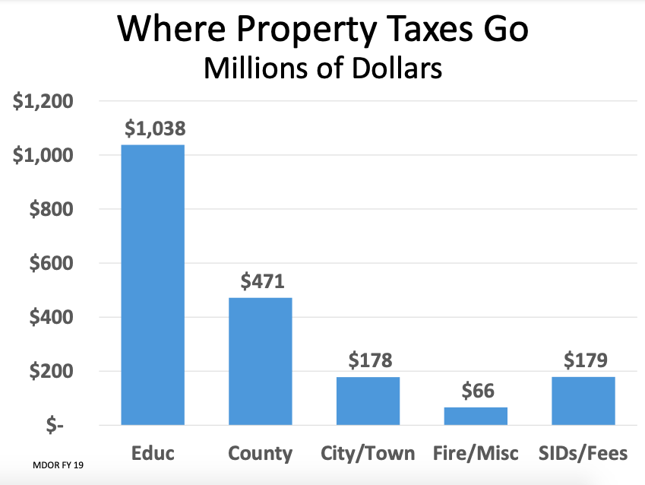
Importance of property taxes
More than half of property taxes collected goes to the public education system

Slide 16
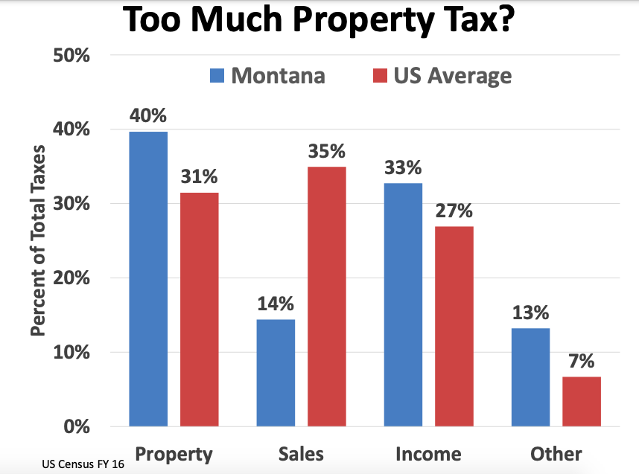
Property tax Comparison of Montana to US Average
Montana does not have sales tax, meaning they do not get the funding that other states do, hence the reliability on property tax

Slide 17
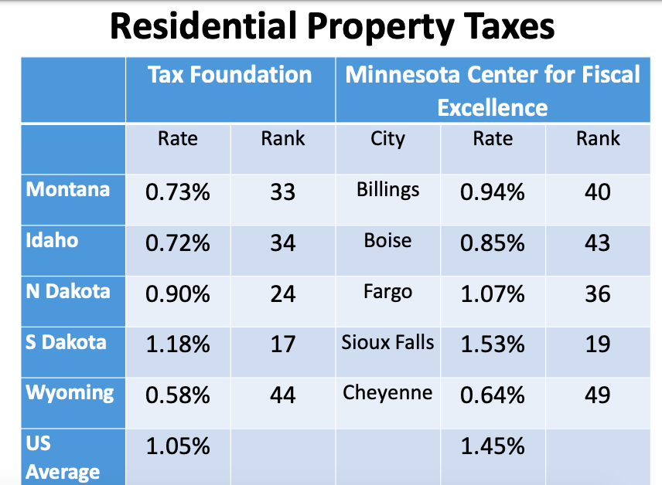
Property Tax Comparisons
Scan the QR code to discover more information about property taxes within the US.

Slide 18
Graduation Rates
Montana compared to US average?
Why is graduating important?
Why leads students becoming more likely to dropout?

Slide 19
Why is graduating important? (Graduation counts)
Graduating high school is a right of passage, seen through graduation ceremonies, parties, gifts, familial and friend attendance, etc…
Schools receive more financial support when they have higher graduation rates
Students who do not graduate from high school are not able to add to the economy as effectively as those who do, there is a “loss to the national economy in terms of work participation, tax revenue, and wealth accumulation.”
Alliance for Excellent Education says, “improving our nation’s high school graduation rate is smart economic policy.”
There is a “direct connection between education and asset accumulation,” therefore those who do not graduate end up in the lower class, often leading to a harder time saving money and gaining wealth

Slide 20
Why do students drop out? (graduation counts)
Certain factors lead to a higher likelihood of a student dropping out such as repeating grades, being behind their cohort in performance, many suspensions or behavior problems, ongoing lack of engagement or attention, ongoing absenteeism, or tardiness
Improving the odds: Make sure to start from the ground up, support for low-income families, having community and family support starting at a young age
Graduation Matters Montana
Suggests policy review related to attendance, retaining, and promoting attendance, grading, and how or when a student is recommended to attain their GED or attend an alternative school
Policy review for nontraditional students who might have to work a full-time job, a lot of absences possibly due to raising a child, or struggling academically
There are also suggestions to add warning systems for students who might not be on track or at risk of dropping out with another system letting administration know when they are on-track again
Based on location, not one program for whole state

Slide 21
Missoula School Districts

Slide 26
Scan the QR code to explore more information about Montana graduation rates, dropout rates, student characteristics, and more

Slide 28
Conclusion
Montana is doing a great job of getting students to graduate and the formula for property taxes in Montana, although different than other states, functions properly and efficiently to help fund the education system.

Slide 29
Where do we go from here?
Where are students who benefit from free and reduced lunch graduating from/attending school?
What are the high school demographics for counties in Montana?
How are property tax funds being allocated to the education system?
What programs exist to help students graduate?

Slide 30
Thank you for your guidance and help!
Tobin Shearer
University of Montana
Connected me to Preston Parrish and informed me of Montana Budget and Policy, Missoula County JEDI program, and connected me to Ashley Brittner Wells
Ashley Brittner Wells
Baucus Leaders Montana
Fellow and National League of Cities JEDI Coordinator – City of Missoula

Slide 31
Thank you for your guidance and help!
Preston Parrish
Montana Budget and Policy Center
Deputy Director, Equity Policy, & Programs
Rose Bender
Montana Budget and Policy Center
Deputy Director of Research
Has helped make sure I narrow down what I am asking
Connected me to Dylan Cole

Slide 32
Thank you for your guidance and help!
Dylan Cole
Department of Revenue
Katie LaPointe
Missoula County Public Schools
New Faculty Coach
Deb Pengelly
Missoula County Public Schools
Records Clerk Big Sky High School
Extremely helpful in guiding my research!

Slide 33
Resources!
“Cities of Opportunity.” National League of Cities, 23 Jan. 2021, www.nlc.org/initiative/cities-of-opportunity.
The Future of U.S. Public School Revenue from the Property Tax https://www.lincolninst.edu/sites/default/files/pubfiles/future-us-public-school-revenue-policy-brief_0.pdf
Graduation Counts: Connection Between Education and Economy (2012) https://www.proquest.com/docview/1223514318?fromopenview=true&pq-origsite=gscholar
“Graduation Requirements / Graduation Requirements.” Missoula County Public Schools, www.mcpsmt.org/domain/2385. Accessed 19 Apr. 2022.
“Graduation Matters Missoula Initiative / GMM Introduction.” Missoula County Public Schools, www.mcpsmt.org/Page/9087. Accessed 19 Apr. 2022.
“Justice, Equity, Diversity, and Inclusion.” Engage Missoula, www.engagemissoula.com/jedi. Accessed 19 Apr. 2022.
“Montana Budget and Policy Center | Tuition Tax Credits: A Threat to Montana-Based Education Solutions.” Montana Budget and Policy Center, 3 Dec. 2021, montanabudget.org/report/tuition-tax-credits-2021.
Montana Graduation Rates tick up to new record, but fall short of goals in federal plan https://www.proquest.com/docview/2334870824?pq-origsite=primo&accountid=14593
Montana Property Taxes – Rising Property Taxes: What You Should Know https://leg.mt.gov/content/Committees/Interim/2019-2020/Revenue/Meetings/January-2020/young-Montana%20Property-Taxes%202019.pdf
MT Biennial Report Property Taxes https://www.lincolninst.edu/sites/default/files/tax_rate/mt_2018_2020_biennial_report_department_of_revenue.pdf
Superintendent Elsie Arntzen Announces Graduation Rates and Dropout Rates with Proposed Solutions https://news.mt.gov/Office-of-Public-Instruction/Superintendent-Elsie-Arntzen-Announces-Graduation-Rates-and-Dropout-Rates-with-Proposed-Solutions

