Slide 1
Depictions of Strikes on Social Media
Zach Mangels

Slide 2
Abstract
Social media: useful for understanding social movements
Organized labor is one type of social movement
Right now, unions are more popular than ever
Does the profession of workers on strike influence how the public reacts to the movement?
Two strikes:
Journalists at The New York Times: Strike on December 8, 2022
Nurses at Montefiore Medical Center and Mount Sinai Medical Center: Strike from January 9, 2023 to January 11, 2023

Slide 3
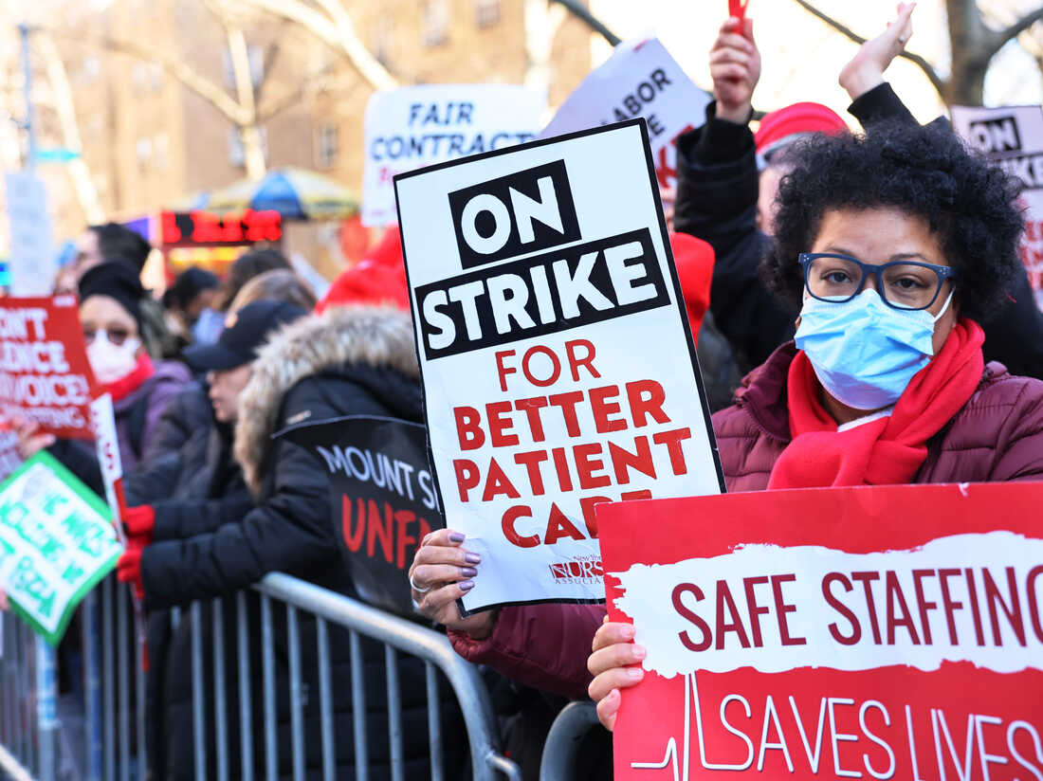
Literature Review
What influences public support for organized labor?
Economic conditions (Edwards & Bain, 1988; Jarley & Kuruvilla, 1994)
Proximity to inequality (Newman & Kane, 2017)
The media (Schmidt, 1993; Carreiro, 2005; Bruno, 2009; Kane & Newman, 2019)
Miscellaneous (Aleks et al., 2021; Lyon, 2022; McAleese & Day, 2022)
(Santiago, 2023)

Slide 4
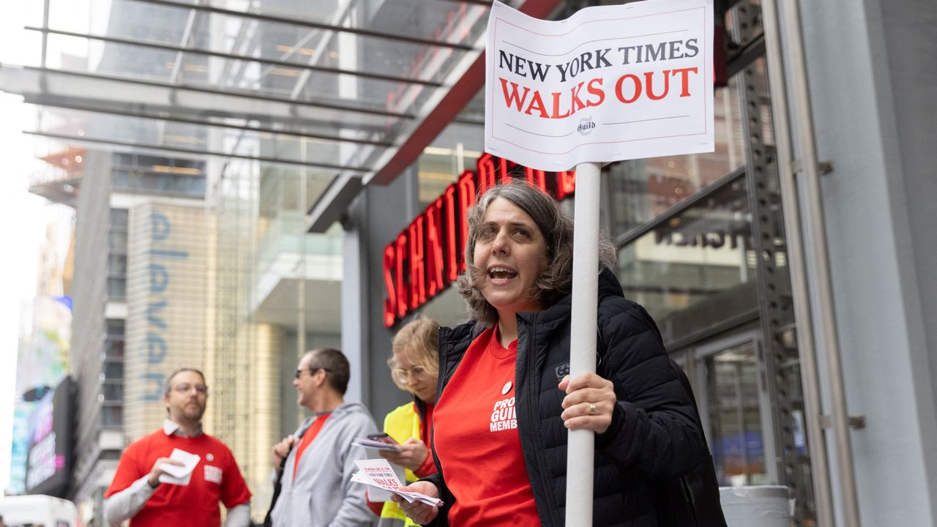
Literature REview
What influences public support for strikes?
Whether someone is directly affected (Day et al., 2006; Kelloway et al., 2008)
Profession
Previous positive experiences (Naughton, 2022; Hertel-Fernandez et al., 2021)
Wages/salary
Safety
(Moon, 2022)

Slide 5
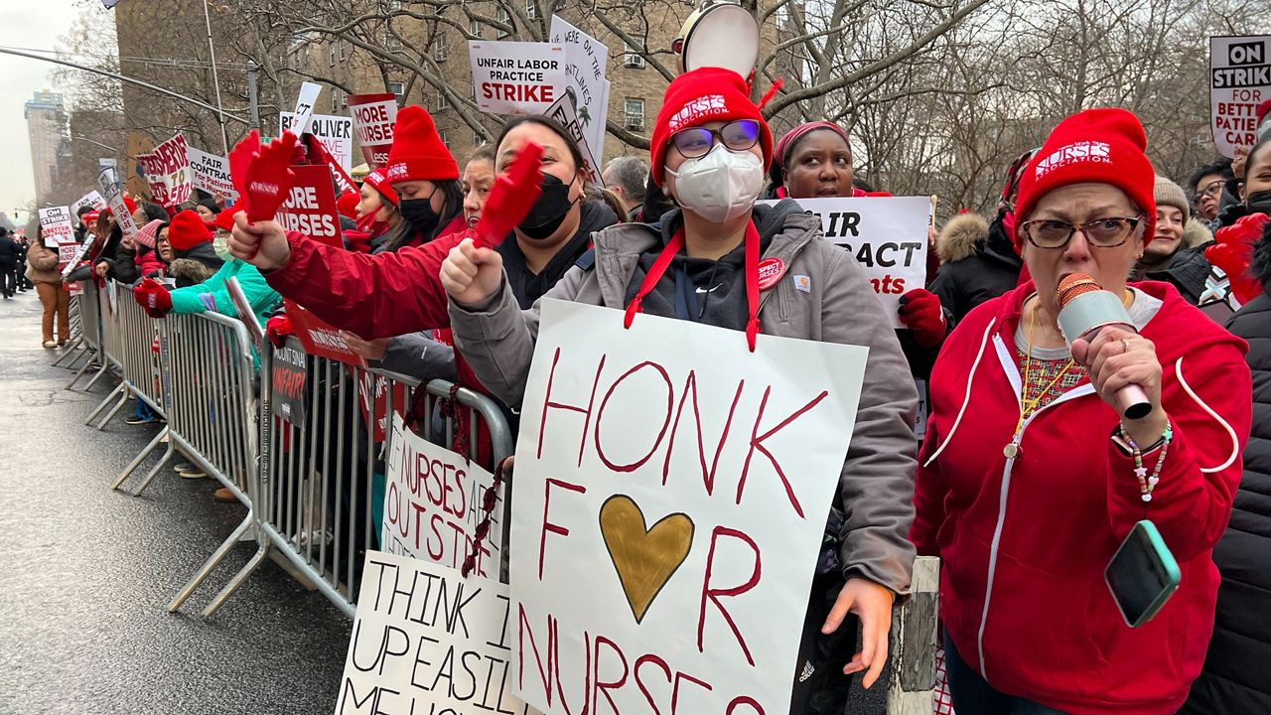
Limitations
Studies typically done of public sector employees
Little study of the influence of demographics or occupation of strikers on public opinion
Little study of organized labor and/on social media
Naughton (2022)
Reveilhac & Eisner (2022)
(Velarde, 2023)

Slide 6
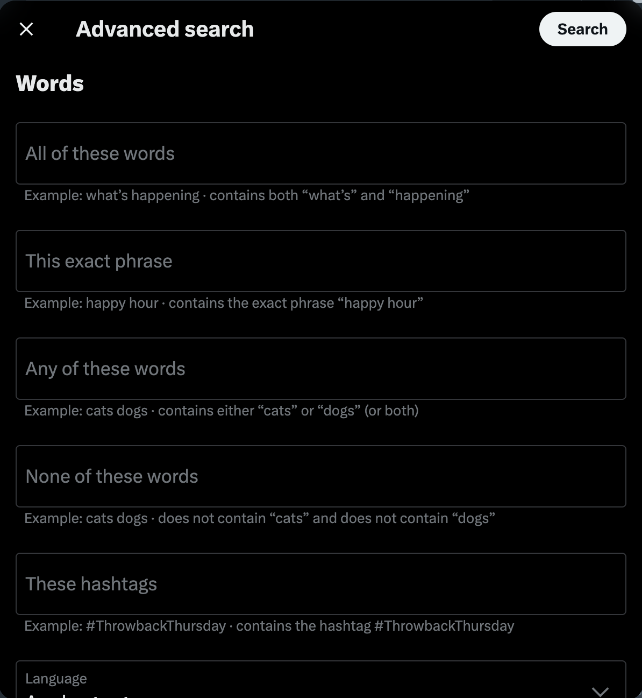
Methods
Twitter Advanced Search
Data collected from:
Tweets from between the day before the strike began and the day after it ended
Tweets mentioning the union’s Twitter account
Tweets mentioning the employer’s Twitter account
Tweets containing the word “strike” or “walk out” or “walkout”
Copy-and-paste text into spreadsheet
Included descriptions of images of GIFs that were tweeted
Coding: Position and sentiment

Slide 7
Results
N = 1825 Tweets
N = 1001 for The New York Times
N = 824 for Nurses

Slide 8
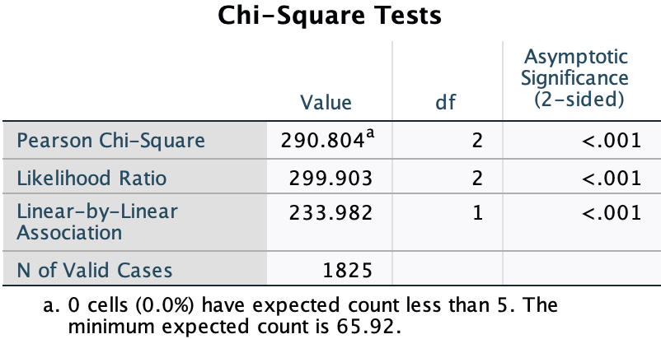
Results

Slide 9
Results

Slide 10
Types of messages
Support
Solidarity: “solidarity my puzzling comrades” “✊🫡” “NO links NO clicks NO games #SolidarityWithStrikes”
General Support: “incredible” “Beautiful 😍” “I support NYTimesGuild”
Information: “hi, does this include The Athletic? Support your cause and don't want to be crossing any picket lines” “Is the strike over? So I may play wordle again.”
Opposition
Anti Media: “Please come back to work What would we do without the ny times who would give us in writing all the lies and fake news” “You lie to us daily and now we’re supposed to support you?..good luck with that..”
Anti Solidarity: “Let’s all get over to the failing @nytimes websites to make sure their viewership stays up during the strike. This the same company that blares on and on about the benefits of belonging to a union, except when that union represents employees of the New York Times. 🤡🤡🤡”
General Opposition: “so sorry, don't care” “😂😂😂😂😂🖕”

Slide 11
Results

Slide 12
Types of messages
Support
Safety: “Better late than never” “Thank you for your work and fight for safe staffing for NYC patients. #NYCNurseStrike”
Pay: “healthcare admins all over are pushing ridiculously unsafe staffing while lining their pockets. congrats on the successful strike! 💪💪💪💪” “Lolllll this hospital is a joke. They get 8-10k per Covid death at there hospital, they can pay travel nurses 2x. But you can’t give ur current employees safe staffing and a raise that’s probably a rounding error on your taxes. Makes me sick. Do the right thing”
General Support: “I totally support the Nurses!#StandWithNurses #SafeStaffingSavesLives” “Congratulations 🎈”
Opposition
Safety: “BS you don't give a crap about patients or you'd be inside taking care of them instead of letting them go unattended or attended by some temp worker. You should quit and look for another job if you don't like that huge paycheck you get every week. Most wish they made that much.”
General Opposition: “Why is healthcare so expensive? Greedy nurses and medical residents”
Anti Vax: “You should have held out to reinstate your fellow co-workers who were fired for the mandates”

Slide 13
Results
Why was response to nurses strike more positive?
Employer behavior on social media
Prior positive experience with nurses (Naughton 2022; Hertel-Fernandez 2021)
Lack of (explicit) gendered language in tweets

Slide 14
Limitations and next steps
Geography
Twitter
Professions

Slide 15
Works cited
Aleks, R., Saksida, T., & Wolf, A. S. (2021). Hero or villain? A cohort and generational analysis of how youth attitudes towards unions have changed over time. British Journal of Industrial Relations, 59(2), 532-567.
Bruno, R. (2009). Evidence of bias in the Chicago Tribune coverage of organized labor. Labor Studies Journal, 34(3), 385-407.
Carreiro, J. L. (2005). Newspaper coverage of the U.S. labor movement: The case of anti-union firings. Labor Studies Journal, 30(3), 1-20.
Day, A. L., Stinson, V., Catano, V. M., & Kelloway, E. K. (2006). Third-party attitudes and strain reactions to the threat of a labor strike. Journal of Occupational Health Psychology, 11(1), 3-12.
Edwards, P. K., & Bain, G. S. (1988). Why are trade unions becoming more popular? Unions and public opinion in Britain. British Journal of Industrial Relations, 26(1), 311-326.
Hertel-Fernandez, A., Naidu, S., & Reich, A. Schooled by strikes? The effects of large-scale labor unrest on mass attitudes toward the labor movement. Perspectives on Politics, 19(1), 73-91.
Jarley, P., & Kuruvilla, S. (1994). American trade unions and public approval: Can unions please all of the people all of the time? Journal of Labor Research, 15(1), 97-116.
Kane, J. V., & Newman, B. J. (2019). Organized labor as the new undeserving rich?: Mass media, class-based anti-union rhetoric and public support for unions in the United States. British Journal of Political Science, 49(3), 997-1026.
Kelloway, E. K., Francis, L., Catano, V. M., Dupré, K. E. (2008). Third-party support for strike action. Journal of Applied Psychology, 93(4), 806-817.
Lyon, G. (2022). Citizenship, work, and labor policy preferences. Politics, Groups, and Identities, 10(5), 817-827.
Moon, J. (2022). Stacy Cowley holds a sign outside the New York Times building in Manhattan, New York, U.S. CNN. Retrieved April 19, 2023, from https://www.cnn.com/2022/12/07/media/new-york-times-strike/index.html.
McAleese, O., & Day, M. V. (2022). Some psychological determinants of broad union attitudes. Journal of Social and Political Psychology, 10(2), 588-606.
Naughton, M. (2022). Mobilising societal power: Understanding public support for nursing strikes. Industrial Relations Journal, 53(2), 93-109.
Newman, B. J., & Kane, J. V. (2017). Economic inequality and public support for organized labor. Political Research Quarterly, 70(4), 918-932.
Reveilhac, M., & Eisner, L. (2022). Political polarization on gender equality: The case of the Swiss women’s strike on Twitter. Statistics, Politics, and Policy, 13(3), 255-278.
Roper Center . (2014, August 29). The public and labor unions. https://ropercenter.cornell.edu/public-and-labor-unions
Santiago, M. M. (2023). Nurses from Mount Sinai Hospital strike outside the hospital on Monday in the Upper East Side neighborhood of New York City. NPR. Retrieved April 19, 2023, from https://www.npr.org/2023/01/12/1148648031/new-york-nurses-strike-mount-sinai-montefiore-agreement.
Schmidt, D. E. (1993). Public opinion and media coverage of labor unions. Journal of Labor Research, 14(2), 151-164.
Velarde, E. (2023). Nurses strike at Mount Sinai Hospital in Manhattan on Jan. 6, 2023. NY1. Retrieved April 19, 2023, from https://www.ny1.com/nyc/all-boroughs/health/2023/01/09/nurses-strike-at-mount-sinai-and-montefiore-hospitals-in-new-york-city.

