Slide 1
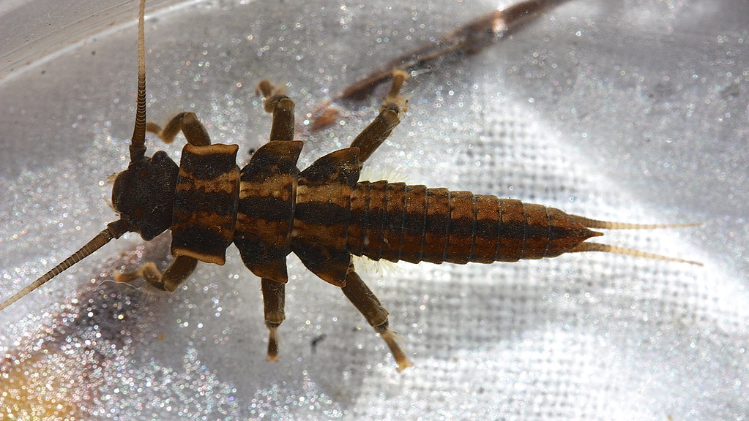
Effects of warming and drying on the survival and performance of giant salmonfly nymphs (Pteronarcys californica)
Kailie Todd
This Photo by Unknown Author is licensed under CC BY-SA

Slide 2
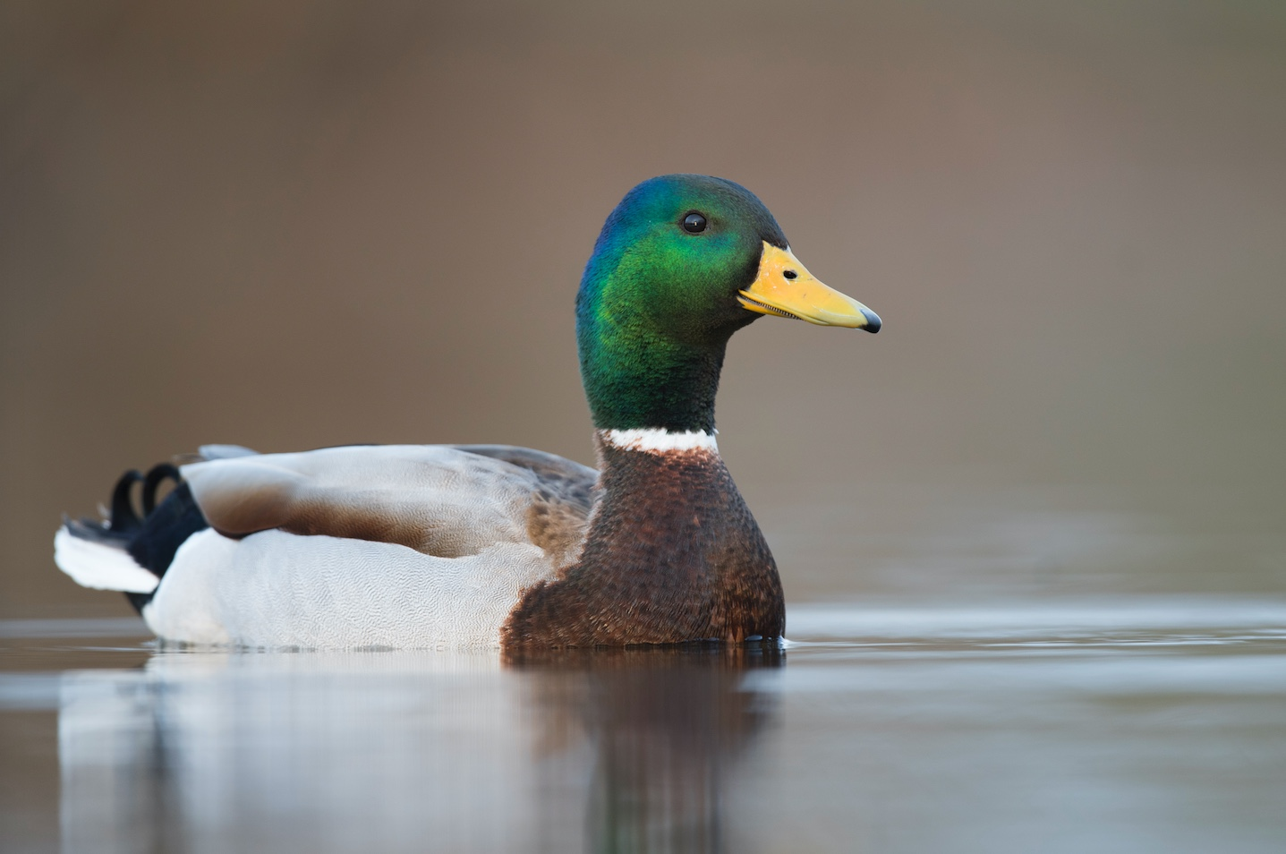
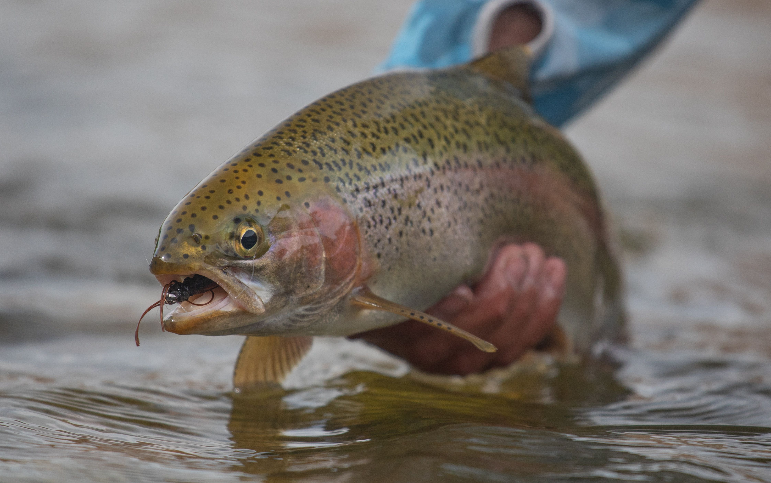
Ecology
Salmonfly nymphs are aquatic insects that occupy rivers in the west
Live in the water for 3-5 years before becoming adults
Essential source of food

Slide 3
Physiology
Salmonflies are ectotherms so physiological rates controlled by ambient environment
Oxygen concentrations lower in water than in air
Temperature exacerbates problem

Slide 4
Warm temperatures increase oxygen demand
Oxygen demand
Temperature
Notes:
Warm water temperatures can exacerbate this oxygen problem. Because insects are ectotherms, as water tempratures incrase, so do their body temperatures, their metabolism, and thus, their need for oxygen.

Slide 5
Warm temperatures increase oxygen demand
more than supply
Oxygen Demand
Oxygen supply & demand
Oxygen Supply
Temperature
Verberk et al. 2011
Notes:
Warm water temperatures can exacerbate this oxygen problem. Because insects are ectotherms, as water tempratures incrase, so do their body temperatures, their metabolism, and thus, their need for oxygen.

Slide 6
Mismatches between supply and demand at high temperatures
Oxygen Demand
Mismatch
Oxygen supply & demand
Oxygen Supply
Available oxygen
Temperature
Verberk et al. 2016, Pörtner et al. 2018; Woods 1999
Notes:
BRING FLOW UP HERE.

Slide 7
Flow helps
Thick
boundary Layer
Low Flow
O₂
O₂
O₂
O₂
O₂
High Flow
Small
boundary Layer
O₂
O₂
O₂
O₂
O₂
Frakes, Birrell et al. (2021)
Notes:
Flow influences insect respiration by altering the boundarly layers that form around insect bodies. In flow flows, like it is under those rocks or perhaps during a drought, thick boundarly layers form…

Slide 8
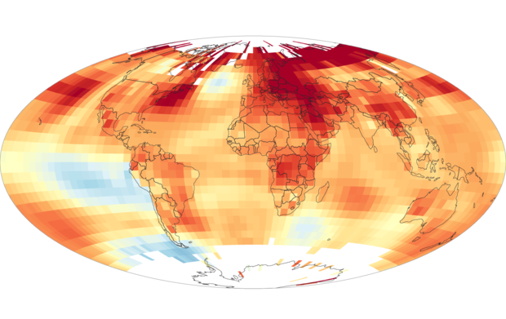
Reason #1 for my Research
Climate change

Slide 9
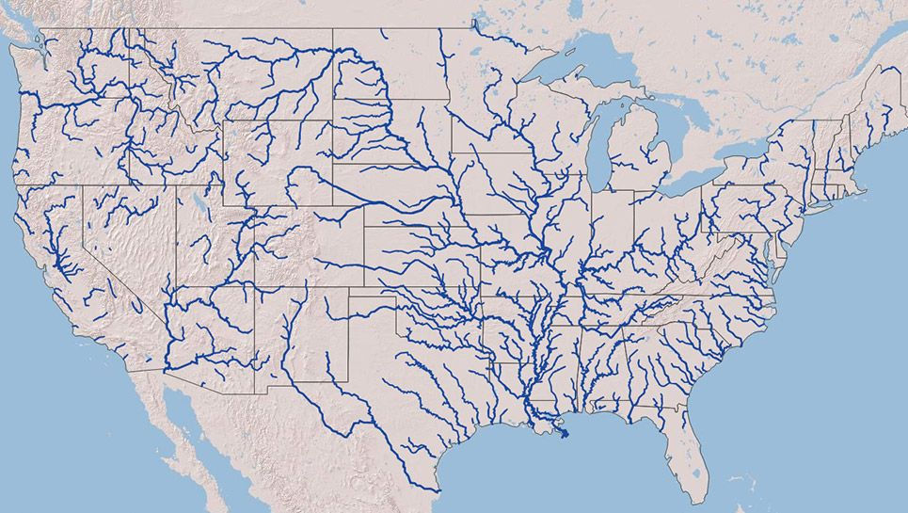
Reason #1 for my Research
Climate change
Temperature of not only air but rivers predicted to increase

Slide 10
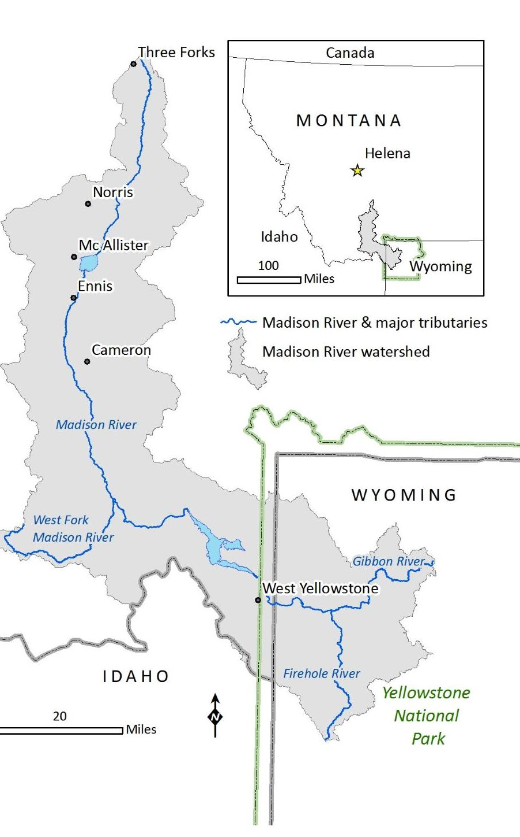
Reason #2
The effects of the 2021 dam malfunction on the Madison River on salmonfly nymphs

Slide 11
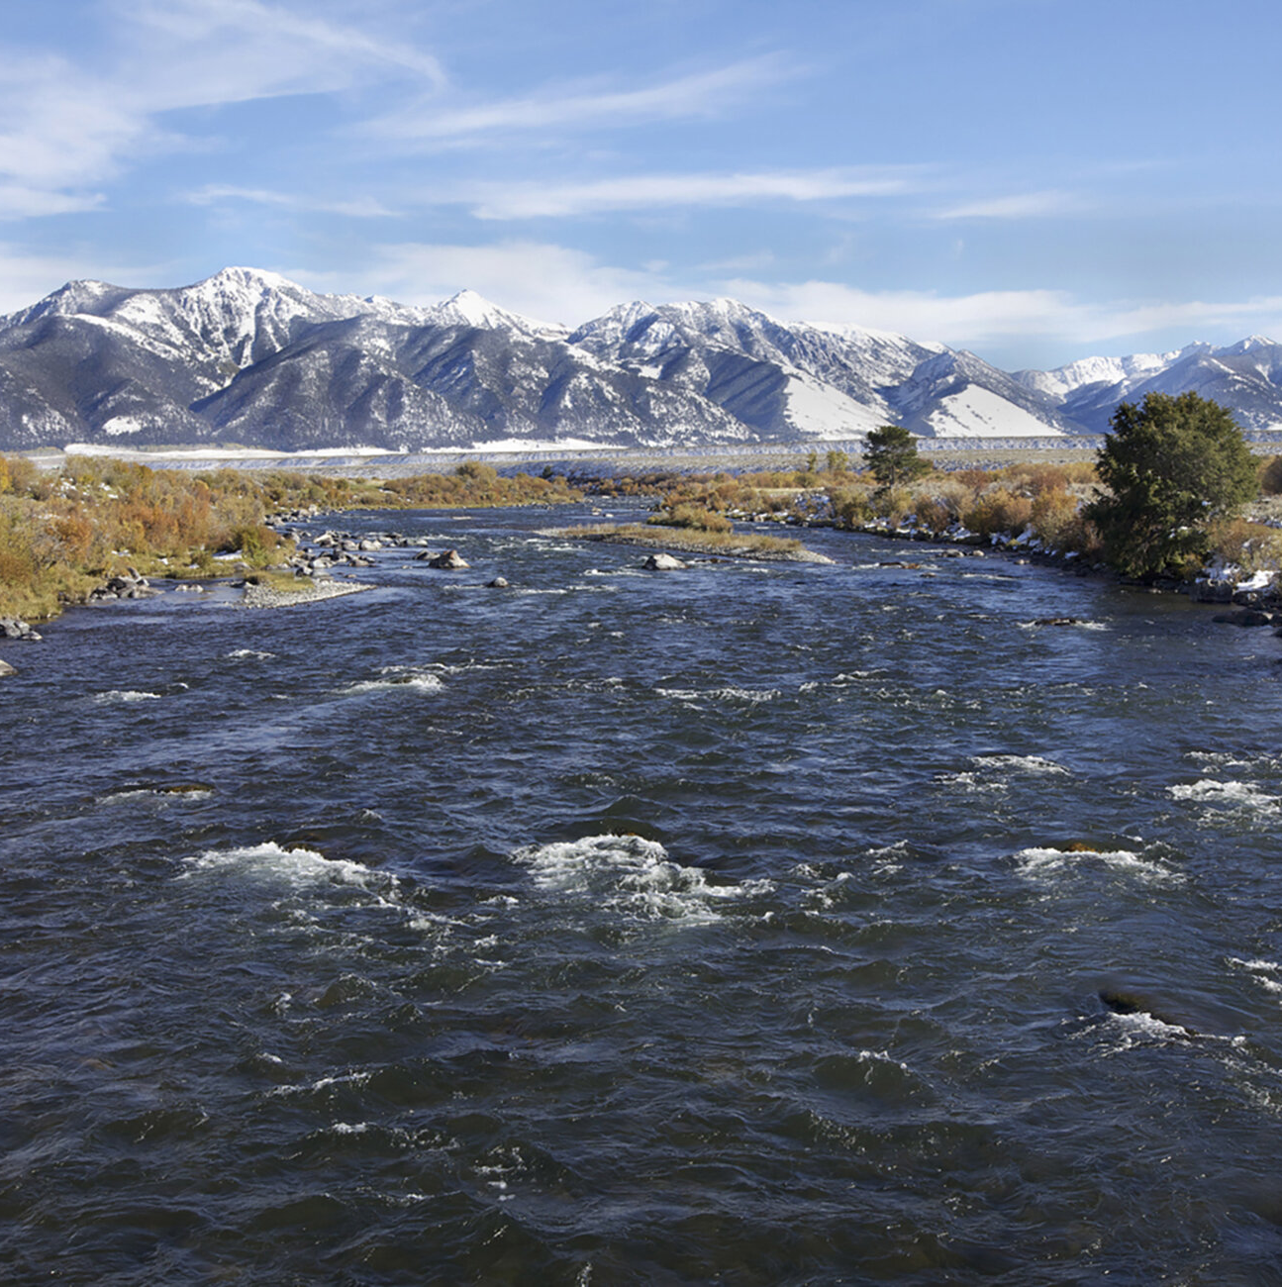
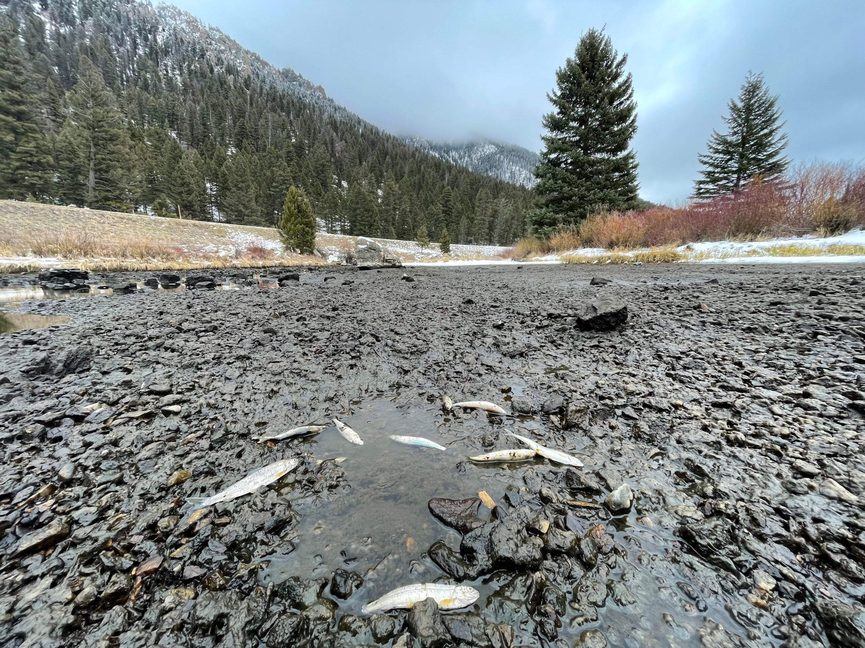
70% reduction flow and drought for fifty hours
Immediate concerns were for fish
Impacts on salmonflies unknown
Low flow and drought is concerning

Slide 12
My Study: Simulate warming and dam malfunction
Survival in air at 75% and 100% relative humidity (RH) at five temperatures (5, 12.5, 20, 25, and 35 ℃) for two weeks
Survival and performance (pushups, feeding, growth) in still water at four different temperatures (5, 12.5, 20, and 25 ℃) for two weeks

Slide 13
Hypotheses
The interaction between oxygen and temperature will cause low flow and increases in temperature to decrease survival and performance.
In air, the struggles from drying out will cause drought and low humidity to decrease survival.

Slide 14
Predictions

Slide 15
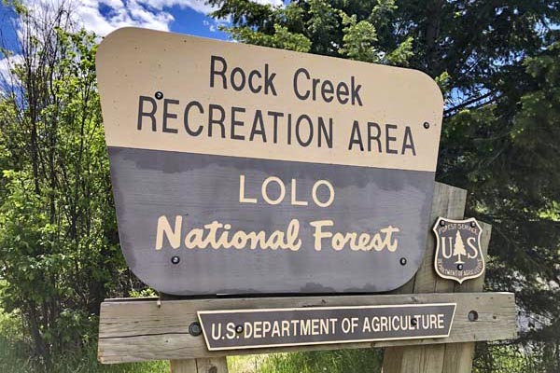
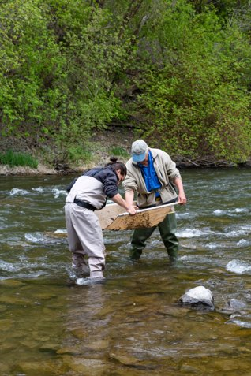
Field Work
Mile Marker 1 to collect insects
October 4th and brought back to lab to acclimate for 24 hours

Slide 16
Set Up (no-flow)
12 insects per trt. weighed and placed in bags with leave
4 treatments (5, 12.5, 20, and 25 ℃)
Air bubblers placed in all
Notes:
These notes will show up on your monitor, but not on the projector when you put presentation in present mode

Slide 17
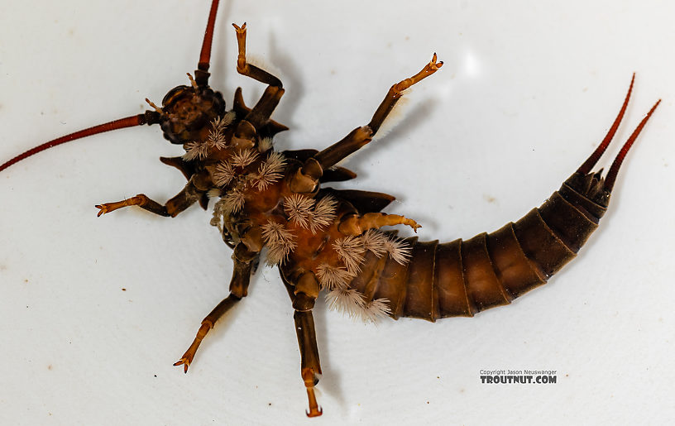
Data Collection (no-flow)
Checked on every two hours from 8 am to 8 pm
Oxygen
Temperature
Survival
Pushups

Slide 18
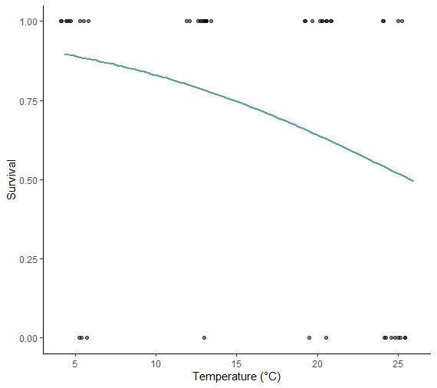
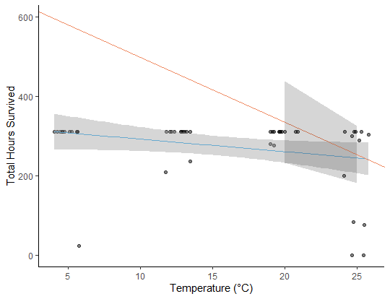
Results (no-flow)
Temperature had a statistically significant affect on survival.

Slide 19
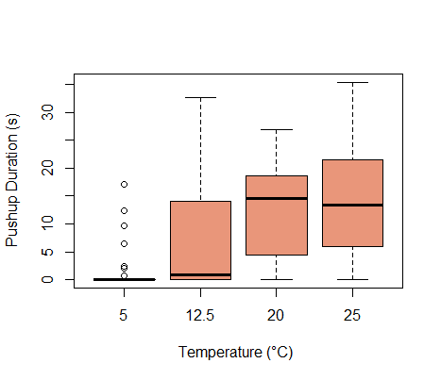
Results (no-flow)
Leaf consumption insignificant
Growth insignificant
Spent significantly more time performing pushups as temperature increased

Slide 20
Field Work
Mile Marker 1 to collect insects
February 21st and brought back to lab to acclimate for 1 week

Slide 21
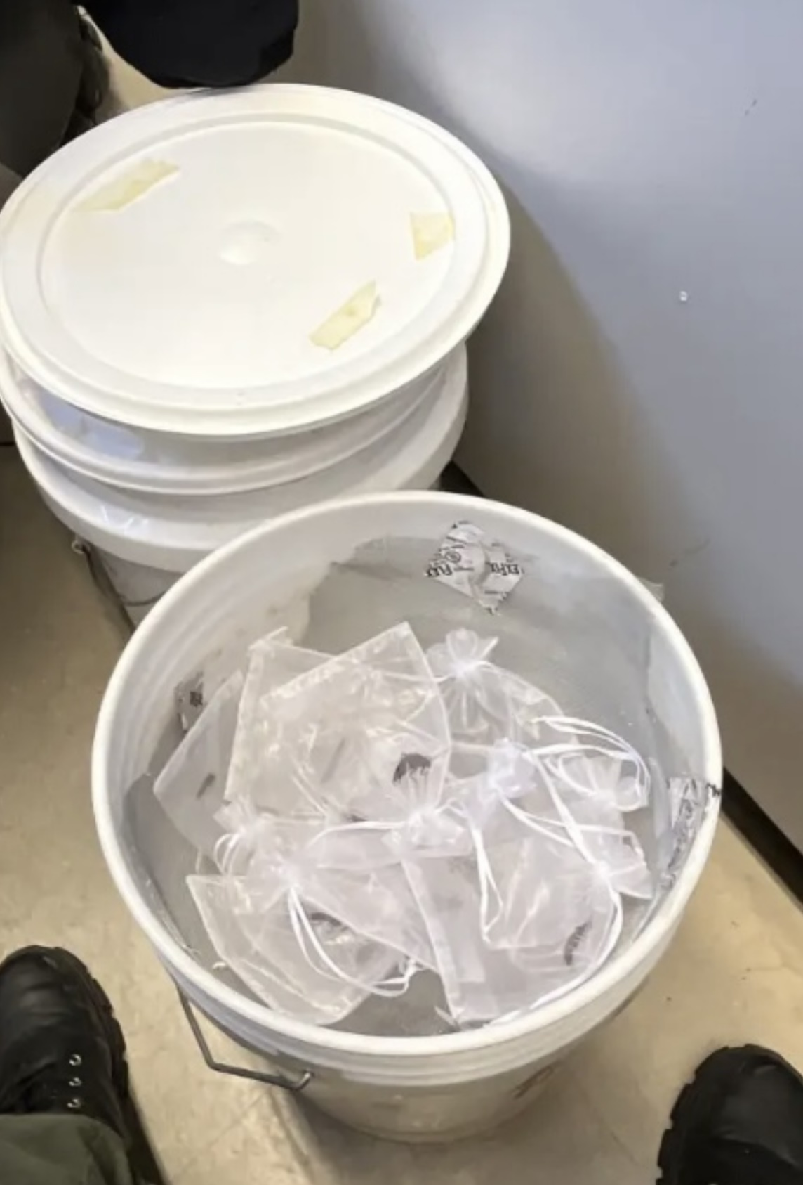
Set Up (dry)
Five buckets 100% RH
Five buckets 75% RH
Nymphs in bags on mesh

Slide 22
Data Collection (dry)
Checked every two hours 8 am-10 pm
Determine survival by movement

Slide 23
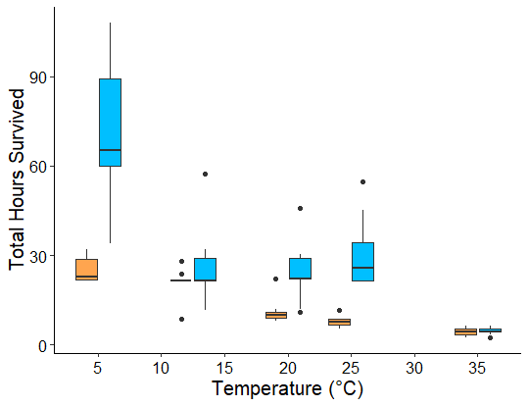
Results (air)

Slide 24
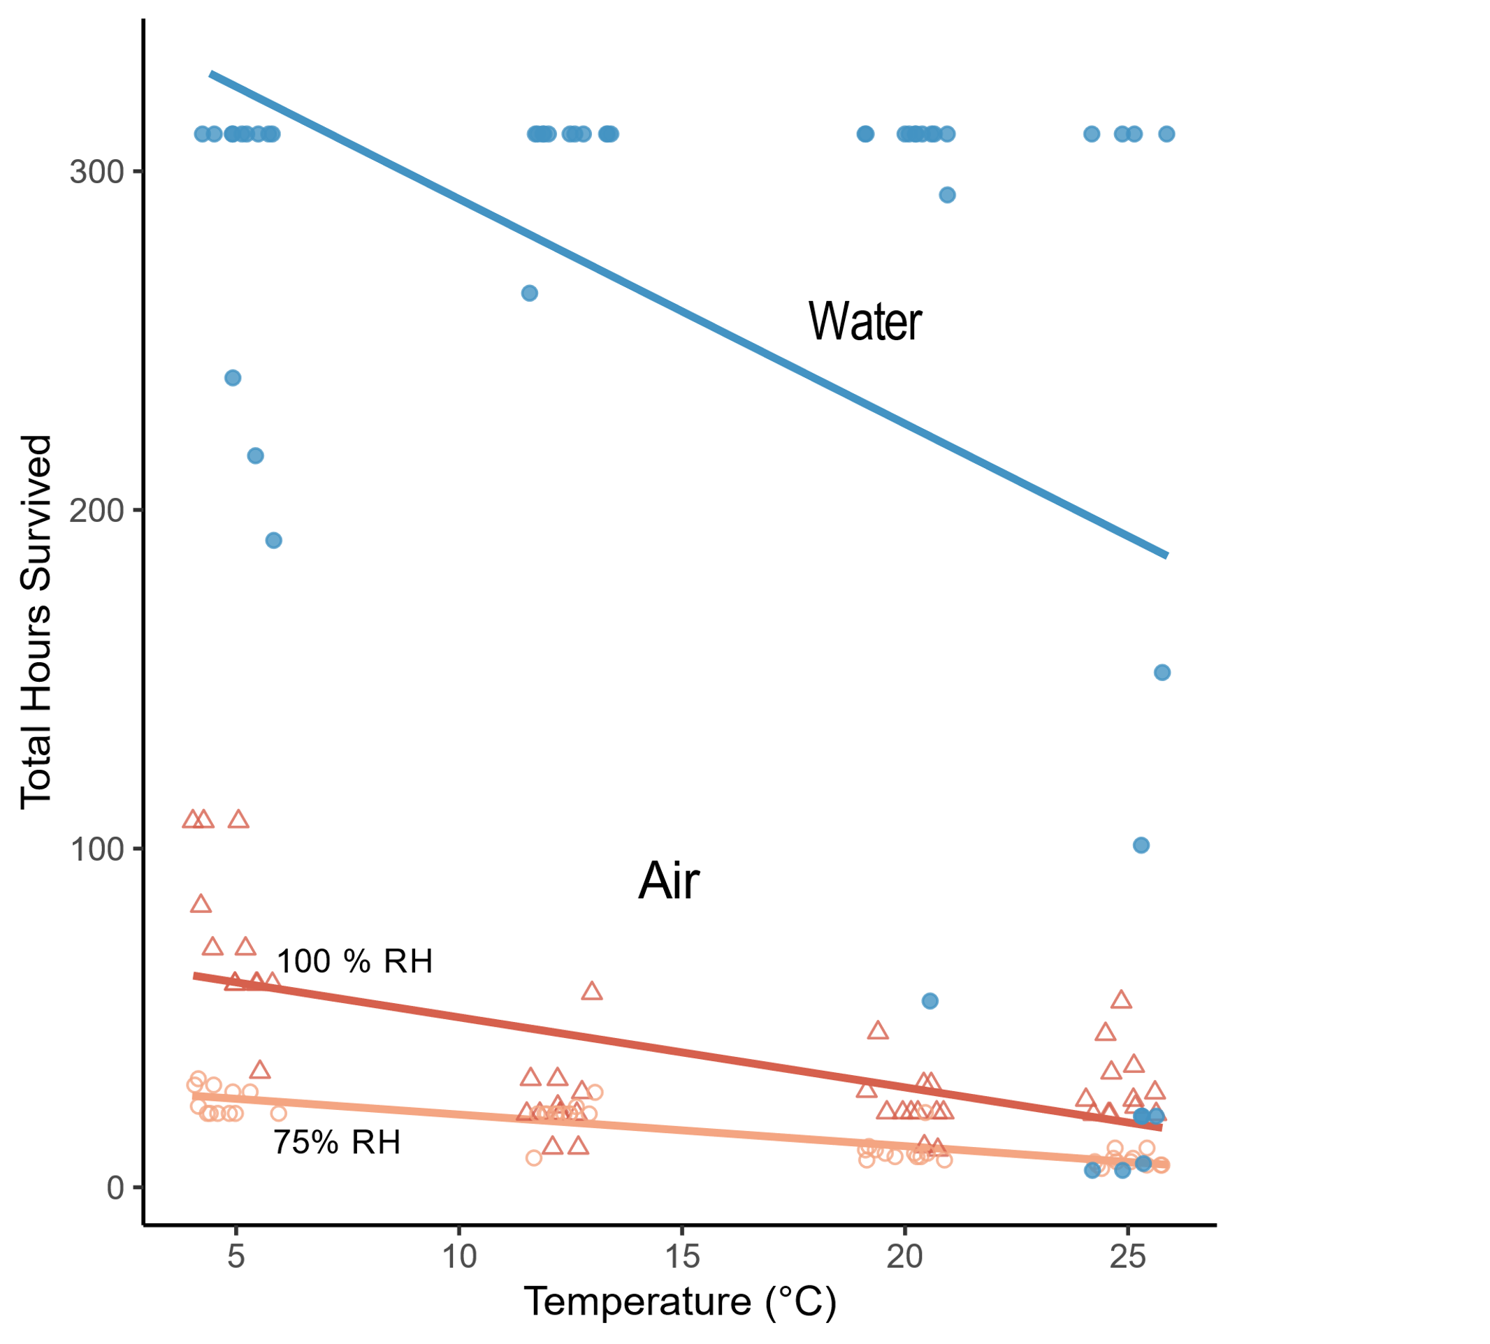
Results (air vs. water)

Slide 25
Data Anaylsis
R Studio version 2023.03.0 implementing R version 4.2.3.
Linear mixed effects model-pushups (package nlme).
Logistic regression-survival data from the no-flow experiment
Censored regression model total hours survived and mass (package censReg)
Linear regression models-growth, feeding, humidity, temperature, mass (air)
This Photo by Unknown Author is licensed under CC BY-SA

Slide 26
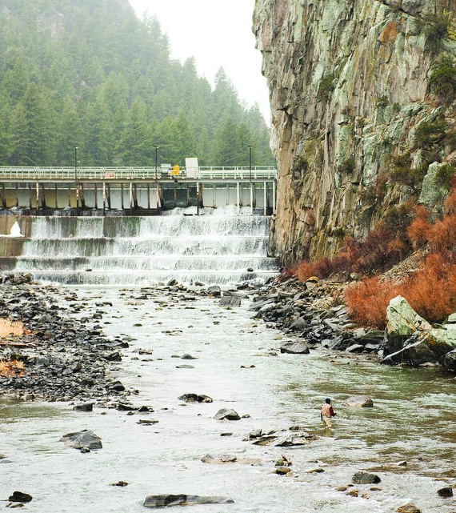
Discussion
Dam on Madison River
Data suggest drought, reduction in flow, humidity and temperature significantly affect salmonfly performance and survival.
Outcome of Madison Dam malfunction depends on duration, temperature, humidity, and presence of water.
Nymphs are resilient.

Slide 27
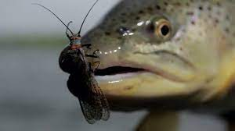
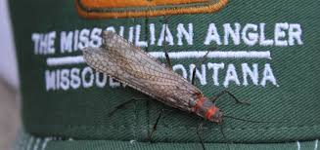
Significance of Research
Salmonflies important economically, ecologically and culturally throughout the western U.S.
Aquatic organisms disproportionately affected.

Slide 28
Future Use
Results can guide further research on aquatic organisms and effects of anthropogenic changes.
Albertson Lab at Montana State

Slide 29
Works Cited
Albertson, L.K., Briggs, M.A., Maguire, Z., Swart, S., Cross, W.F., Twining, C.W., Wesner, J.S., Baxter, C.V., Walters, D.M. (2022) Dietary composition and fatty acid content of giant salmonflies (Pteronarcys californica) in two Rocky Mountain rivers. Ecosphere, 13(1), e3904. https://doi.org/10.1002/ecs2.3904
Anderson, H.E., Albertson, L.K., Walters, D.M. (2019) Water Temperature drives variability in salmonfly abundance, emergence, timing, and body size. River Research and Application, 35(7), p. 1013,1022. https://doi.org/10.1002/rra.3464
Frakes, J.I, Birrell, J.H, Shah, A.A., Woods, H.A., (2021). Flow increases tolerance of heat and hypoxia of an aquatic insect. Biology Letters. 17, 20210004. https://doi.org/10.1098/rsbl.2021.0004
Isaak, D.J., Wollrab, S., Horan, D., Chandler, G. (2012) Climate change effects on stream and river temperatures across the northwest U.S. from 1980– 2009 and implications for salmonid fishes. Climatic Change, 113, 499–524 https://doi.org/10.1007/s10584-011-0326-z
Jacobsen, D. (2020). The dilemma of altitudinal shifts: caught between high temperature and low oxygen. Frontiers in Ecology and the Environment, 18(4), p. 211-218. https://doi.org/10.1002/fee.2161
Malison, R.L., Frakes, J.I., Andreas, A.L., Keller, P.R., Hamant, E., Shah, A.A., Woods, H.A. (2022). Plasticity of salmonfly (Pteronarcys californica) respiratory phenotypes in response to changes in temperature and oxygen. J. Experimental Biology, 225(18), jeb244253. https://doi.org/10.1242/jeb.244253
Pörtner, H.O., Knust, R., (2007). Climate change affects marine fishes through the oxygen Limitation of Thermal Tolerance. Science 8(315), 95–97. https://doi.org/10.1126/science.1135471
Verberk, W.C.E.P, Bilton, D.T. (2011). Can oxygen set thermal limits in an insect and drive gigantism? PLoS One, 6, e22610. https://doi.org/10.1371/journal.pone.0022610
Verberk, W.C.E.P., Bilton, D.T., Calosi, P., Spicer, J.I., (2011). Oxygen supply in aquatic ectotherms: Partial pressure and solubility together explain biodiversity and size patterns. Ecology 92, 1565–1572. https://doi.org/10.1890/10-2369.1
Walters, A.W., Post, D.M. (2011). How low can you go? Effects of a low-flow disturbance on aquatic insect communities. Ecological Applications, 21(1), p 163-174. https://doi.org/10.1890/09-2323.1
Winston, P.W., and Bates D.H. (1960). Saturated solutions for the control of humidity in biological research. Ecology 41:1, 232-237. https://doi.org/10.2307/1931961
Woods, H.A., (1999). Egg-mass size and cell size: Effects of temperature on oxygen distribution. Am. Zool. 39, 244–252. https://doi.org/10.1093/icb/39.2.244

Slide 30
Acknowledgements
Mentor: Art Woods
Graduate student: Jackson Birrell
Undergraduate: Lukas Sokalksi
Associate Professor at MSU: Lindsey Albertson
MSU graduate student: Jade Ortiz

Slide 31
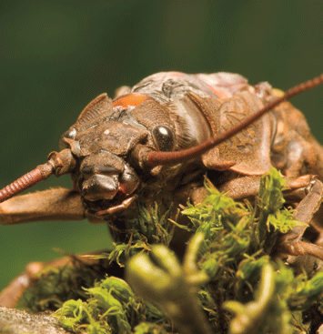
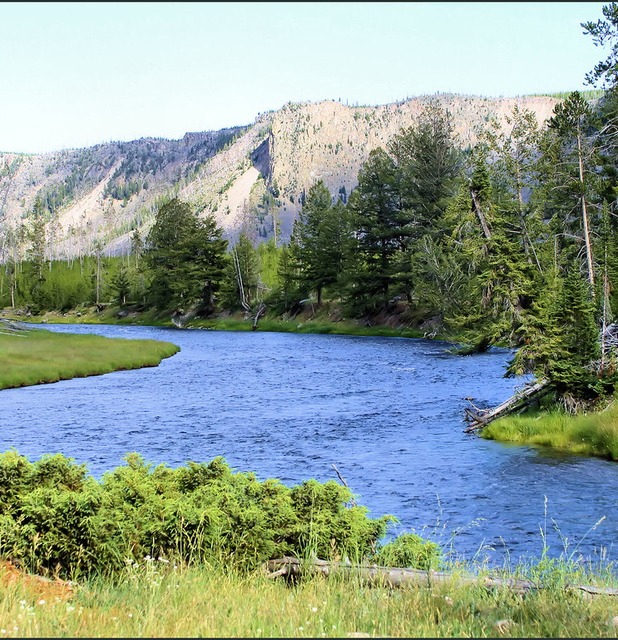
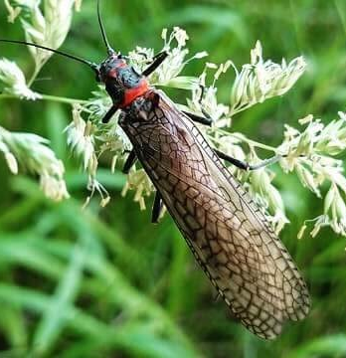
Questions?
This Photo by Unknown Author is licensed under CC BY-SA

