Slide 1
Cooking With a Conscience: OUR FOOD SYSTEM AND CLIMATE CHANGE
By the Sustainable Chefs:
Sonia Bornemann, Jonah Britton, Kennedy Delap, Brooke DeRuwe, Hallee Olsen, Aidan Potter, Morgan White, Ashley Wilson

Slide 2
CLIMATE CHANGE
How can a cookbook mitigate the impacts of climate change?
Education + Convenience + Minimizing Food Miles

Slide 3
Research Questions
What access do people have to sustainable foods?
How do we get people to act more sustainably?
Notes:
Hallee: To tackle this daunting project we first had to come up with our main research questions. Those being “What access do people have to sustainable foods?” and “How do we get people to act more sustainably?”

Slide 4
LITERATURE REVIEW
Sustainability
The Typical American Diet
Our Food Supply System
Harmful Dietary Behaviors
Diets Around the Globe
Local Accessibility
Notes:
Hallee: From there we had to look at the information that is already out there. We separated our literature review into 6 different sections. Sustainability, Our food supply system, the typical american diet, harmful dietary behavior, diets around the globe, and local accessibility. We first needed to define what exactly sustainability would be for this project. We defined it as “Something that can be maintained from generation to generation,”. We then had to learn about the current food supply system we operate in. What exactly is it, how is it being implemented and how sustainable is it truly. We learned that, surprise surprise, our current food system is extremely unsustainable and is a very large greenhouse gas emitter. Then we looked at the general american diet and our harmful dietary behaviors in North America. We learned that in general, Americans eat lots of carbs and eat very unsustainably. Which was very different than diets found around the globe. It showed that there is much that we Americans have to learn from the rest of the world. Then to scale in more locally in Missoula, we looked at the resources that we have to shop, cook, and eat sustainably. It was exciting to find more resources than I had previously expected to find. Our hope is that through this cookbook, we can also promote some of this hidden resources to help people act more sustainable
From there we had to look at the information that is already out there. We separated our literature review into 6 different sections. First we had to figure out what exactly sustainability means for this project. We defined sustainability as: “something that can be maintained from generation to generation” From there we then had to fully understand the food system that we operate in currently. What is it, how it is being implemented and how sustainable is it. We learned, surprise surprise, the global food system is a very large greenhouse gas emitter. Then we needed to understand the typical american diet and the general harmful dietary behaviors in North America. We learned that in America, we eat lots of carbs and in general eat unsustainably. Which is very different from the other diets found around the globe. It showed there is much that we Americans can learn from the rest of the world. But then to focus in on Missoula, what resources do we have to shop, cook, and eat sustainably. We found a lot more resources than we thought were present, our hope is that within this cookbook we can also promote some of the hidden resources to help people shop sustainably.
Go through the sections first

Slide 5
METHODOLOGY
Survey
Experts
Cookbook
Research
Interviews
Action
Notes:
Following our research into the sustainability of humanity’s global food system, we prioritized zooming in on our local community and distributed a comprehensive survey to students of the University of Montana in order to diagnose specific issues within the problem that we have the practical ability to solve. Our survey gathered around 200 responses across a wide variety of disciplines, demographics, spending habits,etc. After distributing and analyzing our survey, we reached out to around a dozen experts with boots in the ground (or hands in the soil) within the food system of Missoula County and gathered thoughtful insights from interviews. Eventually, we incorporated our knowledge into a diverse and aesthetically-pleasing online cookbook full of delicious recipes as well as insights into developing a more conscious, intentional and sustainable diet.

Slide 6
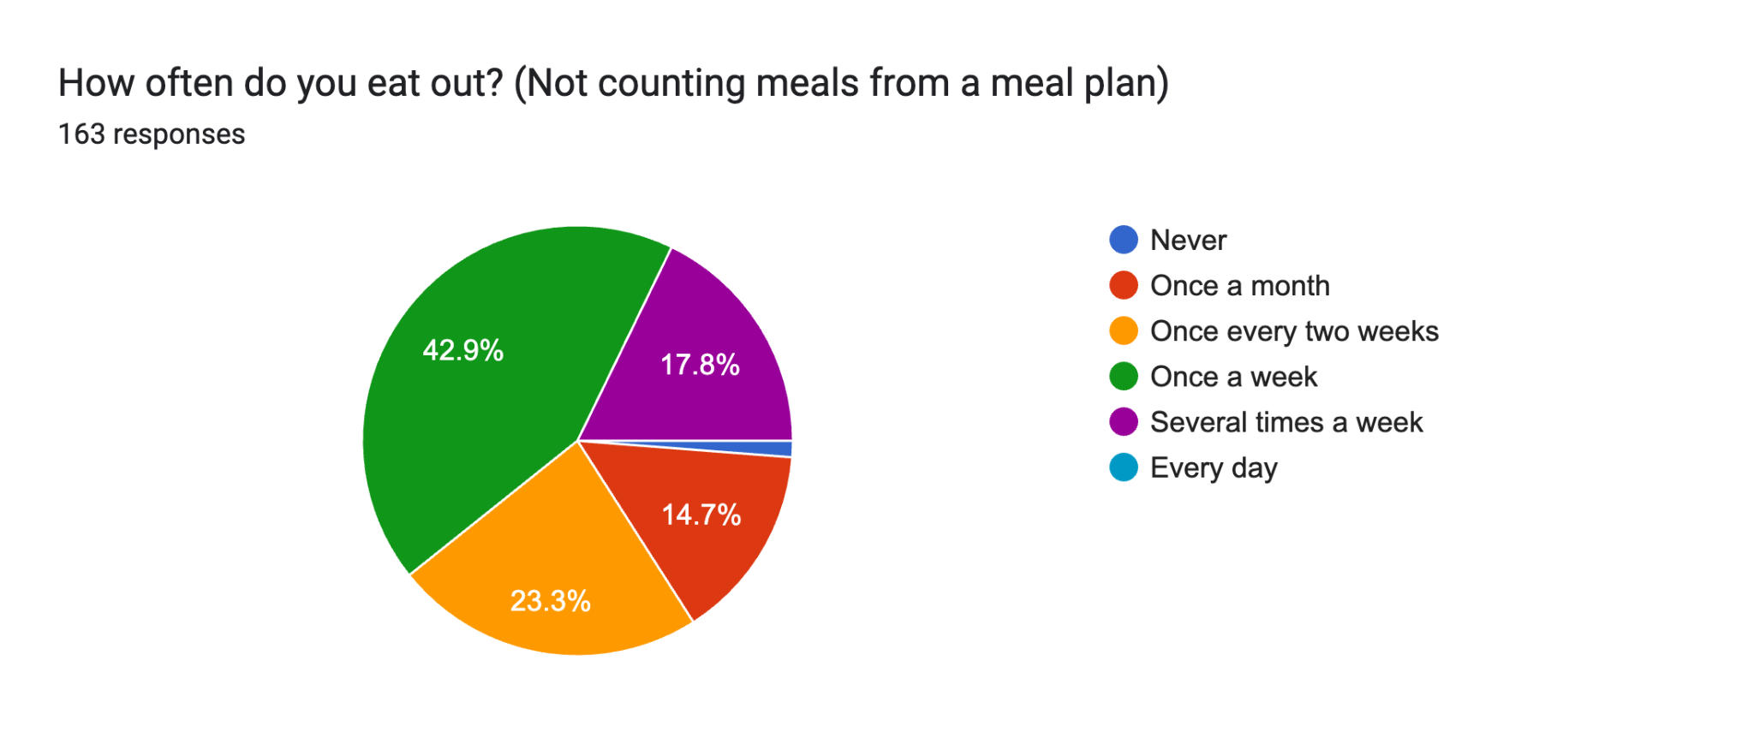
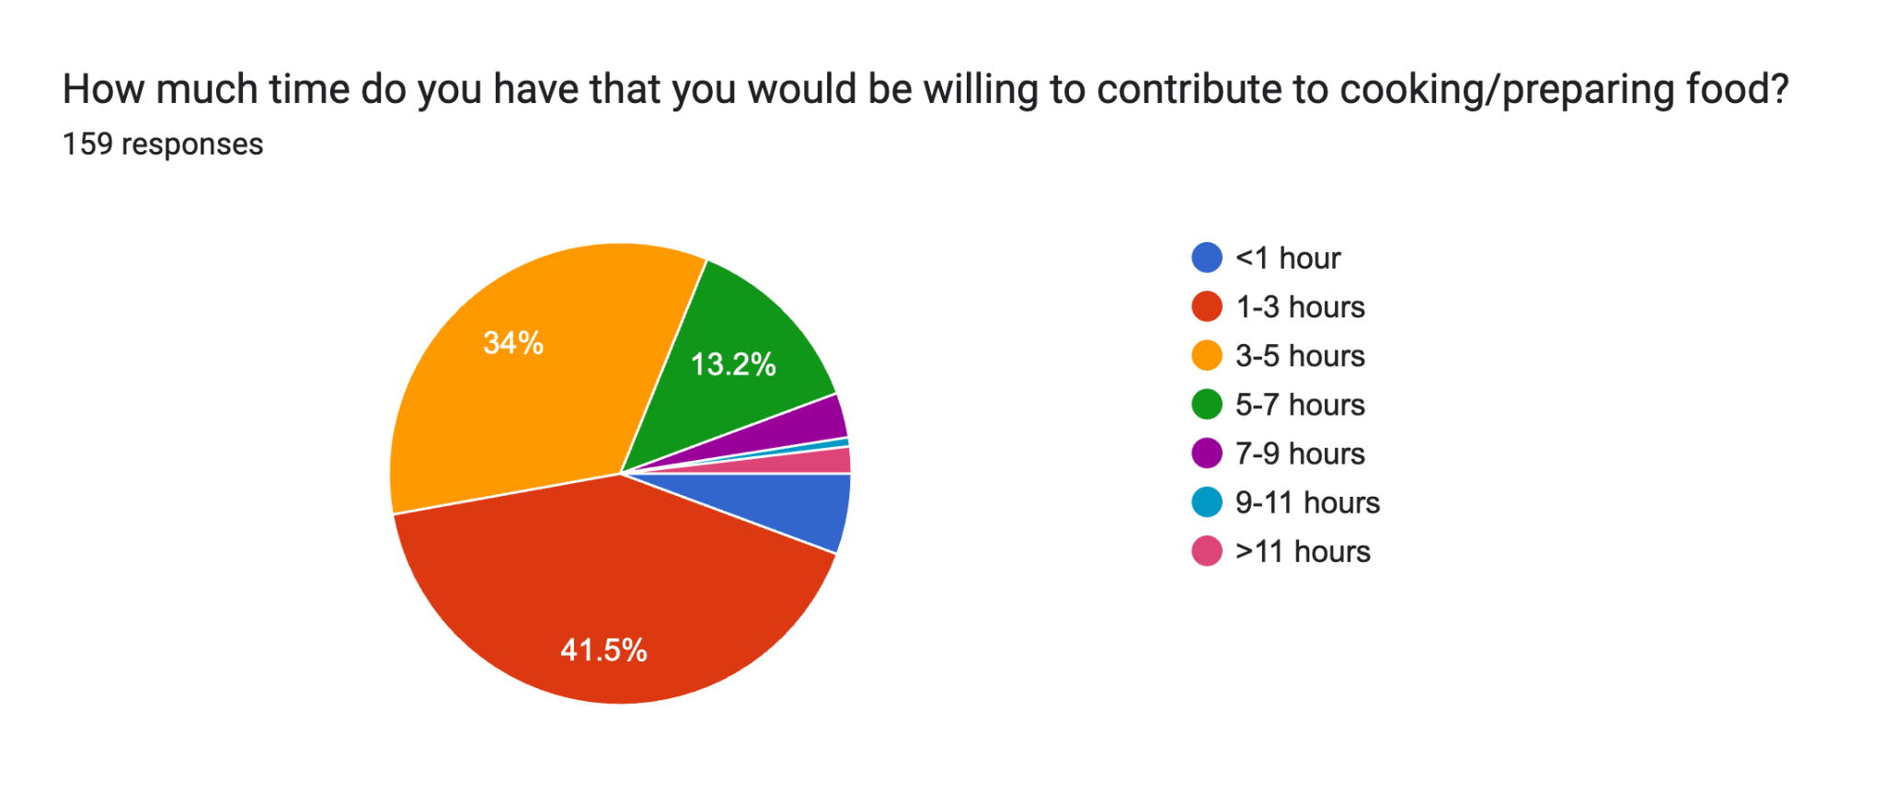
Survey Takeaways and Project Implementation
General Food Questions
Garden to Table
Costs/Spending
Grocery/Food Prep
Demographics
Notes:
In order to find out exactly what kind of information we needed to include in our cookbook, we conducted a survey of UM students about their food habits. We wrote sections of questions about general food habits, garden-to-table, cost/spending, grocery/food prep, and general demographics. Through these questions, we were able to get a good basis of what the community is lacking in knowledge and resources. This helped us tailor our cookbook to their needs and hopefully make eventual changes in their diets.
Unfortunately, our survey did not reach as many students as we had initially hoped. However, we did receive enough responses (163 to be exact) to get an idea of where the student body is currently at with their dietary habits.

Slide 7
Interviews
Who did we interview?
Key Takeaways
Themes
“The way to save planet Earth is from the mouth of a cow”
Bart Morris, Oxbow Cattle
“Sustainable foods look different in different places and in different cultural and political and economic contexts”
Caroline Stephens, Peas Farm Lecturer
“Ranchers have just been mining the land and taking from it, now ranchers are realizing if you take care of the land it will take care of you”
Bart Morris, Oxbow Cattle

Slide 8
Cooking with a Conscience
Cooking with a Conscience
Our cookbook
Designed based on what we learned
Accessible, easy to use, free
Our cookbook
Designed based on what we learned
Accessible, easy to use, free

Slide 9
Why a Website?
Accessibility
Convenience
Environment
Affordable
Notes:
Morgan
Some of the main reasons we chose to do a website are accessibility and convenience. We wanted to make this available to as many people as possible and as easy to access as we could. Based on our research people are willing to eat sustainably if it’s easy. By making a website that’s simple and easy to use we were able to accomplish that. Additionally, by creating a website version of a cookbook, it’s better for the environment as we aren’t printing a ton of copies on paper and it’s also more affordable, since we didn’t have to pay to make it and people don’t have to pay to get access to it.

Slide 10
Organization/Layout
Recipes
Gardening
Techniques
Local Resources
Notes:
Morgan
On the website, we sorted the recipes several ways. The first way was based on meal time. We separated breakfast, lunch, dinner, snacks/sides and desserts. This allows users to easily access recipes specific to what type of meal they were wanting to cook for. Additionally, we separated the recipes by season. Part of eating sustainably involves eating produce that is in season, so we sorted recipes to encourage users to make and eat foods that are currently in season.
We also included sections about different culinary techniques, such as pickling and fermentation. This gives users some other ideas of other simple things that they can do with food.
Additionally, there is a section related to gardening. Many people expressed interest in gardening but don’t know where to start. We provided information on how to start your own garden for people who have the means to do so (as well as information on where people can access local gardens if they can’t make their own.)
Lastly, there is a section on local resources. The provides users with access to information about local sustainable restaurants, where to shop local and sustainable foods, and additional information for people who want to get more involved and learn more.

Slide 11
A PICTURE IS WORTH A THOUSAND WORDS
Notes:
Promoted website through GLI social media

Slide 12
CONCLUSIONS
Global Components
Moving Forward
What is next for the Sustainable Chefs?
How did we overcome our challenges, and ensure that our project includes global perspectives?
Notes:
Slide #13- Now we will conclude the presentation of our online sustainable cookbook and describe the challenges we overcame when creating this project, the global aspects of our project, and lastly, the next steps that we plan on taking!
We decided to take on a multi-faceted project that examines a very serious global issue: climate change. Therefore, our biggest challenge involved carrying out a feasible project that had the potential to implement change. We overcame this challenge by first conducting extensive research about how food systems and various diets play a role in our changing climate, along with conducting a multitude of interviews with inspiring community members to learn more about how to eat and live more sustainably.

Slide 13
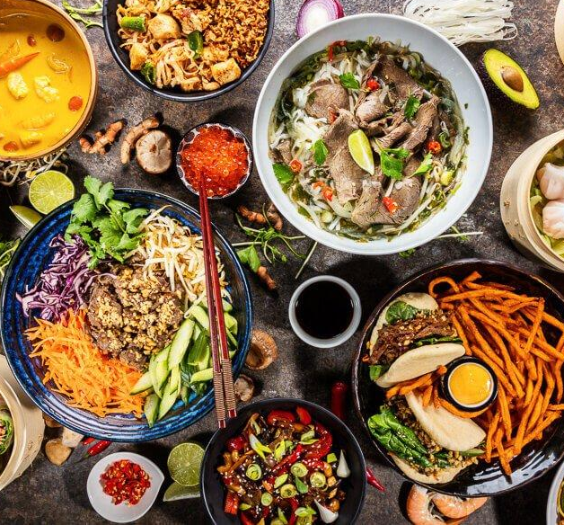
Global Components
GLOBAL RECIPES
FOOD SYSTEMS ABROAD
DIVERSE PERSPECTIVES
Our online cookbook features recipes from a variety of different countries!
Not only did we research food systems in the United States, we extended our research to other countries.
We conducted interviews internationally to add a more diverse perspective to our online cookbook!
Notes:
Slide #14- To give our project more depth and perspective, we also included multiple global components, such as featuring recipes from a diverse array of countries, researching modern food systems and food culture in countries outside of the United States, and conducting interviews abroad. These components help make our cookbook more nuanced, diverse, and inclusive.
Climate change is a global problem, however, by taking individual steps toward sustainable solutions, a brighter future is within reach, and inspiring local communities to take these initial steps is the primary intention of our cookbook.

Slide 14
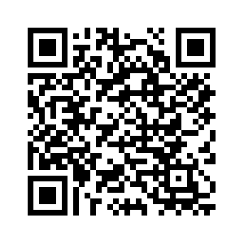
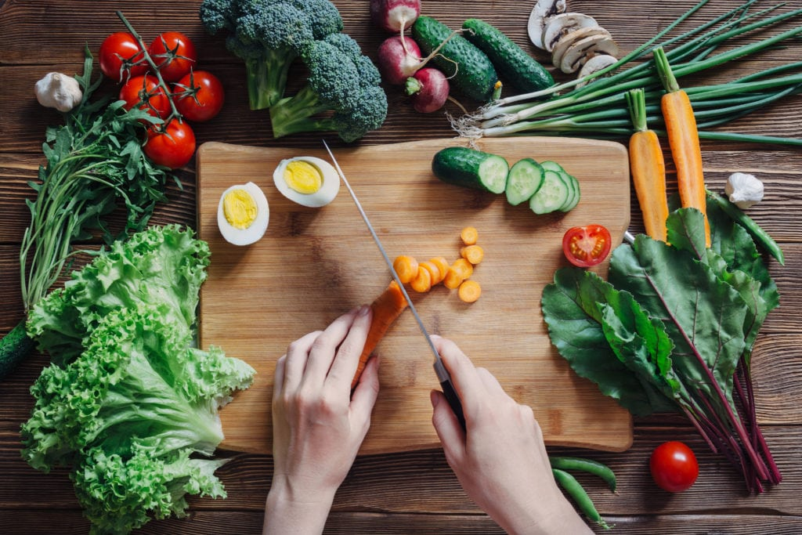
Thank You!
Do you have any questions?
Notes:
Slide #15- Moving forward we plan on continuing to share and use our online cookbook, along with continuing to live out the principles of sustainable eating and living to the best of our abilities.
With that, we would like to thank all of you for your time and attention. Do you have any questions?

