Slide 1
Community Outdoor Recreation Realization:
Pilot Review and Recommendations
Parks, Tourism and Recreation Management Capstone
Ashley Castro, Jazzelle Elias, Grace Friend, Lisa Spang, Grace Walhus

Slide 2
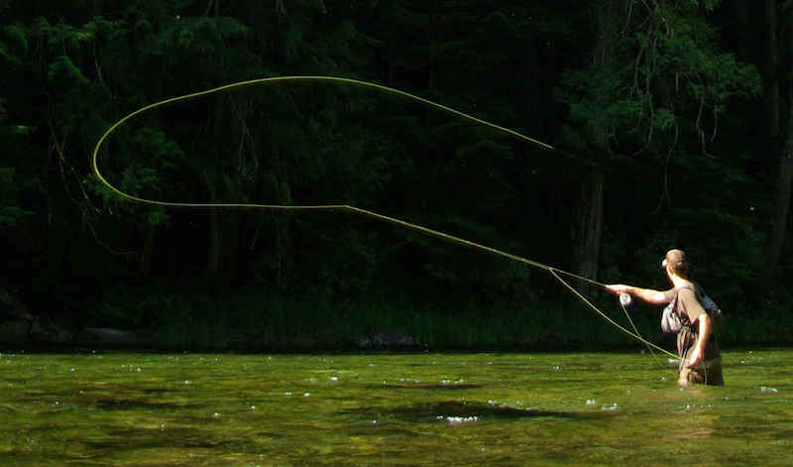
Introduction
Why do we need outdoor recreation?
For communities:
Improves mental and physical health
Strengthened sense of community
For Montana:
~71,000 Montanans work in the outdoor recreation industry
Generates ~$7.1B in consumer spending
Communities across the state struggle to develop projects that improve their recreation opportunities
Notes:
Grace W.

Slide 3
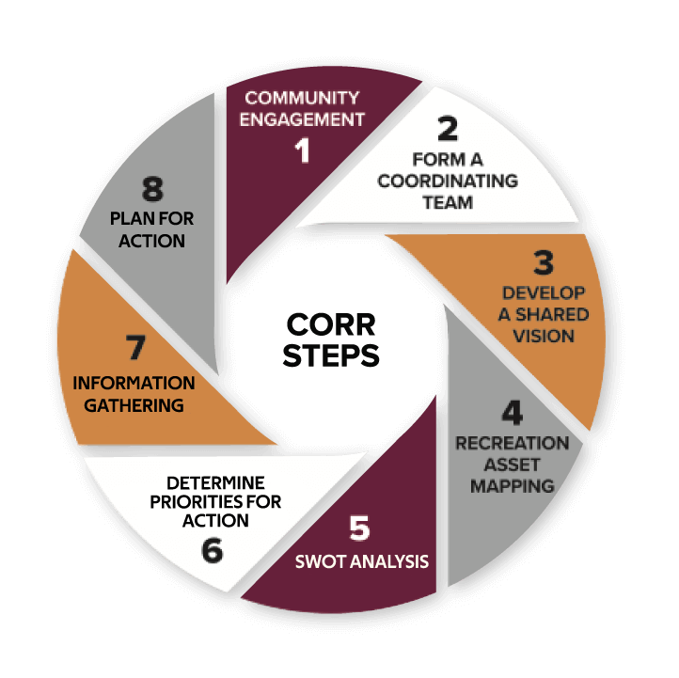
Introduction
What is CORR?
CORR is a step by step guidance tool for communities throughout Montana to help support the planning, vision, and implementation of outdoor recreation.
Objectives:
-To enhance community well-being and way of life
-To assist in the growth of the outdoor recreation economy through the public and private sector
Notes:
Lisa
CORR can help Montana communities realize their recreation visions. Communities can tailor CORR to fit their specific community needs. The process can, and is encouraged to be inclusive of various partners at the local, state, tribal, regional, and federal levels.

Slide 4
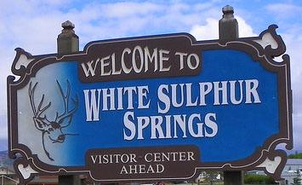
Introduction
Community Outdoor Recreation Realization:
Pilot Review and Recommendations
Pilot Process:
Capstone Work:
Pilot Process Observation
Recommendations
Toolkit
White Sulphur Springs
Population: 1,052
Central Montana near the Smith River
Columbia Falls
Population: 5,651
Northwest Montana near Glacier National Park
Notes:
Grace F.

Slide 5
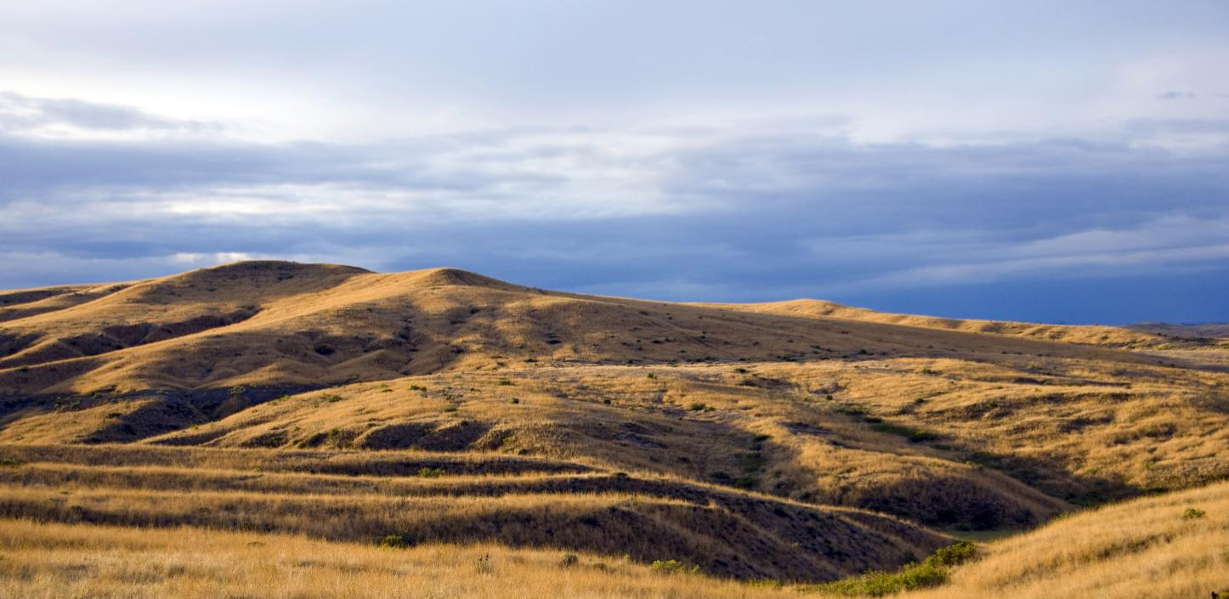
Methods
What We did to Achieve Our Results
Step 1:
-Interview community members
-Interview CORR facilitators
Step 2:
-Analyze
-Summarize
-Brainstorming ideas
Step 3:
-Putting it all together
-Developed Toolkit with resources
Notes:
Ashley
Step 1: Conducted zoom and in person interviews with members from each community and the CORR facilitating team. Community members were all asked the same questions regarding each step in the process and a few general questions about the overall process. The CORR facilitators were asked similar questions for each step and the same general questions.
Step 2: We took notes and transcribes during all of the interview and were able to analyze and summarize the answers to each of out interview question. We then came together as a group to brainstorm what these findings met and how we could best use them to better the CORR process
Step 3: After this we put all of our ideas and summaries together to create the results and recommendations for the CORR process

Slide 6
Results
Lack of Connectivity Between Steps
Interview Statements:
“Step 7 (Priorities for action), ranking priorities for action was difficult”
- CORR Facilitator
“Throughout the process, the community needs to remember to go back to vision- pause and think through this - it's the foundation for the whole process”
-CORR Facilitator
“Disjointed–how do you make all of these things connected”
-Member from Columbia Falls
Notes:
Ashley

Slide 7
Recommendations
Recommendation #1:
Change CORR Steps Order
Notes:
Ashley

Slide 8
Recommendation #1: Change CORR Steps Order
 | Current CORR Steps
Step 1 | Community Engagement
Step 2 | Form a Coordinating Team
Step 3 | Develop a Shared Vision
Step 4 | Recreational Asset Mapping
Step 5 | Information Gathering
Step 6 | Identify Opportunities and SWOT Analysis
Step 7 | Determine Priorities for Action
Step 8 | Take Action
 | Suggested CORR Steps
Step 1 | Community Engagement
Step 2 | Form a Coordinating Team
Step 3 | Develop a Shared Vision
Step 4 | Recreational Asset Mapping
Step 5 | SWOT Analysis
Step 6 | Determine Priorities for Action
Step 7 | Information Gathering
Step 8 | Plan for Action
Notes:
Ashley

Slide 9
Results
Timeline Difficulties
March
2021
Columbia Falls: Community Engagement (Step 1)
Interview Statements:
White Sulphur Springs: Community Engagement
(Step 1)
“It's almost like Step 7 and Step 8 could have been separate meetings.”
–Member from Columbia Falls
May
2021
October
2022
White Sulphur Springs: Determine Priorities for Action/Take Action
(Step 7/Step 8)
“The process isn’t done yet, even though it's been over a year.”
–Member from White Sulphur Springs
November
2022
Columbia Falls: Determine Priorities for Action/Take Action
(Step 7/Step 8)
“I think somehow condensing the timeline would help.”
–CORR Facilitator
Notes:
Jazzelle
Another result we found were some difficulties with the CORR timeline. Both communities started the process in Spring of 2021 and had their last meeting in fall of 2022. With the process stretching well over a year, communities found that it was hard to keep their enthusiasm about CORR up and found it hard to remember what happened in the previous meetings.
Interview results revealed a theme of frustration with the timeline of the CORR process. It is worth mentioning that the pilot communities started the CORR process during the COVID-19 pandemic in early 2021, which undoubtedly affected the timeline.

Slide 10
Recommendations
Recommendation #1:
Change CORR Steps Order
Recommendation #2:
Define the Timeline
Notes:
Jazzelle
This result informed the recommendation for the CORR process to include a defined timeline to set clear time expectations. This lowers the risk of participant frustration and encourages participants to stay engaged for the duration of the process. In our Toolkit, we included a suggested timeline to help communities with this aspect.

Slide 11
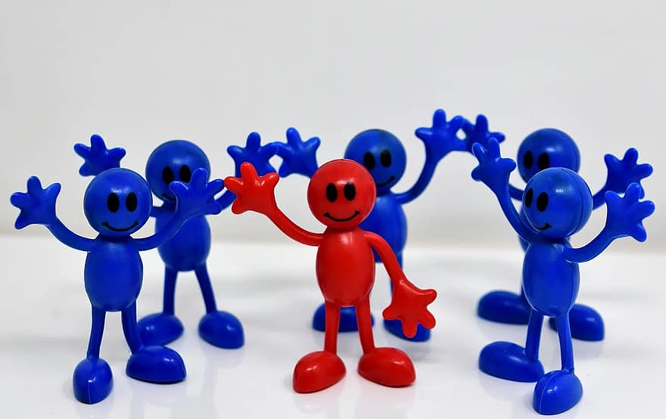
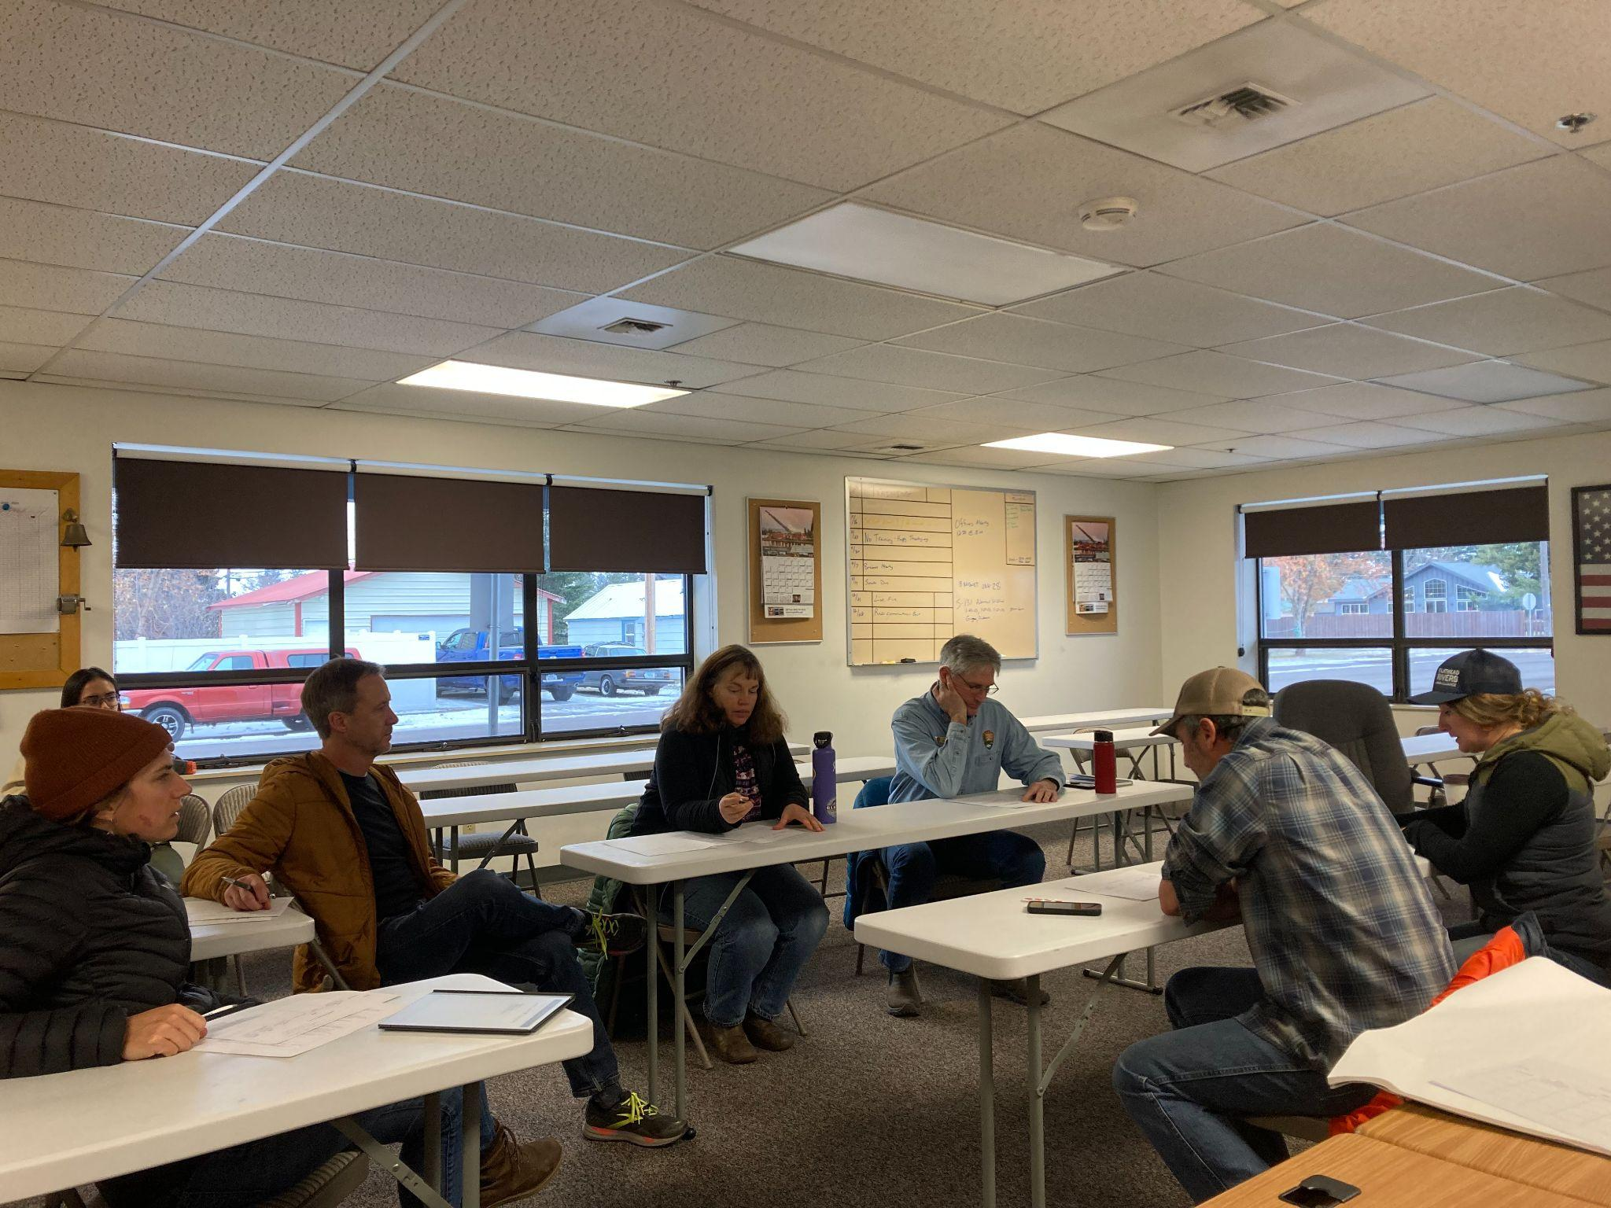
Results
Dependent on Facilitator
“So a community could do it themselves just fine. Or, they could hire a facilitator to develop the plan for them.”
–CORR Facilitators
“Initial process needs a facilitator–if not, the process can blow up because personal opinions can halt it”
–Member from Columbia Falls
“Oh, God, I don't think we would have gotten it done. I mean, having an outside person come in, well, first we wouldn't have had the group.”
–Member from White Sulphur Springs
Notes:
Lisa
Team leaders are necessary with the lack of facilitators/The CORR team to lead pilot communities and getting others motivated.
Getting people to show up to the meetings was the hardest part. The team usually consisted of community members that volunteer for everything.
These people can provide roles and responsibilities to reach the take action step.

Slide 12
Recommendations
Recommendation #1:
Change CORR Steps Order
Recommendation #3:
Establish a CORR Team Leader
Recommendation #2:
Define the Timeline

Slide 13
Results
Lack of Resources/Facilitators
Interview Statements:
“There is a lack of curated information for rural communities.”
–CORR Facilitator
“We don't know what we don’t know.”
–Member from White Sulphur Springs
“A whole strategic planning process like this still requires a facilitator even if you could do it yourselves.”
–Member from Columbia Falls
Notes:
Jazzelle
One result we found was a lack of resources for rural communities. In our interviews, the CORR facilitators and community members all acknowledged the challenges that come from the lack of applicable and accessible resources. In the same vein, we found that communities were struggling to imagine the CORR process without a proper facilitator. The CORR facilitators played a major role in these pilot communities.
Interview results revealed that the CORR process was daunting, would be hard to do without a facilitator, and that it would be difficult to do without curated resources.

Slide 14
Recommendations
Recommendation #1:
Change CORR Steps Order
Recommendation #3:
Establish a Coordinating Team Leader
Recommendation #2:
Define the Timeline
Recommendation #4:
Suggested CORR Toolkit
Notes:
Jazzelle
These results led us to develop a “CORR Toolkit” to support future communities who want to use the CORR framework. This toolkit helps guide communities through the CORR process, provides applicable resources, and is formatted in an approachable manner. All of the language in this toolkit is easy to read, follow, and is accessible to a wide audience.

Slide 15
Recommendation #4: Suggested Toolkit
Overview Page
Goal
Objectives
Who is CORR for
The process
Contents
Steps
Description
Necessary information
Helpful Considerations
Examples
Resources
Appendices
Worksheets
Notes:
Step 3
Step 6
Step 8: So, step 8 was found to be the most difficult for both communities and facilitators. In turn, the toolkit for this step is very thorough to help communities get a good grasp as to what this step will entail. We go through all of the CORR action steps in the worksheet and outline what exactly it means, what would be helpful to think about in this action step, and how it looks in the example Action Plan. I think it is worth noting that all of the language in this toolkit is easy to read, follow, and is accessible to a wide audience.
Below the outline of each action step, we also included helpful considerations communities should think about while completing their action plan. We incorporated ideas the facilitators such as asking the communities “what success looks like for this project” and reminding that this is a planning process, and is therefore not static. We also incorporated our ideas from our interviews and what we saw from the meeting such as a recommendation to work through an action plan as a group and to keep in mind that this would require patience–and perhaps another meeting.
In our resources, we heard from communities that money is the biggest struggle they have or will face when they have action plans completed, so we included several grant/funding resources. Our main focus for resources in this section was master lists of recreation resources. We have the wonderful recreation toolkit put together by Montana Access Project, Society of Outdoor Recreation Professionals technical resources, and Grants.Gov for grant resources.

Slide 16
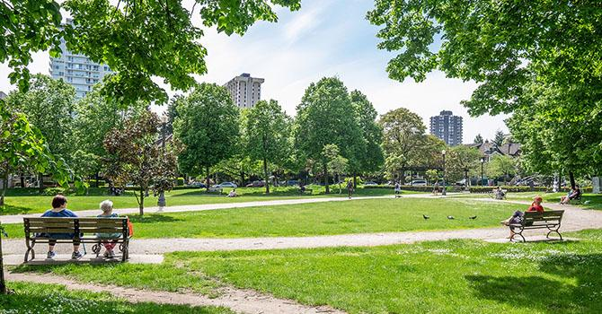
Discussion & Limitations
Project planning is very difficult in reality
The CORR process is voluntary and time consuming
Going through the effort to develop recreation opportunities is necessary and worth it!
Notes:
Grace W.

Slide 17
Questions?

