Slide 1
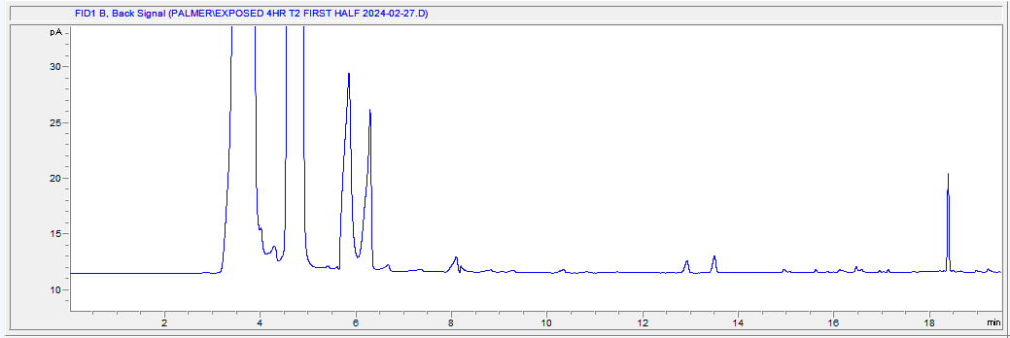
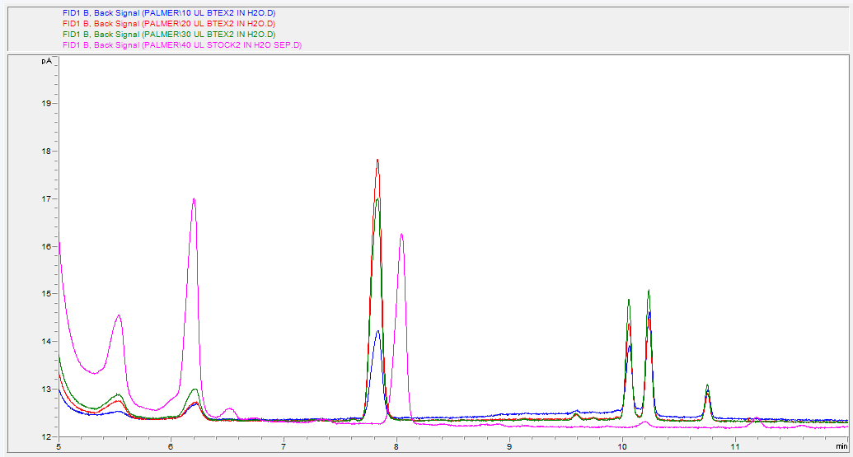
Wood Smoke Exposure Analysis using Silicon Wristbands as Passive Samplers
Maysen Mindt and Christopher P. Palmer*
Department of Chemistry & Biochemistry  University of Montana, Missoula, MT, USA, 59812
Introduction
Results and Discussion
Woodsmoke exposure is a public health concern and prolonged exposure can result in serious adverse health effects. Wood smoke contains both particulate matter and volatile organic compounds such as benzene (a known carcinogen), toluene, ethylbenzene, and xylene (BTEX). There is thus a need to quantify incidental or occupational exposure to wood smoke in order to manage exposure and to facilitate studies of the effects of exposure.
In the current study, we evaluate the use of silicone wristbands as passive samplers to quantify exposure to volatile organic compounds in wood smoke. The purpose of this experiment is to evaluate headspace gas chromatography analysis of exposed wristbands as a method to quantify exposure to volatile organic compounds. Headspace analysis is a technique for sampling and examining the volatiles in a solid or liquid sample. It is an analysis of the components present in the gas phase above the sample in a vial.
Unidentified Volatile Organics, quantified together as “peak 1”
Benzene
Combined analysis of all wristbands for a given treatment shows very poor reproducibility, rendering the results quantitatively meaningless.
Toluene
Xylenes
Figure 1: Chromatogram of one half of a highly absorptive wristband exposed for 4 hours
Conclusions
Methods
Spiked water samples were run to optimize the analytical conditions, identify analytes by retention times, and confirm quantitative response.
Wristbands are not consistently absorbative, might be classified as "highly (pk1 >10,000)", "moderately (1000<pk1<10,000)", or "poorly (pk1<=250)" absorbative. Highly absorbative wristbands produce very high signals and numerous additional unidentified peaks.
Relative standard deviation w/in a class of wristband is typically about 2-5%, suggesting that this is the indeterminate error in sample collection, processing and analysis.
Moderately and highly absorptive wristbands give signals well and significantly higher than blank.
Some poorly absorptive wristbands also give signals significantly above blank (just), but no signal was detected for others.
Because of inconsistent absorbative properties, overall standard deviation is often larger than overall average, rendering it meaningless.
Among highly absorbative wristbands, there is no statistically significant difference in signals, and no correlation between exposure and signal, between different treatments. This implies that even if we could work out how to make bands consistently absorbative, we would not be able to quantitatively distinguish integrated exposures.
The overall conclusion of this study is that, although headspace gas chromatography can be used to measure volatile organic species on silicone wristbands, said passive wristband samplers cannot be utilized for quantitative analysis of exposure unless wristbands with more consistent absorbative properties can be identified and utilized.
Wristbands were cleaned using a vacuum oven overnight while at elevated temperature.
In the background, prepare stock solution of BTEX (20ppm benzene, 20ppm toluene, 20ppm ethylbenzene, and 20ppm xylene in carbon disulfide)
Wristbands were exposed in Mary Buford’s woodsmoke lab on campus
Day 1 – 5 wristbands exposed for 2 hours at a mean particulate matter concentration of 0.83 mg/m^3
Day 2 – 5 wristbands exposed for 2 hours at a mean particulate matter concentration of 1.1 mg/m^3
Another group of 5 wristbands were exposed over both days for a total of 4 hours
Develop method for Headspace/FID instrument
Headspace Parameters
Oven and Loop Temperature set at 120ºC
Transfer Line Temperature set at 135ºC
Set to single extraction mode
Gas Chromatography - FID Parameters
Set injection to splitless mode
Set temperature program to begin at 40ºC and hold for 5 minutes to then increase by 10ºC/min until reaching 55ºC and holding for an additional 5 minutes then spiking to 125ºC
Set Hydrogen flow to 40mL/min, air flow to 400mL/min, and makeup flow to 15mL/min
Total run time is 55.5 minutes for solid sample
Run a variety of spiked samples in water to identify target peaks
Run additional spiked samples on wristbands to further identify target peaks and evaluate sensitivity
Run exposed wristbands and collect and analyze data
Each wristband cut in half and each half analyzed separately.
Figure 2: Chromatograms of 10uL, 20uL, 30uL, and 40uL spikes of BTEX in water
.
A significant observation and conclusion of this study is that wristbands exposed to a given treatment gave inconsistent results, with about 40% being highly absorbative and about 60% being poorly absorbative.
Future Directions
Identify, if possible, a source of wristbands that are consistently absorbative.
Conduct similar studies with mass spectrometric detection to identify the absorbed volatile organics and select and utilize those specific to biomass combustion for further study.

